Slide 1
Stabilization matrix method (Ridge regression) Morten Nielsen Department of Health Technology, DTU

Slide 2
Data driven method training
A prediction method contains a very large set of parameters
A matrix for predicting binding for 9meric peptides has 9x20=180 weights
Over fitting is a problem
Temperature
years

Slide 3
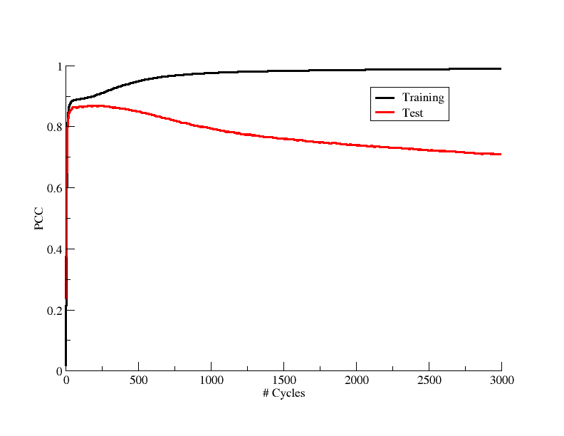
Model over-fitting (early stopping)
Stop training
Evaluate on 600 MHC:peptide binding data
PCC=0.89

Slide 4
Stabilization matrix method The mathematics
y = ax + b
2 parameter model
Good description, poor fit
y = ax⁶+bx⁵+cx⁴+dx³+ex²+fx+g
7 parameter model
Poor description, good fit

Slide 5
Stabilization matrix method The mathematics
y = ax + b
2 parameter model
Good description, poor fit
y = ax⁶+bx⁵+cx⁴+dx³+ex²+fx+g
7 parameter model
Poor description, good fit

Slide 6
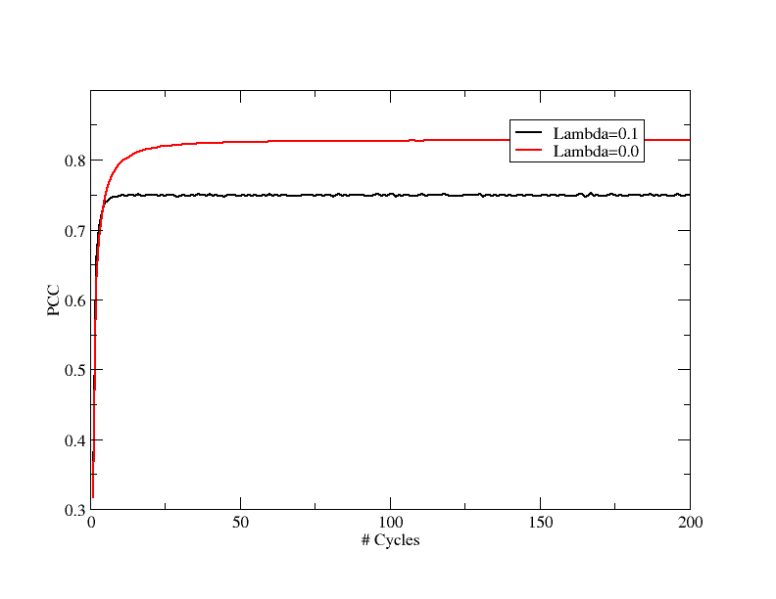
SMM training
Evaluate on 600 MHC:peptide binding data
L=0: PCC=0.70
L=0.1 PCC = 0.78

Slide 7
Stabilization matrix method. The analytic solution
Each peptide is represented as 9*20 number (180)
H is a stack of such vectors of 180 values
t is the target value (the measured binding)
λ is a parameter introduced to suppress the effect of noise in the experimental data and lower the effect of overfitting

Slide 8
SMM - Stabilization matrix method - the numerical solution
Linear function
Sum over weights
I₁
I₂
Sum over data points
w₁
w₂
o

Slide 9
SMM - Stabilization matrix method
Global error:
Linear function
Sum over weights
Sum over data points
I₁
I₂
Per target error:
w₁
w₂
o

Slide 10
SMM - Stabilization matrix method Do it yourself
Linear function
λ per target
I₁
I₂
w₁
w₂
o

Slide 11
And now you

Slide 12
SMM - Stabilization matrix method
Linear function
λ per target
I₁
I₂
w₁
w₂
o

Slide 13
SMM - Stabilization matrix method
Linear function
I₁
I₂
w₁
w₂
o

Slide 14
SMM - Stabilization matrix method Monte Carlo
Global:
Linear function
Make random change to weights
Calculate change in “global” error
Update weights if MC move is accepted
I₁
I₂
w₁
w₂
o
Note difference between MC and GD in the use of “global” versus “per target” error

Slide 15
Training/evaluation procedure
Define method
Select data
Deal with data redundancy
In method (sequence weighting)
In data (Hobohm)
Deal with over-fitting either
in method (SMM regulation term) or
in training (stop fitting on test set performance)
Evaluate method using cross-validation

Slide 16
A small doit tcsh script
#! /bin/tcsh -f
set DATADIR = /home/projects/mniel/ALGO/data/SMM/
foreach a ( A0101 A3002 )
mkdir -p $a
cd $a
# Here you can type the lambdas to test
foreach l ( 0 0.02 )
mkdir -p l.$l
cd l.$l
# Loop over the 5 cross validation configurations
foreach n ( 0 1 2 3 4 )
# Do training
smm -l $l ../f00$n > mat.$n
# Do evaluation
pep2score -mat mat.$n ../c00$n > c00$n.pred
end
# Do concatinated evaluation
echo $a $l `cat c00?.pred | grep -v "#" | gawk '{print $2,$3}' | xycorr` \
`cat c00?.pred | grep -v "#" | gawk '{print $2,$3}' | gawk 'BEGIN{n+0; e=0.0}{n++; e += ($1-$2)*($1-$2)}END{print e/n}' `
cd ..
end
cd ..
end

