Slide 1
Optimization methods Morten Nielsen Department of Health Technology, DTU

Slide 2
Minimization
The path to the closest local minimum = local minimization
*Adapted from slides by Chen Kaeasar, Ben-Gurion University

Slide 3
Minimization
The path to the closest local minimum = local minimization
*Adapted from slides by Chen Kaeasar, Ben-Gurion University

Slide 4
Minimization
The path to the global minimum
*Adapted from slides by Chen Kaeasar, Ben-Gurion University

Slide 5
Outline
Optimization procedures
Gradient descent
Monte Carlo

Slide 6
Linear methods. Error estimate
Linear function
I₁
I₂
w₁
w₂
o

Slide 7
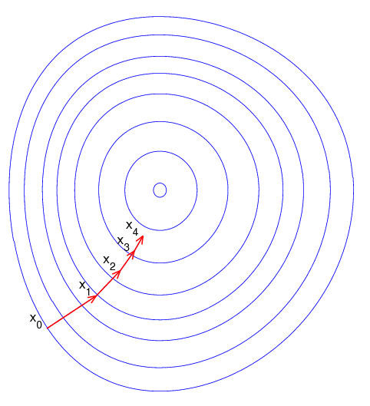
Gradient descent (from wekipedia)
Gradient descent is based on the observation that if the real-valued function F(x) is defined and differentiable in a neighborhood of a point a, then F(x) decreases fastest if one goes from a in the direction of the negative gradient of F at a.
It follows that, if
for ε > 0 a small enough number,
then F(b)<F(a)

Slide 8
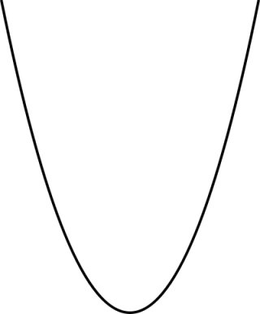
Gradient descent (example)

Slide 9
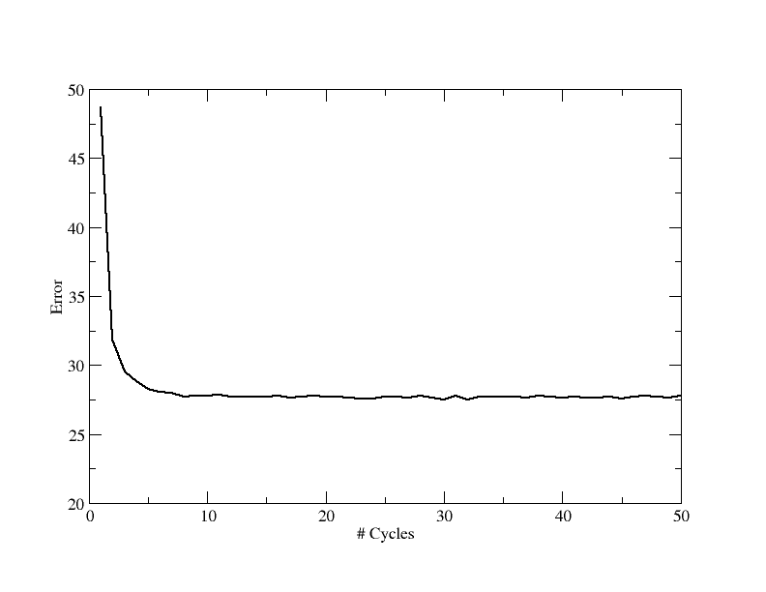
Gradient descent

Slide 10
Gradient descent
Weights are changed in the opposite direction of the gradient of the error

Slide 11
Gradient descent (Linear function)
Weights are changed in the opposite direction of the gradient of the error
Linear function
I₁
I₂
w₁
w₂
o

Slide 12
Gradient descent
Weights are changed in the opposite direction of the gradient of the error
Linear function
I₁
I₂
w₁
w₂
o

Slide 13
Gradient descent. Example
Weights are changed in the opposite direction of the gradient of the error
Linear function
I₁
I₂
w₁
w₂
o

Slide 14
Gradient descent. Example
Weights are changed in the opposite direction of the gradient of the error
Linear function
I₁
I₂
w₁
w₂
o

Slide 15
Gradient descent. Doing it your self
Weights are changed in the opposite direction of the gradient of the error
Linear function
1
0
W₁=0.1
W₂=0.1
o
What are the weights after 2 forward (calculate predictions) and backward (update weights) iterations with the given input, and has the error decrease (use ε=0.1, and t=1)?

Slide 16
Fill out the table
What are the weights after 2 forward/backward iterations with the given input, and has the error decrease (use ε=0.1, t=1)?
itr | W1 | W2 | O
0 | 0.1 | 0.1
1
2
Linear function
1
0
W₁=0.1
W₂=0.1
o

Slide 17
Fill out the table

Slide 18
Fill out the table
What are the weights after 2 forward/backward iterations with the given input, and has the error decrease (use ε=0.1, t=1)?
itr | W1 | W2 | O
0 | 0.1 | 0.1 | 0.1
1 | 0.19 | 0.1 | 0.19
2 | 0.27 | 0.1 | 0.27
Linear function
1
0
W₁=0.1
W₂=0.1
o

Slide 19
The Metropolis-Hastings Criterion
"Equations of State Calculations by Fast Computing Machines“ – Metropolis, N. et al. Journal of Chemical Physics (1953)
Boltzman Distribution:
The energy score and temperature are computed (quite) easily
The “only” problem is calculating Z (the “partition function”) – this requires summing over all states.
Metropolis showed that MCMC will converge to the true Boltzman distribution, if we accept a new proposal with probability
Slides adapted from Barak Raveh

Slide 20
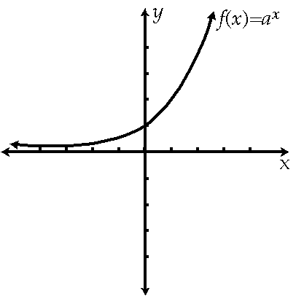
Monte Carlo (Minimization)
dE>0
dE<0

Slide 21
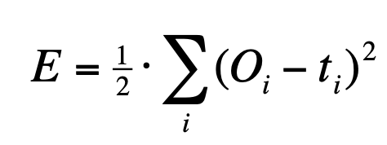
Gibbs sampling Monte Carlo simulations
A R N D C Q E G H I L K M F P S T W Y V
1 0.6 0.4 -3.5 -2.4 -0.4 -1.9 -2.7 0.3 -1.1 1.0 0.3 0.0 1.4 1.2 -2.7 1.4 -1.2 -2.0 1.1 0.7
2 -1.6 -6.6 -6.5 -5.4 -2.5 -4.0 -4.7 -3.7 -6.3 1.0 5.1 -3.7 3.1 -4.2 -4.3 -4.2 -0.2 -5.9 -3.8 0.4
3 0.2 -1.3 0.1 1.5 0.0 -1.8 -3.3 0.4 0.5 -1.0 0.3 -2.5 1.2 1.0 -0.1 -0.3 -0.5 3.4 1.6 0.0
4 -0.1 -0.1 -2.0 2.0 -1.6 0.5 0.8 2.0 -3.3 0.1 -1.7 -1.0 -2.2 -1.6 1.7 -0.6 -0.2 1.3 -6.8 -0.7
5 -1.6 -0.1 0.1 -2.2 -1.2 0.4 -0.5 1.9 1.2 -2.2 -0.5 -1.3 -2.2 1.7 1.2 -2.5 -0.1 1.7 1.5 1.0
6 -0.7 -1.4 -1.0 -2.3 1.1 -1.3 -1.4 -0.2 -1.0 1.8 0.8 -1.9 0.2 1.0 -0.4 -0.6 0.4 -0.5 -0.0 2.1
7 1.1 -3.8 -0.2 -1.3 1.3 -0.3 -1.3 -1.4 2.1 0.6 0.7 -5.0 1.1 0.9 1.3 -0.5 -0.9 2.9 -0.4 0.5
8 -2.2 1.0 -0.8 -2.9 -1.4 0.4 0.1 -0.4 0.2 -0.0 1.1 -0.5 -0.5 0.7 -0.3 0.8 0.8 -0.7 1.3 -1.1
9 -0.2 -3.5 -6.1 -4.5 0.7 -0.8 -2.5 -4.0 -2.6 0.9 2.8 -3.0 -1.8 -1.4 -6.2 -1.9 -1.6 -4.9 -1.6 4.5
E1 = 1.5

Slide 22
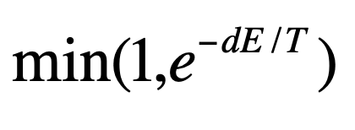
Gibbs sampling Monte Carlo simulations
A R N D C Q E G H I L K M F P S T W Y V
1 0.6 0.4 -3.5 -2.4 -0.4 -1.9 -2.7 0.3 -1.1 1.0 0.3 0.0 1.4 1.2 -2.7 1.4 -1.2 -2.0 1.1 0.7
2 -1.6 -6.6 -6.5 -5.4 -2.5 -4.0 -4.7 -3.7 -6.3 1.0 5.1 -3.7 3.1 -4.2 -4.3 -4.2 -0.2 -5.9 -3.8 0.4
3 0.2 -1.3 0.1 1.5 0.0 -1.8 -3.3 0.4 0.5 -1.0 0.3 -2.5 1.2 1.0 -0.1 -0.3 -0.5 3.4 1.6 0.0
4 -0.1 -0.1 -2.0 2.0 -1.6 0.5 0.8 2.0 -3.3 0.1 -1.7 -1.0 -2.2 -1.6 1.7 -0.6 -0.2 1.3 -6.8 -0.7
5 -1.6 -0.1 0.1 -2.2 -1.2 0.4 -0.5 1.9 1.2 -2.2 -0.5 -1.3 -2.2 1.7 1.2 -2.5 -0.1 1.7 1.5 1.0
6 -0.7 -1.4 -1.0 -2.3 1.1 -1.3 -1.4 -0.2 -1.0 1.8 0.8 -1.9 0.2 1.0 -0.4 -0.6 0.4 -0.5 -0.0 2.1
7 1.1 -3.8 -0.2 -1.3 1.3 -0.3 -1.3 -1.4 2.1 0.6 0.7 -5.0 1.1 0.9 1.3 -0.5 -0.9 2.9 -0.4 0.5
8 -2.2 1.0 -0.8 -2.9 -1.4 0.4 0.1 -0.4 0.2 -0.0 1.1 -0.5 -0.5 0.7 -0.3 0.8 0.8 -0.7 1.3 -1.1
9 -0.2 -3.5 -6.1 -4.5 0.7 -0.8 -2.5 -4.0 -2.6 0.9 2.8 -3.0 -1.8 -1.4 -6.2 -1.9 -1.6 -4.9 -1.6 4.5
-1.3
E1 = 1.5
E2 = 1.3
dE<0; P_{accept} =1
E2 = 1.7
dE>0; 0 < P_{accept} < 1

Slide 23
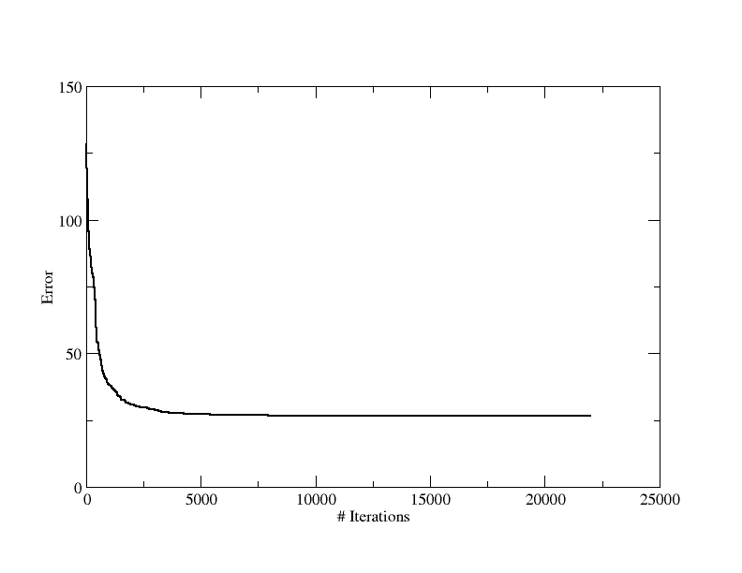
MC minimization

Slide 24
Monte Carlo Temperature
What is the Monte Carlo temperature?
Say dE=0.2, T=1
T=0.001

