Slide 1
Sequence motifs, information content, and sequence logos
Morten Nielsen,
Department of Health Technology,
DTU

Slide 2
Why weight matrices?
The vast majority of biological motifs are characterized by a linear motif
  Post translational modifications
  Signal peptides
  T cell epitopes
  Transcription binding sites
  SH2/SH3 domain binding
  MHC binding
  ….
Predict impact of sequence variation (SNP)
Used to prediction protein structure and function

Slide 3
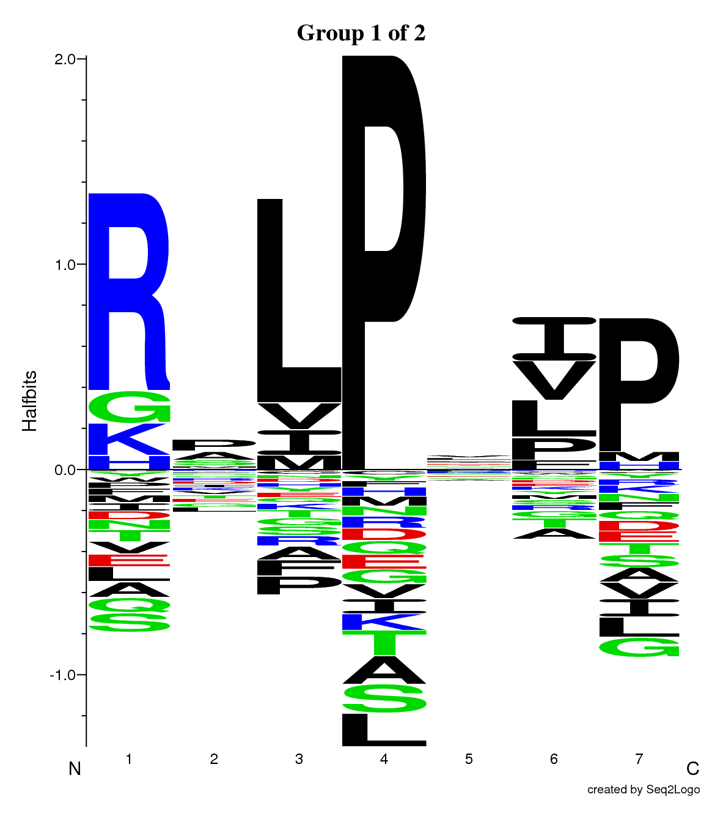
Identifying binding motifs (SH3 )
Peptide | Signal
LMLSLFEQSLSCQAQ | 9
QGTDATKSIIFEAER | -12
RLEEAQAYLAAGQHD | 10
EISELRTKVQEQQKQ | 44
FAGAKKIFGSLAFLP | 70
VRASSRVSGSFPEDS | -7
CKAFFKRSIQGHNDY | 86
CEGCKAFFKRSIQGH | 100
RLSEADIRGFVAAVV | -7

Slide 4
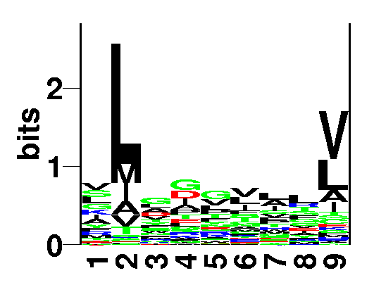
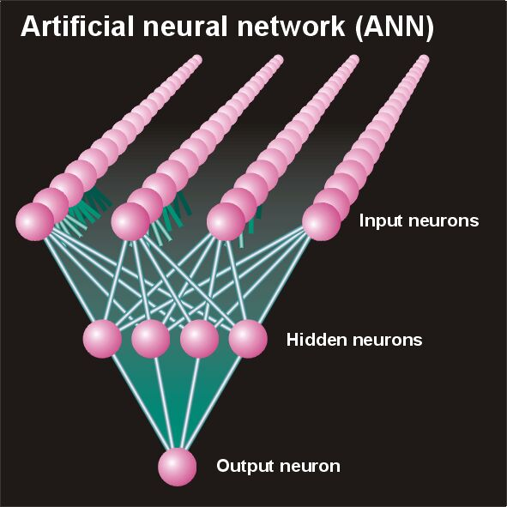

Bioinformatics in a nutshell
YMNGTMSQV
GILGFVFTL
ALWGFFPVV
ILKEPVHGV
ILGFVFTLT
LLFGYPVYV
GLSPTVWLS
WLSLLVPFV
FLPSDFFPS
CVGGLLTMV
FIAGNSAYE
List of peptides that have a given biological feature
Mathematical model (neural network, hidden Markov model)
Search databases for other biological sequences with the same feature/property
>polymerase“
MERIKELRDLMSQSRTREILTKTTVDHMAIIKKYTSGRQEKNPALRMKWMMAMKYPITAD
KRIMEMIPERNEQGQTLWSKTNDAGSDRVMVSPLAVTWWNRNGPTTSTVHYPKVYKTYFE
KVERLKHGTFGPVHFRNQVKIRRRVDINPGHADLSAKEAQDVIMEVVFPNEVGARILTSE
SQLTITKEKKEELQDCKIAPLMVAYMLERELVRKTRFLPVAGGTSSVYIEVLHLTQGTCW
EQMYTPGGEVRNDDVDQSLIIAARNIVRRATVSADPLASLLEMCHSTQIGGIRMVDILRQ
NPTEEQAVDICKAAMGLRISSSFSFGGFTFKRTNGSSVKKEEEVLTGNLQTLKIKVHEGY
EEFTMVGRRATAILRKATRRLIQLIVSGRDEQSIAEAIIVAMVFSQEDCMIKAVRGDLNF
...

Slide 5
Objectives
Visualization of binding motifs
  Construction of sequence logos
Understand the concepts of weight matrix construction
  One of the most important methods of bioinformatics
How to deal with data redundancy
How to deal with low counts (few observations)
How to use weight matrices to characterize receptor-ligand interactions
Case story from the MHC-peptide interactions guiding immune system reactions

Slide 6
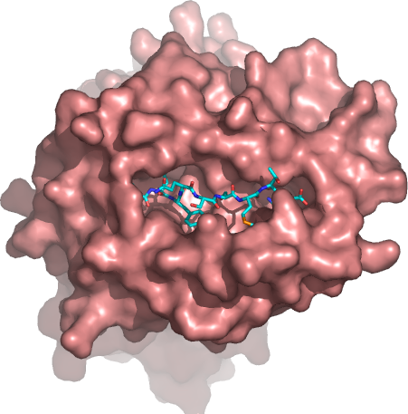
Binding Motif. MHC class I with peptide
Anchor positions

Slide 7
Sequence information
SLLPAIVEL YLLPAIVHI TLWVDPYEV GLVPFLVSV KLLEPVLLL LLDVPTAAV LLDVPTAAV LLDVPTAAV
LLDVPTAAV VLFRGGPRG MVDGTLLLL YMNGTMSQV MLLSVPLLL SLLGLLVEV ALLPPINIL TLIKIQHTL
HLIDYLVTS ILAPPVVKL ALFPQLVIL GILGFVFTL STNRQSGRQ GLDVLTAKV RILGAVAKV QVCERIPTI
ILFGHENRV ILMEHIHKL ILDQKINEV SLAGGIIGV LLIENVASL FLLWATAEA SLPDFGISY KKREEAPSL
LERPGGNEI ALSNLEVKL ALNELLQHV DLERKVESL FLGENISNF ALSDHHIYL GLSEFTEYL STAPPAHGV
PLDGEYFTL GVLVGVALI RTLDKVLEV HLSTAFARV RLDSYVRSL YMNGTMSQV GILGFVFTL ILKEPVHGV
ILGFVFTLT LLFGYPVYV GLSPTVWLS WLSLLVPFV FLPSDFFPS CLGGLLTMV FIAGNSAYE KLGEFYNQM
KLVALGINA DLMGYIPLV RLVTLKDIV MLLAVLYCL AAGIGILTV YLEPGPVTA LLDGTATLR ITDQVPFSV
KTWGQYWQV TITDQVPFS AFHHVAREL YLNKIQNSL MMRKLAILS AIMDKNIIL IMDKNIILK SMVGNWAKV
SLLAPGAKQ KIFGSLAFL ELVSEFSRM KLTPLCVTL VLYRYGSFS YIGEVLVSV CINGVCWTV VMNILLQYV
ILTVILGVL KVLEYVIKV FLWGPRALV GLSRYVARL FLLTRILTI HLGNVKYLV GIAGGLALL GLQDCTMLV
TGAPVTYST VIYQYMDDL VLPDVFIRC VLPDVFIRC AVGIGIAVV LVVLGLLAV ALGLGLLPV GIGIGVLAA
GAGIGVAVL IAGIGILAI LIVIGILIL LAGIGLIAA VDGIGILTI GAGIGVLTA AAGIGIIQI QAGIGILLA
KARDPHSGH KACDPHSGH ACDPHSGHF SLYNTVATL RGPGRAFVT NLVPMVATV GLHCYEQLV PLKQHFQIV
AVFDRKSDA LLDFVRFMG VLVKSPNHV GLAPPQHLI LLGRNSFEV PLTFGWCYK VLEWRFDSR TLNAWVKVV
GLCTLVAML FIDSYICQV IISAVVGIL VMAGVGSPY LLWTLVVLL SVRDRLARL LLMDCSGSI CLTSTVQLV
VLHDDLLEA LMWITQCFL SLLMWITQC QLSLLMWIT LLGATCMFV RLTRFLSRV YMDGTMSQV FLTPKKLQC
ISNDVCAQV VKTDGNPPE SVYDFFVWL FLYGALLLA VLFSSDFRI LMWAKIGPV SLLLELEEV SLSRFSWGA
YTAFTIPSI RLMKQDFSV RLPRIFCSC FLWGPRAYA RLLQETELV SLFEGIDFY SLDQSVVEL RLNMFTPYI
NMFTPYIGV LMIIPLINV TLFIGSHVV SLVIVTTFV VLQWASLAV ILAKFLHWL STAPPHVNV LLLLTVLTV
VVLGVVFGI ILHNGAYSL MIMVKCWMI MLGTHTMEV MLGTHTMEV SLADTNSLA LLWAARPRL GVALQTMKQ
GLYDGMEHL KMVELVHFL YLQLVFGIE MLMAQEALA LMAQEALAF VYDGREHTV YLSGANLNL RMFPNAPYL
EAAGIGILT TLDSQVMSL STPPPGTRV KVAELVHFL IMIGVLVGV ALCRWGLLL LLFAGVQCQ VLLCESTAV
YLSTAFARV YLLEMLWRL SLDDYNHLV RTLDKVLEV GLPVEYLQV KLIANNTRV FIYAGSLSA KLVANNTRL
FLDEFMEGV ALQPGTALL VLDGLDVLL SLYSFPEPE ALYVDSLFF SLLQHLIGL ELTLGEFLK MINAYLDKL
AAGIGILTV FLPSDFFPS SVRDRLARL SLREWLLRI LLSAWILTA AAGIGILTV AVPDEIPPL FAYDGKDYI
AAGIGILTV FLPSDFFPS AAGIGILTV FLPSDFFPS AAGIGILTV FLWGPRALV ETVSEQSNV ITLWQRPLV

Slide 8


Information content
A R N D C Q E G H I L K M F P S T W Y V S I
1 0.10 0.06 0.01 0.02 0.01 0.02 0.02 0.09 0.01 0.07 0.11 0.06 0.04 0.08 0.01 0.11 0.03 0.01 0.05 0.08 3.96 0.37
2 0.07 0.00 0.00 0.01 0.01 0.00 0.01 0.01 0.00 0.08 0.59 0.01 0.07 0.01 0.00 0.01 0.06 0.00 0.01 0.08 2.16 2.16
3 0.08 0.03 0.05 0.10 0.02 0.02 0.01 0.12 0.02 0.03 0.12 0.01 0.03 0.05 0.06 0.06 0.04 0.04 0.04 0.07 4.06 0.26
4 0.07 0.04 0.02 0.11 0.01 0.04 0.08 0.15 0.01 0.10 0.04 0.03 0.01 0.02 0.09 0.07 0.04 0.02 0.00 0.05 3.87 0.45
5 0.04 0.04 0.04 0.04 0.01 0.04 0.05 0.16 0.04 0.02 0.08 0.04 0.01 0.06 0.10 0.02 0.06 0.02 0.05 0.09 4.04 0.28
6 0.04 0.03 0.03 0.01 0.02 0.03 0.03 0.04 0.02 0.14 0.13 0.02 0.03 0.07 0.03 0.05 0.08 0.01 0.03 0.15 3.92 0.40
7 0.14 0.01 0.03 0.03 0.02 0.03 0.04 0.03 0.05 0.07 0.15 0.01 0.03 0.07 0.06 0.07 0.04 0.03 0.02 0.08 3.98 0.34
8 0.05 0.09 0.04 0.01 0.01 0.05 0.07 0.05 0.02 0.04 0.14 0.04 0.02 0.05 0.05 0.08 0.10 0.01 0.04 0.03 4.04 0.28
9 0.07 0.01 0.00 0.00 0.02 0.02 0.02 0.01 0.01 0.08 0.26 0.01 0.01 0.02 0.00 0.04 0.02 0.00 0.01 0.38 2.78 1.55

Slide 9
Sequence Information
Say that a peptide must have L at P₂ in order to bind, and that A,F,W,and Y are found at P₁. Which position has most information?
How many questions do I need to ask to tell if a peptide binds looking at only P₁ or P₂?

Slide 10
Sequence Information
Say that a peptide must have L at P₂ in order to bind, and that A,F,W,and Y are found at P₁. Which position has most information?
How many questions do I need to ask to tell if a peptide binds looking at only P₁ or P₂?
P1: 4 questions (at most)
P2: 1 question (L or not)
P2 has the most information

Slide 11
Sequence Information
Say that a peptide must have L at P₂ in order to bind, and that A,F,W,and Y are found at P₁. Which position has most information?
How many questions do I need to ask to tell if a peptide binds looking at only P₁ or P₂?
P1: 4 questions (at most)
P2: 1 question (L or not)
P2 has the most information
Calculate p_{a} at each position
Entropy
Information content
Conserved positions
  P_{L}=1, P_{!L}=0 => S=0, I=log(20)
Mutable positions
  P_{aa}=1/20 => S=log(20), I=0

Slide 12
Information content
A R N D C Q E G H I L K M F P S T W Y V I
1 0.09 0.06 0.01 0.01 0.01 0.01 0.02 0.09 0.01 0.08 0.11 0.07 0.04 0.07 0.01 0.12 0.04 0.01 0.06 0.09 0.20
2 0.06 0.00 0.00 0.01 0.01 0.00 0.01 0.01 0.00 0.09 0.62 0.01 0.08 0.01 0.00 0.01 0.05 0.00 0.01 0.07 1.59
3 0.08 0.03 0.05 0.10 0.02 0.02 0.01 0.10 0.02 0.03 0.12 0.01 0.04 0.06 0.04 0.07 0.04 0.04 0.05 0.07 0.17
4 0.08 0.05 0.02 0.11 0.01 0.04 0.09 0.15 0.01 0.08 0.04 0.04 0.01 0.02 0.10 0.05 0.04 0.02 0.00 0.04 0.30
5 0.05 0.04 0.04 0.02 0.01 0.04 0.05 0.15 0.04 0.03 0.09 0.04 0.01 0.06 0.08 0.02 0.06 0.03 0.06 0.09 0.21
6 0.04 0.03 0.04 0.01 0.03 0.03 0.03 0.05 0.02 0.13 0.14 0.03 0.03 0.06 0.04 0.06 0.06 0.01 0.03 0.16 0.19
7 0.13 0.01 0.04 0.03 0.02 0.03 0.04 0.04 0.06 0.08 0.14 0.01 0.03 0.06 0.07 0.06 0.04 0.04 0.03 0.09 0.21
8 0.04 0.09 0.03 0.01 0.01 0.05 0.07 0.06 0.03 0.04 0.15 0.05 0.02 0.06 0.04 0.09 0.09 0.01 0.05 0.03 0.18
9 0.08 0.01 0.00 0.00 0.02 0.02 0.02 0.01 0.01 0.09 0.28 0.01 0.01 0.02 0.00 0.03 0.03 0.00 0.01 0.35 0.98
Shannon, q_{a}=0.05
Kullback - Leibler

Slide 13
Sequence logos
Height of a column equal to I
Relative height of a letter is p
Highly useful tool to visualize sequence motifs
HLA-A0201
High information
positions
http://www.cbs.dtu.dk/biotools/Seq2Logo

Slide 14
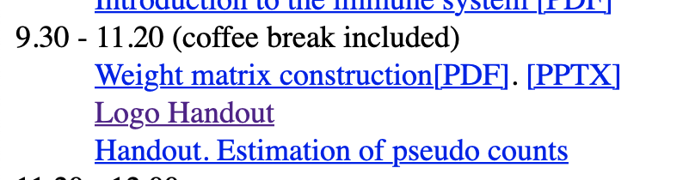
Logo handout
https://teaching.healthtech.dtu.dk/morten_teaching/27625.algo/presentations/PSSM/Ex_Logo.pdf

Slide 15
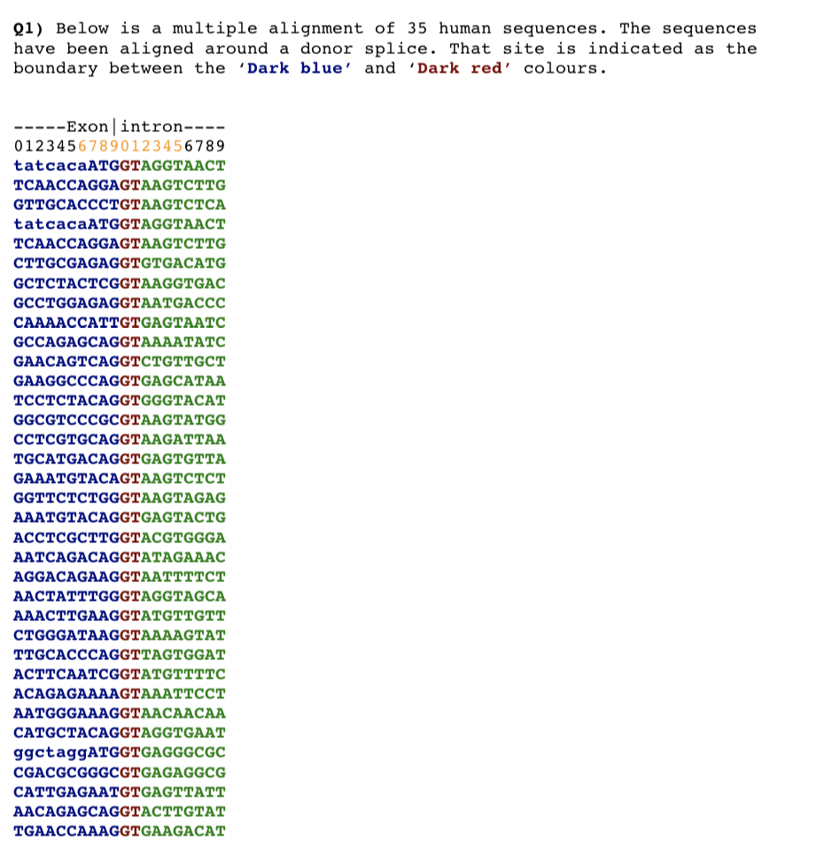
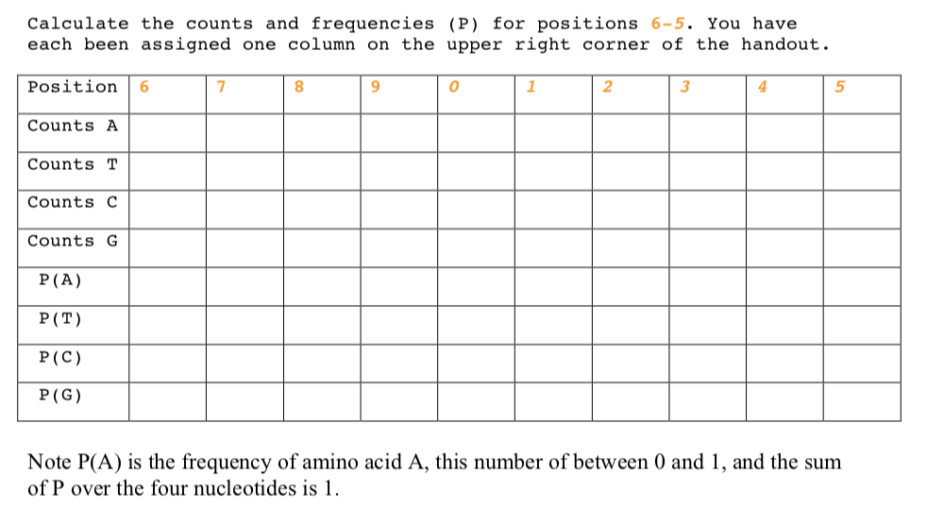
Logo handout

Slide 16
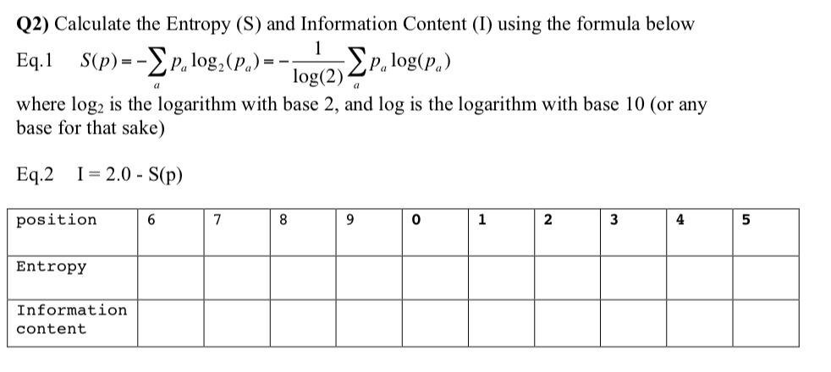
Logo handout

Slide 17
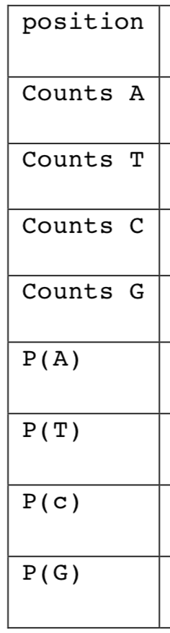
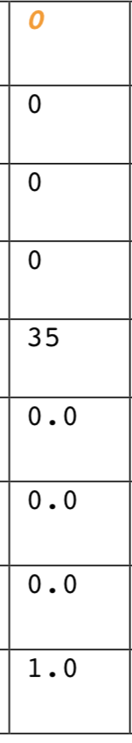
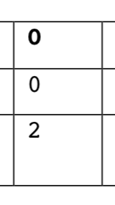
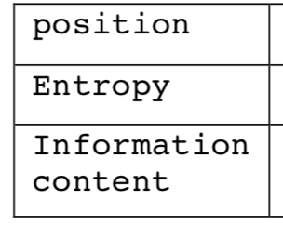

Slide 18
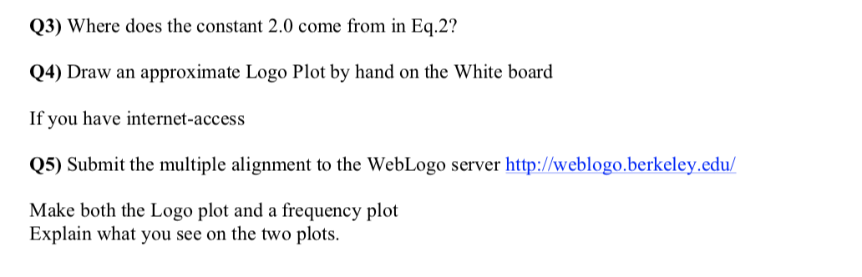

Slide 19
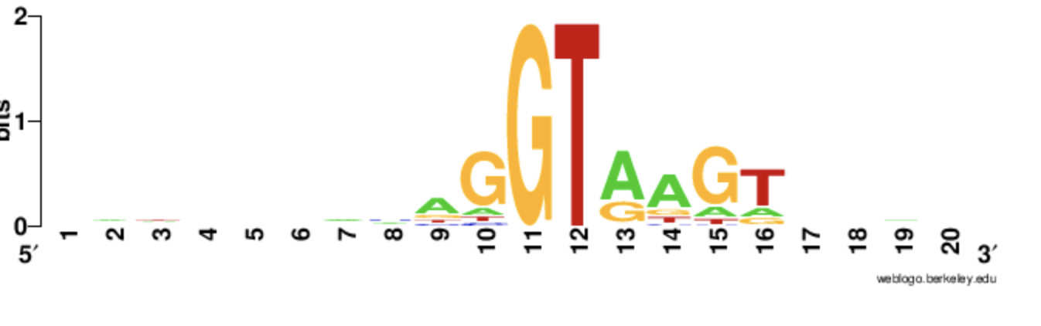
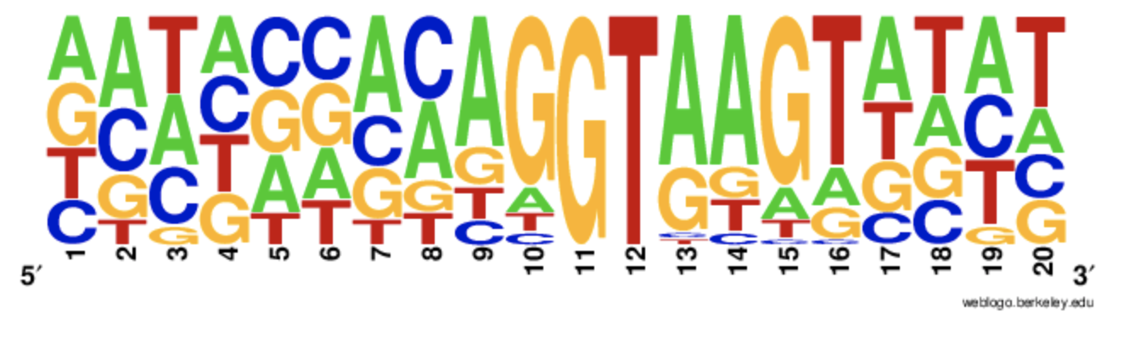

Slide 20
Characterizing a binding motif from small data sets
10 MHC restricted peptides
What can we learn?
A at P1 favors
  binding?
I is not allowed at P9?
Which positions are important for binding?
ALAKAAAAM
ALAKAAAAN
ALAKAAAAR
ALAKAAAAT
ALAKAAAAV
GMNERPILT
GILGFVFTM
TLNAWVKVV
KLNEPVLLL
AVVPFIVSV

Slide 21
Simple motifs
Yes/No rules
10 MHC restricted peptides
ALAKAAAAM
ALAKAAAAN
ALAKAAAAR
ALAKAAAAT
ALAKAAAAV
GMNERPILT
GILGFVFTM
TLNAWVKVV
KLNEPVLLL
AVVPFIVSV
Only 11 of 212 peptides identified!
Need more flexible rules
  If not fit P1 but fit P2 then ok
Not all positions are equally important
  We know that P2 and P9 determine binding more than other positions
Cannot discriminate between good and very good binders

Slide 22
Extended motifs
Fitness of aa at each position given by P(aa)
Example P1
  P_{A} = 6/10
  P_{G} = 2/10
  P_{T} = P_{K} = 1/10
  P_{C} = P_{D} = …P_{V} = 0
Problems
  Few data
  Data redundancy/duplication
ALAKAAAAM
ALAKAAAAN
ALAKAAAAR
ALAKAAAAT
ALAKAAAAV
GMNERPILT
GILGFVFTM
TLNAWVKVV
KLNEPVLLL
AVVPFIVSV
RLLDDTPEV 84 nM
GLLGNVSTV 23 nM
ALAKAAAAL 309 nM

Slide 23
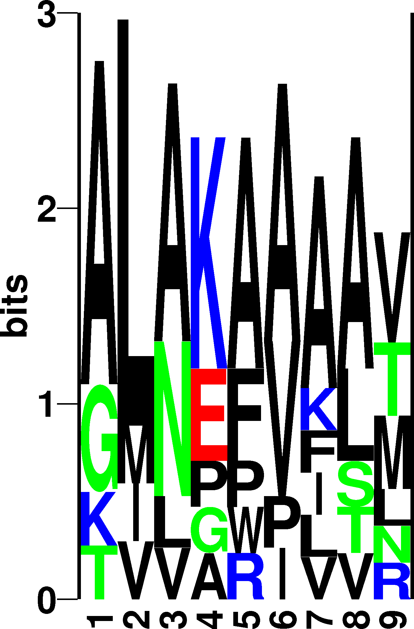
Sequence information
Raw sequence counting
ALAKAAAAM
ALAKAAAAN
ALAKAAAAR
ALAKAAAAT
ALAKAAAAV
GMNERPILT
GILGFVFTM
TLNAWVKVV
KLNEPVLLL
AVVPFIVSV

Slide 24
Sequence weighting
ALAKAAAAM
ALAKAAAAN
ALAKAAAAR
ALAKAAAAT
ALAKAAAAV
GMNERPILT
GILGFVFTM
TLNAWVKVV
KLNEPVLLL
AVVPFIVSV
}
Similar sequences
Weight 1/5
Poor or biased sampling of sequence space
Example P1
  P_{A} = 2/6
  P_{G} = 2/6
  P_{T} = P_{K} = 1/6
  P_{C} = P_{D} = …P_{V} = 0
RLLDDTPEV 84 nM
GLLGNVSTV 23 nM
ALAKAAAAL 309 nM

Slide 25
Sequence weighting
How to define clusters?
  Hobohm algorithm
    We will work on Hobohm later in the course
    Slow when data sets are large
  Heuristics
    Less accurate
    Fast

Slide 26
Sequence weighting - Clustering, Hobohm 1
}
Peptide Weight
ALAKAAAAM 0.20
ALAKAAAAN 0.20
ALAKAAAAR 0.20
ALAKAAAAT 0.20
ALAKAAAAV 0.20
GMNERPILT 1.00
GILGFVFTM 1.00
TLNAWVKVV 1.00
KLNEPVLLL 1.00
AVVPFIVSV 1.00
Similar sequences;
Weight 1/5

Slide 27
Sequence weighting
Heuristics - weight on peptide k at position p
  where r is the number of different amino acids in the column p, and s is the number occurrence of amino acid a in that column
Weight of sequence k is the sum of the weights over all positions

Slide 28
Sequence weighting
  r is the number of different amino acids in the column p, and s is the number occurrence of amino acid a in that column
In random sequences r=20, and s=0.05*N
where N is the number of sequences

Slide 29
Example
Peptide Weight
ALAKAAAAM 0.41
ALAKAAAAN 0.50
ALAKAAAAR 0.50
ALAKAAAAT 0.41
ALAKAAAAV 0.39
GMNERPILT 1.36
GILGFVFTM 1.46
TLNAWVKVV 1.27
KLNEPVLLL 1.19
AVVPFIVSV 1.51
r is the number of different amino acids in the column p, and s is the number occurrence of amino acids a in that column

Slide 30
Example (weight on each sequence)
Peptide Weight
ALAKAAAAM 0.41
ALAKAAAAN 0.50
ALAKAAAAR 0.50
ALAKAAAAT 0.41
ALAKAAAAV 0.39
GMNERPILT 1.36
GILGFVFTM 1.46
TLNAWVKVV 1.27
KLNEPVLLL 1.19
AVVPFIVSV 1.51
r is the number of different amino acids in the column p, and s is the number occurrence of amino acids a in that column
W₁₁= 1/(4*6) = 0.042
W₁₂= 1/(4*7) = 0.036
W₁₃= 1/(4*5) = 0.050
W₁₄= 1/(5*5) = 0.040
W₁₅= 1/(5*5) = 0.040
W₁₆= 1/(4*5) = 0.050
W₁₇= 1/(6*5) = 0.033
W₁₈= 1/(5*5) = 0.040
W₁₉= 1/(6*2) = 0.083
Sum = 0.414

Slide 31
Example (weight on each column)
Peptide Weight
ALAKAAAAM 0.41
ALAKAAAAN 0.50
ALAKAAAAR 0.50
ALAKAAAAT 0.41
ALAKAAAAV 0.39
GMNERPILT 1.36
GILGFVFTM 1.46
TLNAWVKVV 1.27
KLNEPVLLL 1.19
AVVPFIVSV 1.51
Sum = 9.00
r is the number of different amino acids in the column p, and s is the number occurrence of amino acids a in that column
W₁₁= 1/(4*6) = 0.042
W₂₁= 1/(4*6) = 0.042
W₃₁= 1/(4*6) = 0.042
W₄₁= 1/(4*6) = 0.042
W₅₁= 1/(4*6) = 0.042
W₆₁= 1/(4*2) = 0.125
W₇₁= 1/(4*2) = 0.125
W₈₁= 1/(4*1) = 0.250
W₉₁= 1/(4*1) = 0.250
W₁₀₁= 1/(4*6) = 0.042
Sum = 1.000

Slide 32
Example (weight on each column)
Peptide Weight
ALAKAAAAM 0.41
ALAKAAAAN 0.50
ALAKAAAAR 0.50
ALAKAAAAT 0.41
ALAKAAAAV 0.39
GMNERPILT 1.36
GILGFVFTM 1.46
TLNAWVKVV 1.27
KLNEPVLLL 1.19
AVVPFIVSV 1.51
Sum = 9.00
r is the number of different amino acids in the column p, and s is the number occurrence of amino acids a in that column
W₁₁= 1/(4*6) = 0.042
W₂₁= 1/(4*6) = 0.042
W₃₁= 1/(4*6) = 0.042
W₄₁= 1/(4*6) = 0.042
W₅₁= 1/(4*6) = 0.042
W₆₁= 1/(4*2) = 0.125
W₇₁= 1/(4*2) = 0.125
W₈₁= 1/(4*1) = 0.250
W₉₁= 1/(4*1) = 0.250
W₁₀₁= 1/(4*6) = 0.042
Sum = 1.000
Sum of weights for all sequences is hence L (=9)

Slide 33
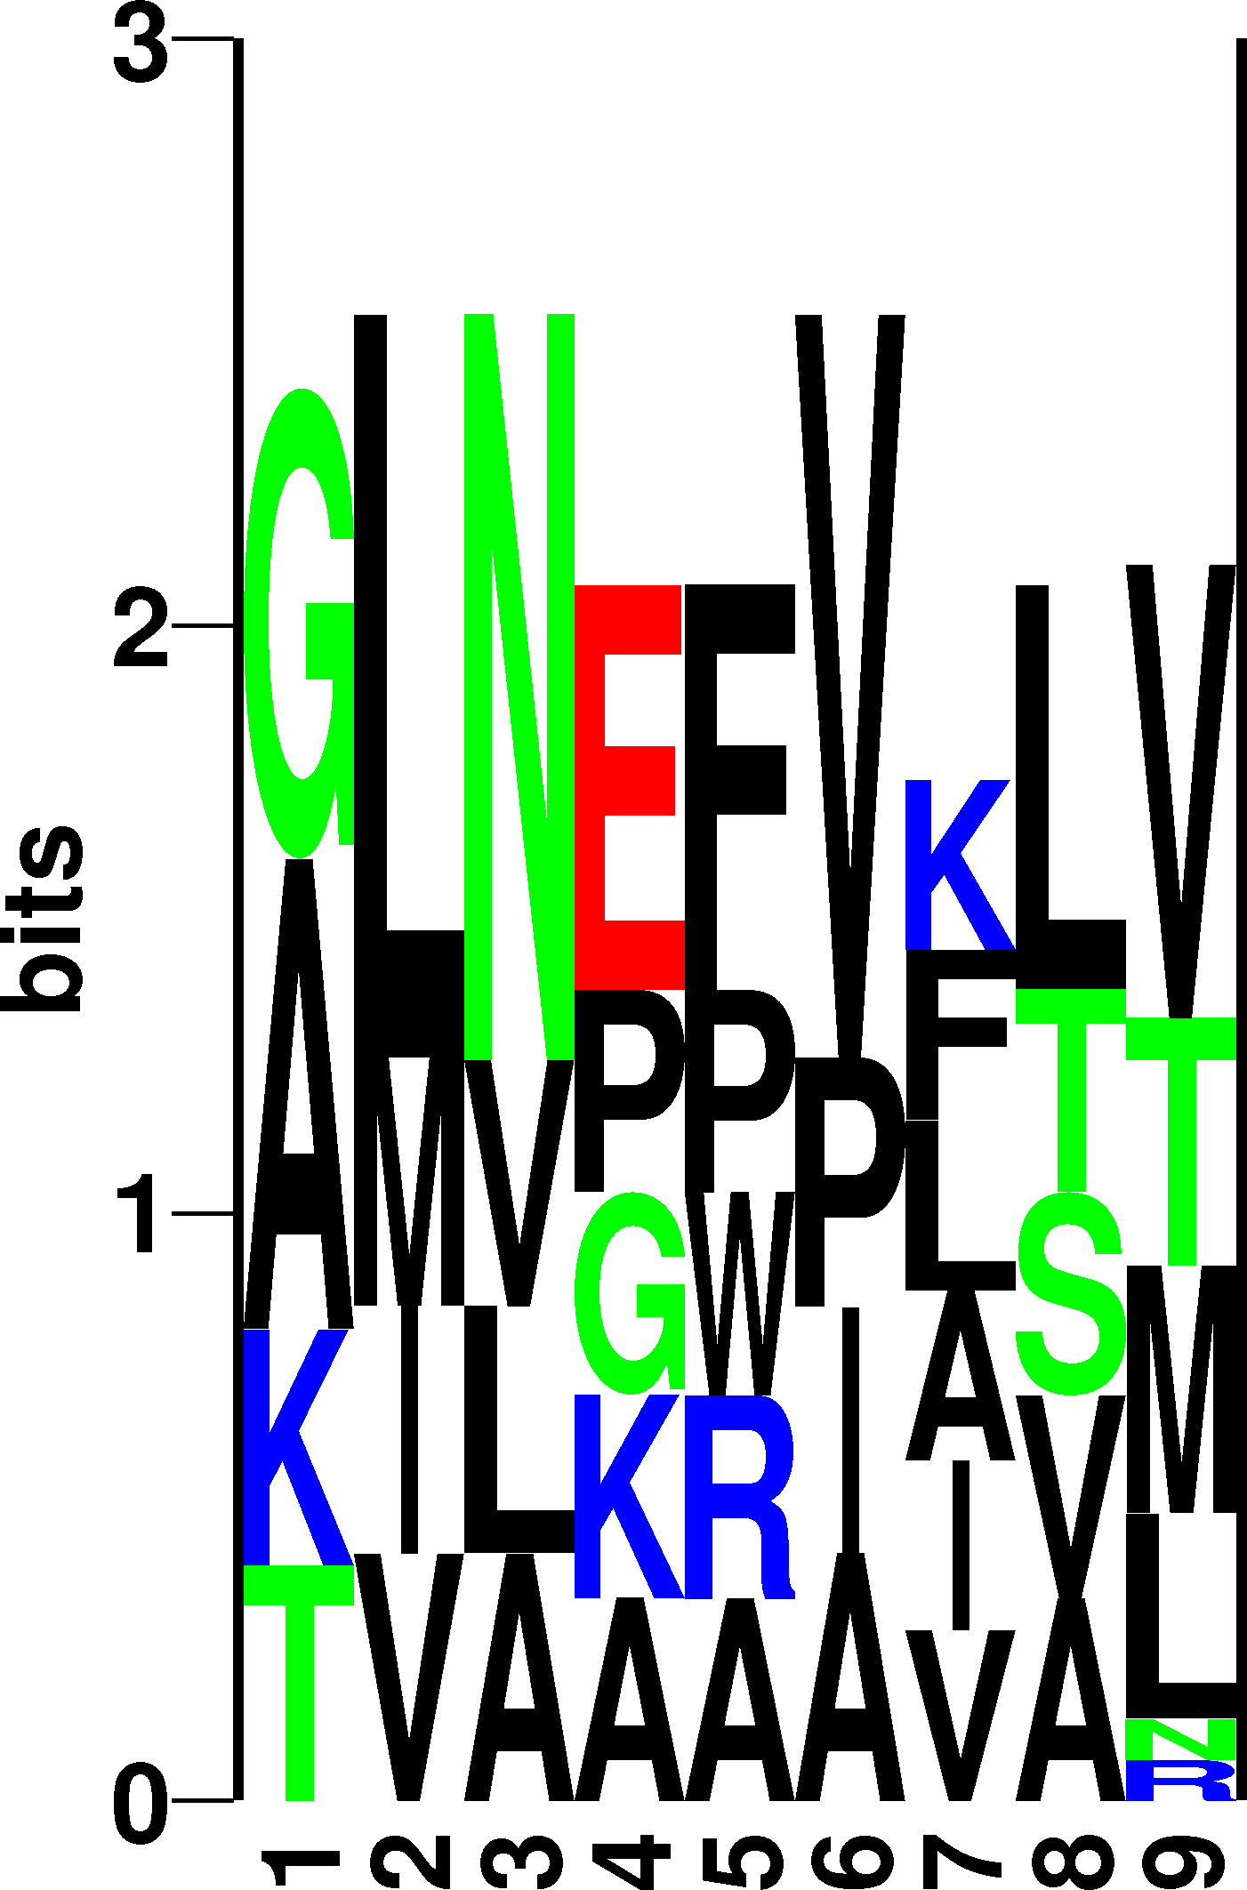
Sequence weighting
ALAKAAAAM
ALAKAAAAN
ALAKAAAAR
ALAKAAAAT
ALAKAAAAV
GMNERPILT
GILGFVFTM
TLNAWVKVV
KLNEPVLLL
AVVPFIVSV

Slide 34
Pseudo counts
I is not found at position P9. Does this mean that I is forbidden (P(I)=0)?
No! Use Blosum substitution matrix to estimate pseudo frequency of I at P9
ALAKAAAAM
ALAKAAAAN
ALAKAAAAR
ALAKAAAAT
ALAKAAAAV
GMNERPILT
GILGFVFTM
TLNAWVKVV
KLNEPVLLL
AVVPFIVSV

Slide 35
The Blosum (substitution frequency) matrix
A R N D C Q E G H I L K M F P S T W Y V
A 0.29 0.03 0.03 0.03 0.02 0.03 0.04 0.08 0.01 0.04 0.06 0.04 0.02 0.02 0.03 0.09 0.05 0.01 0.02 0.07
R 0.04 0.34 0.04 0.03 0.01 0.05 0.05 0.03 0.02 0.02 0.05 0.12 0.02 0.02 0.02 0.04 0.03 0.01 0.02 0.03
N 0.04 0.04 0.32 0.08 0.01 0.03 0.05 0.07 0.03 0.02 0.03 0.05 0.01 0.02 0.02 0.07 0.05 0.00 0.02 0.03
D 0.04 0.03 0.07 0.40 0.01 0.03 0.09 0.05 0.02 0.02 0.03 0.04 0.01 0.01 0.02 0.05 0.04 0.00 0.01 0.02
C 0.07 0.02 0.02 0.02 0.48 0.01 0.02 0.03 0.01 0.04 0.07 0.02 0.02 0.02 0.02 0.04 0.04 0.00 0.01 0.06
Q 0.06 0.07 0.04 0.05 0.01 0.21 0.10 0.04 0.03 0.03 0.05 0.09 0.02 0.01 0.02 0.06 0.04 0.01 0.02 0.04
E 0.06 0.05 0.04 0.09 0.01 0.06 0.30 0.04 0.03 0.02 0.04 0.08 0.01 0.02 0.03 0.06 0.04 0.01 0.02 0.03
G 0.08 0.02 0.04 0.03 0.01 0.02 0.03 0.51 0.01 0.02 0.03 0.03 0.01 0.02 0.02 0.05 0.03 0.01 0.01 0.02
H 0.04 0.05 0.05 0.04 0.01 0.04 0.05 0.04 0.35 0.02 0.04 0.05 0.02 0.03 0.02 0.04 0.03 0.01 0.06 0.02
I 0.05 0.02 0.01 0.02 0.02 0.01 0.02 0.02 0.01 0.27 0.17 0.02 0.04 0.04 0.01 0.03 0.04 0.01 0.02 0.18
L 0.04 0.02 0.01 0.02 0.02 0.02 0.02 0.02 0.01 0.12 0.38 0.03 0.05 0.05 0.01 0.02 0.03 0.01 0.02 0.10
K 0.06 0.11 0.04 0.04 0.01 0.05 0.07 0.04 0.02 0.03 0.04 0.28 0.02 0.02 0.03 0.05 0.04 0.01 0.02 0.03
M 0.05 0.03 0.02 0.02 0.02 0.03 0.03 0.03 0.02 0.10 0.20 0.04 0.16 0.05 0.02 0.04 0.04 0.01 0.02 0.09
F 0.03 0.02 0.02 0.02 0.01 0.01 0.02 0.03 0.02 0.06 0.11 0.02 0.03 0.39 0.01 0.03 0.03 0.02 0.09 0.06
P 0.06 0.03 0.02 0.03 0.01 0.02 0.04 0.04 0.01 0.03 0.04 0.04 0.01 0.01 0.49 0.04 0.04 0.00 0.01 0.03
S 0.11 0.04 0.05 0.05 0.02 0.03 0.05 0.07 0.02 0.03 0.04 0.05 0.02 0.02 0.03 0.22 0.08 0.01 0.02 0.04
T 0.07 0.04 0.04 0.04 0.02 0.03 0.04 0.04 0.01 0.05 0.07 0.05 0.02 0.02 0.03 0.09 0.25 0.01 0.02 0.07
W 0.03 0.02 0.02 0.02 0.01 0.02 0.02 0.03 0.02 0.03 0.05 0.02 0.02 0.06 0.01 0.02 0.02 0.49 0.07 0.03
Y 0.04 0.03 0.02 0.02 0.01 0.02 0.03 0.02 0.05 0.04 0.07 0.03 0.02 0.13 0.02 0.03 0.03 0.03 0.32 0.05
V 0.07 0.02 0.02 0.02 0.02 0.02 0.02 0.02 0.01 0.16 0.13 0.03 0.03 0.04 0.02 0.03 0.05 0.01 0.02 0.27
Some amino acids are highly conserved (i.e. C), some have a high change of mutation (i.e. I)

Slide 36
What is a pseudo count?
A R N D C Q E G H I L K M F P S T W Y V
A 0.29 0.03 0.03 0.03 0.02 0.03 0.04 0.08 0.01 0.04 0.06 0.04 0.02 0.02 0.03 0.09 0.05 0.01 0.02 0.07
R 0.04 0.34 0.04 0.03 0.01 0.05 0.05 0.03 0.02 0.02 0.05 0.12 0.02 0.02 0.02 0.04 0.03 0.01 0.02 0.03
N 0.04 0.04 0.32 0.08 0.01 0.03 0.05 0.07 0.03 0.02 0.03 0.05 0.01 0.02 0.02 0.07 0.05 0.00 0.02 0.03
D 0.04 0.03 0.07 0.40 0.01 0.03 0.09 0.05 0.02 0.02 0.03 0.04 0.01 0.01 0.02 0.05 0.04 0.00 0.01 0.02
C 0.07 0.02 0.02 0.02 0.48 0.01 0.02 0.03 0.01 0.04 0.07 0.02 0.02 0.02 0.02 0.04 0.04 0.00 0.01 0.06
….
Y 0.04 0.03 0.02 0.02 0.01 0.02 0.03 0.02 0.05 0.04 0.07 0.03 0.02 0.13 0.02 0.03 0.03 0.03 0.32 0.05
V 0.07 0.02 0.02 0.02 0.02 0.02 0.02 0.02 0.01 0.16 0.13 0.03 0.03 0.04 0.02 0.03 0.05 0.01 0.02 0.27
Say V is observed at P2
Knowing that V at P2 binds, what is the probability that a peptide could have I at P2?
P(I|V) = 0.16

Slide 37
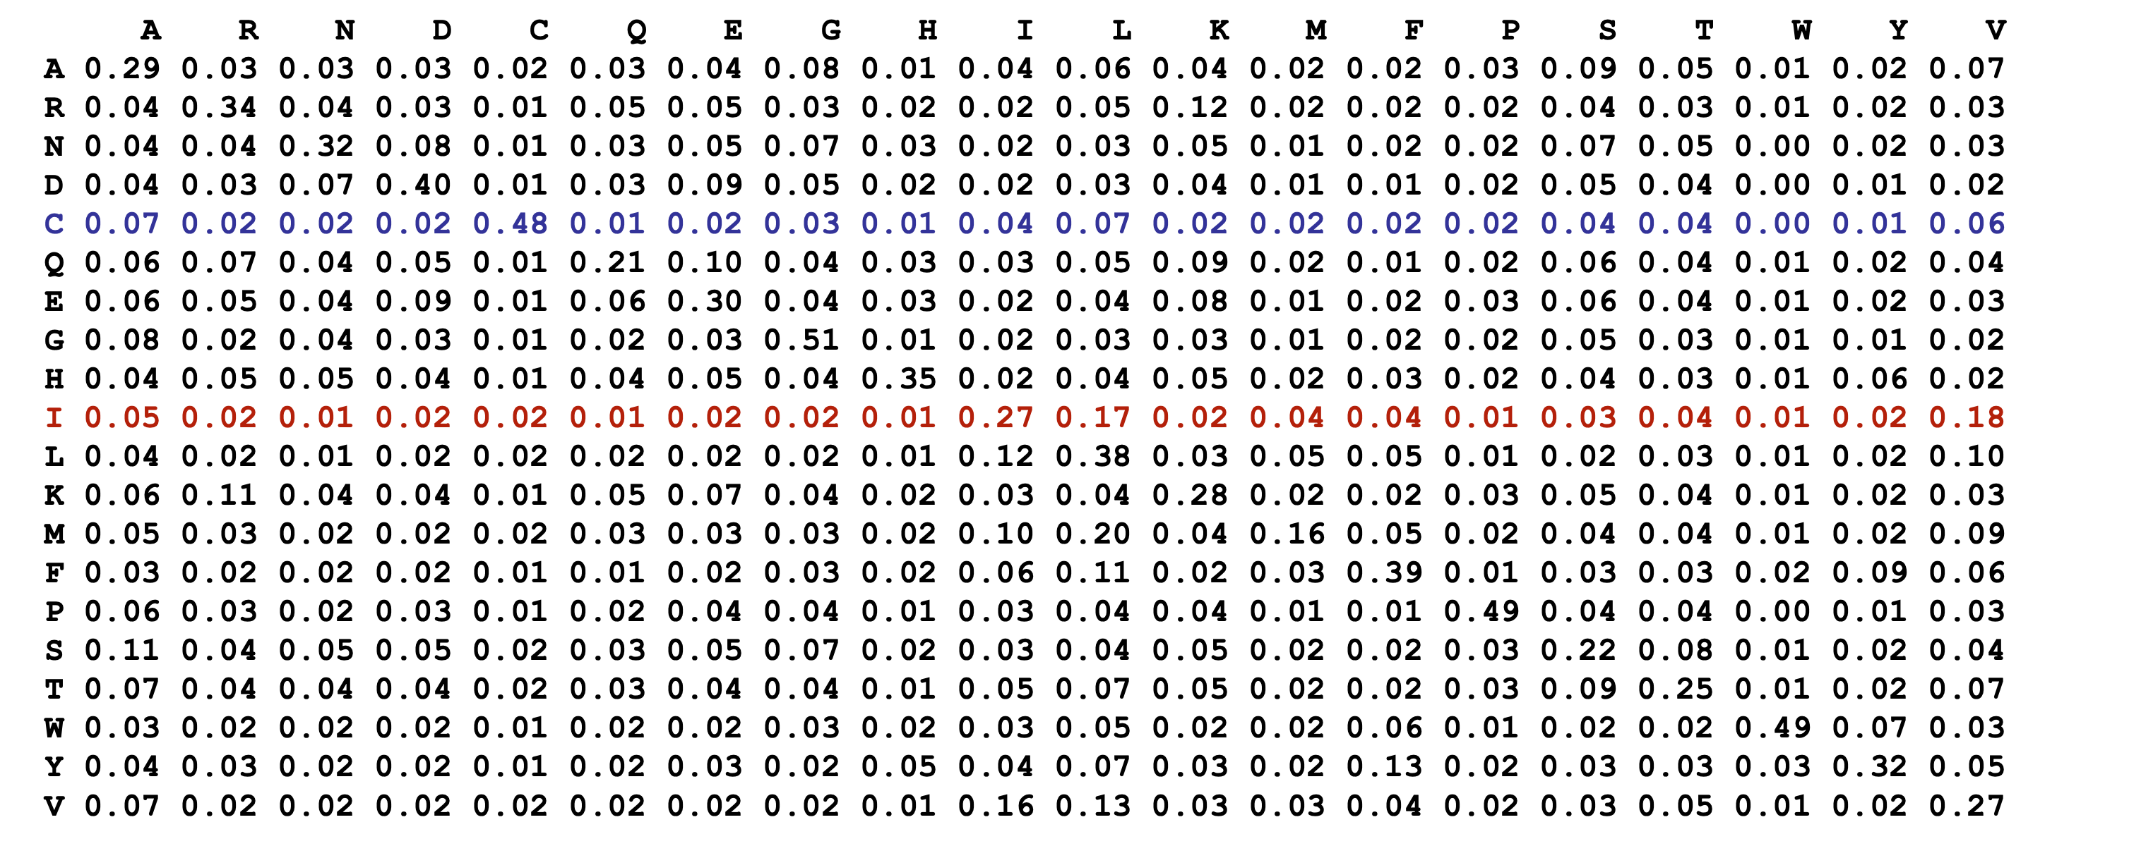
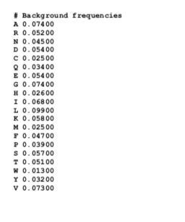
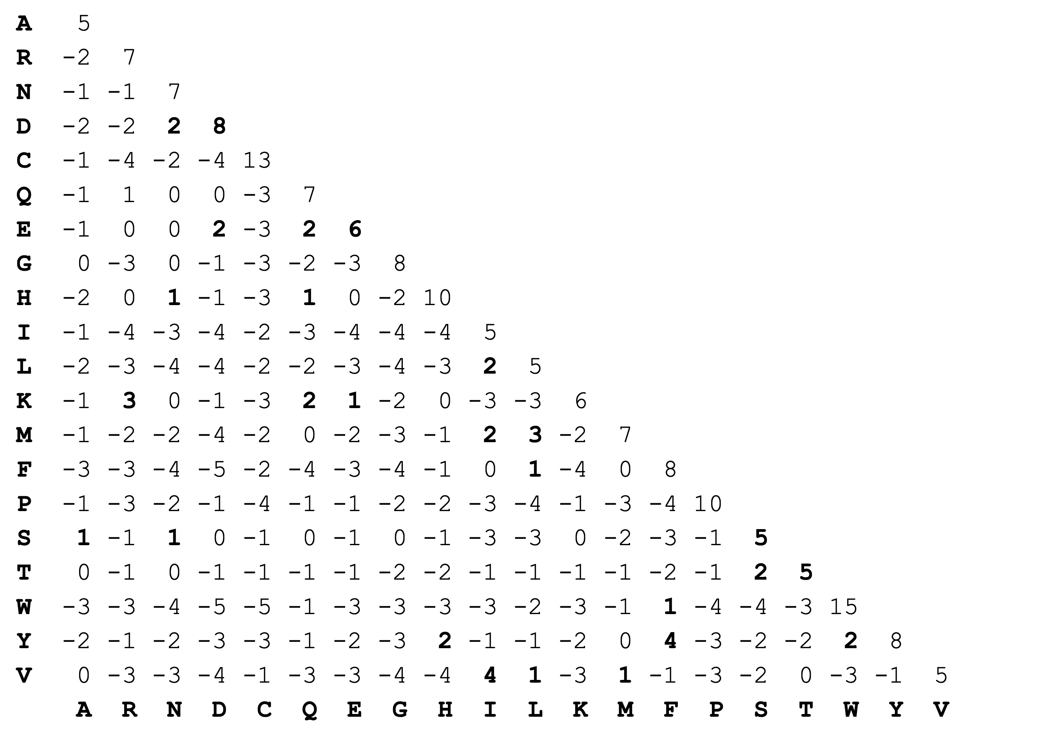
Relationship between the two Blosum matrices
W(V,R) = 2* log₂(p(R|V)/q(R))
= 2 * log₂(0.02/0.052)
= -2.76

Slide 38

Pseudo count estimation
Calculate observed amino acids frequencies f_{a}
Pseudo frequency for amino acid b
Example
ALAKAAAAM
ALAKAAAAN
ALAKAAAAR
ALAKAAAAT
ALAKAAAAV
GMNERPILT
GILGFVFTM
TLNAWVKVV
KLNEPVLLL
AVVPFIVSV
D

Slide 39

Weight on pseudo count
Pseudo counts are important when only limited data is available
With large data sets only “true” observation should count
α is the effective number of sequences -1, β is the weight on prior/weght on pseudo count
  In clustering α= #clusters -1
  In heuristics α= <# different amino acids in each column> -1
ALAKAAAAM
ALAKAAAAN
ALAKAAAAR
ALAKAAAAT
ALAKAAAAV
GMNERPILT
GILGFVFTM
TLNAWVKVV
KLNEPVLLL
AVVPFIVSV

Slide 40
Example
Peptide Weight
ALAKAAAAM 0.41
ALAKAAAAN 0.50
ALAKAAAAR 0.50
ALAKAAAAT 0.41
ALAKAAAAV 0.39
GMNERPILT 1.36
GILGFVFTM 1.46
TLNAWVKVV 1.27
KLNEPVLLL 1.19
AVVPFIVSV 1.51
  In heuristics
  α= <# different amino acids in each column> -1
  α =(4+4+4+5+5+4+6+5+6)/9
  = 4.8
  Note: α <= 20!

Slide 41
Weight on pseudo count
ALAKAAAAM
ALAKAAAAN
ALAKAAAAR
ALAKAAAAT
ALAKAAAAV
GMNERPILT
GILGFVFTM
TLNAWVKVV
KLNEPVLLL
AVVPFIVSV
Example
If α large, p ≈ f and only the observed data defines the motif
If α small, p ≈ g and the pseudo counts (or prior) defines the motif
β is [50-200] normally

Slide 42
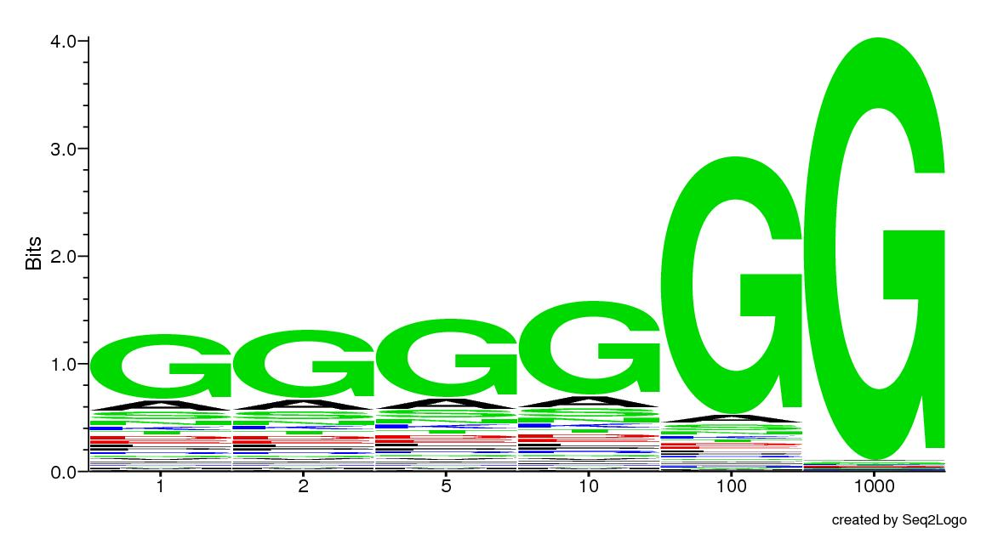
Gaining confidence
α

Slide 43
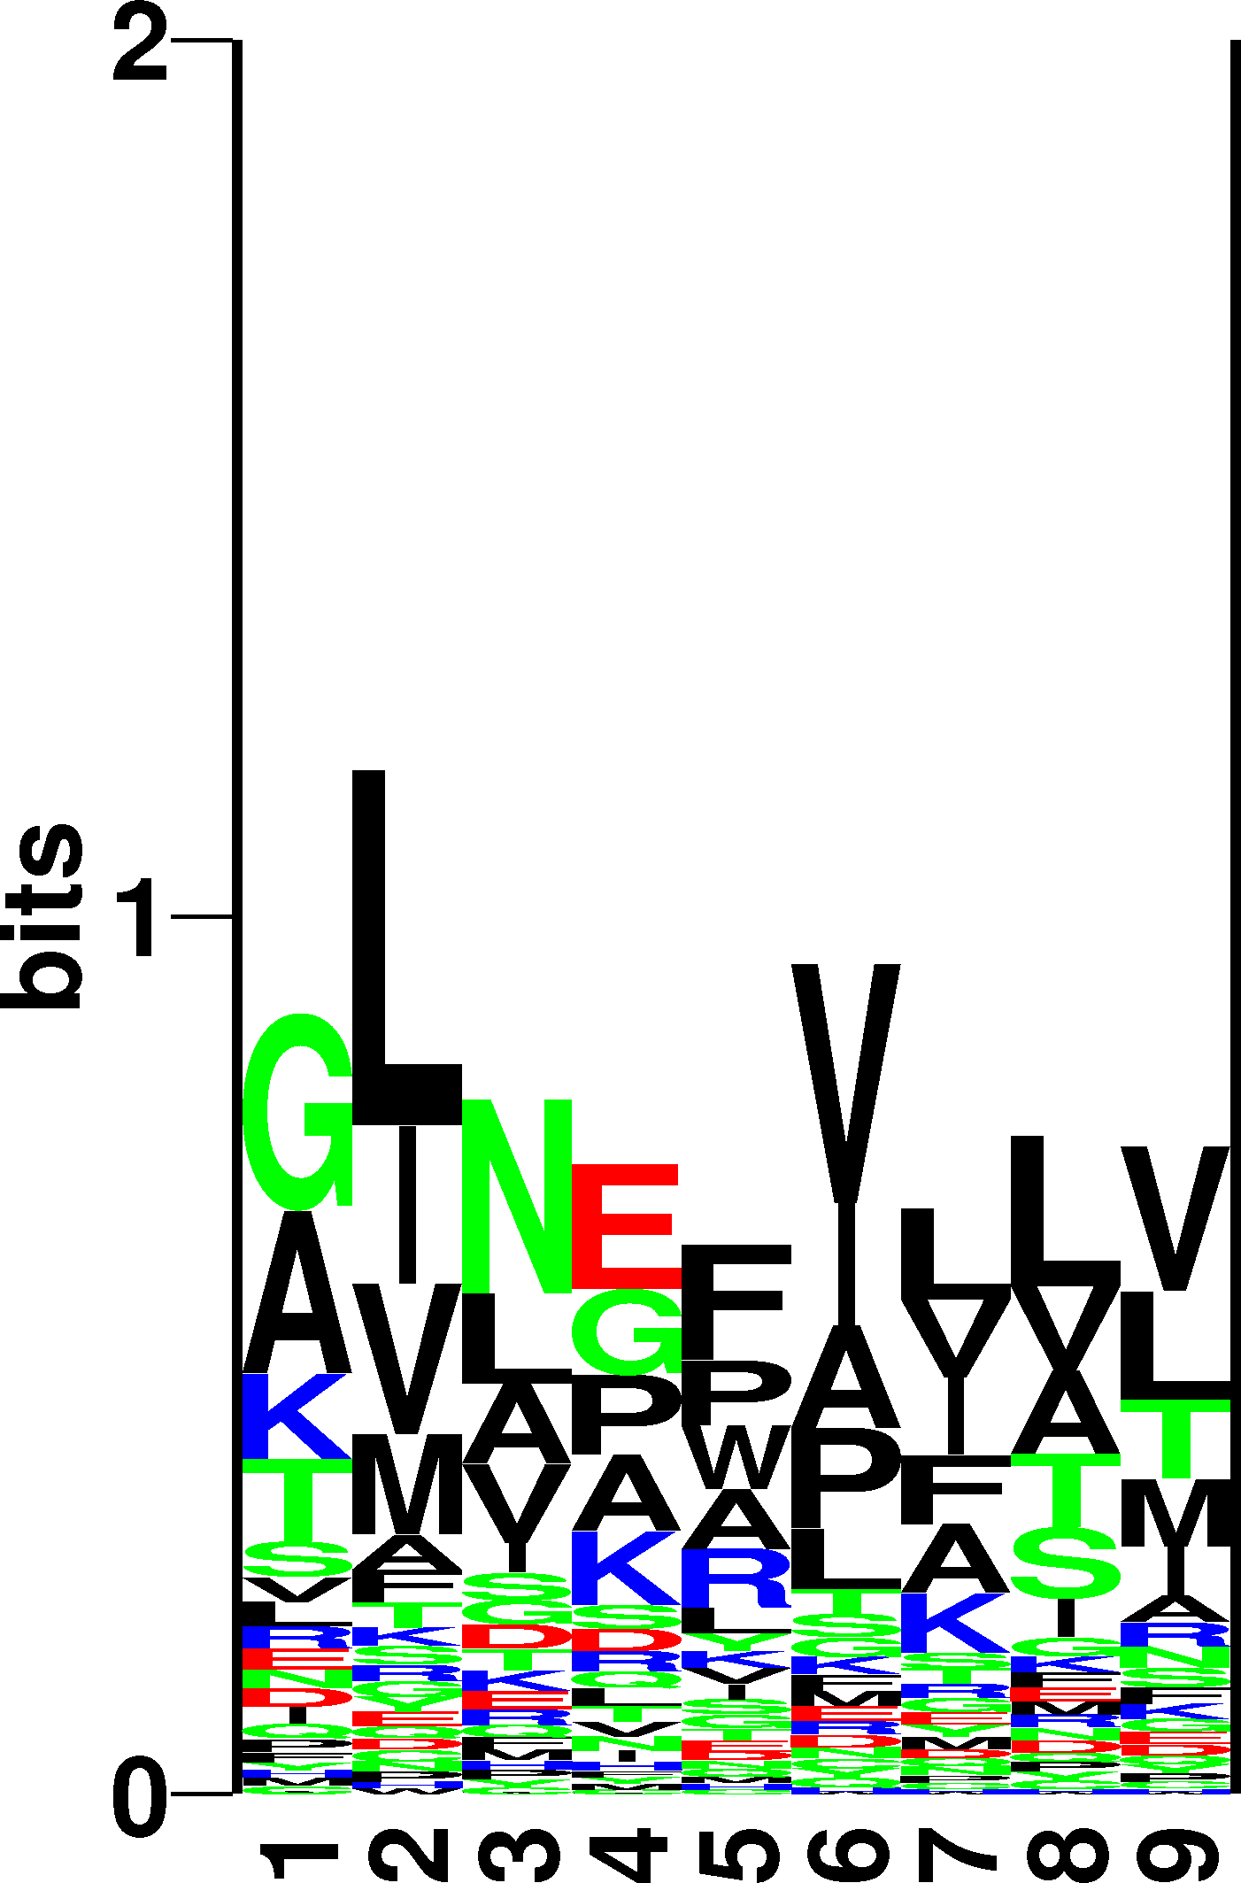
Sequence weighting and pseudo counts
ALAKAAAAM
ALAKAAAAN
ALAKAAAAR
ALAKAAAAT
ALAKAAAAV
GMNERPILT
GILGFVFTM
TLNAWVKVV
KLNEPVLLL
AVVPFIVSV

Slide 44
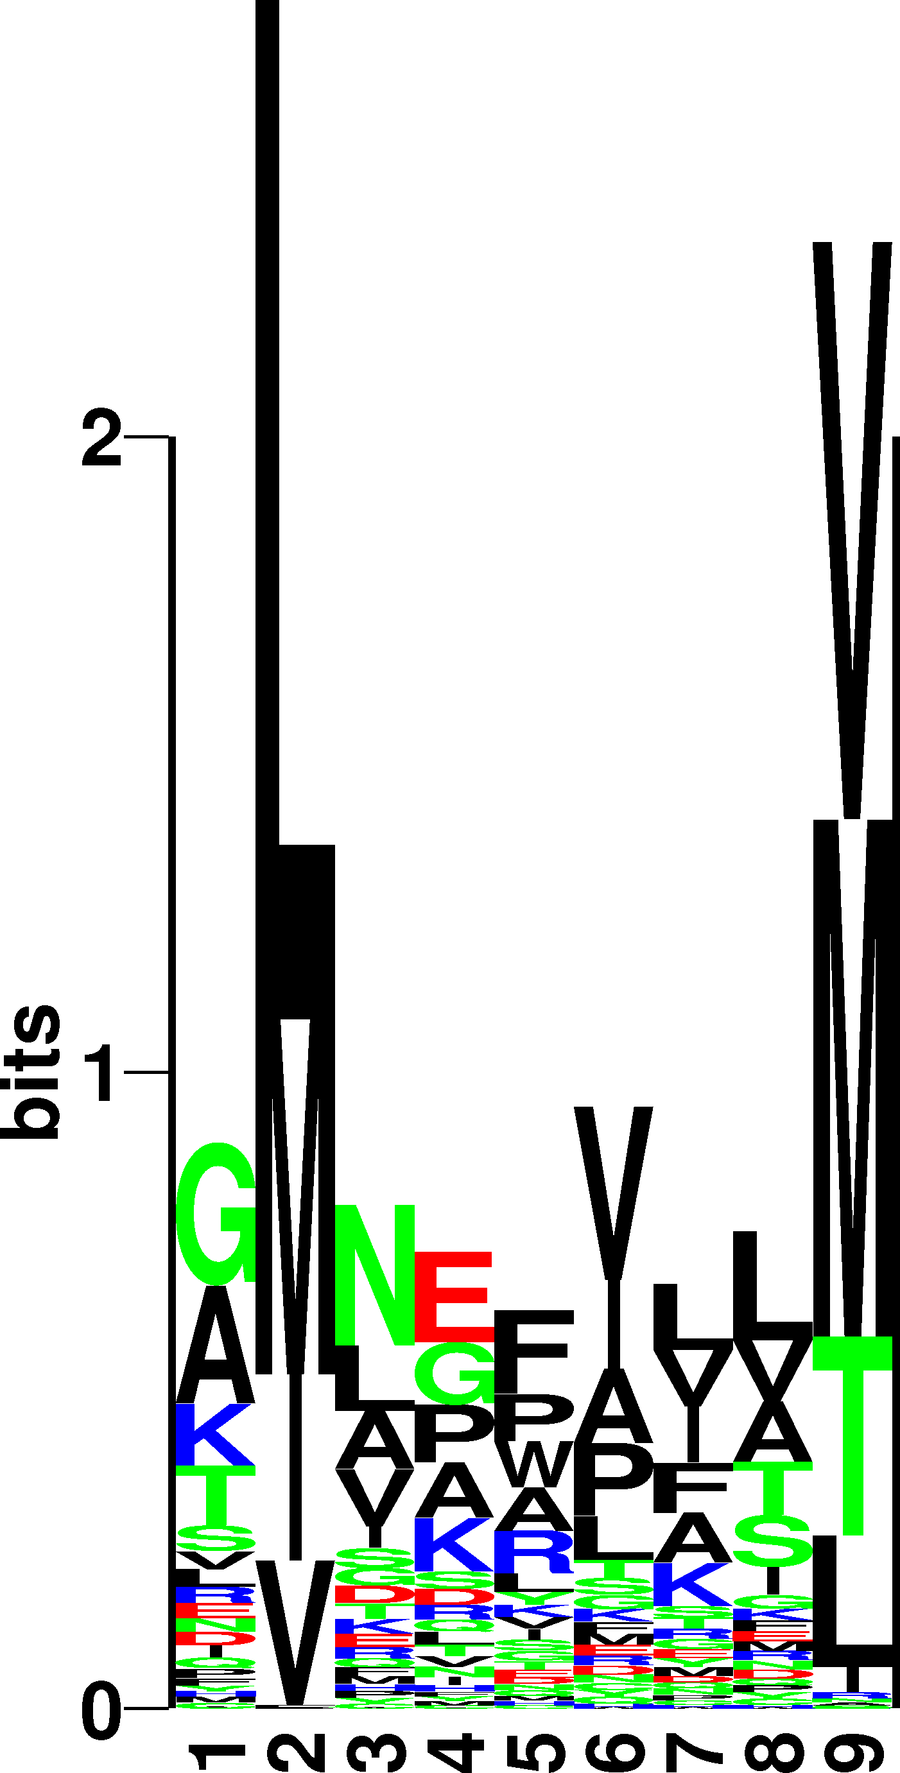
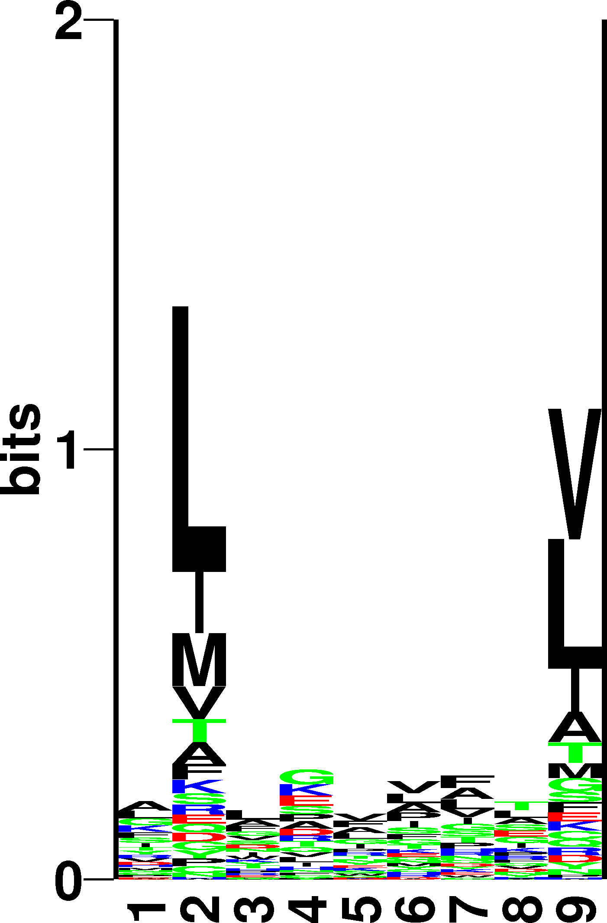
Position specific weighting
We know that positions 2 and 9 are anchor positions for most MHC binding motifs
  Increase weight on high information positions
Motif found on large data set

Slide 45
Weight matrices
Estimate amino acid frequencies from alignment including sequence weighting and pseudo count
What do the numbers mean?
  P2(V)>P2(M). Does this mean that V enables binding more than M.
  In nature not all amino acids are found equally often
    In nature V is found more often than M, so we must somehow rescale with the background
    q_{M} = 0.025, q_{V} = 0.073
    Finding 7% V is hence not significant, but 7% M highly significant
A R N D C Q E G H I L K M F P S T W Y V
1 0.08 0.06 0.02 0.03 0.02 0.02 0.03 0.08 0.02 0.08 0.11 0.06 0.04 0.06 0.02 0.09 0.04 0.01 0.04 0.08
2 0.04 0.01 0.01 0.01 0.01 0.01 0.02 0.02 0.01 0.11 0.44 0.02 0.06 0.03 0.01 0.02 0.05 0.00 0.01 0.10
3 0.08 0.04 0.05 0.07 0.02 0.03 0.03 0.08 0.02 0.05 0.11 0.03 0.03 0.06 0.04 0.06 0.05 0.03 0.05 0.07
4 0.08 0.05 0.03 0.10 0.01 0.05 0.08 0.13 0.01 0.05 0.06 0.05 0.01 0.03 0.08 0.06 0.04 0.02 0.01 0.05
5 0.06 0.04 0.05 0.03 0.01 0.04 0.05 0.11 0.03 0.04 0.09 0.04 0.02 0.06 0.06 0.04 0.05 0.02 0.05 0.08
6 0.06 0.03 0.03 0.03 0.03 0.03 0.04 0.06 0.02 0.10 0.14 0.04 0.03 0.05 0.04 0.06 0.06 0.01 0.03 0.13
7 0.10 0.02 0.04 0.04 0.02 0.03 0.04 0.05 0.04 0.08 0.12 0.02 0.03 0.06 0.07 0.06 0.05 0.03 0.03 0.08
8 0.05 0.07 0.04 0.03 0.01 0.04 0.06 0.06 0.03 0.06 0.13 0.06 0.02 0.05 0.04 0.08 0.07 0.01 0.04 0.05
9 0.08 0.02 0.01 0.01 0.02 0.02 0.03 0.02 0.01 0.10 0.23 0.03 0.02 0.04 0.01 0.04 0.04 0.00 0.02 0.25

Slide 46
Weight matrices
A weight matrix is given as
  W_{ij} = log(p_{ij}/q_{j})
  where i is a position in the motif, and j an amino acid. q_{j} is the background frequency for amino acid j.
W is a L x 20 matrix, L is motif length
A R N D C Q E G H I L K M F P S T W Y V
1 0.6 0.4 -3.5 -2.4 -0.4 -1.9 -2.7 0.3 -1.1 1.0 0.3 0.0 1.4 1.2 -2.7 1.4 -1.2 -2.0 1.1 0.7
2 -1.6 -6.6 -6.5 -5.4 -2.5 -4.0 -4.7 -3.7 -6.3 1.0 5.1 -3.7 3.1 -4.2 -4.3 -4.2 -0.2 -5.9 -3.8 0.4
3 0.2 -1.3 0.1 1.5 0.0 -1.8 -3.3 0.4 0.5 -1.0 0.3 -2.5 1.2 1.0 -0.1 -0.3 -0.5 3.4 1.6 0.0
4 -0.1 -0.1 -2.0 2.0 -1.6 0.5 0.8 2.0 -3.3 0.1 -1.7 -1.0 -2.2 -1.6 1.7 -0.6 -0.2 1.3 -6.8 -0.7
5 -1.6 -0.1 0.1 -2.2 -1.2 0.4 -0.5 1.9 1.2 -2.2 -0.5 -1.3 -2.2 1.7 1.2 -2.5 -0.1 1.7 1.5 1.0
6 -0.7 -1.4 -1.0 -2.3 1.1 -1.3 -1.4 -0.2 -1.0 1.8 0.8 -1.9 0.2 1.0 -0.4 -0.6 0.4 -0.5 -0.0 2.1
7 1.1 -3.8 -0.2 -1.3 1.3 -0.3 -1.3 -1.4 2.1 0.6 0.7 -5.0 1.1 0.9 1.3 -0.5 -0.9 2.9 -0.4 0.5
8 -2.2 1.0 -0.8 -2.9 -1.4 0.4 0.1 -0.4 0.2 -0.0 1.1 -0.5 -0.5 0.7 -0.3 0.8 0.8 -0.7 1.3 -1.1
9 -0.2 -3.5 -6.1 -4.5 0.7 -0.8 -2.5 -4.0 -2.6 0.9 2.8 -3.0 -1.8 -1.4 -6.2 -1.9 -1.6 -4.9 -1.6 4.5

Slide 47
Scoring a sequence to a weight matrix
Score sequences to weight matrix by looking up and adding L values from the matrix
A R N D C Q E G H I L K M F P S T W Y V
1 0.6 0.4 -3.5 -2.4 -0.4 -1.9 -2.7 0.3 -1.1 1.0 0.3 0.0 1.4 1.2 -2.7 1.4 -1.2 -2.0 1.1 0.7
2 -1.6 -6.6 -6.5 -5.4 -2.5 -4.0 -4.7 -3.7 -6.3 1.0 5.1 -3.7 3.1 -4.2 -4.3 -4.2 -0.2 -5.9 -3.8 0.4
3 0.2 -1.3 0.1 1.5 0.0 -1.8 -3.3 0.4 0.5 -1.0 0.3 -2.5 1.2 1.0 -0.1 -0.3 -0.5 3.4 1.6 0.0
4 -0.1 -0.1 -2.0 2.0 -1.6 0.5 0.8 2.0 -3.3 0.1 -1.7 -1.0 -2.2 -1.6 1.7 -0.6 -0.2 1.3 -6.8 -0.7
5 -1.6 -0.1 0.1 -2.2 -1.2 0.4 -0.5 1.9 1.2 -2.2 -0.5 -1.3 -2.2 1.7 1.2 -2.5 -0.1 1.7 1.5 1.0
6 -0.7 -1.4 -1.0 -2.3 1.1 -1.3 -1.4 -0.2 -1.0 1.8 0.8 -1.9 0.2 1.0 -0.4 -0.6 0.4 -0.5 -0.0 2.1
7 1.1 -3.8 -0.2 -1.3 1.3 -0.3 -1.3 -1.4 2.1 0.6 0.7 -5.0 1.1 0.9 1.3 -0.5 -0.9 2.9 -0.4 0.5
8 -2.2 1.0 -0.8 -2.9 -1.4 0.4 0.1 -0.4 0.2 -0.0 1.1 -0.5 -0.5 0.7 -0.3 0.8 0.8 -0.7 1.3 -1.1
9 -0.2 -3.5 -6.1 -4.5 0.7 -0.8 -2.5 -4.0 -2.6 0.9 2.8 -3.0 -1.8 -1.4 -6.2 -1.9 -1.6 -4.9 -1.6 4.5
RLLDDTPEV
GLLGNVSTV
ALAKAAAAL
11.9
14.7
4.3
84nM
23nM
309nM
Which peptide is most likely to bind?
Which peptide second?

Slide 48
An example!!
(See handout)

Slide 49
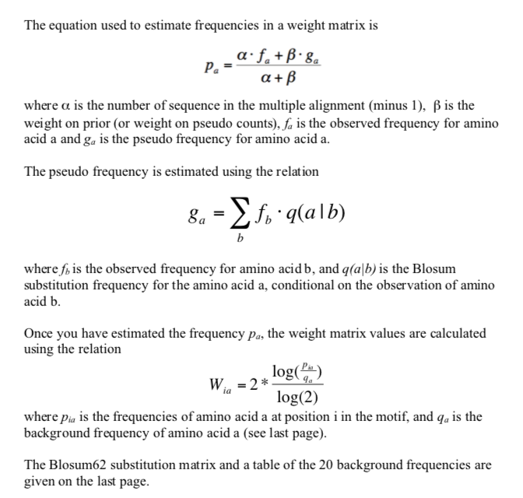
Logo handout - 2

Slide 50
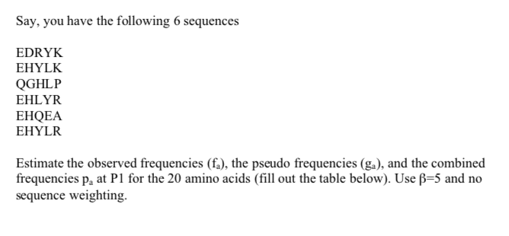
Logo handout - 2

Slide 51
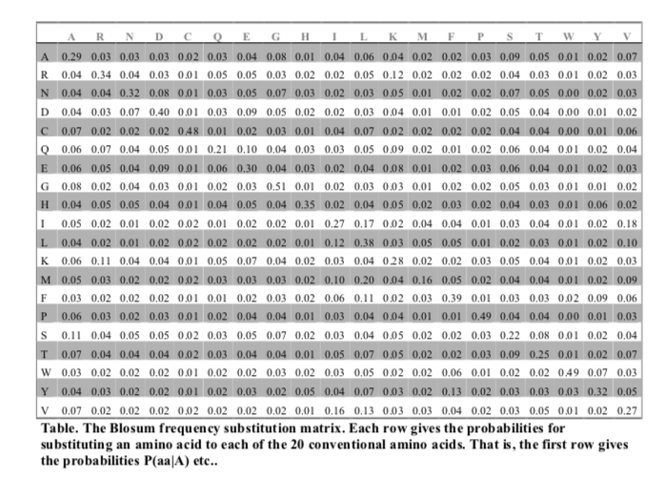
Logo handout - 2

Slide 52
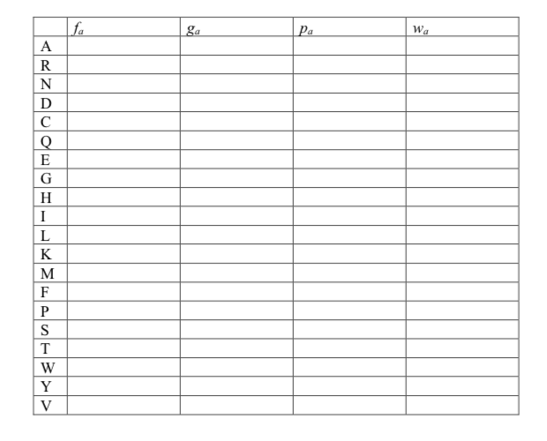
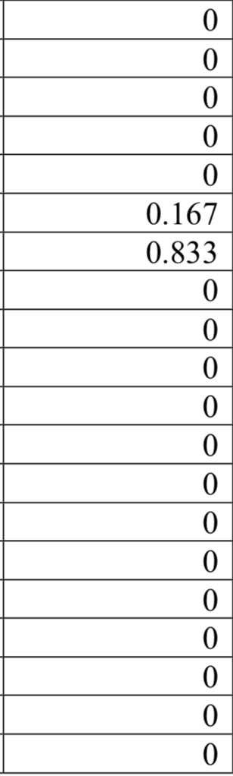
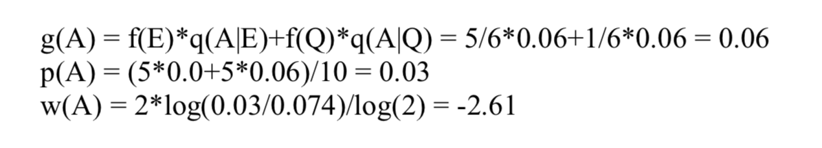
Logo handout - 2

Slide 53
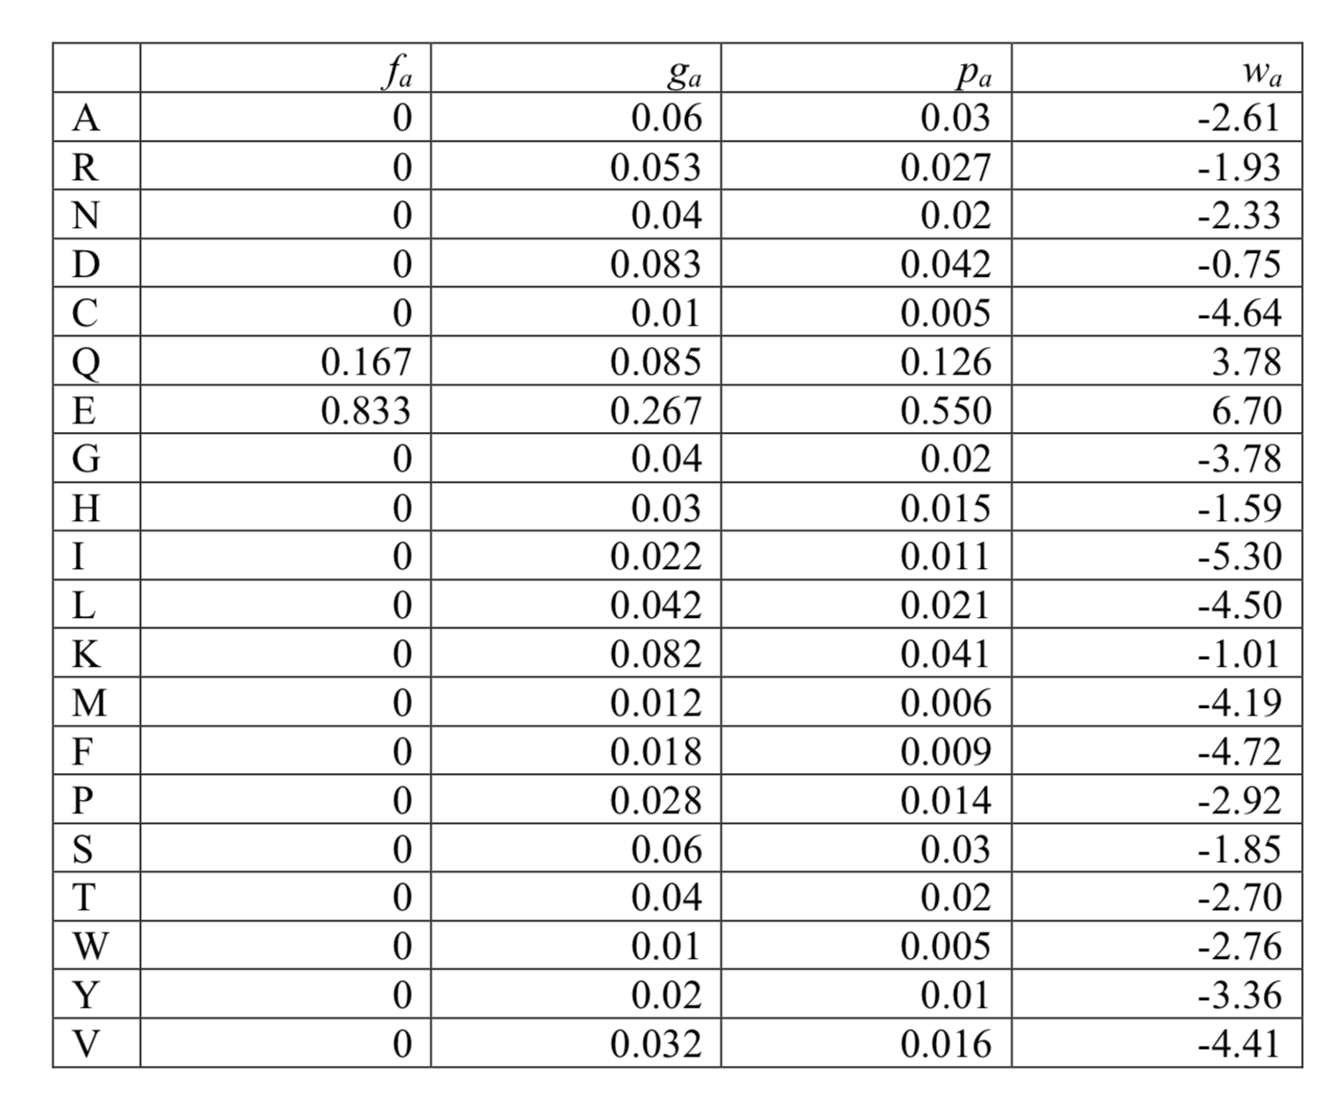
Logo handout – 2 - Answers

Slide 54
Information content (Kullback-Leibler)
A R N D C Q E G H I L K M F P S T W Y V I
1 0.09 0.06 0.01 0.01 0.01 0.01 0.02 0.09 0.01 0.08 0.11 0.07 0.04 0.07 0.01 0.12 0.04 0.01 0.06 0.09 0.20
2 0.06 0.00 0.00 0.01 0.01 0.00 0.01 0.01 0.00 0.09 0.62 0.01 0.08 0.01 0.00 0.01 0.05 0.00 0.01 0.07 1.59
3 0.08 0.03 0.05 0.10 0.02 0.02 0.01 0.10 0.02 0.03 0.12 0.01 0.04 0.06 0.04 0.07 0.04 0.04 0.05 0.07 0.17
4 0.08 0.05 0.02 0.11 0.01 0.04 0.09 0.15 0.01 0.08 0.04 0.04 0.01 0.02 0.10 0.05 0.04 0.02 0.00 0.04 0.30
5 0.05 0.04 0.04 0.02 0.01 0.04 0.05 0.15 0.04 0.03 0.09 0.04 0.01 0.06 0.08 0.02 0.06 0.03 0.06 0.09 0.21
6 0.04 0.03 0.04 0.01 0.03 0.03 0.03 0.05 0.02 0.13 0.14 0.03 0.03 0.06 0.04 0.06 0.06 0.01 0.03 0.16 0.19
7 0.13 0.01 0.04 0.03 0.02 0.03 0.04 0.04 0.06 0.08 0.14 0.01 0.03 0.06 0.07 0.06 0.04 0.04 0.03 0.09 0.21
8 0.04 0.09 0.03 0.01 0.01 0.05 0.07 0.06 0.03 0.04 0.15 0.05 0.02 0.06 0.04 0.09 0.09 0.01 0.05 0.03 0.18
9 0.08 0.01 0.00 0.00 0.02 0.02 0.02 0.01 0.01 0.09 0.28 0.01 0.01 0.02 0.00 0.03 0.03 0.00 0.01 0.35 0.98
Shannon
Kullback - Leibler
KL == Shannon if q=0.05 for all AA

Slide 55
Sequence logos
Height of a column equal to I
Relative height of a letter is p
Highly useful tool to visualize sequence motifs
HLA-A0201
High information
positions
http://www.cbs.dtu.dk/biotools/Seq2Logo

Slide 56
Special case
What happens when α = 0?
  we only have one sequence, ILVKAIPHL

Slide 57
ILVKAIPHL
A R N D C Q E G H I L K M F P S T W Y V
1 I -1.3 -3.1 -3.2 -3.2 -1.3 -2.7 -3.2 -3.7 -3.1 4.0 1.5 -2.6 1.1 -0.2 -2.8 -2.4 -0.7 -2.3 -1.3 2.6
2 L -1.5 -2.2 -3.3 -3.7 -1.3 -2.1 -2.8 -3.6 -2.7 1.5 3.8 -2.4 2.0 0.4 -2.9 -2.5 -1.2 -1.7 -1.0 0.8
3 V -0.2 -2.5 -2.9 -3.2 -0.8 -2.1 -2.4 -3.2 -3.3 2.5 0.8 -2.3 0.7 -0.8 -2.5 -1.6 -0.1 -2.5 -1.3 3.8
4 K -0.8 2.1 -0.2 -0.8 -3.1 1.3 0.8 -1.6 -0.7 -2.6 -2.4 4.5 -1.4 -3.2 -1.0 -0.2 -0.7 -2.6 -1.8 -2.3
5 A 3.9 -1.5 -1.6 -1.7 -0.4 -0.8 -0.8 0.2 -1.6 -1.3 -1.5 -0.8 -1.0 -2.2 -0.8 1.2 -0.1 -2.5 -1.7 -0.2
6 I -1.3 -3.1 -3.2 -3.2 -1.3 -2.7 -3.2 -3.7 -3.1 4.0 1.5 -2.6 1.1 -0.2 -2.8 -2.4 -0.7 -2.3 -1.3 2.6
7 P -0.8 -2.0 -1.9 -1.6 -2.6 -1.4 -1.2 -2.1 -2.0 -2.8 -2.9 -1.0 -2.6 -3.7 7.3 -0.8 -1.0 -4.6 -2.6 -2.5
8 H -1.6 -0.4 0.5 -1.0 -3.4 0.3 -0.0 -1.9 7.5 -3.1 -2.7 -0.7 -1.4 -1.2 -2.1 -0.9 -1.9 -1.5 1.7 -3.3
9 L -1.5 -2.2 -3.3 -3.7 -1.3 -2.1 -2.8 -3.6 -2.7 1.5 3.8 -2.4 2.0 0.4 -2.9 -2.5 -1.2 -1.7 -1.0 0.8
A R N D C Q E G H I L K M F P S T W Y V
A 4 -1 -2 -2 0 -1 -1 0 -2 -1 -1 -1 -1 -2 -1 1 0 -3 -2 0
R -1 5 0 -2 -3 1 0 -2 0 -3 -2 2 -1 -3 -2 -1 -1 -3 -2 -3
N -2 0 6 1 -3 0 0 0 1 -3 -3 0 -2 -3 -2 1 0 -4 -2 -3
D -2 -2 1 6 -3 0 2 -1 -1 -3 -4 -1 -3 -3 -1 0 -1 -4 -3 -3
C 0 -3 -3 -3 9 -3 -4 -3 -3 -1 -1 -3 -1 -2 -3 -1 -1 -2 -2 -1
Q -1 1 0 0 -3 5 2 -2 0 -3 -2 1 0 -3 -1 0 -1 -2 -1 -2
E -1 0 0 2 -4 2 5 -2 0 -3 -3 1 -2 -3 -1 0 -1 -3 -2 -2
G 0 -2 0 -1 -3 -2 -2 6 -2 -4 -4 -2 -3 -3 -2 0 -2 -2 -3 -3
H -2 0 1 -1 -3 0 0 -2 8 -3 -3 -1 -2 -1 -2 -1 -2 -2 2 -3
I -1 -3 -3 -3 -1 -3 -3 -4 -3 4 2 -3 1 0 -3 -2 -1 -3 -1 3
L -1 -2 -3 -4 -1 -2 -3 -4 -3 2 4 -2 2 0 -3 -2 -1 -2 -1 1
K -1 2 0 -1 -3 1 1 -2 -1 -3 -2 5 -1 -3 -1 0 -1 -3 -2 -2
M -1 -1 -2 -3 -1 0 -2 -3 -2 1 2 -1 5 0 -2 -1 -1 -1 -1 1
F -2 -3 -3 -3 -2 -3 -3 -3 -1 0 0 -3 0 6 -4 -2 -2 1 3 -1
P -1 -2 -2 -1 -3 -1 -1 -2 -2 -3 -3 -1 -2 -4 7 -1 -1 -4 -3 -2
S 1 -1 1 0 -1 0 0 0 -1 -2 -2 0 -1 -2 -1 4 1 -3 -2 -2
T 0 -1 0 -1 -1 -1 -1 -2 -2 -1 -1 -1 -1 -2 -1 1 5 -2 -2 0
W -3 -3 -4 -4 -2 -2 -3 -2 -2 -3 -2 -3 -1 1 -4 -3 -2 11 2 -3
Y -2 -2 -2 -3 -2 -1 -2 -3 2 -1 -1 -2 -1 3 -3 -2 -2 2 7 -1
V 0 -3 -3 -3 -1 -2 -2 -3 -3 3 1 -2 1 -1 -2 -2 0 -3 -1 4
Notes:
The weight matrix is identical to the Blosum row for each amino adis

Slide 58
Example from real life
10 peptides from MHCpep database
Bind to the MHC complex
Relevant for immune system recognition
Estimate sequence motif and weight matrix
Evaluate motif “correctness” on 528 peptides
ALAKAAAAM
ALAKAAAAN
ALAKAAAAR
ALAKAAAAT
ALAKAAAAV
GMNERPILT
GILGFVFTM
TLNAWVKVV
KLNEPVLLL
AVVPFIVSV

Slide 59
Prediction accuracy
Pearson correlation 0.62
Measured affinity
Prediction score

Slide 60
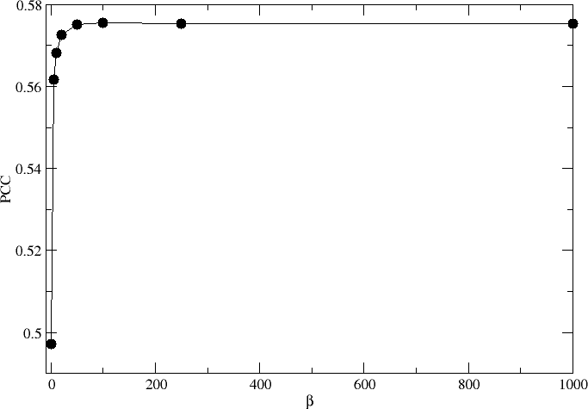
How to define β?
Optimal performance.
β=100

Slide 61
Predictive performance

Slide 62
Summary
Sequence logo is a power tool to visualize (binding) motifs
  Information content identifies essential residues for function and/or structural stability
Weight matrices can be derived from very limited number of data using the techniques of
  Sequence weighting
  Pseudo counts

