Slide 1
Deep learning:
Feed-forward (continued) & NNAlign
Eric Bautista Farrerons and Pablo Vivero Fernandez
Immunoinformatics and Machine Learning (IML) group

Slide 2
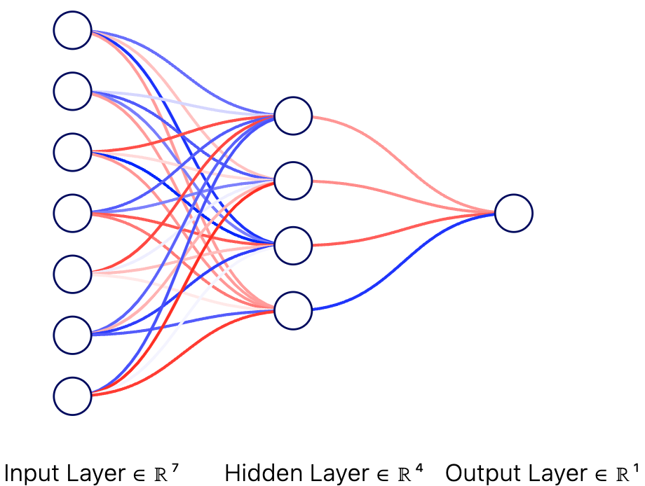

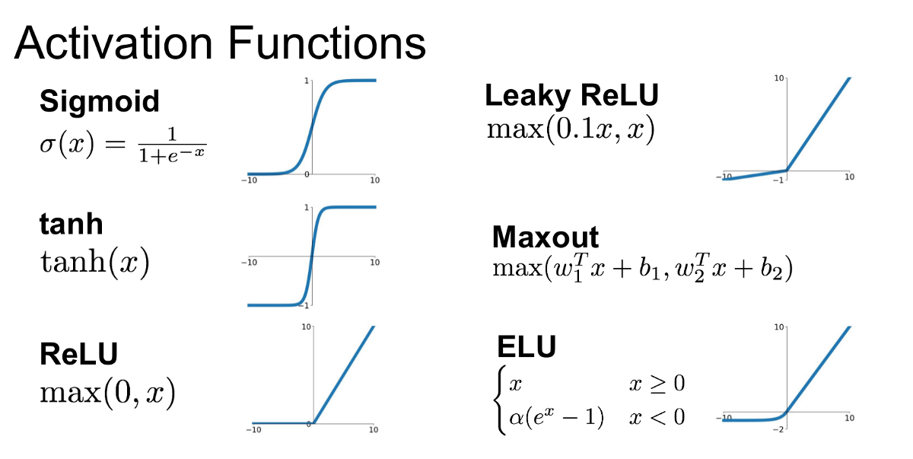
Recap: Feed-forward Networks (FFNs)
Weights (+)
Keypoints:
Weights connecting every node together
Activation functions after layers
Weights (-)
Node / Unit

Slide 3
Recap: Feed-forward Networks (FFNs)
Weights (+)
Neighbourhood
Weights (-)
Use features to :
predict (scalar values)
classify (labels)
Ex:
Predict the price of a house based on features
Node / Unit
# rooms
Construction
year
Has garden
(Y/N)
…
Predicted price (scalar)
OR
Predicted price range (class)
(Ex: low, medium, …)

Slide 4
Accelerating your models
Yesterday we implemented a neural network using Python for loops.
It is good for gaining an intuition for neural networks.
But it is really not very efficient...

Slide 5
Accelerating your models
Python for loops are extremely slow.
For larger models we need to use more efficient implementations.
Deep learning libraries with C++ backends provide this. For example:
  PyTorch
  TensorFlow
  JAX + NumPy

Slide 6
Accelerating your models
Python for loops are extremely slow.
For larger models we need to use more efficient implementations.
Deep learning libraries with C++ backends provide this. For example:
  PyTorch
  TensorFlow
  JAX + NumPy
Today's goal: make few but large matrix operations so model training and data processing is more efficient.
How?
  1. We will use NumPy so you understand the impact of matrix multiplications.
  2. And later the vectorization and automatic differentiation (Autograd) capabilties of PyTorch.

Slide 7
Using vectorized matrix operations to speed up processing
Last time:
def forward(X):
for j in range(hidden_layer_dim):
  z = 0.0
  for i in range(input_layer_dim+1):
  z += X[0][i]* w1[i,j]
  X[1][j] = sigmoid(z)
w_{ij}
X[1][j]
X[0][i]

Slide 8


Using vectorized matrix operations to speed up processing
Last time:
def forward(X):
for j in range(hidden_layer_dim):
  z = 0.0
  for i in range(input_layer_dim+1):
  z += X[0][i]* w1[i,j]
  X[1][j] = sigmoid(z)
w_{ij}
X[1][j]
X[0][i]

Slide 9
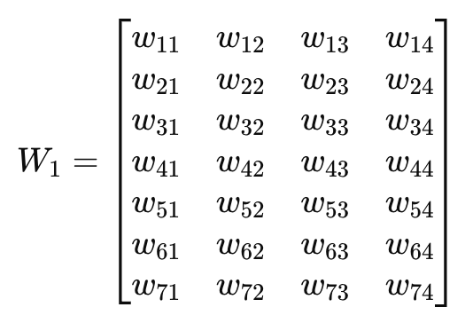



Using vectorized matrix operations to speed up processing
We can process an input in terms of matrix operations.
Today:
NumPy
PyTorch
def forward(x):​
# First layer​
z1 = np.dot(x, W1)​
a1 = activation(z1)​
def forward(self, x):​
# First layer
z1 = self.in_layer(x)​
a1 = self.hidden_act(z1)​
​
a1
W1
x
X
=
(1 x 4)
(1 x 4)
(1 x 7)
(7 x 4)

Slide 10
Batching data to speed up processing
Last time:
predictions = []
for peptide_sequence in dataset:
y_pred = forward(peptide_sequence)
predictions.append(y_pred)

Slide 11


Batching data to speed up processing
Last time:
predictions = []
for peptide_sequence in dataset:
y_pred = forward(peptide_sequence)
predictions.append(y_pred)

Slide 12
Batching data to speed up processing
We can process batches of data at the same time.
Today:
predictions = net(dataset)
Encoding of input data (peptides)
N_input
ALAKAAAAM
ALAKAAAAN
ALAKAAAAR
ALAKAAAAT
ALAKAAAAV
GMNERPILT
GILGFVFTM
TLNAWVKVV
KLNEPVLLL
AVVPFIVSV
0.9 0.05 0.05 …
0.9 0.05 0.05 ..
x1_1 | x1_2 | x1_3 | x1_4 | x1_5
x2_1 | x2_2 | x2_3 | x2_4 | x2_5
…
xn_1 | xn_2 | xn_3 | xn_4 | xn_5
N_datasize/batch

Slide 13
Batching data to speed up processing
We can process batches of data at the same time.
We can apply the weights of all hidden neurons to the input in fewer operations.
Columns and rows
must have equal dimension
Number of columns
Neu1 N2 N3 …..
Inp_1. Inp_2 Inp 5
Neuron_1 N2. N3. …..
x1_1 | x1_2 | x1_3 | x1_4 | x1_5
x2_1 | x2_2 | x2_3 | x2_4 | x2_5
…
xn_1 | xn_2 | xn_3 | xn_4 | xn_5
w1_1 | w1_2 | w1_3
w2_1 | w2_2 | w2_3
w3_1 | w3_2 | w3_3
w4_1 | w4_2 | w4_3
w5_1 | w5_2 | w5_3
H[1][1] …..
X
Number of rows
I1 I2 …. .... I5
=
x1 x2 …. .... xn
x1 x2 …. .... xn

Slide 14
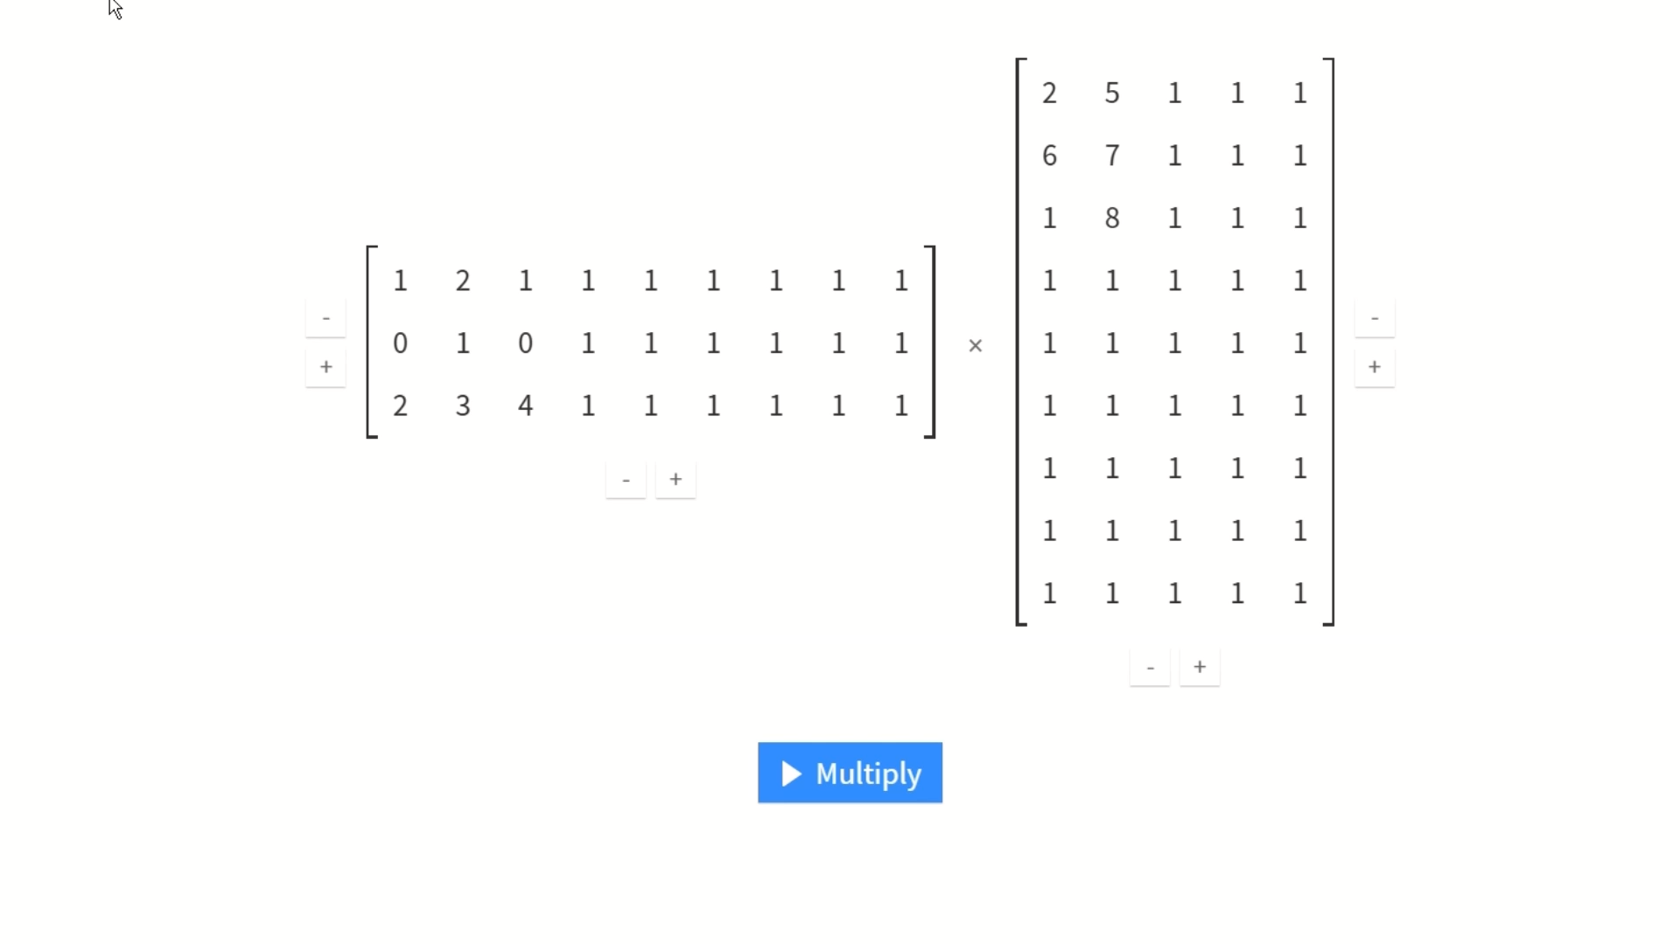
Key takeaways
A
B
In a for loop, each operation is executed sequentially, meaning one must finish before the next begins — this is slow
When you vectorize, the operations involved in multiplying two matrices can be executed in parallel. This is especially effective on GPUs.
Libraries like NumPy and PyTorch use highly optimized C/C++ under the hood to perform these operations much faster than pure Python.
Nice online matrix multiplication visualization tool:
https://matrixmultiplication.xyz/

Slide 15
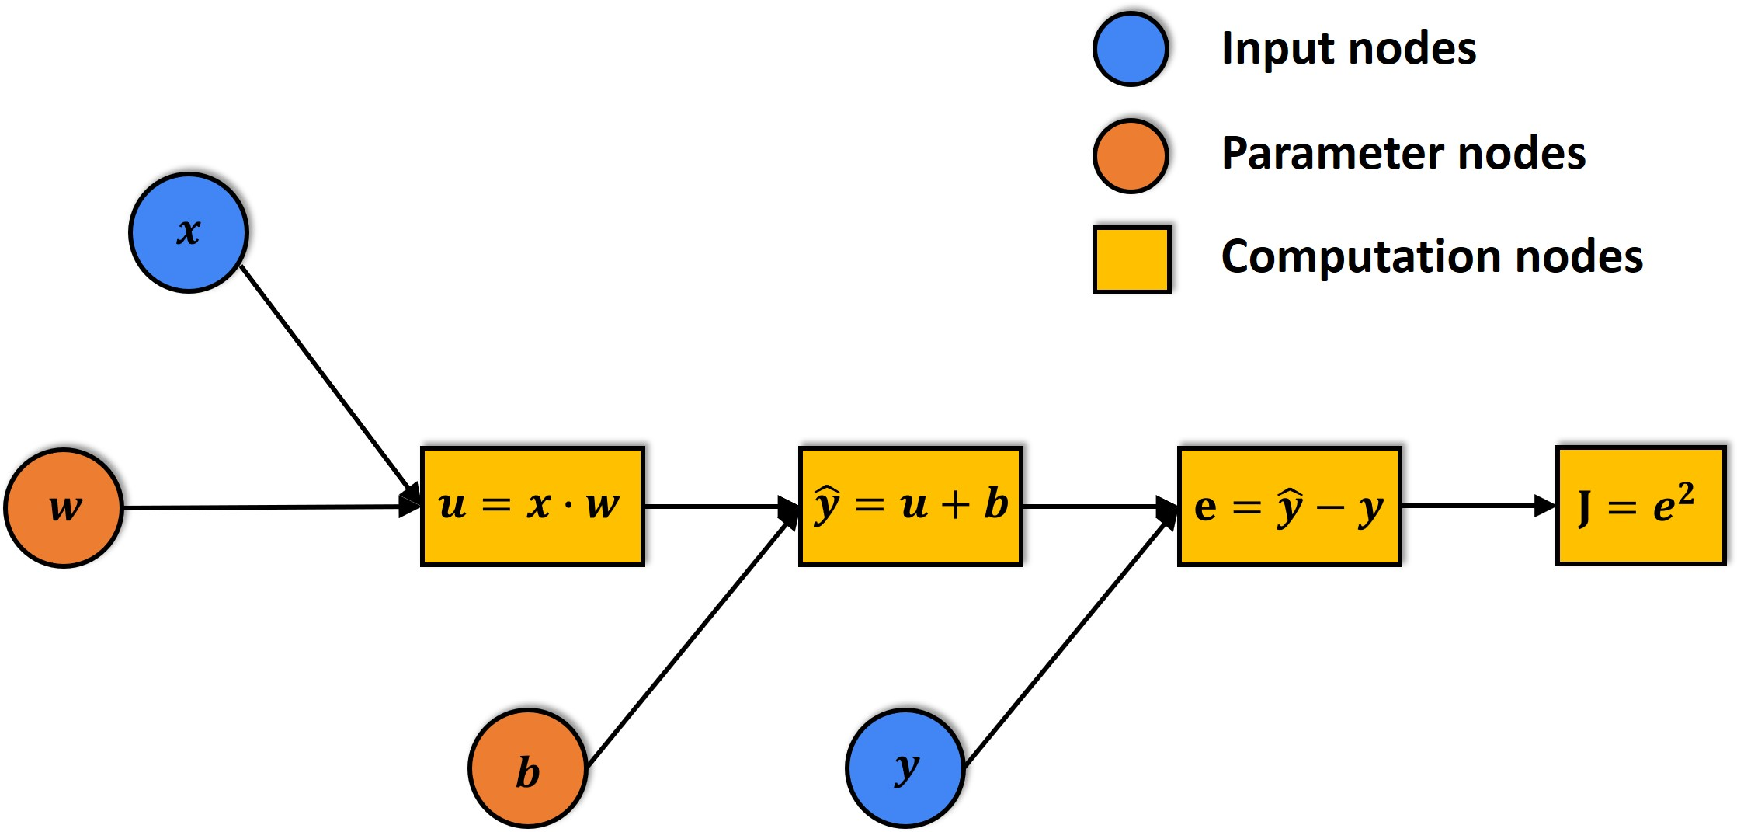
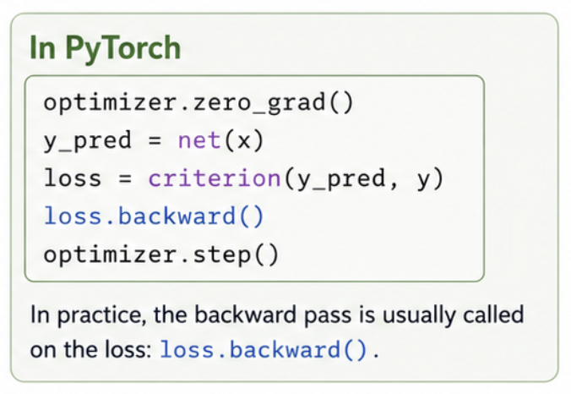
Automatic differentiation - Autograd

Slide 16
What about peptides which are not 9-mers?
If all our peptides are 9-mers, FFNN works fine
However, what about a 12-21mers?
Need to pad the sequences to the maximum peptide length
CAHHFWTK
TINYTIFK
WMNSTGFTK
YIFWIRTPR
TTTIKPVSYK
WLWGFLSRNK
CAHHFWTKXX
TINYTIFKXX
WMNSTGFTKX
YIFWIRTPRX
TTTIKPVSYK
WLWGFLSRNK

Slide 17
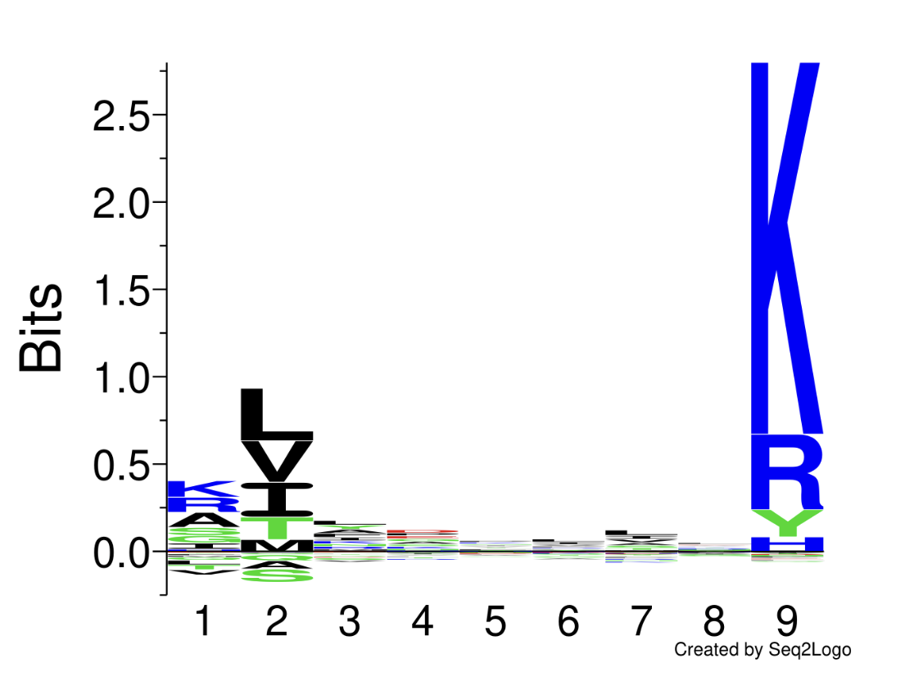
What about peptides which are not 9-mers?
However, this padding creates a problem: The anchor residues are no longer aligned!
CAHHFWTKXX
TINYTIFKXX
WMNSTGFTKX
YIFWIRTPRX
TTTIKPVSYK
WLWGFLSRNK

Slide 18
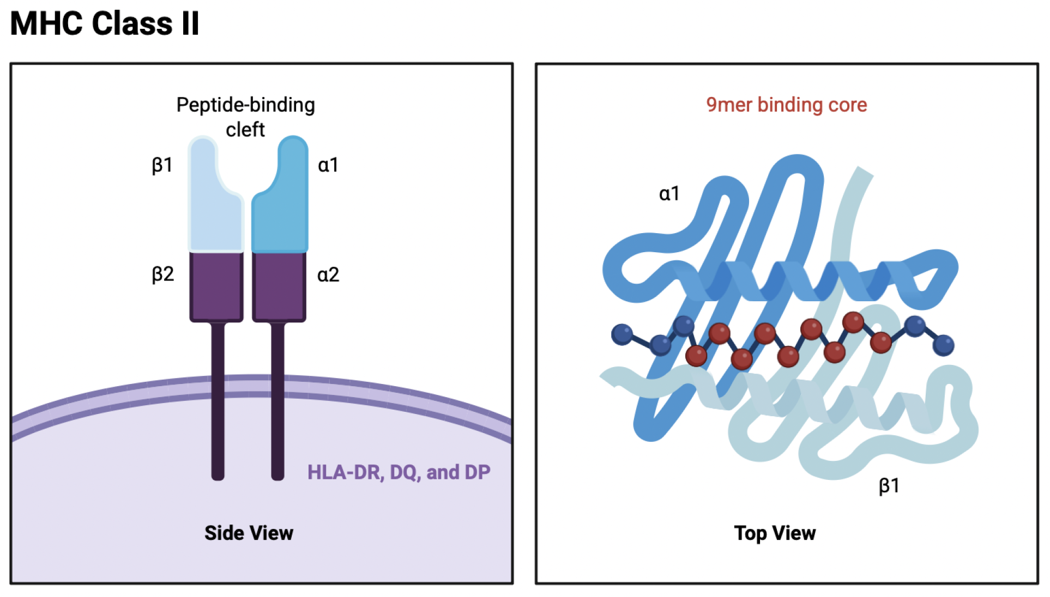
What about peptides which are not 9-mers?
MHC class II peptides are usually longer than 9 amino acids
Binding is mainly driven by a 9-mer core within the peptide
The 9-mer core can occur at different positions in the peptide

Slide 19
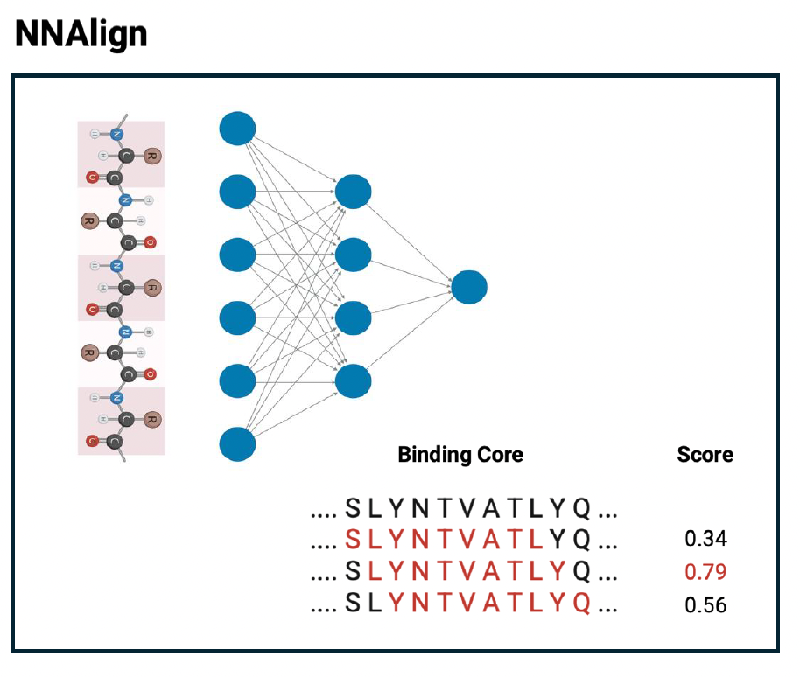
What about peptides which are not 9-mers?
NNAlign evaluates all possible 9-mer binding cores within each MHC class II peptide during the forward pass
The peptide score is defined as the highest score among these candidate cores, and backpropagation is performed through the best-scoring 9-mer core.

Slide 20
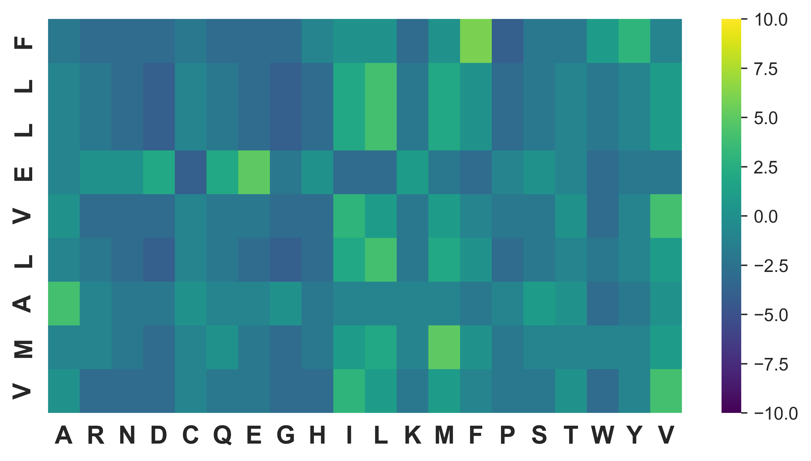
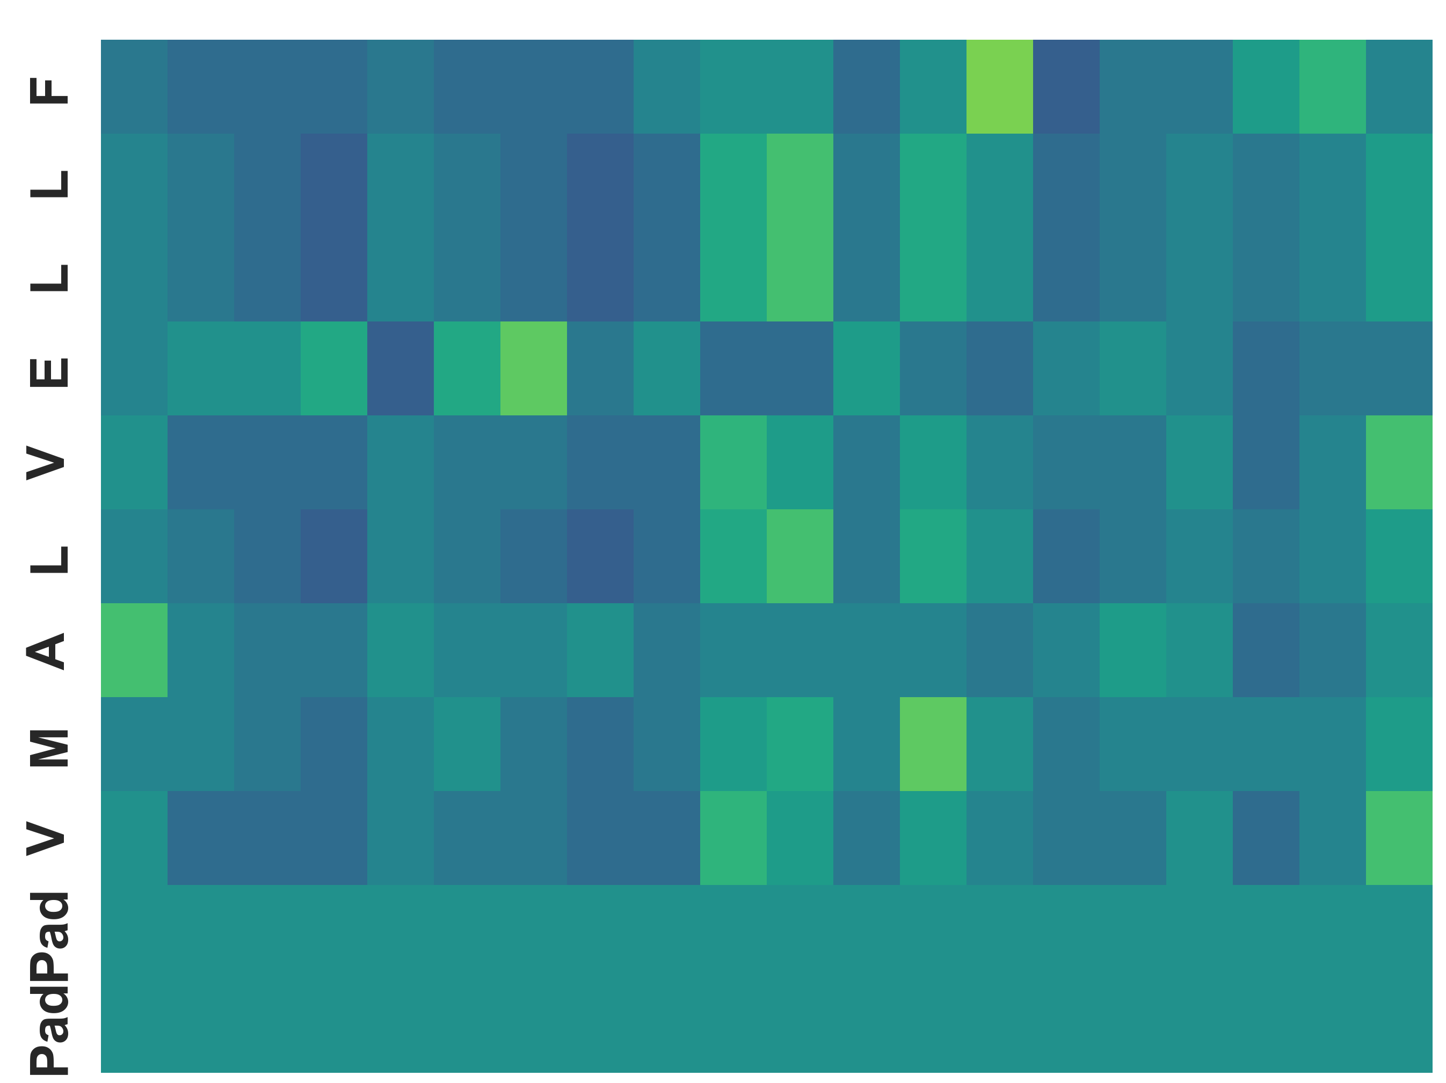
Part I - FFNN exercise
Implement an FFNN using efficient matrix
multiplication operations.
Peptides may have different lengths. Shorter
sequences must be padded. Why?
Use a flattened array as input.
Try to change the learning rate or number of
neurons and see if it impacts performance.
Compare your performance and computation
speed with last times NN exercise.
…
FFNN
Input
D=Max pep len * 20
Hidden
Dim=?
Hidden
Dim=1

Slide 21
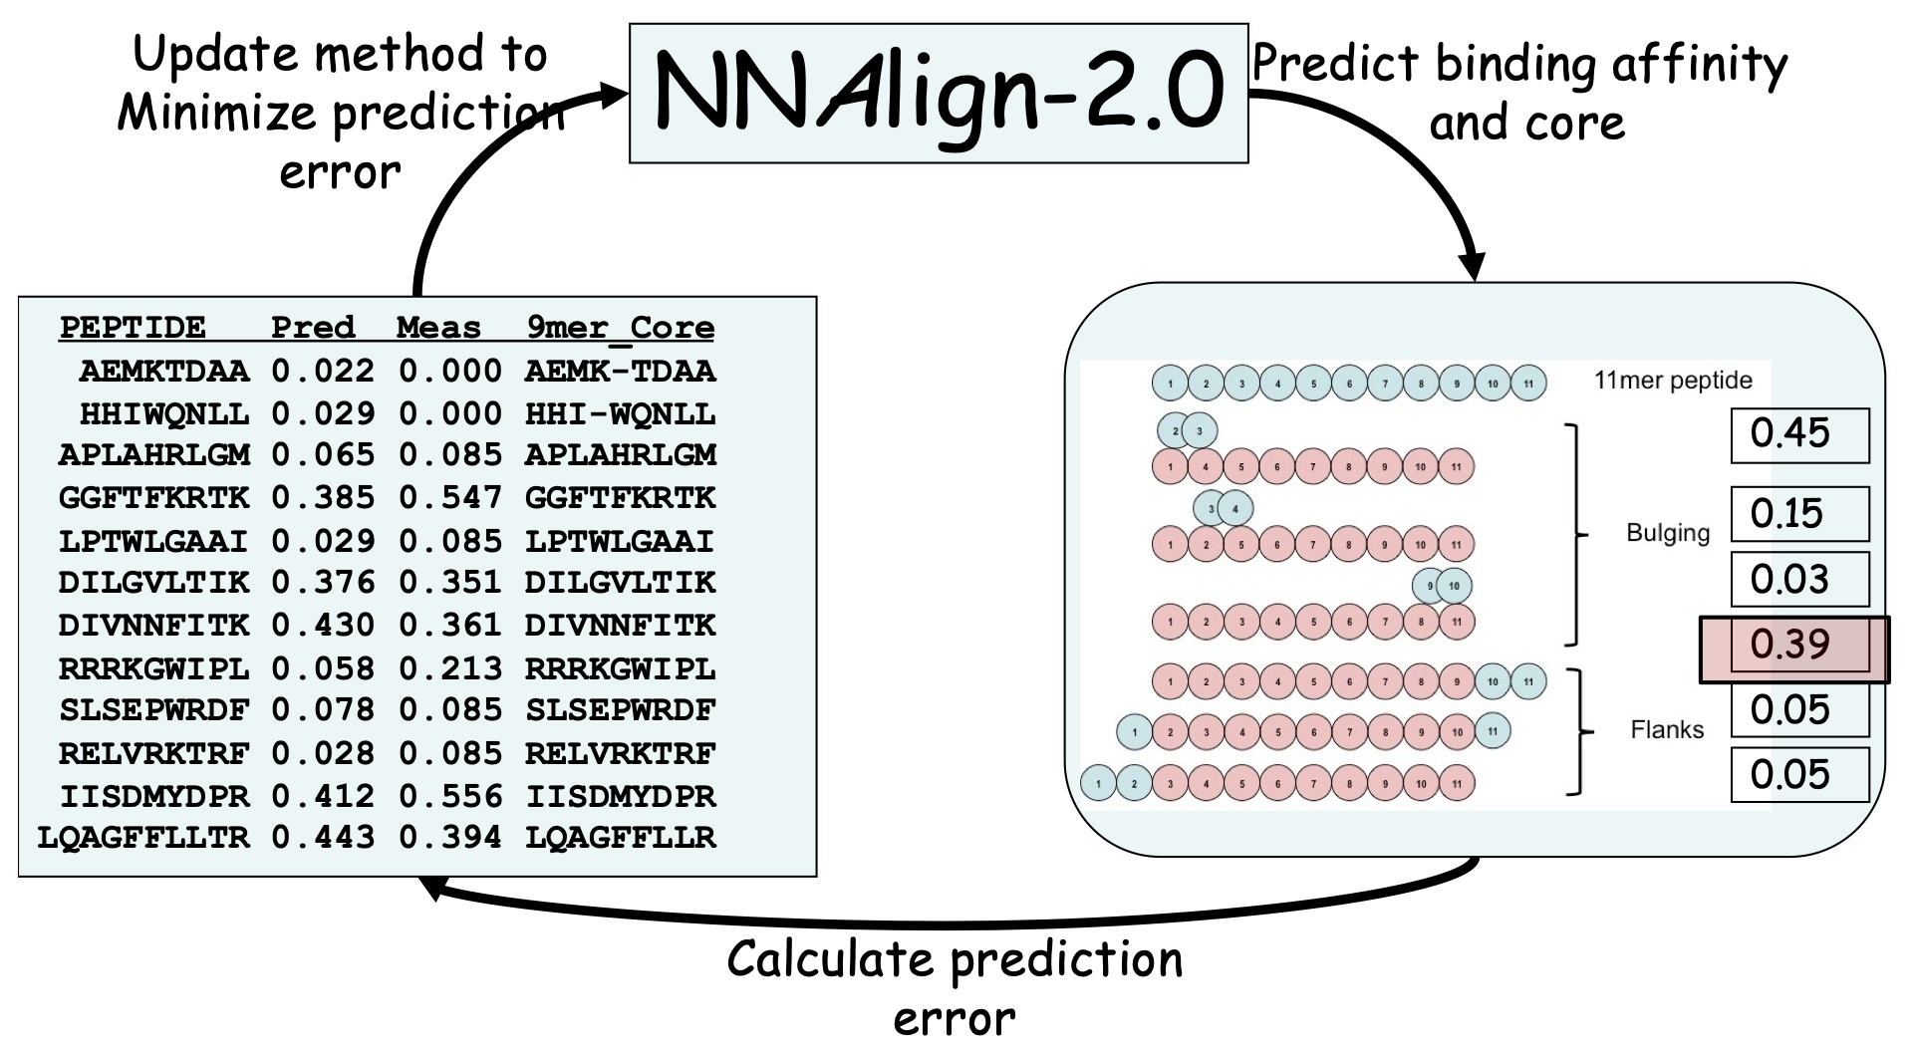
Today’s exercises: Part 2
Implement the forward pass of the NNAlign method
Compare the performance of the NNAlign method vs standard Feed-forward neural network. Is NNAlign performing better?
Aside from potential performance gains, what other advantages are there of the NNAlign method’s predictions? (hint: interpretibility)

Slide 22
We are here to take your questions.
(when in doubt: Print output of a given operation and their dimensions of a tensor x using x.shape or x.size)

