Slide 1
Deep learning: Feed-forward & Convolutional neural networks
Sebastian N. Deleuran & Yat-Tsai Richie Wan
Immunoinformatics and Machine Learning (IML) group

Slide 2
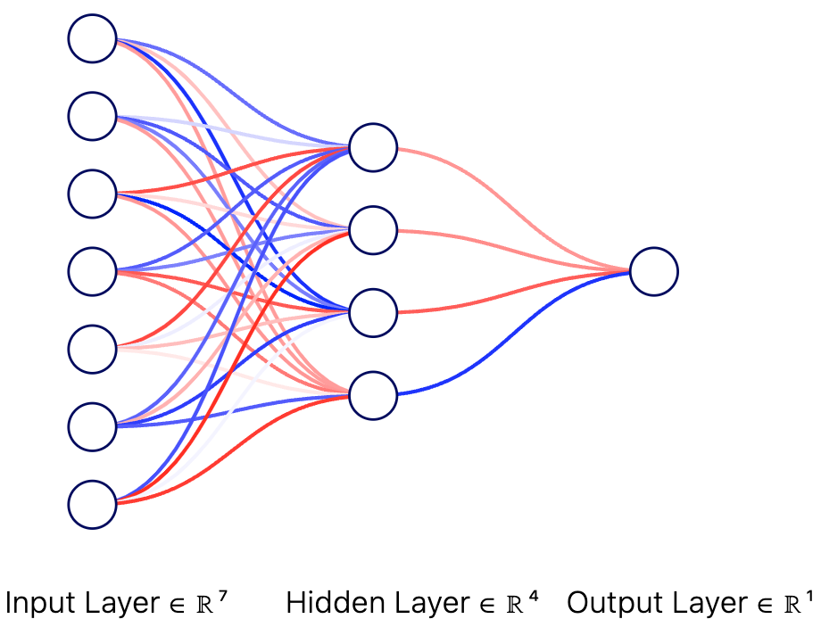
Recap: Feed-forward Networks (FFNs)
Weights (+)
Keypoints:
Weights connecting every node together
activation functions after layers
Weights (-)
Node / Unit

Slide 3
Recap: Feed-forward Networks (FFNs)
Weights (+)
Neighbourhood
Weights (-)
Use features to :
predict (scalar values)
classify (labels)
Ex:
Predict the price of a house based on features
Node / Unit
# rooms
Construction
year
Has garden
(Y/N)
…
Predicted price (scalar)
OR
Predicted price range (class)
(Ex: low, medium, …)

Slide 4
Accelerating your models
Yesterday we implemented a neural network using for loops.
However: Python for loops are extremely slow!
For larger models we need to use more efficient implementations.

Slide 5
Accelerating your models
Python for loops are extremely slow.
For larger models we need to use more efficient implementations.
Deep learning libraries with C++ backends provide this. For example:
PyTorch
TensorFlow
JAX + NumPy

Slide 6
Accelerating your models
Python for loops are extremely slow.
For larger models we need to use more efficient implementations.
Deep learning libraries with C++ backends provide this. For example:
PyTorch
TensorFlow
JAX + NumPy
Today we will use the vectorization capabilties of NumPy to speed up our models.
The goal: make few but large matrix operations.

Slide 7
Using vectorized matrix operations to speed up processing
We can process an input in terms of matrix operations.
Yesterday:
def forward(X):
for j in range(hidden_layer_dim):
z = 0.0
for i in range(input_layer_dim+1):
z += X[0][i]* w1[i,j]
X[1][j] = sigmoid(z)

Slide 8
Using vectorized matrix operations to speed up processing
We can process an input in terms of matrix operations.
Yesterday:
def forward(X):
for j in range(hidden_layer_dim):
z = 0.0
for i in range(input_layer_dim+1):
z += X[0][i]* w1[i,j]
X[1][j] = sigmoid(z)

Slide 9
Using vectorized matrix operations to speed up processing
We can process an input in terms of matrix operations.
Today:
def forward(x):
# First layer
z1 = np.dot(x, W1)
a1 = activation(z1)
# Output layer
z2 = np.dot(a1, W2)
a2 = activation(z2)

Slide 10
Batching data to speed up processing
We can process batches of data at the same time using NumPy broadcasting.
Yesterday:
predictions = []
for peptide_sequence in dataset:
y_pred = forward(peptide_sequence)
predictions.append(y_pred)

Slide 11
Batching data to speed up processing
We can process batches of data at the same time using NumPy broadcasting.
Yesterday:
predictions = []
for peptide_sequence in dataset:
y_pred = forward(peptide_sequence)
predictions.append(y_pred)

Slide 12
Batching data to speed up processing
We can process batches of data at the same time.
Today:
predictions = forward(dataset)
Encoding of input data (peptides)
N_input
ALAKAAAAM
ALAKAAAAN
ALAKAAAAR
ALAKAAAAT
ALAKAAAAV
GMNERPILT
GILGFVFTM
TLNAWVKVV
KLNEPVLLL
AVVPFIVSV
0.9 0.05 0.05 …
0.9 0.05 0.05 ..
x1_1 | x1_2 | x1_3 | x1_4 | x1_5
x2_1 | x2_2 | x2_3 | x2_4 | x2_5
…
xn_1 | xn_2 | xn_3 | xn_4 | xn_5
N_datasize/batch

Slide 13
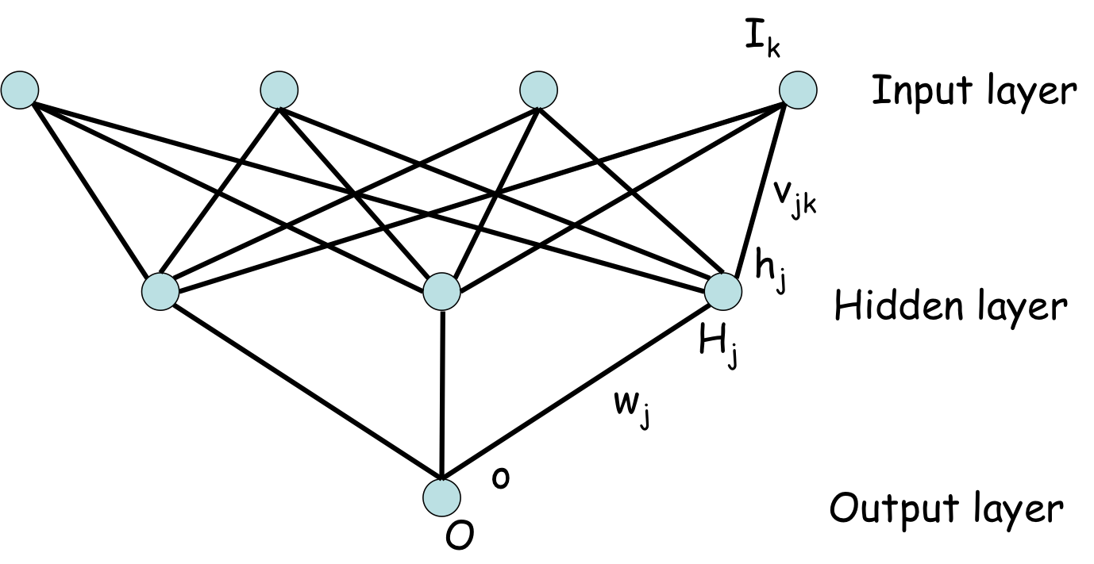
Batching data to speed up processing
Neuron_1 N2. N3. …..
We can process batches of data at the same time.
Today:
predictions = forward(dataset)
w1_1 | w1_2 | w1_3
w2_1 | w2_2 | w2_3
w3_1 | w3_2 | w3_3
w4_1 | w4_2 | w4_3
w5_1 | w5_2 | w5_3
{
N_input
…
…
…
…
…
Network weights

Slide 14
Batching data to speed up processing
We can process batches of data at the same time.
We can apply the weights of all hidden neurons to the input in a single operation.
n
Neu1 N2 N3 …..
Inp_1. Inp_2 Inp 5
x1_1 | x1_2 | x1_3 | x1_4 | x1_5
x2_1 | x2_2 | x2_3 | x2_4 | x2_5
…
xn_1 | xn_2 | xn_3 | xn_4 | xn_5
Neuron_1 N2. N3. …..
w1_1 | w1_2 | w1_3
w2_1 | w2_2 | w2_3
w3_1 | w3_2 | w3_3
w4_1 | w4_2 | w4_3
w5_1 | w5_2 | w5_3
H[1][1] …..
x
=
x1 x2 …. .... xn
I1 I2 …. .... I5
x1 x2 …. .... xn

Slide 15
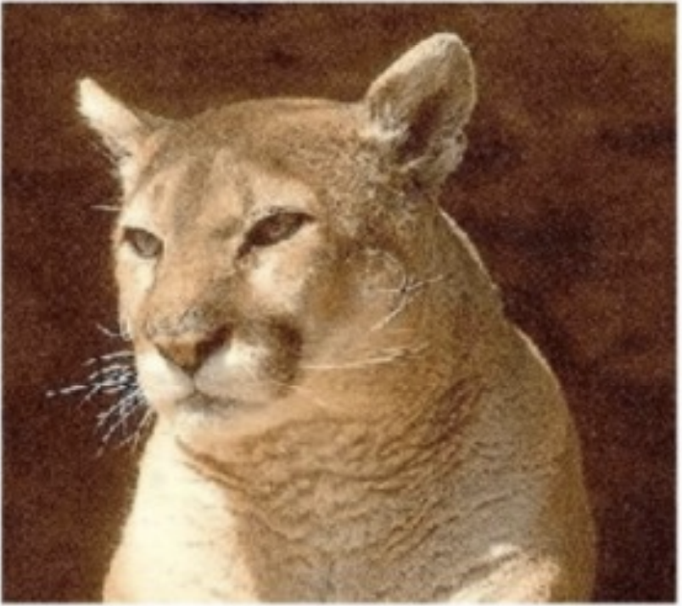
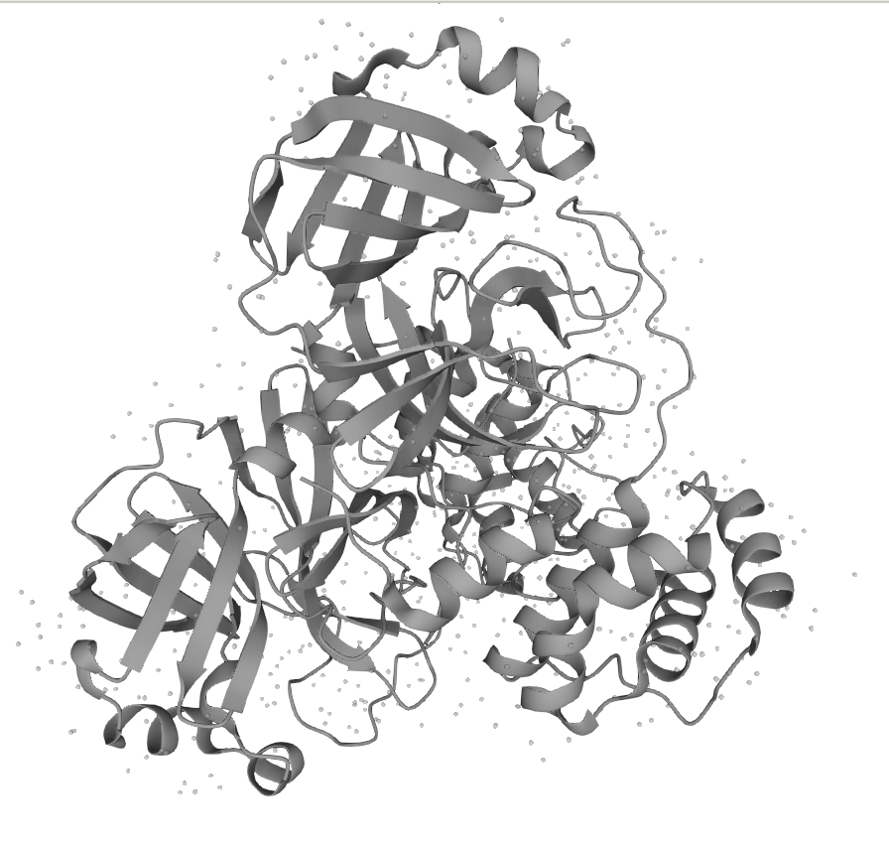
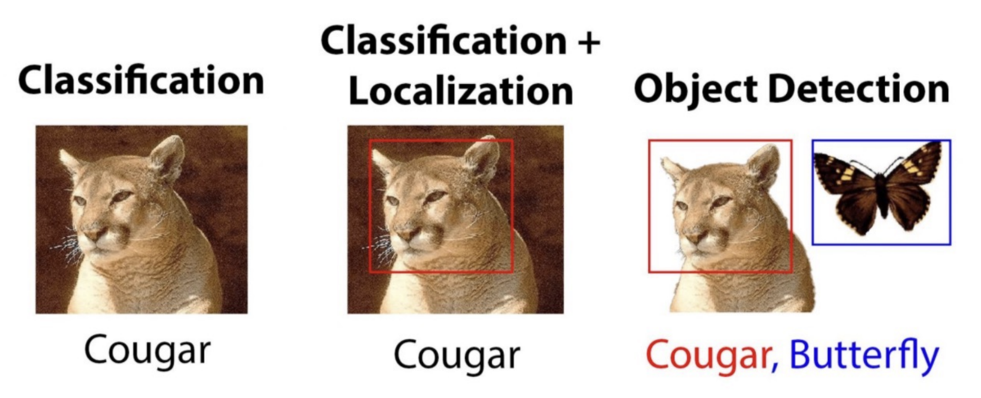
Different inputs?
FFN do not perform well on more complex inputs and tasks:
Computer vision
Sequential data
12 | 75 | 82
23 | 7 | 0
92
MESLVPGFNEKTHVQLSLPVLQVRDV…
5 | 23 | 21
12
0
6 | 1 | 2
0 | 0 | 6
12 | 72 | 95

Slide 16
Convolutional Neural Networks
Based on filters to extract features from the input
Can be used on 1D, 2D, 3D inputs (sequences, Images, etc.)
Handles inputs of different size (ex: different sequence lengths)
Preserves signal structure & local information motifs
Input
Intermediate filters
Maxpooled filters
Reshaped + Linear
Output prediction
1
Reshaping
(flatten)
Hidden
layers
Convolution
MaxPooling

Slide 17
Convolutional Neural Networks
Based on filters to extract features from the input
Can be used on 1D, 2D, 3D inputs (sequences, Images, etc.)
Handles inputs of different size (ex: different sequence lengths)
Preserves signal structure & local information motifs
Basic convolution operation:
Kernel / Filter
Weights tensor
Input tensor
Bias tensor
Output tensor
Activation
5*2+0*0 + 5*-1+5*-1+10*-3+2* -1+15*0+10*1+0*0 + 15 =-7
5 | 0 | 5 | 17
5 | 10 | 2 | 12
15 | 10 | 0 | 16
2 | 0 | -1
-1 | -3 | -1
0 | 1 | 0
σ( )
+
=
-7 | -30
-7 | -30
*
15
A K L R

Slide 18
Convolutional Neural Networks
Based on filters to extract features from the input
Can be used on 1D, 2D, 3D inputs (sequences, Images, etc.)
Handles inputs of different size (ex: different sequence lengths)
Preserves signal structure & local information motifs
Basic convolution operation:
Kernel / Filter
Weights tensor
Output tensor
(n_filter, seq_len – kernel_size)
Input tensor
Bias tensor
Activation
5 | 0 | 5 | 17
5 | 10 | 2 | 12
15 | 10 | 0 | 16
2 | 0 | -1
-1 | -3 | -1
0 | 1 | 0
2 | 0 | -1
-1 | -3 | -1
0 | 1 | 0
2 | 0 | -1
-1 | -3 | -1
0 | 1 | 0
-7 | -30
2 | 0 | -1
-1 | -3 | -1
0 | 1 | 0
-7 | -30
σ( )
*
+
15
=
-2 | -1
-2 | -1
1 | 8
1 | 8
0 | -2
0 | -2
A K L R

Slide 19
Batching data to speed up processing
We can process batches of data at the same time.
If we want to apply different matrices of weights at the same time (e.g. different filters), we can fuse those weights into a single matrix and use only a single matrix multiplication call.
F1_1_1 | F1_1_2 | F1_1_3
F1_2_1 | F1_2_2 | F1_2_3
F1_3_1 | F1_3_2 | F1_3_3
F1_4_1 | F1_4_2 | F1_4_3
F1_5_1 | F1_5_2 | F1_5_3
F2_1_1 | F2_1_2 | F2_1_3
F2_2_1 | F2_2_2 | F2_2_3
F2_3_1 | F2_3_2 | F2_3_3
F2_4_1 | F2_4_2 | F2_4_3
F2_5_1 | F2_5_2 | F2_5_3
x1_1 | x1_2 | x1_3 | x1_4 | x1_5
x2_1 | x2_2 | x2_3 | x2_4 | x2_5
…
xn_1 | xn_2 | xn_3 | xn_4 | xn_5
…
…
…
…
…
x
Fn_1_1 | Fn_1_2 | Fn_1_3
Fn_2_1 | Fn_2_2 | Fn_2_3
Fn_3_1 | Fn_3_2 | Fn_3_3
Fn_4_1 | Fn_4_2 | Fn_4_3
Fn_5_1 | Fn_5_2 | Fn_5_3

Slide 20
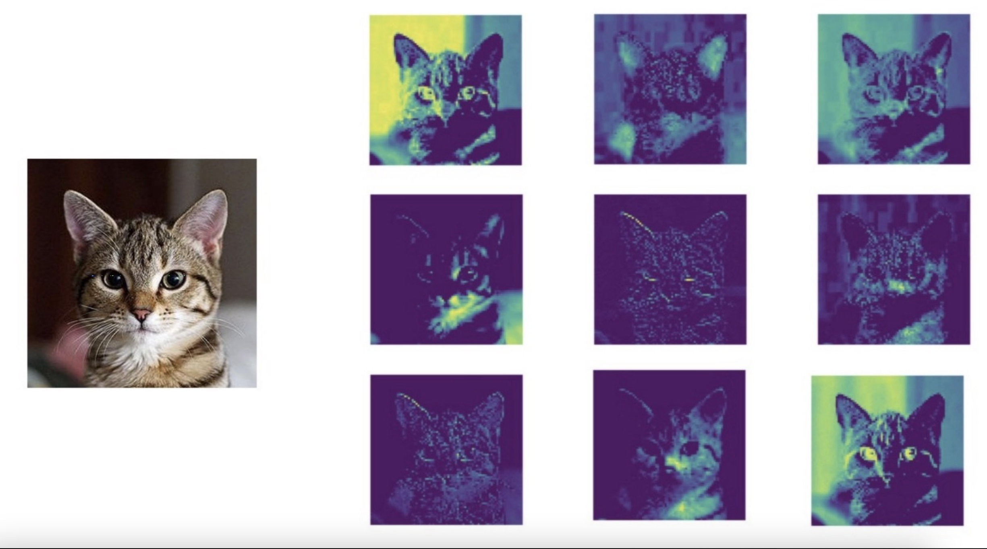
Example: Visualising learned filters

Slide 21
Convolutional Neural Networks
Based on filters to extract features from the input
Can be used on 1D, 2D, 3D inputs (sequences, Images, etc.)
Handles inputs of different size (ex: different sequence lengths)
Preserves signal structure & local information motifs
MaxPool operation for multiple filters:
MaxPool
output
17 | 0
17 | 12 | 2 | 3
… N filters
5 | 12
2 | 0
3 | 1
… N filters

Slide 22
Backpropagation intuition in Convolutional Neural Networks
Forward pass:
Basic convolution operation:
Kernel / Filter
Weights tensor
Input tensor
Output tensor
5 | 0 | 5 | 17 | …
5 | 10 | 2 | 12 | …
15 | 10 | 0 | 16 | …
2 | 0 | -1
-1 | -3 | -1
0 | 1 | 0
*
=
z_1 | z_2 | z_n
A K L R
z_1 = x₁₁ w₁₁ + x₁₂ w₁₂ + x₁₃ w₁₃ + x₂₁ w₂₁ + x₂₂ w₂₂ + x₂₃ w₂₃ + x₃₁ w₃₁ + x₃₂ w₃₂ + x₃₃ w₃₃
z_2 = x₁₂ w₁₁ + x₁₃ w₁₂ + x₁₄ w₁₃ + x₂₂ w₂₁ + x₂₃ w₂₂ + x₂₄ w₂₃ + x₃₂ w₃₁ + x₃₃ w₃₂ + x₃₄ w₃₃
z_n = ...

Slide 23
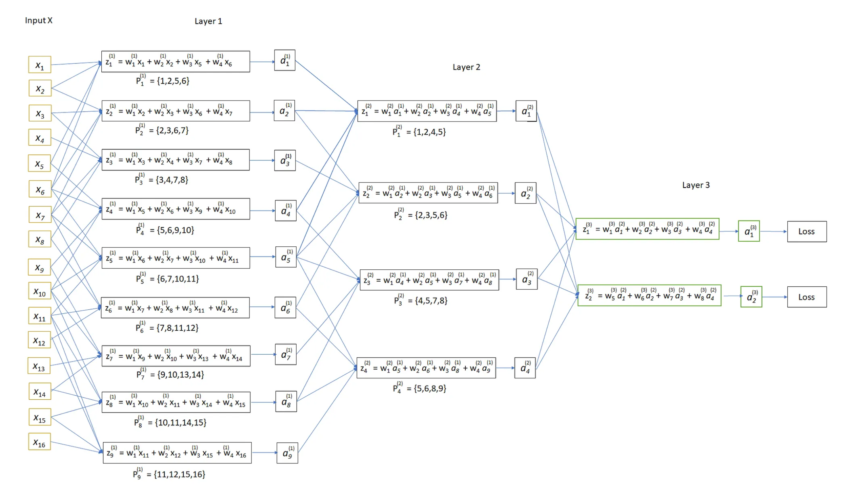
Backpropagation intuition in Convolutional Neural Networks
Source: https://towardsdatascience.com/backpropagation-in-fully-convolutional-networks-fcns-1a13b75fb56a

Slide 24
Backpropagation intuition in Convolutional Neural Networks
Max pooling removes information.
The gradient can only flow through max value indices.
We keep track of the max indices during the forward pass.
MaxPool
Pool output
5 | 0 | 5 | 17
5 | 10 | 2 | 12
15 | 10 | 0 | 16
2 | 0 | -1
-1 | -3 | -1
0 | 1 | 0
17 | 12 | 2 | 3
*
17 | ??
Max indices
?? | 12
0 | 1 | 0 | 0
2 | ??
3 | ??
Source: https://towardsdatascience.com/backpropagation-in-fully-convolutional-networks-fcns-1a13b75fb56a

Slide 25
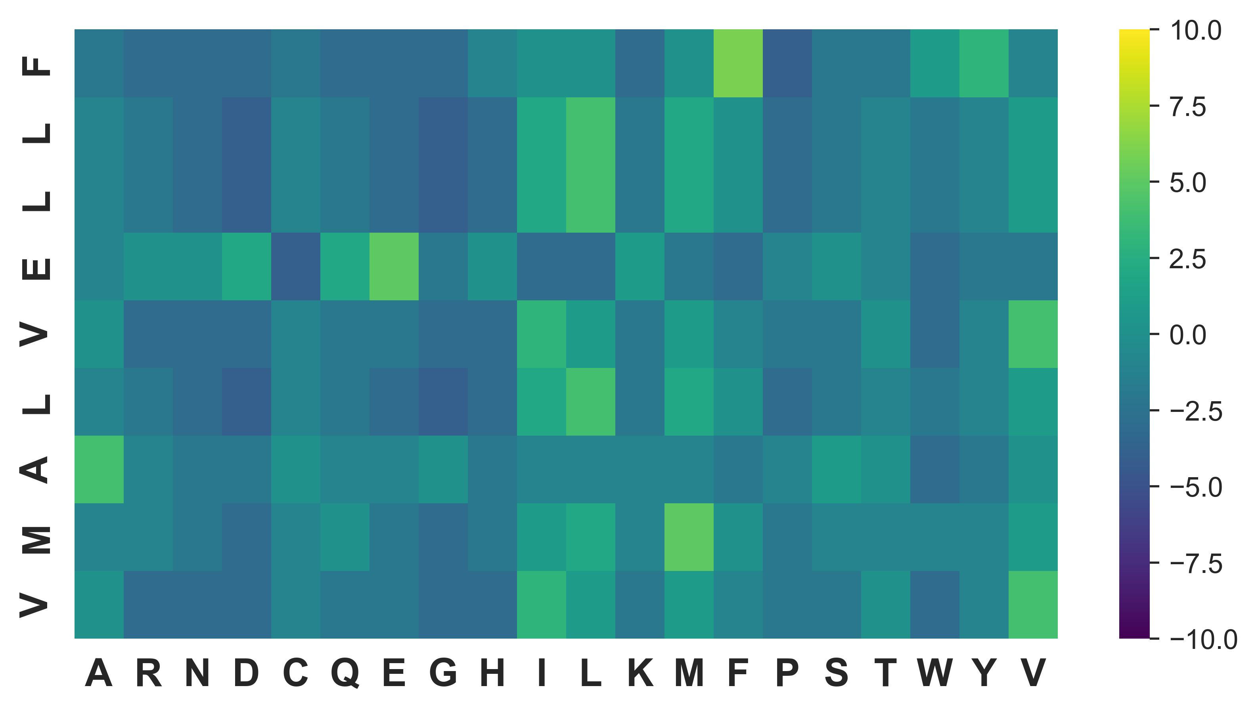
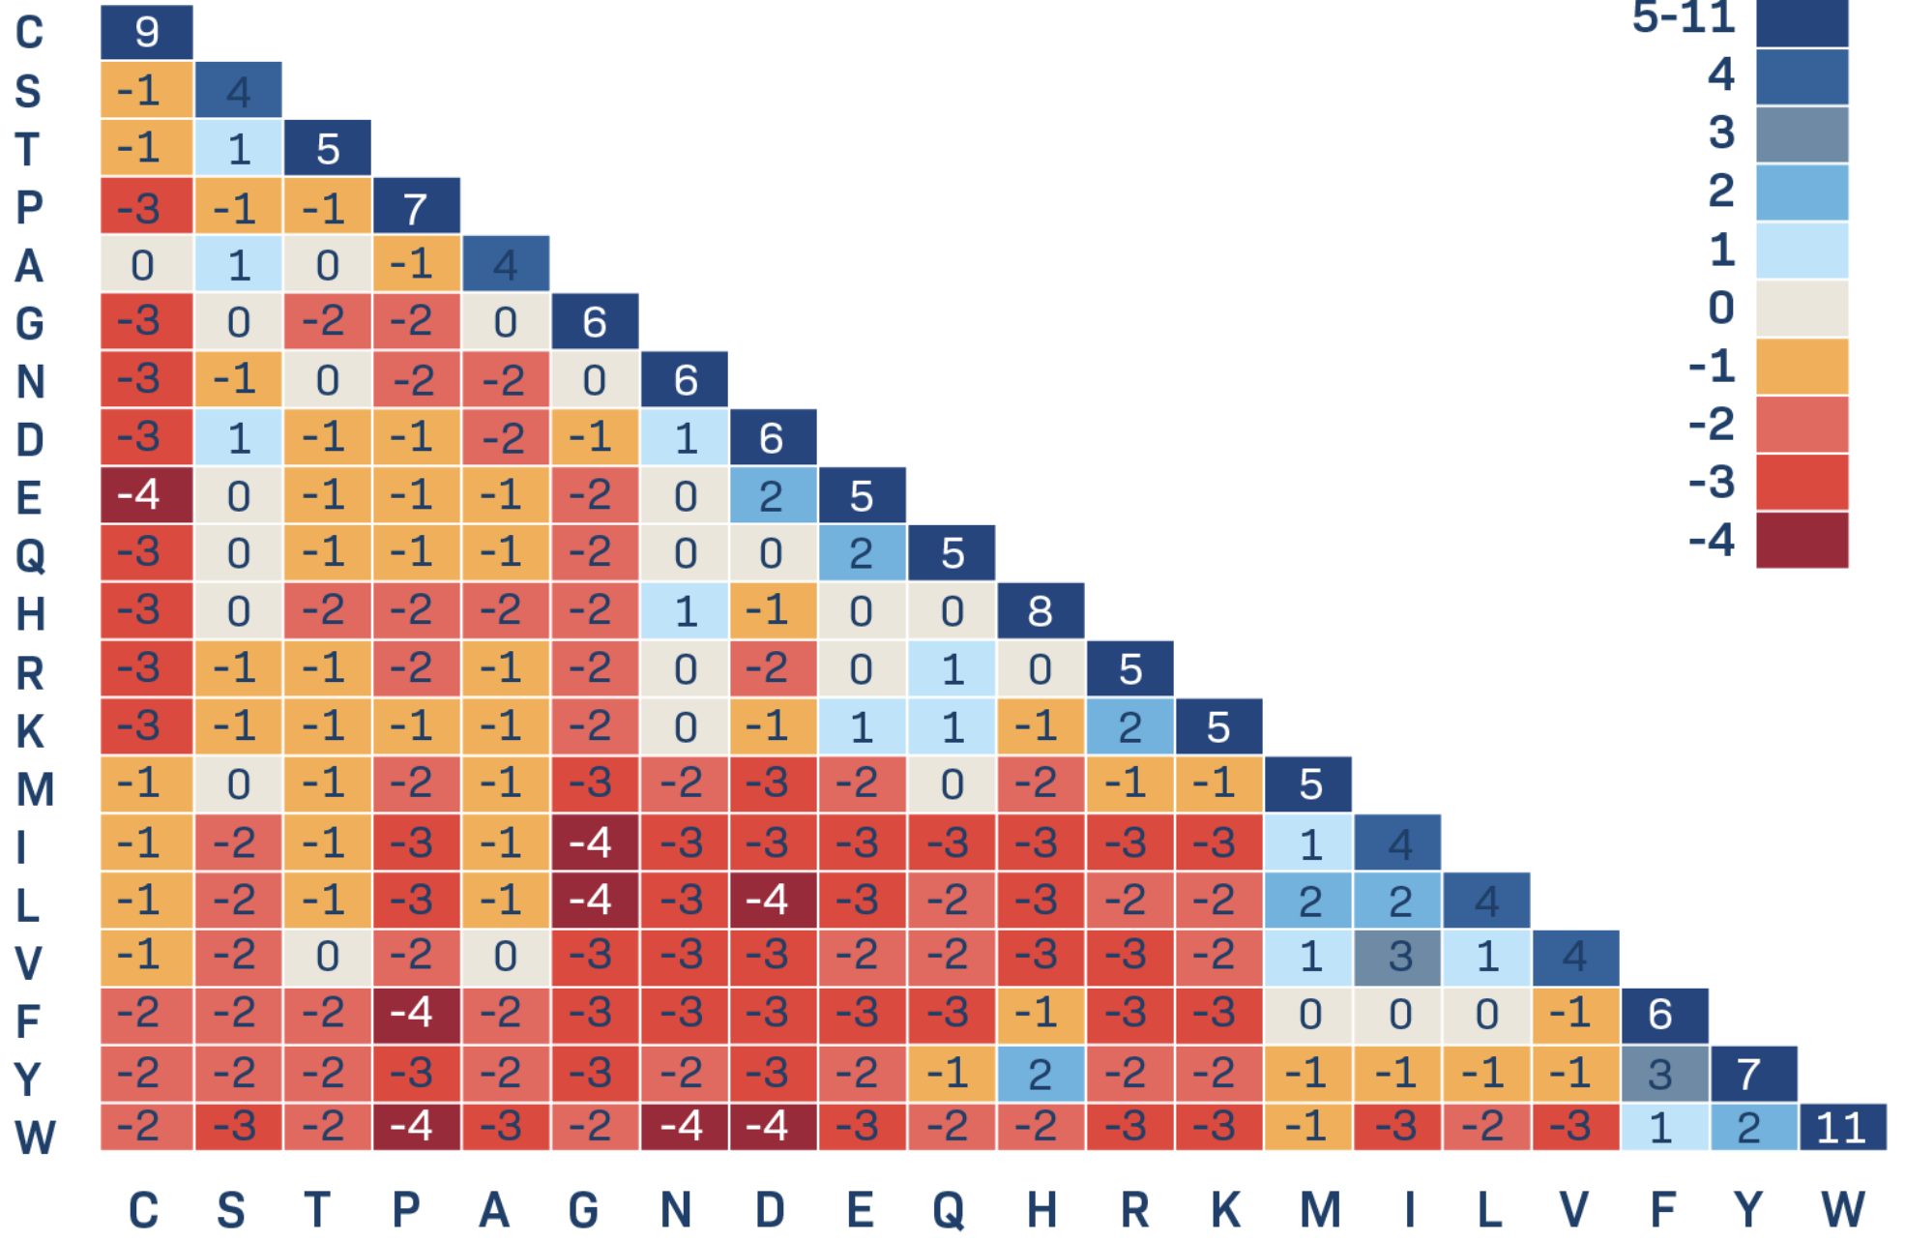
Today’s exercises: peptide-MHC binding affinity prediction
Train a model to predict the binding afffinity of a peptide sequence for a given HLA allele
Sequence representation: encode sequence using BLOSUM matrix
Input sequence
BL62 (or 50)
BLOSUM-encoded sequence
FLLEVLAMV
*

Slide 26
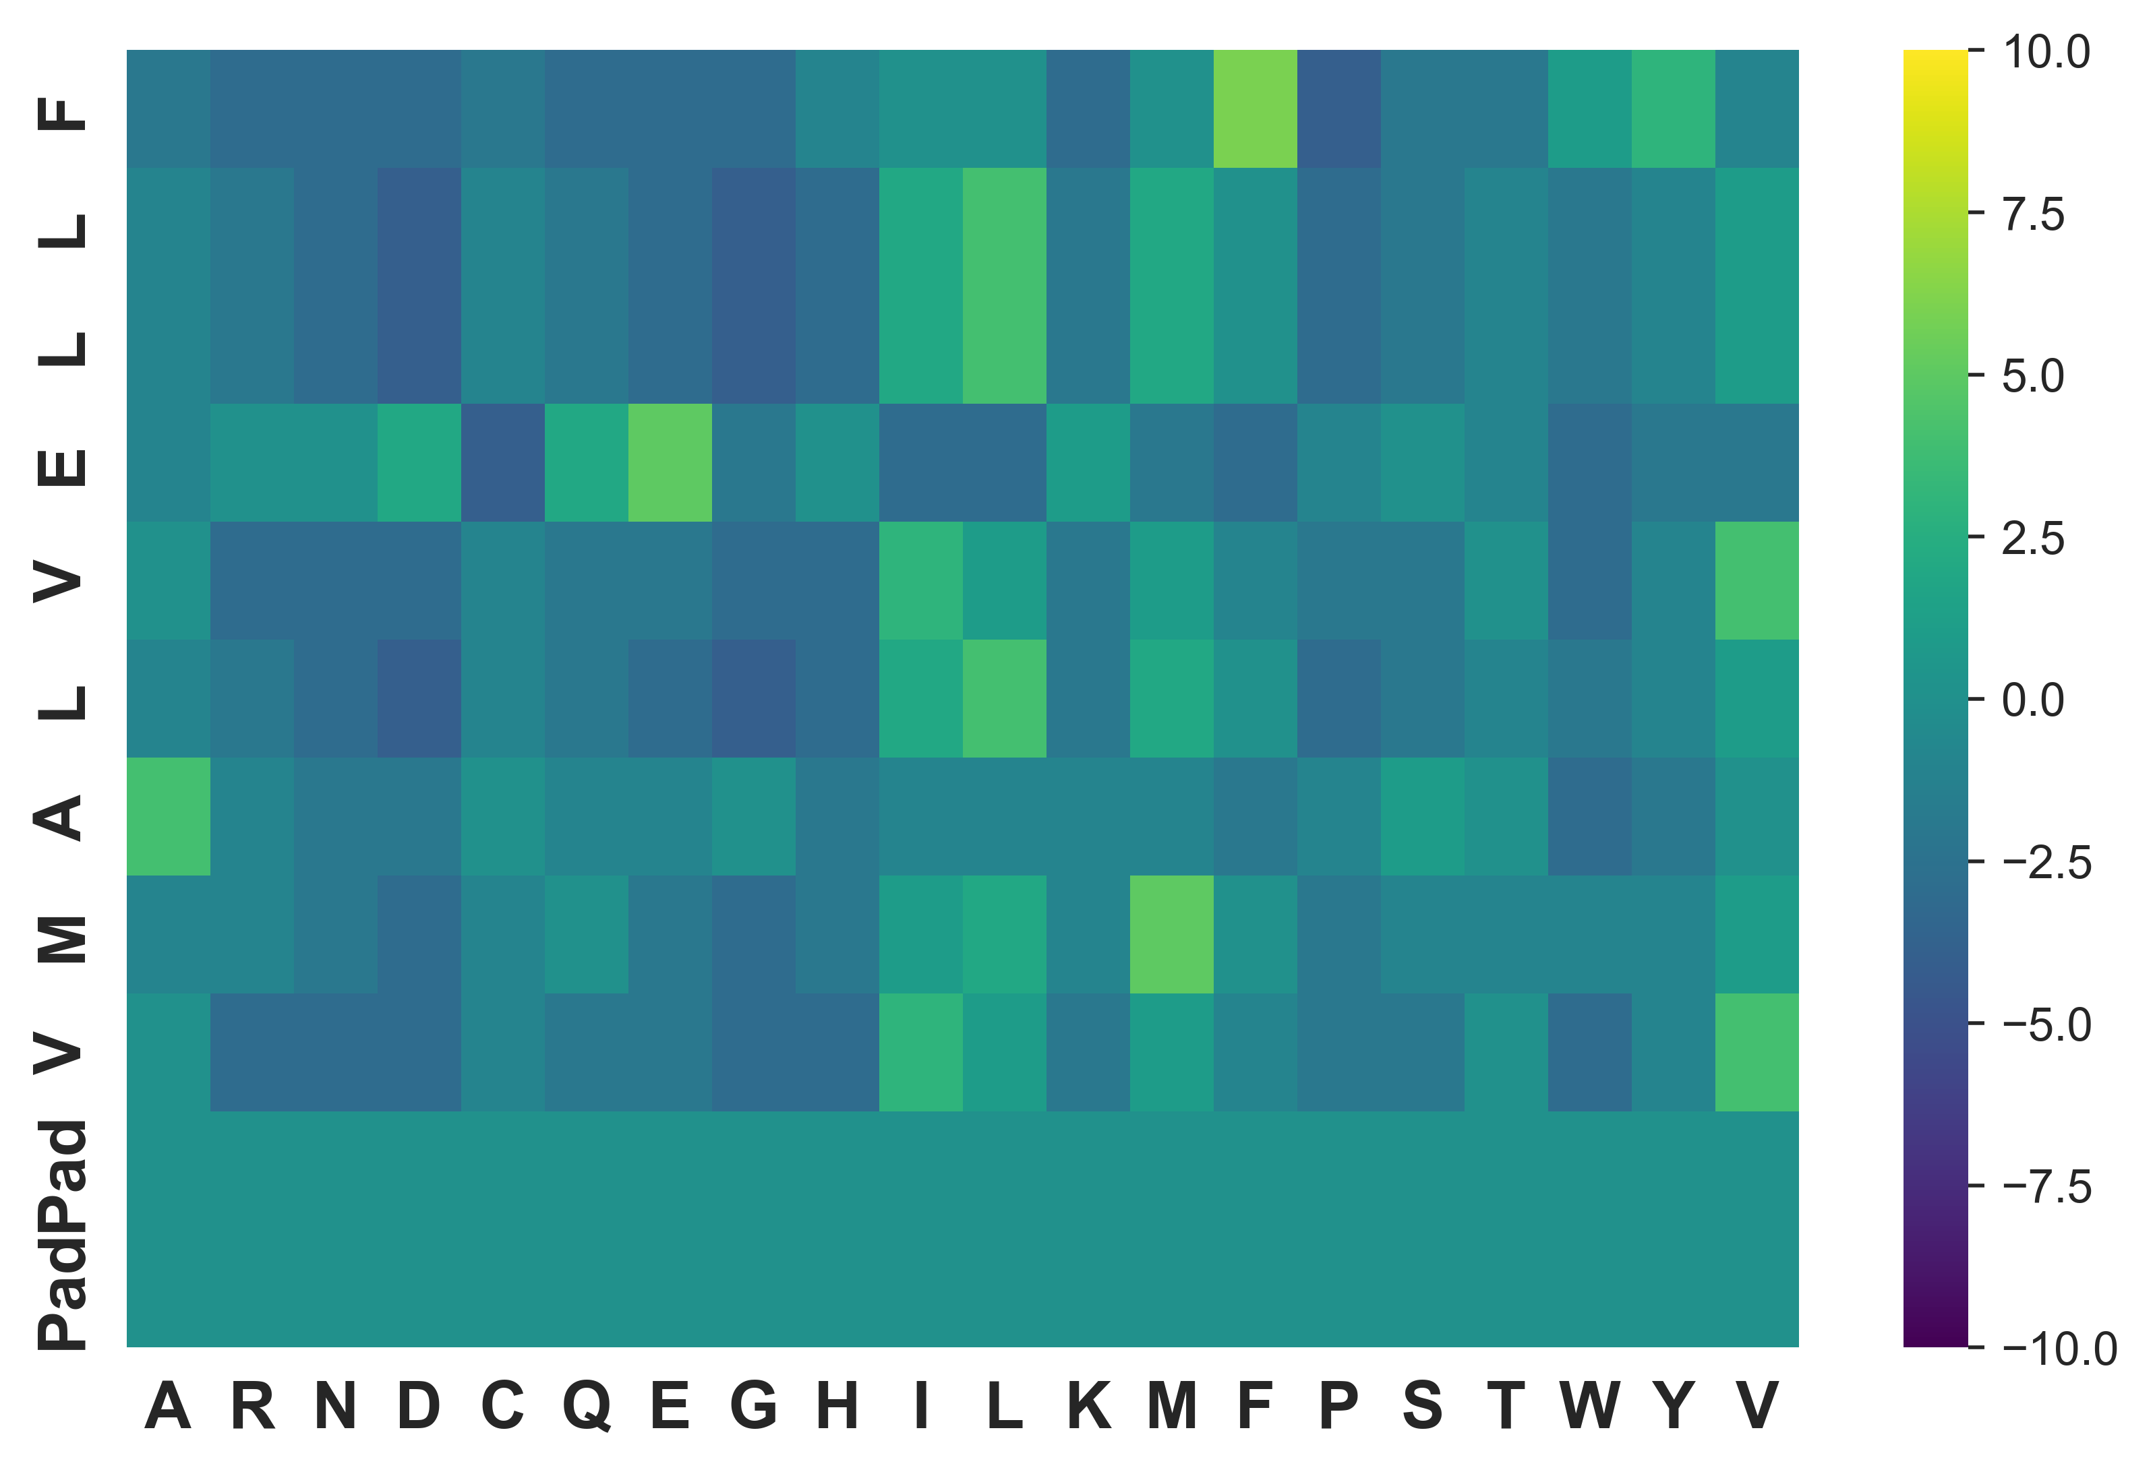
Today’s exercises: Part 1
Implement an FFNN using efficient matrix multiplication operations.
Peptides may have different lengths. Shorter sequences must be padded. Why?
Use a flattened array as input.
Try to change the learning rate or number of neurons and see if it impacts performance.
…
FFN
Input
D=Max pep len * 20
Hidden
Dim=?
Hidden
Dim=1

Slide 27
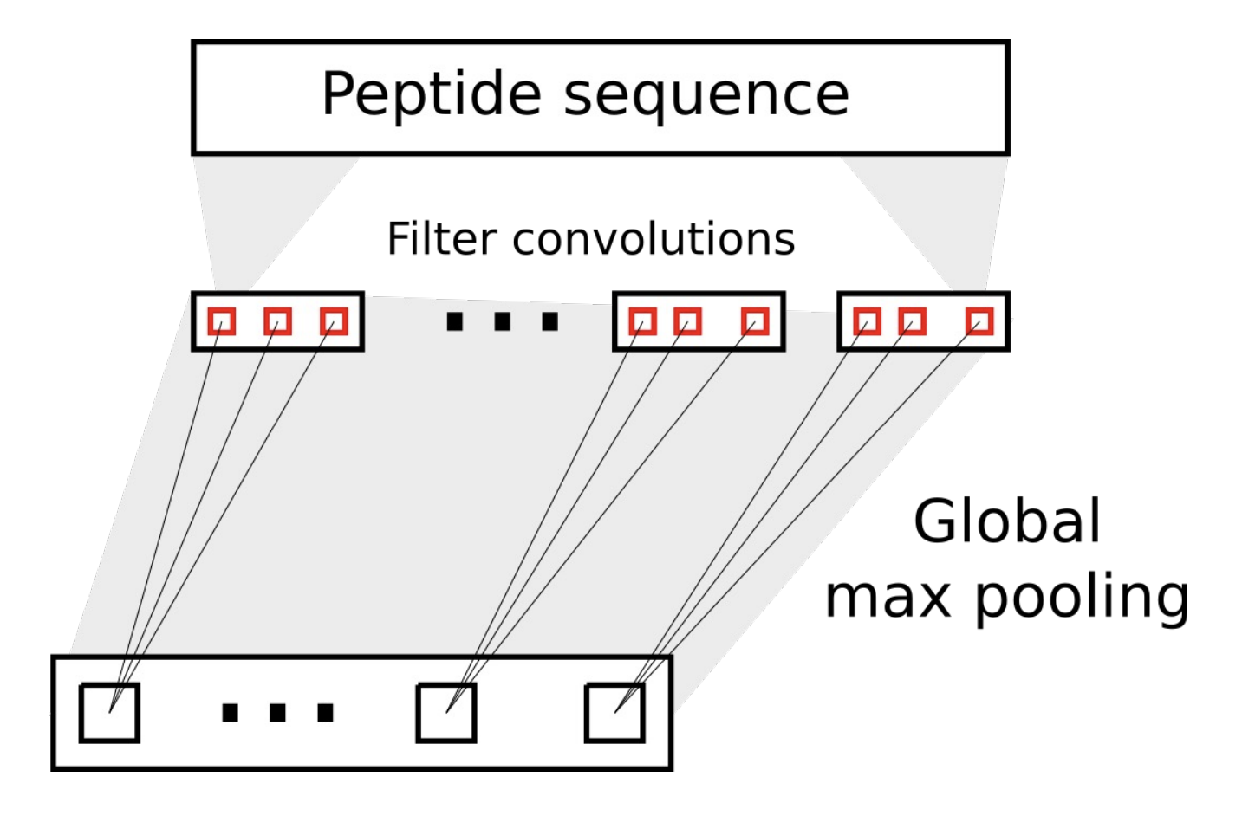
Today’s exercises: Part 2
2d Tensor input
Implement an CNN using efficient matrix multiplication operations.
Peptides may have different lengths. Shorter sequences must be padded.
The CNN operates on a sequence of vectors.
A CNN can take inputs of variable length, so why must we still pad?

Slide 28
Today’s exercises: Part 2 in practice
Ex: 9-mer padded to 11-mer
Pad all inputs to the max length (11)
The CNN should learn to ignore padded values
Example : K=3
…
Activation
MaxPool
Reshape

Slide 29
Today’s exercises Part 2: Hyperparameter tuning and cross-validation
Train and test your models using different datasets. Try using the cross-validation data from the SMM exercise.
The same scripts can be used for hyperparameter tuning. Set up a hyperparameter tuning experiment.
Model ensembling almost always improves performance. Train and evaluate an ensemble.

Slide 30
We are here to take your questions.
(when in doubt: Print output of a given operation and their dimensions of a tensor x using x.shape or x.size)

