Slide 1
Artificial Neural Networks 3 Tricks for improved learning Morten Nielsen Department of Systems Biology, DTU

Slide 2
Network architecture
I_{k}
Input layer
v_{jk}
h_{j}
Hidden layer
H_{j}
w_{j}
o
Output layer
O

Slide 3
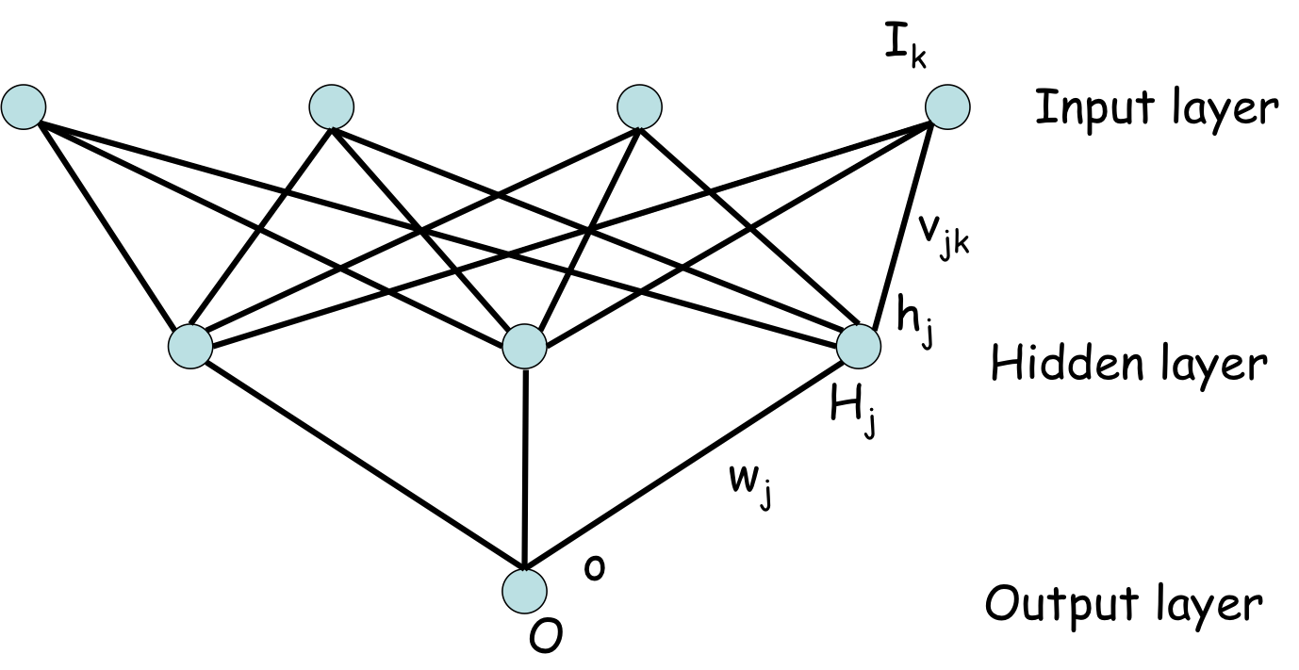
The conventional back-prop

Slide 4
Regularization
Issues:
Different lambda is each layer
Include bias values in regularization?

Slide 5
Batch training
Generally each parameter update in GD is computed w.r.t a few training examples or a minibatch as opposed to a single example. The reason for this is twofold: first this reduces the variance in the parameter update and can lead to more stable convergence, second this allows the computation to take advantage of highly optimized matrix operations that should be used in a well vectorized computation of the cost and gradient.
http://ufldl.stanford.edu/tutorial/supervised/OptimizationStochasticGradientDescent/

Slide 6
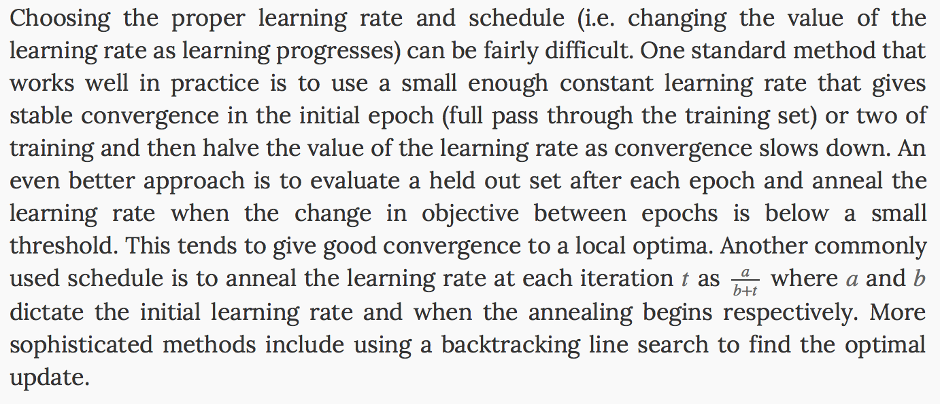
Changing the learning rate
http://ufldl.stanford.edu/tutorial/supervised/OptimizationStochasticGradientDescent/

Slide 7
Using different activation functions – g(x)
Sigmoid
Hyperbolic tangent
…

Slide 8
Momentum
One method of speeding up training per-dimension is the momentum method. This is perhaps the simplest extension to SGD that has been successfully used for decades. The main idea behind momentum is to accelerate progress along dimensions in which gradient consistently point in the same direction and to slow progress along dimensions where the sign of the gradient continues to change.
ADADELTA: AN ADAPTIVE LEARNING RATE METHOD, Matthew D. Zeiler

Slide 9
Network ensembles

Slide 10
Drop out (one network containing the ensemble)

