Slide 1
MHC class II binding predictions NNAlign “Alignment using ANNs”

Slide 2
Class II MHC binding
Binds peptides of length 9-18 (even whole proteins can bind!)
Binding cleft is open
Binding core is 9 aa
Binding motif highly generate
Amino acids flanking the binding core affect binding
Peptide structure might determine binding

Slide 3
Gibbs sampler www.cbs.dtu.dk/biotools/EasyGibbs
100 10mer peptides
2¹⁰⁰~10³⁰ combinations
Monte Carlo simulations can do it

Slide 4
SMM-align method
YKTLRAEQA 0.000000
FGYGAKDVRCHARKAVTHIN 0.000000
AVGGVLLFLSVNVHA 0.800060
ENLPYLVAYQATVCARAQAP 0.871870
KYTVIITVHTGDQHQ 0.807350
TVKVEPHTGDYVAAN 0.000000
TGFLIIILAIIAKEGDCAPE 0.000000
EGVVLLLVGALVL 0.000000
YARFQRQTTLKAAA 0.840780
MSSGSFINISV 0.000000
SPAIFQSSMTKILEP 0.000000
YSGPLKAEIAQRLEDV 0.000000
QNILLSNAVLGPQFP 0.532100
QEQIGWMTNNPPI 0.000000
KPLEDKILVQAGEAE 0.000000
Identify a PSSM (scoring matrix) to get lowest E

Slide 5
NNAlign

Slide 6
The problem. Where is the binding core?
PEPTIDE IC50(nM)
VPLTDLRIPS 48000
GWPYIGSRSQIIGRS 45000
ILVQAGEAETMTPSG 34000
HNWVNHAVPLAMKLI 120
SSTVKLRQNEFGPAR 8045
NMLTHSINSLISDNL 47560
LSSKFNKFVSPKSVS 4
GRWDEDGAKRIPVDV 49350
ACVKDLVSKYLADNE 86
NLYIKSIQSLISDTQ 67
IYGLPWMTTQTSALS 11
QYDVIIQHPADMSWC 15245

Slide 7
Effect of Peptide Flanking Residues
PFR’s can affect binding dramatically
RFYKTLRAEQASQ 34 nM
YKTLRAEQA >10000 nM

Slide 8
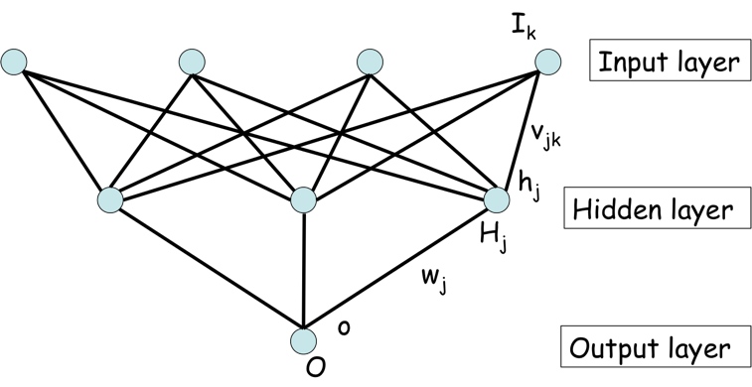
Alignment using ANN
Update method to
Minimize prediction error
NN-align
Predict binding affinity
and core
PEPTIDE Pred Meas
VPLTDLRIPS 0.00 0.03
GWPYIGSRSQIIGRS 0.19 0.08
ILVQAGEAETMTPSG 0.07 0.24
HNWVNHAVPLAMKLI 0.77 0.59
SSTVKLRQNEFGPAR 0.15 0.19
NMLTHSINSLISDNL 0.17 0.02
LSSKFNKFVSPKSVS 0.81 0.97
GRWDEDGAKRIPVDV 0.39 0.45
ACVKDLVSKYLADNE 0.58 0.57
NLYIKSIQSLISDTQ 0.84 0.66
IYGLPWMTTQTSALS 1.00 0.93
QYDVIIQHPADMSWC 0.12 0.11
GRWDEDGAKRIPVDV
0.45
GRWDEDGAK
RIP
0.15
G
RWDEDGAKR
IPV
0.03
GR
WDEDGAKRI
PVD
0.39
GRW
DEDGAKRIP
VDV
0.05
Calculate prediction
error
Nielsen et al. BMC Bioinformatics 2009, 10:296

Slide 9
Binding motif of 14 HLA-DR molecules

Slide 10
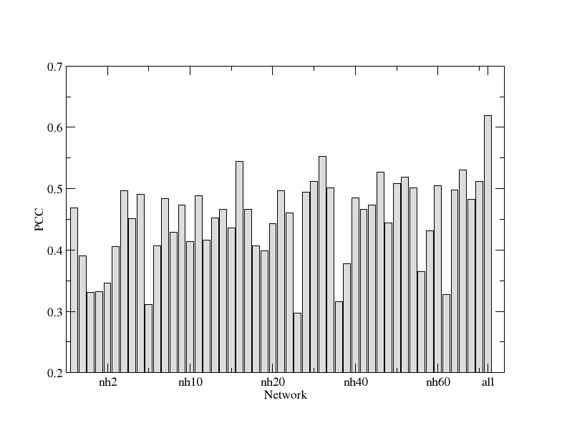
Network ensembles

Slide 11
NNAlign Server
www.cbs.dtu.dk/services/NNAlign

Slide 12
NNAlign Server - Output (1)

Slide 13
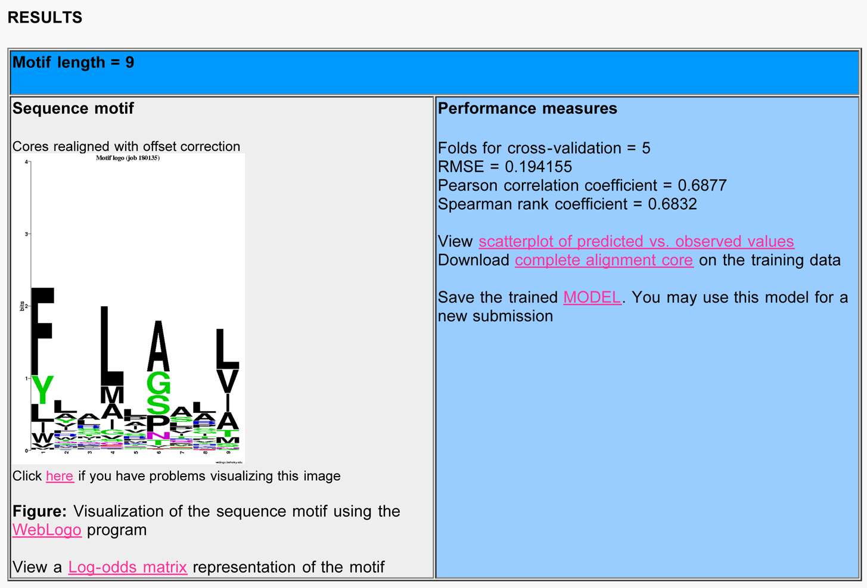
NNAlign Server - Output (2)

Slide 14
The first challenge - Moving beyond 9mers
Most MHC class I binding methods are trained on 9mer peptide binding data only
Close to 30% of binding data available have length <> 9

Slide 15
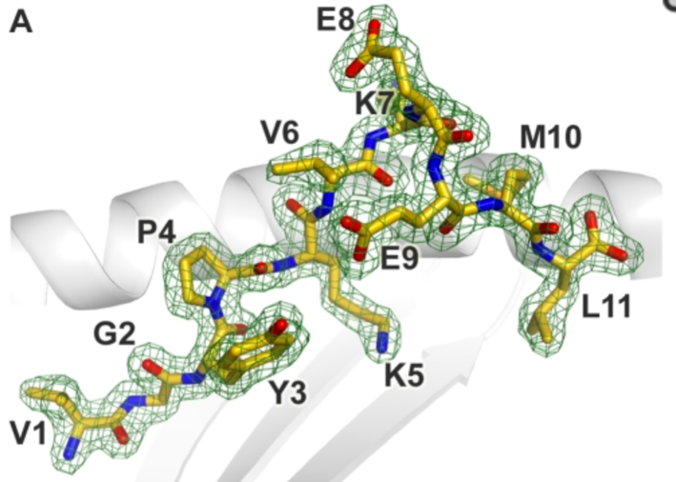
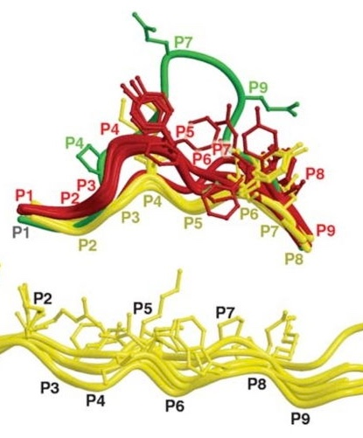
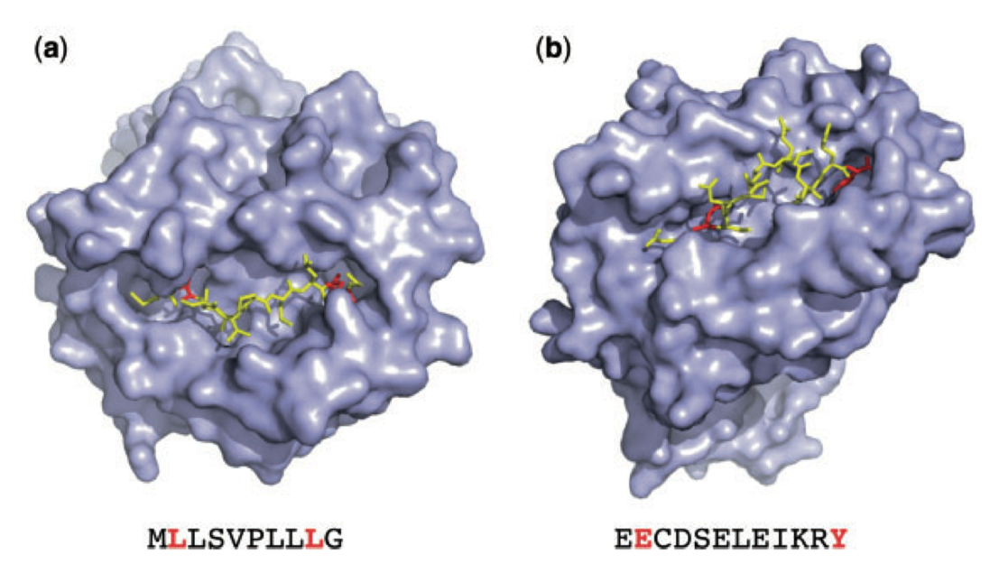
Reconciling multiple binding models –
Peptide binding to MHC class I
BoLA-HD6
VGYPKVKEEML
HLA-A*03:01
MLQGRGPLK 1.0nM MLQGRGPLK
CAHHFWTK 169nM CAHHFWT-K
TMRIYCSLFK 1.2nM TMRYCSLFK
RMRGAHTNDVK 1.0nM RMRGAHTNK

Slide 16
Different possible binding modes
1
2
3
4
5
6
7
8
9
10
11
11mer peptide
2
3
1
4
5
6
7
8
9
10
11
3
4
Bulging
1
2
5
6
7
8
9
10
11
9
10
All peptides become 9mers
1
2
3
4
5
6
7
8
11
1
2
3
4
5
6
7
8
9
10
11
Flanks
1
2
3
4
5
6
7
8
9
10
11

Slide 17
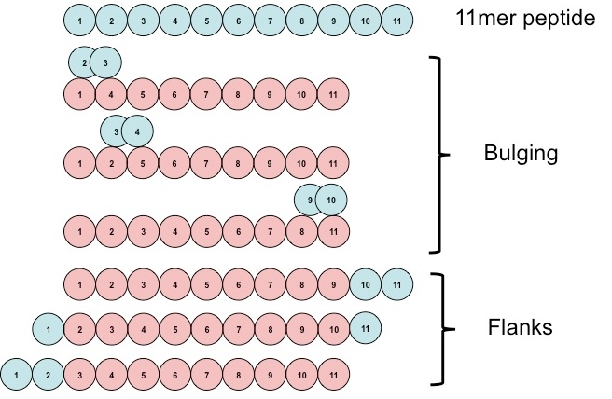
A “CNN like” model before the era of CNN’s
Update method to
Minimize prediction error
NNAlign-2.0
Predict binding affinity
and core
PEPTIDE Pred Meas 9mer_Core
AEMKTDAA 0.022 0.000 AEMK-TDAA
HHIWQNLL 0.029 0.000 HHI-WQNLL
APLAHRLGM 0.065 0.085 APLAHRLGM
GGFTFKRTK 0.385 0.547 GGFTFKRTK
LPTWLGAAI 0.029 0.085 LPTWLGAAI
DILGVLTIK 0.376 0.351 DILGVLTIK
DIVNNFITK 0.430 0.361 DIVNNFITK
RRRKGWIPL 0.058 0.213 RRRKGWIPL
SLSEPWRDF 0.078 0.085 SLSEPWRDF
RELVRKTRF 0.028 0.085 RELVRKTRF
IISDMYDPR 0.412 0.556 IISDMYDPR
LQAGFFLLTR 0.443 0.394 LQAGFFLLR
0.45
0.15
0.03
0.39
0.05
0.05
Calculate prediction
error
Andreatta, Nielsen, Bioinformatics 2016
Nielsen, Andreatta, Genome Medicine, 2016
Nielsen M, Andreatta M., NAR 2017

Slide 18
Interpreting (and benefitting from) MS eluted ligand data sets
In silico analysis
Michal Bassani-Sternberg et. al, MCP, 2015

Slide 19
How to train on mixed data types (benefiting from MS ligand data)?
MS Ligand + MHC sequence
Neural network model
We expand the NNalign approach by adding a second output neuron
Training is performed on both data simultaneously
Resulting model is able to predict binding affinity value and probability of peptide being an eluted ligand
BA Peptide + MHC sequence
Input layer
Shared weights between both data types
Hidden layer
Output layer
Binding affinity
Ligand
185,985 data points covering 153 MHC-I molecules
84,717 data points covering 55 HLA-I molecules
V. Jurtz et al. J Immunol. 2017

Slide 20
Learning from raw MS data – NNAlign_MA
Alvarez et al., 2019

Slide 21
Learning from raw MS data – NNAlign_MA
Alvarez et al., 2019

Slide 22
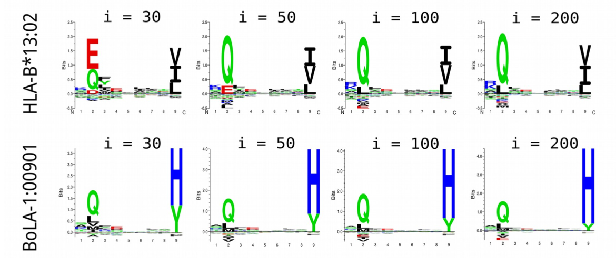
Learning from raw MS data – NNAlign_MA
Alvarez et al., 2019

Slide 23
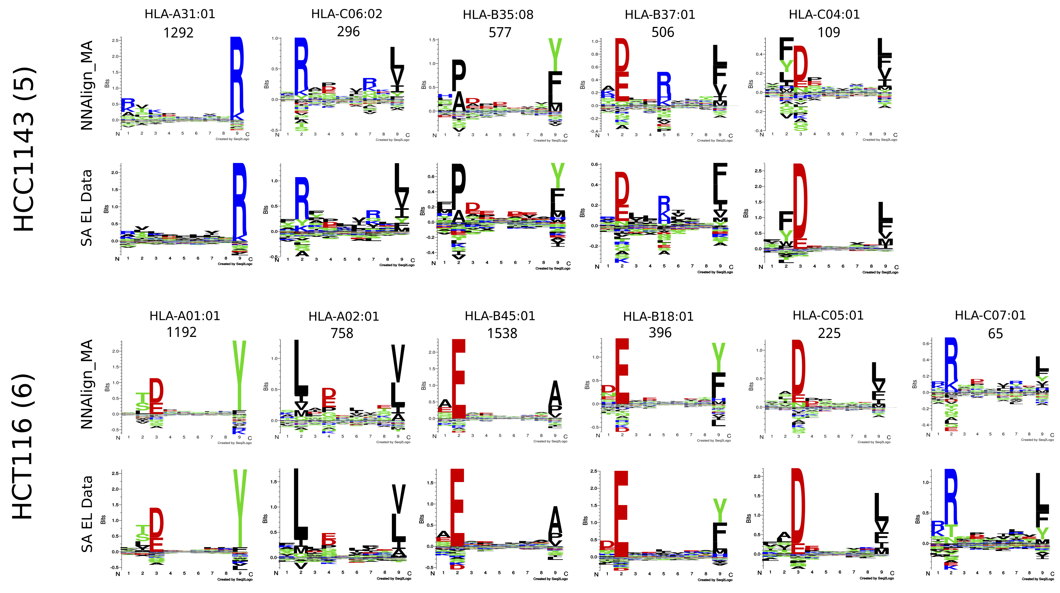
NNAlign_MA
Alvarez et al., 2019

Slide 24
Conclusions and perfectives
Receptor ligand systems are effectively characterized using swallow ANN combined with biological intuition
Knowing how to program a simple FFNN allows you to modify the implementation to integrate mixed data types and to reconcile different peptide binding modes
You might not always have to go Deep :=)

