Slide 1
Artificial Neural Networks 1
Morten Nielsen
Department of Health Technology,
DTU

Slide 2
Objectives
Input
Neural network
Output
Neural network:
  is a black box that no one can understand
  over-predicts performance
  Overfitting - many thousand parameters fitted on few data

Slide 3

HUNKAT

Slide 4
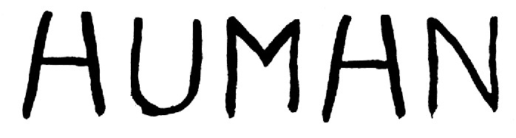

Slide 5
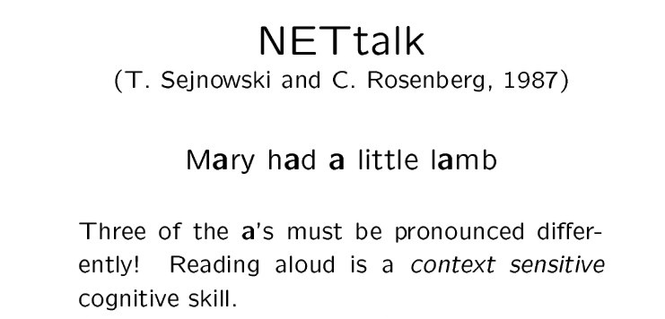

Slide 6
Weight matrices (PSSM)
A weight matrix is given as
  W_{ij} = log(p_{ij}/q_{j})
  where i is a position in the motif, and j an amino acid. q_{j} is the background frequency for amino acid j.
W is a L x 20 matrix, L is motif length
A R N D C Q E G H I L K M F P S T W Y V
1 0.6 0.4 -3.5 -2.4 -0.4 -1.9 -2.7 0.3 -1.1 1.0 0.3 0.0 1.4 1.2 -2.7 1.4 -1.2 -2.0 1.1 0.7
2 -1.6 -6.6 -6.5 -5.4 -2.5 -4.0 -4.7 -3.7 -6.3 1.0 5.1 -3.7 3.1 -4.2 -4.3 -4.2 -0.2 -5.9 -3.8 0.4
3 0.2 -1.3 0.1 1.5 0.0 -1.8 -3.3 0.4 0.5 -1.0 0.3 -2.5 1.2 1.0 -0.1 -0.3 -0.5 3.4 1.6 0.0
4 -0.1 -0.1 -2.0 2.0 -1.6 0.5 0.8 2.0 -3.3 0.1 -1.7 -1.0 -2.2 -1.6 1.7 -0.6 -0.2 1.3 -6.8 -0.7
5 -1.6 -0.1 0.1 -2.2 -1.2 0.4 -0.5 1.9 1.2 -2.2 -0.5 -1.3 -2.2 1.7 1.2 -2.5 -0.1 1.7 1.5 1.0
6 -0.7 -1.4 -1.0 -2.3 1.1 -1.3 -1.4 -0.2 -1.0 1.8 0.8 -1.9 0.2 1.0 -0.4 -0.6 0.4 -0.5 -0.0 2.1
7 1.1 -3.8 -0.2 -1.3 1.3 -0.3 -1.3 -1.4 2.1 0.6 0.7 -5.0 1.1 0.9 1.3 -0.5 -0.9 2.9 -0.4 0.5
8 -2.2 1.0 -0.8 -2.9 -1.4 0.4 0.1 -0.4 0.2 -0.0 1.1 -0.5 -0.5 0.7 -0.3 0.8 0.8 -0.7 1.3 -1.1
9 -0.2 -3.5 -6.1 -4.5 0.7 -0.8 -2.5 -4.0 -2.6 0.9 2.8 -3.0 -1.8 -1.4 -6.2 -1.9 -1.6 -4.9 -1.6 4.5
SLLPAIVEL
YLIPAIVHI
TLWVDPYEV

Slide 7
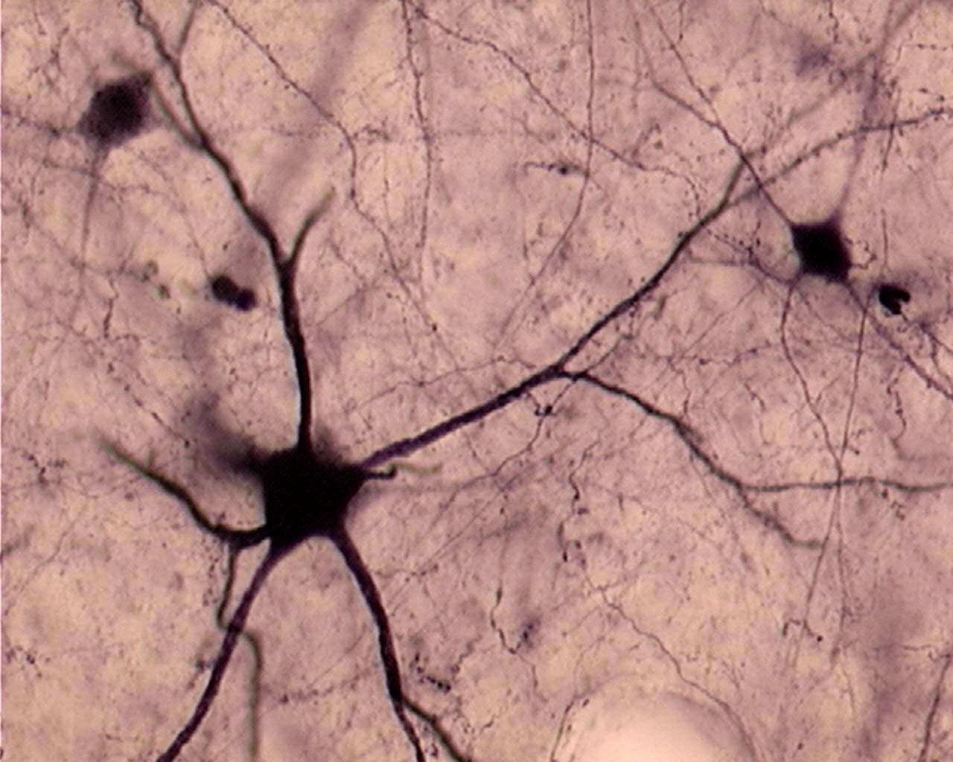
Biological Neural network

Slide 8
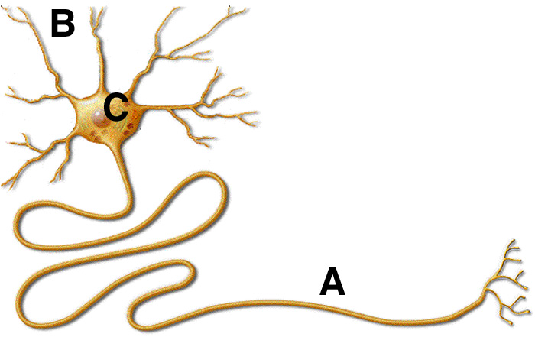
Biological neuron structure

Slide 9
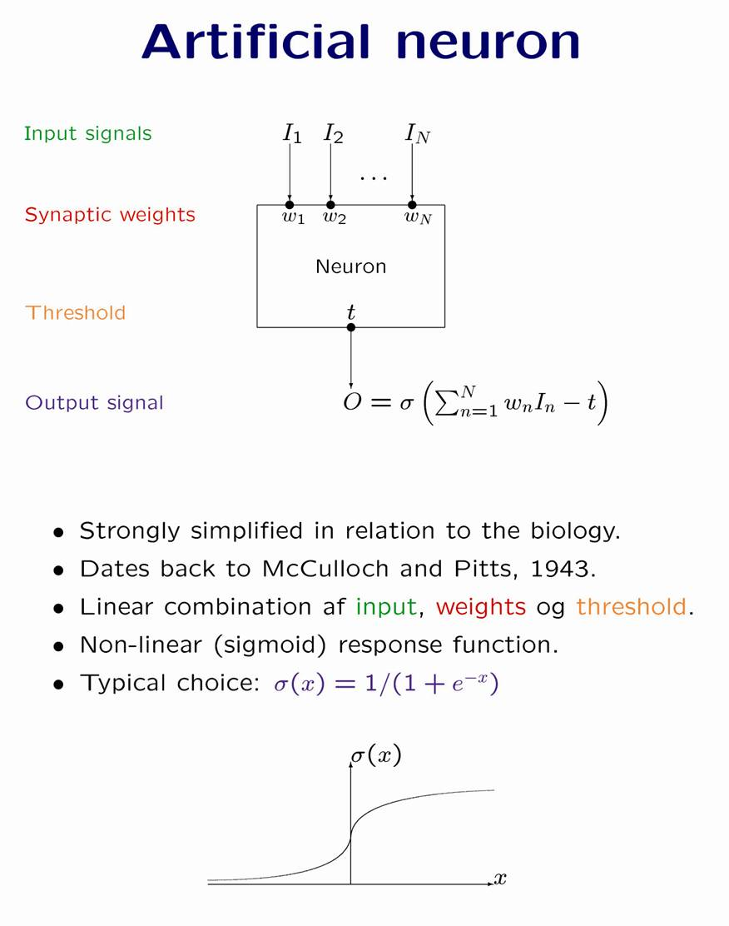

Slide 10
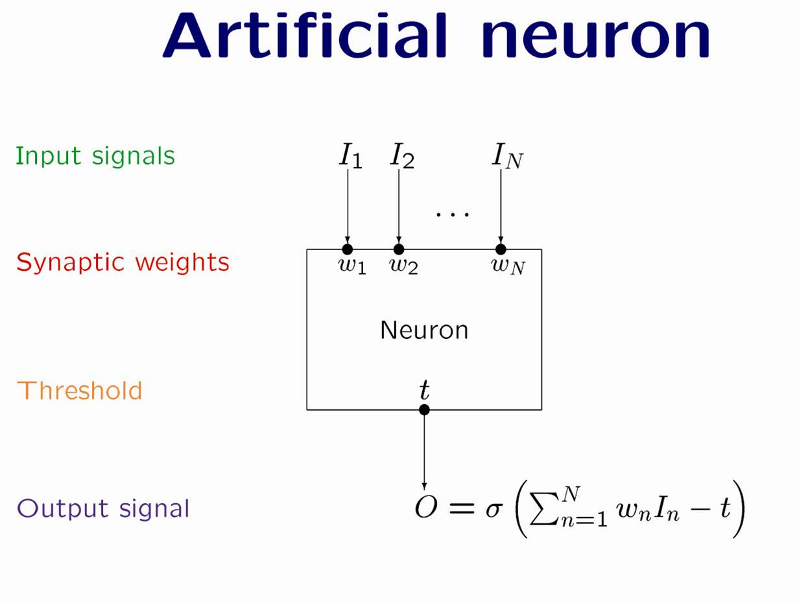

Slide 11
Transfer of biological principles to artificial neural network algorithms
Non-linear relation between input and output
Massively parallel information processing
Data-driven construction of algorithms
Ability to generalize to new data items

Slide 12
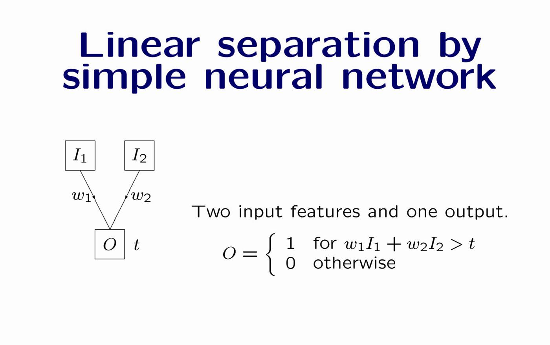
Similar to SMM, except for step function!

Slide 13
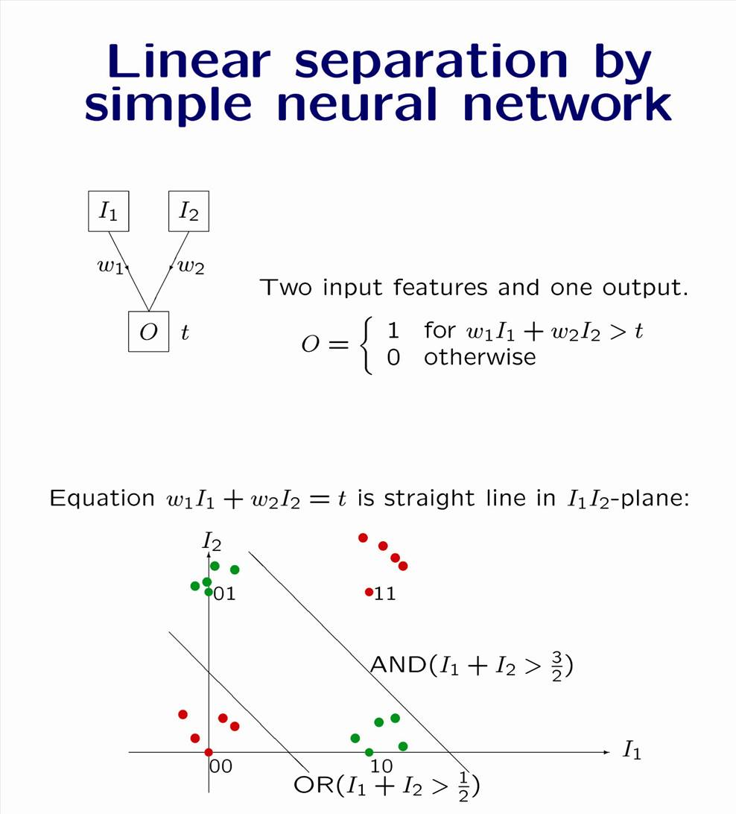
Notes:
Probability of becoming CEO. I1 intelligence, I2 father owns a firm

Slide 15
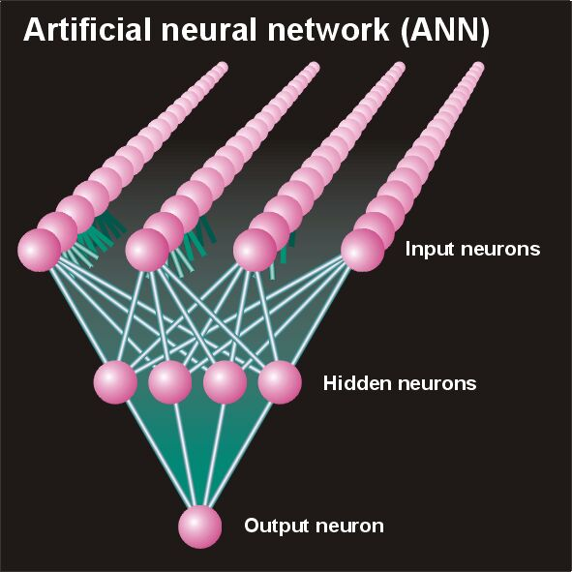
Higher order correlations
The effect on the binding affinity of having a given amino acid at one position can be influenced by the amino acids at other positions in the peptide (sequence correlations).
  Two adjacent amino acids may for example compete for the space in a pocket in the MHC molecule.
Artificial neural networks (ANN) are ideally suited to take such correlations into account

Slide 16
MHC peptide binding
SLLPAIVEL YLLPAIVHI TLWVDPYEV GLVPFLVSV KLLEPVLLL LLDVPTAAV LLDVPTAAV LLDVPTAAV
LLDVPTAAV VLFRGGPRG MVDGTLLLL YMNGTMSQV MLLSVPLLL SLLGLLVEV ALLPPINIL TLIKIQHTL
HLIDYLVTS ILAPPVVKL ALFPQLVIL GILGFVFTL STNRQSGRQ GLDVLTAKV RILGAVAKV QVCERIPTI
ILFGHENRV ILMEHIHKL ILDQKINEV SLAGGIIGV LLIENVASL FLLWATAEA SLPDFGISY KKREEAPSL
LERPGGNEI ALSNLEVKL ALNELLQHV DLERKVESL FLGENISNF ALSDHHIYL GLSEFTEYL STAPPAHGV
PLDGEYFTL GVLVGVALI RTLDKVLEV HLSTAFARV RLDSYVRSL YMNGTMSQV GILGFVFTL ILKEPVHGV
ILGFVFTLT LLFGYPVYV GLSPTVWLS WLSLLVPFV FLPSDFFPS CLGGLLTMV FIAGNSAYE KLGEFYNQM
KLVALGINA DLMGYIPLV RLVTLKDIV MLLAVLYCL AAGIGILTV YLEPGPVTA LLDGTATLR ITDQVPFSV
KTWGQYWQV TITDQVPFS AFHHVAREL YLNKIQNSL MMRKLAILS AIMDKNIIL IMDKNIILK SMVGNWAKV
SLLAPGAKQ KIFGSLAFL ELVSEFSRM KLTPLCVTL VLYRYGSFS YIGEVLVSV CINGVCWTV VMNILLQYV
ILTVILGVL KVLEYVIKV FLWGPRALV GLSRYVARL FLLTRILTI HLGNVKYLV GIAGGLALL GLQDCTMLV
TGAPVTYST VIYQYMDDL VLPDVFIRC VLPDVFIRC AVGIGIAVV LVVLGLLAV ALGLGLLPV GIGIGVLAA
GAGIGVAVL IAGIGILAI LIVIGILIL LAGIGLIAA VDGIGILTI GAGIGVLTA AAGIGIIQI QAGIGILLA
KARDPHSGH KACDPHSGH ACDPHSGHF SLYNTVATL RGPGRAFVT NLVPMVATV GLHCYEQLV PLKQHFQIV
AVFDRKSDA LLDFVRFMG VLVKSPNHV GLAPPQHLI LLGRNSFEV PLTFGWCYK VLEWRFDSR TLNAWVKVV
GLCTLVAML FIDSYICQV IISAVVGIL VMAGVGSPY LLWTLVVLL SVRDRLARL LLMDCSGSI CLTSTVQLV
VLHDDLLEA LMWITQCFL SLLMWITQC QLSLLMWIT LLGATCMFV RLTRFLSRV YMDGTMSQV FLTPKKLQC
ISNDVCAQV VKTDGNPPE SVYDFFVWL FLYGALLLA VLFSSDFRI LMWAKIGPV SLLLELEEV SLSRFSWGA
YTAFTIPSI RLMKQDFSV RLPRIFCSC FLWGPRAYA RLLQETELV SLFEGIDFY SLDQSVVEL RLNMFTPYI
NMFTPYIGV LMIIPLINV TLFIGSHVV SLVIVTTFV VLQWASLAV ILAKFLHWL STAPPHVNV LLLLTVLTV
VVLGVVFGI ILHNGAYSL MIMVKCWMI MLGTHTMEV MLGTHTMEV SLADTNSLA LLWAARPRL GVALQTMKQ
GLYDGMEHL KMVELVHFL YLQLVFGIE MLMAQEALA LMAQEALAF VYDGREHTV YLSGANLNL RMFPNAPYL
EAAGIGILT TLDSQVMSL STPPPGTRV KVAELVHFL IMIGVLVGV ALCRWGLLL LLFAGVQCQ VLLCESTAV
YLSTAFARV YLLEMLWRL SLDDYNHLV RTLDKVLEV GLPVEYLQV KLIANNTRV FIYAGSLSA KLVANNTRL
FLDEFMEGV ALQPGTALL VLDGLDVLL SLYSFPEPE ALYVDSLFF SLLQHLIGL ELTLGEFLK MINAYLDKL
AAGIGILTV FLPSDFFPS SVRDRLARL SLREWLLRI LLSAWILTA AAGIGILTV AVPDEIPPL FAYDGKDYI
AAGIGILTV FLPSDFFPS AAGIGILTV FLPSDFFPS AAGIGILTV FLWGPRALV ETVSEQSNV ITLWQRPLV

Slide 17
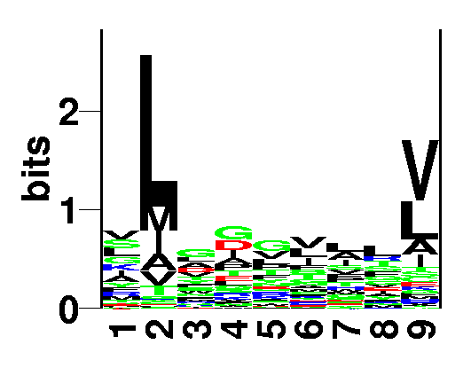
Mutual information
How is mutual information calculated?
Information content was calculated as
  Gives information in a single position
Similar relation for mutual information
  Gives mutual information between two positions

Slide 18
Mutual information. Example
Knowing that you have G at P₁ allows you to make an educated guess on what you will find at P₆.
P(V₆) = 4/10. P(V₆|G₁) = 1.0!
P1
P6
ALWGFFPVA
ILKEPVHGV
ILGFVFTLT
LLFGYPVYV
GLSPTVWLS
YMNGTMSQV
GILGFVFTL
WLSLLVPFV
FLPSDFFPS
WVPLELRDE
P(G₁) = 2/10 = 0.2, ..
P(V₆) = 4/10 = 0.4,..
P(G₁,V₆) = 2/10 = 0.2,
P(G₁)*P(V₆) = 8/100 = 0.0.8
log(0.2/0.08) > 0

Slide 19
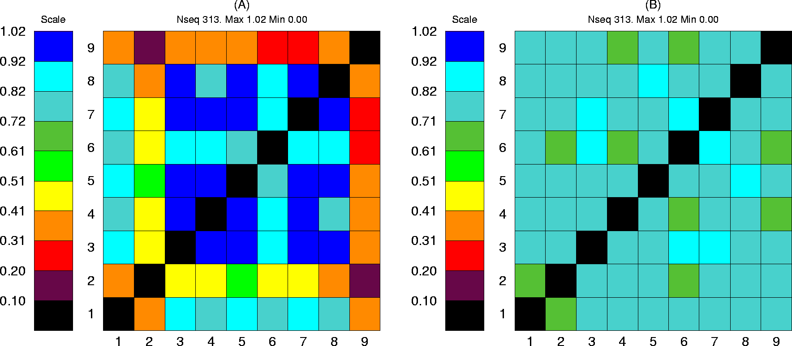
Mutual information
313 binding peptides
313 random peptides

Slide 20
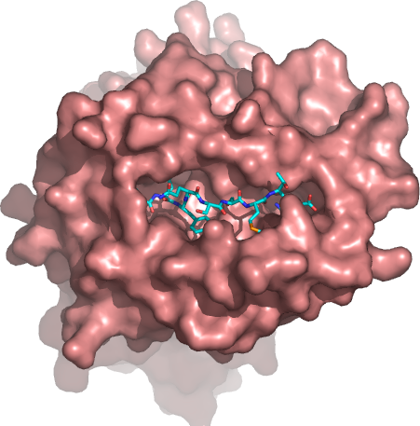
Higher order sequence correlations
Neural networks can learn higher order correlations!
  What does this mean?
Say that the peptide needs one and only one large amino acid in the positions P3 and P4 to fill the binding cleft
How would you formulate this to test if a peptide can bind?
S S => 0
L S => 1
S L => 1
L L => 0
=>
XOR function

Slide 21
Neural networks
Neural networks can learn higher order correlations
XOR
(0,1)
(1,1)
XOR function:
0 0 => 0
1 0 => 1
0 1 => 1
1 1 => 0
AND
(0,0)
(1,0)
No linear function can separate the points
OR

Slide 22
Error estimates
XOR
0 0 => 0
1 0 => 1
0 1 => 1
1 1 => 0
Predict
0
1
1
1
Error
0
0
0
1
(0,1)
(1,1)
(0,0)
(1,0)
Mean error: 1/4

Slide 23
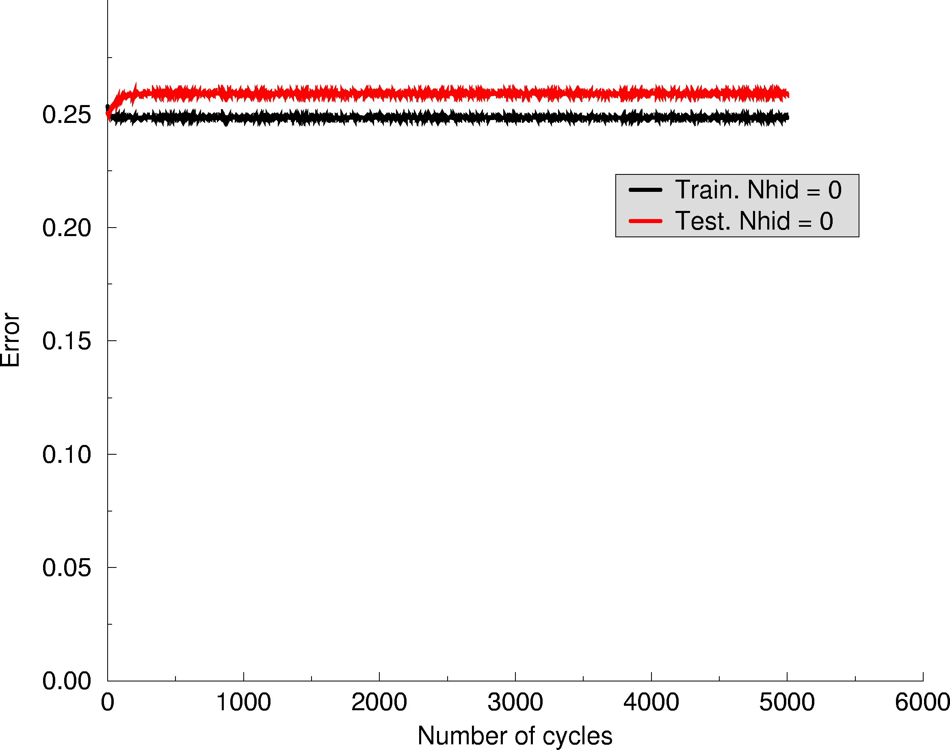
Neural networks
Linear function
v₁
v₂

Slide 24
Neural networks with a hidden layer
Input
{
1 (Bias)
1
w₁₂
w₂₁
w_{t1}
w₁₁
w₂₂
w_{t2}
1
v₁
v₂
v_{t}

Slide 25
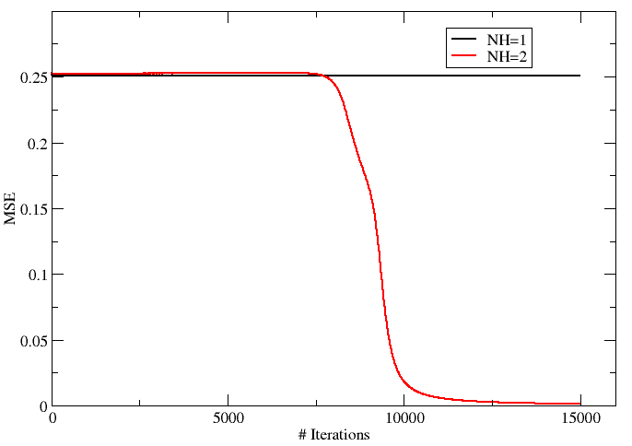
Neural networks

Slide 26
How does it work?
Ex. Input is (0 0)
Input
{
1 (Bias)
0
0
1
6
4
-6
4
6
-2
o₁=-6
O₁=0
o₂=-2
O₂=0
1
-9
9
-4.5
y₁=-4.5
Y₁=0

Slide 27
Neural networks. How does it work?
Hand out

Slide 28
Neural networks (1 0 && 0 1)
Input
{
1 (Bias)
1
0
1
6
4
-6
4
6
-2
o₁=-2
O₁=0
o₂=4
O₂=1
1
-9
9
-4.5
y₁=4.5
Y₁=1

Slide 29
Neural networks (1 1)
Input
{
1 (Bias)
1
1
1
6
4
-6
4
6
-2
o₁=2
O₁=1
o₂=10
O₂=1
1
-9
9
-4.5
y₁=-4.5
Y₁=0

Slide 30
What is going on?
Input
{
1 (Bias)
XOR function:
0 0 => 0
1 0 => 1
0 1 => 1
1 1 => 0
1
6
4
-6
4
6
-2
y₂
y₁
1
-9
9
-4.5

Slide 31
What is going on?
x₂
y₂
(0,1)
(1,1)
(2,2)
(0,0)
(1,0)
(1,0)
x₁
(0,0)
y₁

Slide 32
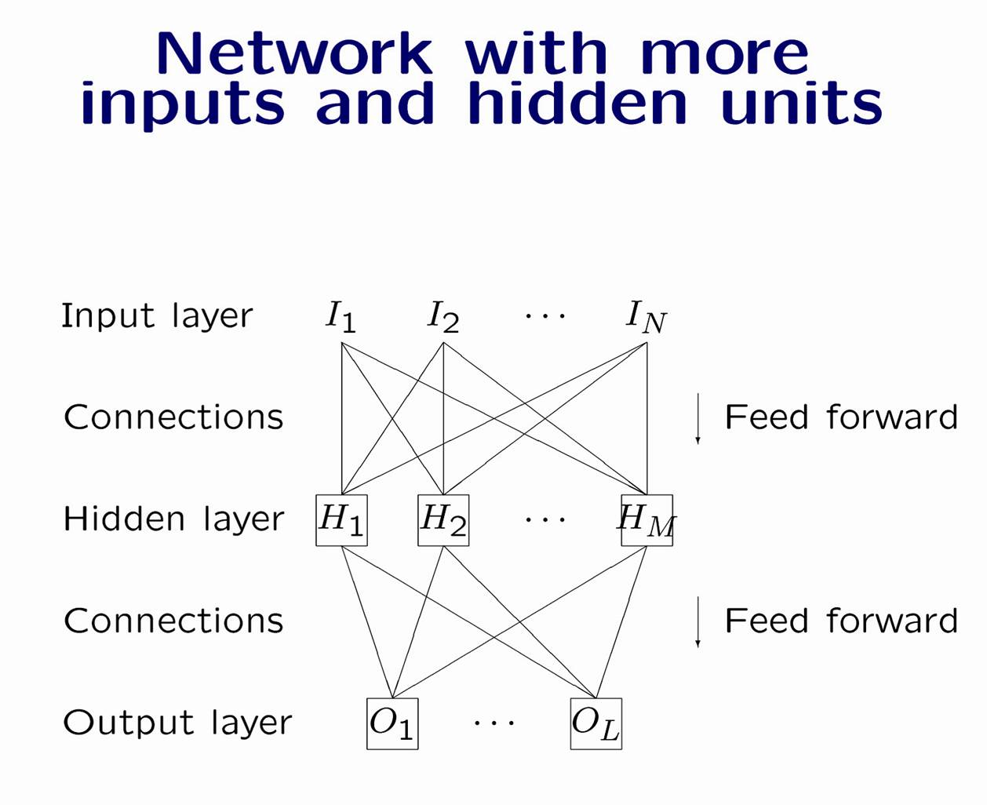

Slide 33
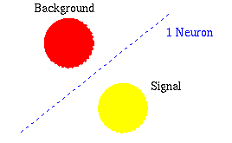
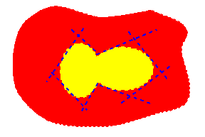
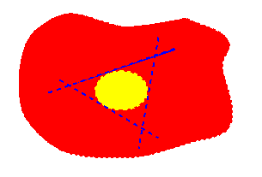

Slide 34
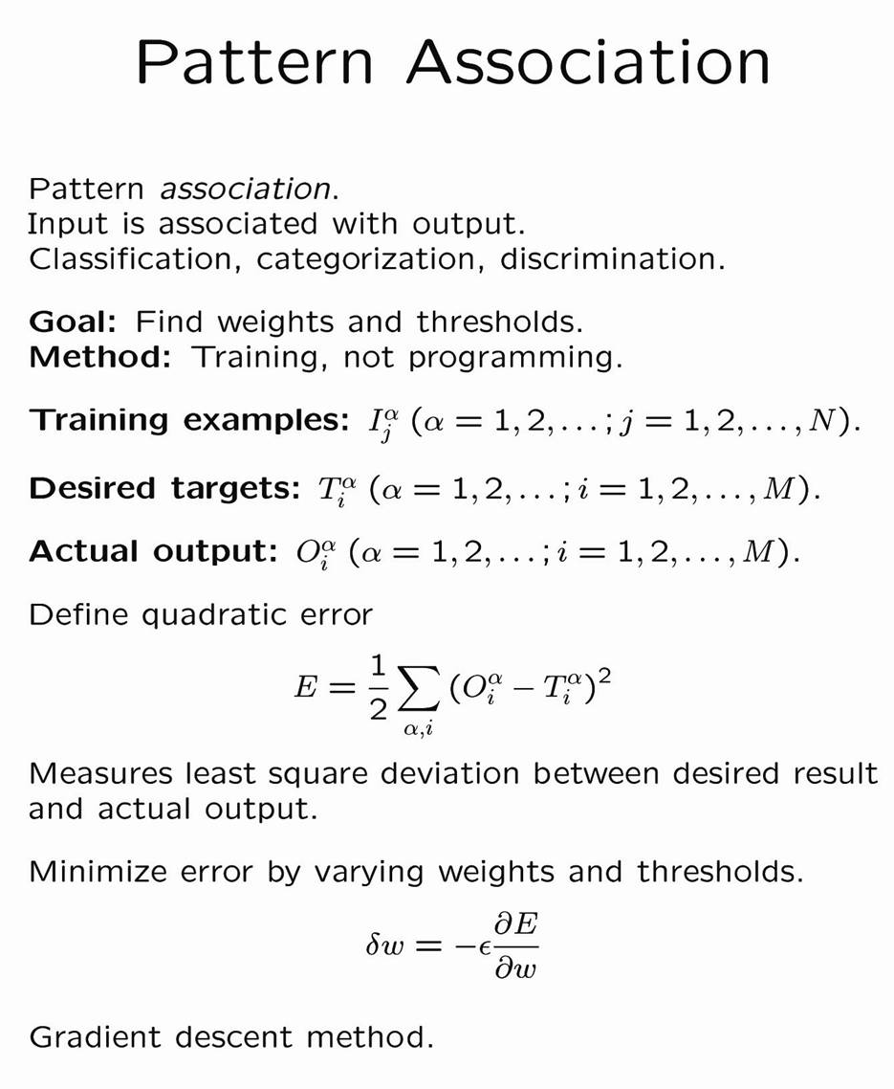

Slide 35
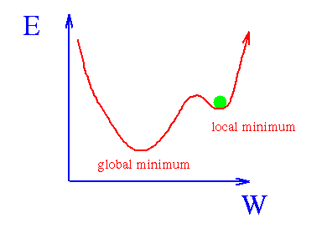
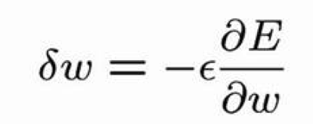
Training and error reduction
ε

Slide 36
Training and error reduction
ε

Slide 37
Training and error reduction
Size matters
ε

Slide 38
Neural network training
A Network contains a very large set of parameters
  A network with 5 hidden neurons predicting binding for 9meric peptides has 9x20x5=900 weights
  5 times as many weights as a matrix-based method
Over fitting is a problem
Stop training when test performance is optimal (use early stopping)
Temperature
years

Slide 39
Neural network training. Cross validation
Cross validation
Train on 4/5 of data
Test on 1/5
=>
Produce 5 different neural networks each with a different prediction focus

Slide 40
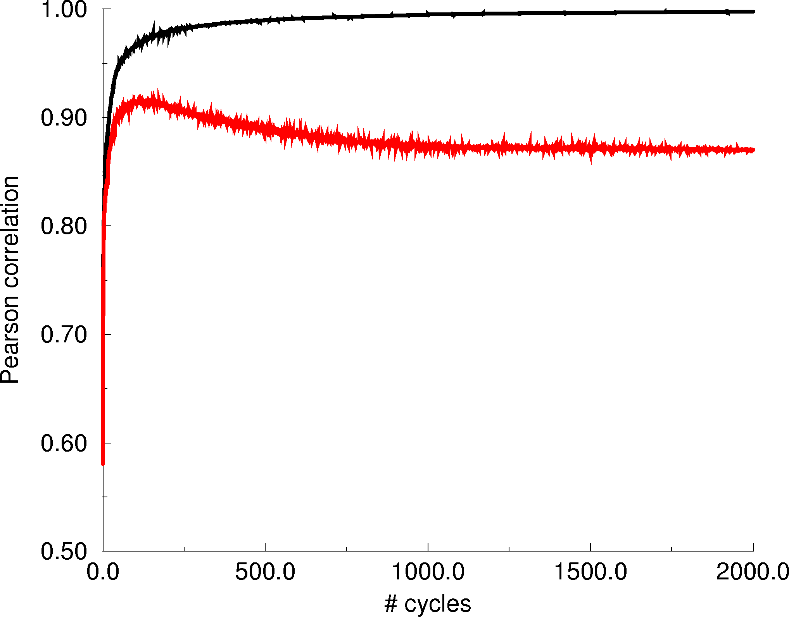
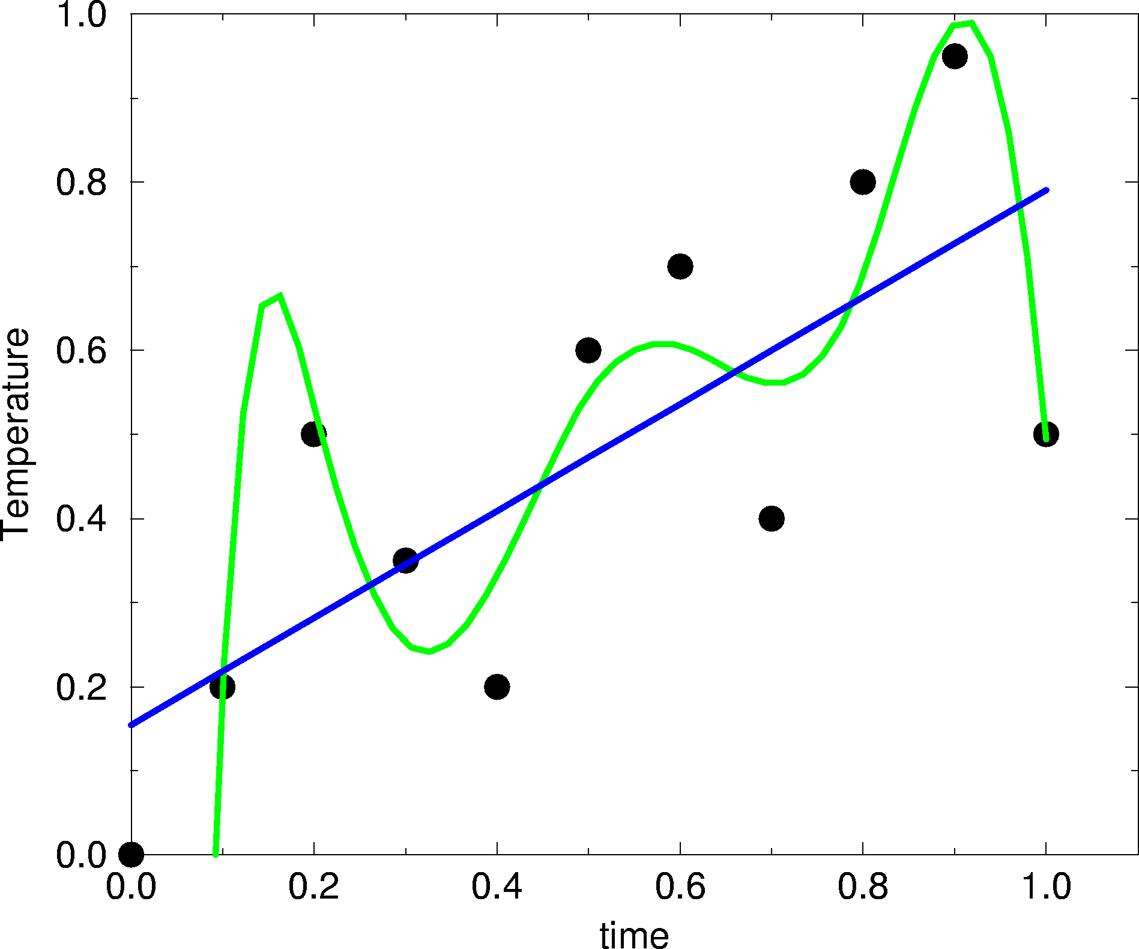
Neural network training curve
Maximum test set performance
Most cable of generalizing

Slide 41
Demo
Notes:
Use comm in /Users/mniel/Courses/Algorithms_in_Bioinf/presentations/NN-1/data

Slide 42
Network training
Encoding of sequence data
  Sparse encoding
  Blosum encoding
  Sequence profile encoding

Slide 43
Sparse encoding
Inp Neuron 1 2 3 4 5 6 7 8 9 10 11 12 13 14 15 16 17 18 19 20
AAcid
A 1 0 0 0 0 0 0 0 0 0 0 0 0 0 0 0 0 0 0 0
R 0 1 0 0 0 0 0 0 0 0 0 0 0 0 0 0 0 0 0 0
N 0 0 1 0 0 0 0 0 0 0 0 0 0 0 0 0 0 0 0 0
D 0 0 0 1 0 0 0 0 0 0 0 0 0 0 0 0 0 0 0 0
C 0 0 0 0 1 0 0 0 0 0 0 0 0 0 0 0 0 0 0 0
Q 0 0 0 0 0 1 0 0 0 0 0 0 0 0 0 0 0 0 0 0
E 0 0 0 0 0 0 1 0 0 0 0 0 0 0 0 0 0 0 0 0

Slide 44
BLOSUM encoding (Blosum50 matrix)
A R N D C Q E G H I L K M F P S T W Y V
A 4 -1 -2 -2 0 -1 -1 0 -2 -1 -1 -1 -1 -2 -1 1 0 -3 -2 0
R -1 5 0 -2 -3 1 0 -2 0 -3 -2 2 -1 -3 -2 -1 -1 -3 -2 -3
N -2 0 6 1 -3 0 0 0 1 -3 -3 0 -2 -3 -2 1 0 -4 -2 -3
D -2 -2 1 6 -3 0 2 -1 -1 -3 -4 -1 -3 -3 -1 0 -1 -4 -3 -3
C 0 -3 -3 -3 9 -3 -4 -3 -3 -1 -1 -3 -1 -2 -3 -1 -1 -2 -2 -1
Q -1 1 0 0 -3 5 2 -2 0 -3 -2 1 0 -3 -1 0 -1 -2 -1 -2
E -1 0 0 2 -4 2 5 -2 0 -3 -3 1 -2 -3 -1 0 -1 -3 -2 -2
G 0 -2 0 -1 -3 -2 -2 6 -2 -4 -4 -2 -3 -3 -2 0 -2 -2 -3 -3
H -2 0 1 -1 -3 0 0 -2 8 -3 -3 -1 -2 -1 -2 -1 -2 -2 2 -3
I -1 -3 -3 -3 -1 -3 -3 -4 -3 4 2 -3 1 0 -3 -2 -1 -3 -1 3
L -1 -2 -3 -4 -1 -2 -3 -4 -3 2 4 -2 2 0 -3 -2 -1 -2 -1 1
K -1 2 0 -1 -3 1 1 -2 -1 -3 -2 5 -1 -3 -1 0 -1 -3 -2 -2
M -1 -1 -2 -3 -1 0 -2 -3 -2 1 2 -1 5 0 -2 -1 -1 -1 -1 1
F -2 -3 -3 -3 -2 -3 -3 -3 -1 0 0 -3 0 6 -4 -2 -2 1 3 -1
P -1 -2 -2 -1 -3 -1 -1 -2 -2 -3 -3 -1 -2 -4 7 -1 -1 -4 -3 -2
S 1 -1 1 0 -1 0 0 0 -1 -2 -2 0 -1 -2 -1 4 1 -3 -2 -2
T 0 -1 0 -1 -1 -1 -1 -2 -2 -1 -1 -1 -1 -2 -1 1 5 -2 -2 0
W -3 -3 -4 -4 -2 -2 -3 -2 -2 -3 -2 -3 -1 1 -4 -3 -2 11 2 -3
Y -2 -2 -2 -3 -2 -1 -2 -3 2 -1 -1 -2 -1 3 -3 -2 -2 2 7 -1
V 0 -3 -3 -3 -1 -2 -2 -3 -3 3 1 -2 1 -1 -2 -2 0 -3 -1 4

Slide 45
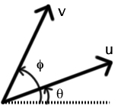
Sequence encoding (continued)
Sparse encoding
  V:0 0 0 0 0 0 0 0 0 0 0 0 0 0 0 0 0 0 0 1
  L:0 0 0 0 0 0 0 0 1 0 0 0 0 0 0 0 0 0 0 0
  V.L=0 (unrelated)
Blosum encoding
  V: 0 -3 -3 -3 -1 -2 -2 -3 -3 3 1 -2 1 -1 -2 -2 0 -3 -1 4
  L:-1 -2 -3 -4 -1 -2 -3 -4 -3 2 4 -2 2 0 -3 -2 -1 -2 -1 1
  V.L = 0.88 (highly related)
  V.R = -0.08 (close to unrelated)

Slide 46

The Wisdom of the Crowds
The Wisdom of Crowds. Why the Many are Smarter than the Few. James Surowiecki
One day in the fall of 1906, the British scientist Fracis Galton left his home and headed for a country fair… He believed that only a very few people had the characteristics necessary to keep societies healthy. He had devoted much of his career to measuring those characteristics, in fact, in order to prove that the vast majority of people did not have them. … Galton came across a weight-judging competition…Eight hundred people tried their luck. They were a diverse lot, butchers, farmers, clerks and many other no-experts…The crowd had guessed … 1.197 pounds, the ox weighted 1.198

Slide 47
Network ensembles
No one single network with a particular architecture and sequence encoding scheme, will constantly perform the best
Also for Neural network predictions will enlightened despotism fail
  For some peptides, BLOSUM encoding with a four neuron hidden layer can best predict the peptide/MHC binding, for other peptides a sparse encoded network with zero hidden neurons performs the best
  Wisdom of the Crowd
    Never use just one neural network
    Use Network ensembles

Slide 48
Evaluation of prediction accuracy
ENS: Ensemble of neural networks trained using sparse,
Blosum, and weight matrix sequence encoding

Slide 49
Applications of artificial neural networks
Talk recognition
Prediction of protein secondary structure
Prediction of Signal peptides
Post translation modifications
  Glycosylation
  Phosphorylation
Proteasomal cleavage
MHC:peptide binding

Slide 51
Prediction of protein secondary structure
Benefits
  General applicable
  Can capture higher order correlations
  Inputs other than sequence information
Drawbacks
  Needs many data (different solved structures).
    However, these does exist today (more than 2500 solved structures with low sequence identity/high resolution)
  Complex method with several pitfalls

Slide 52
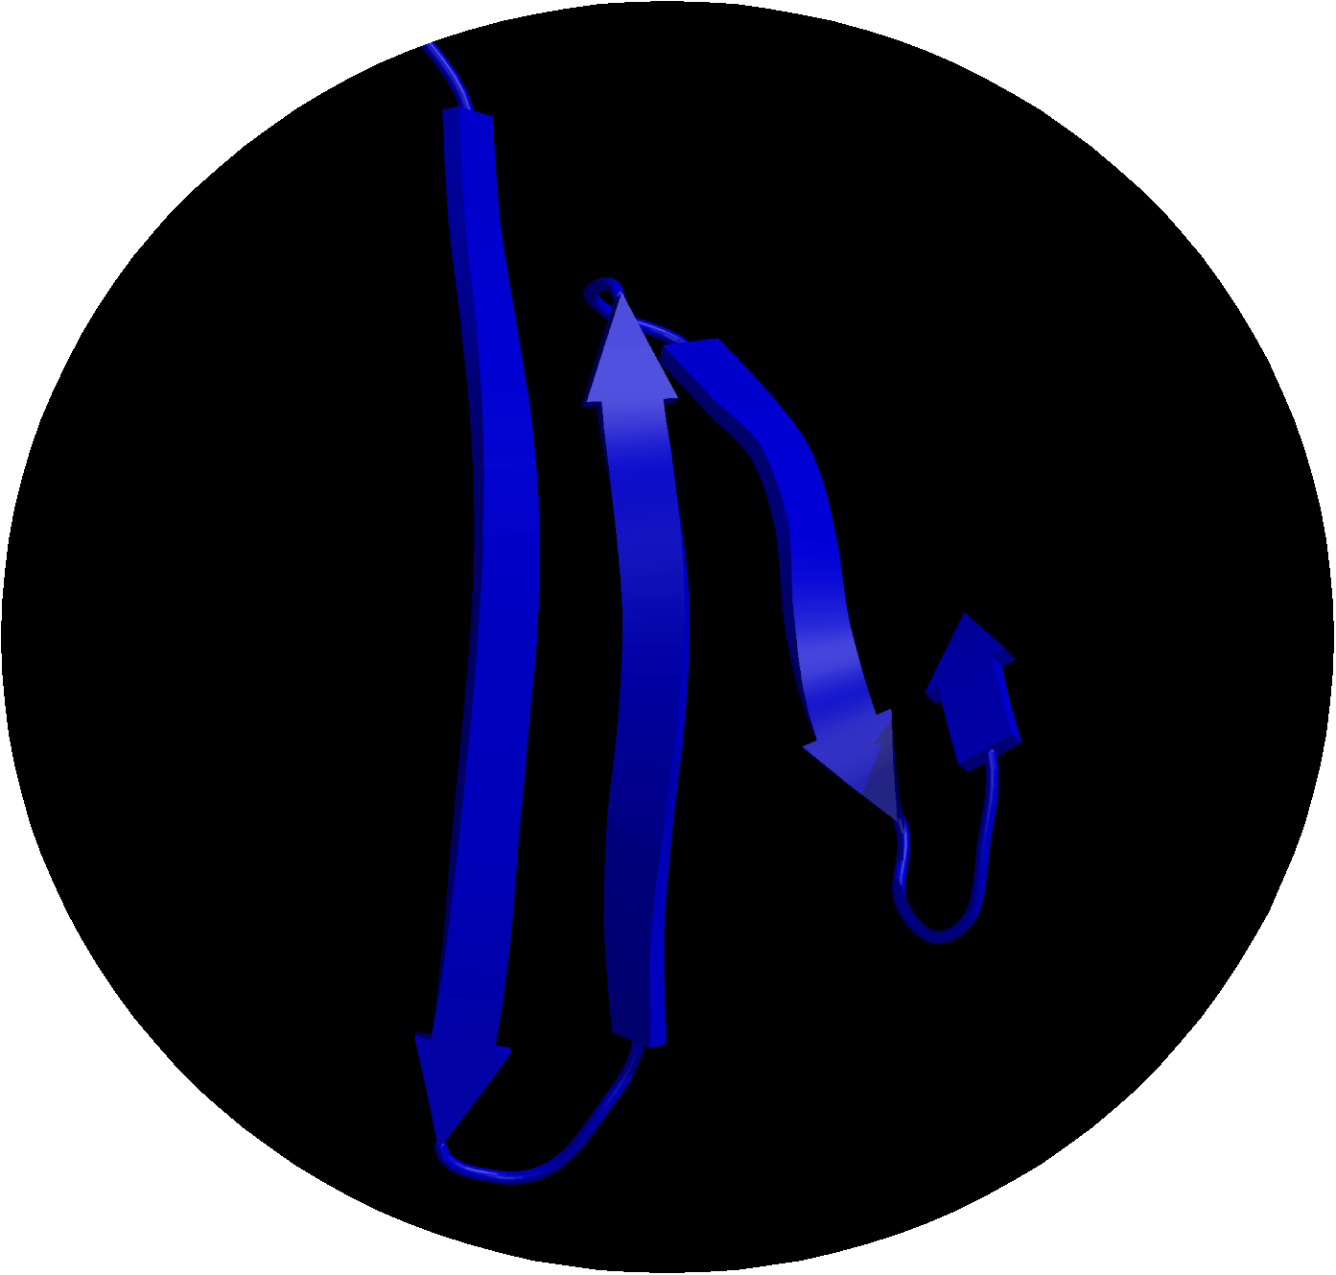
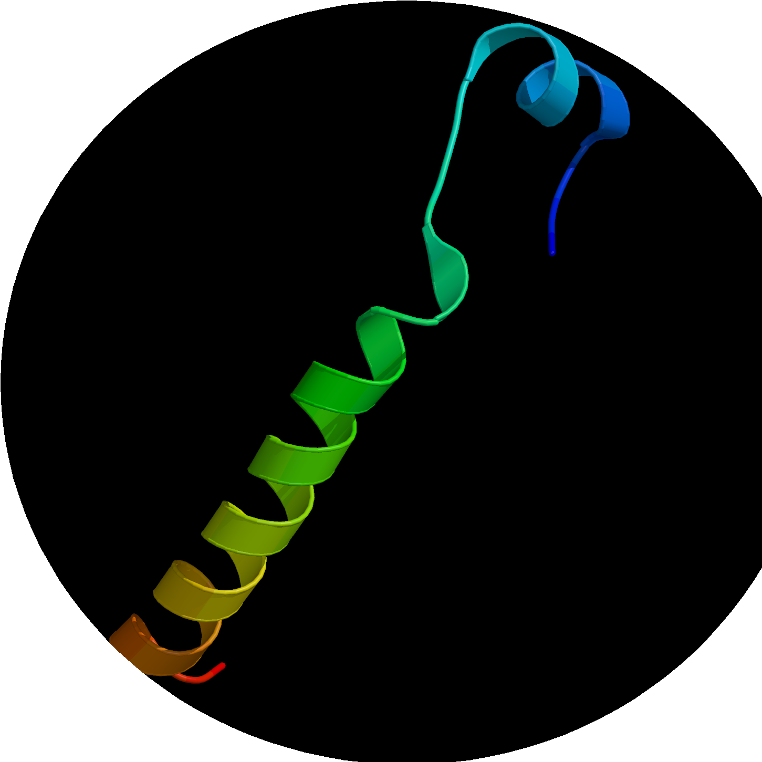
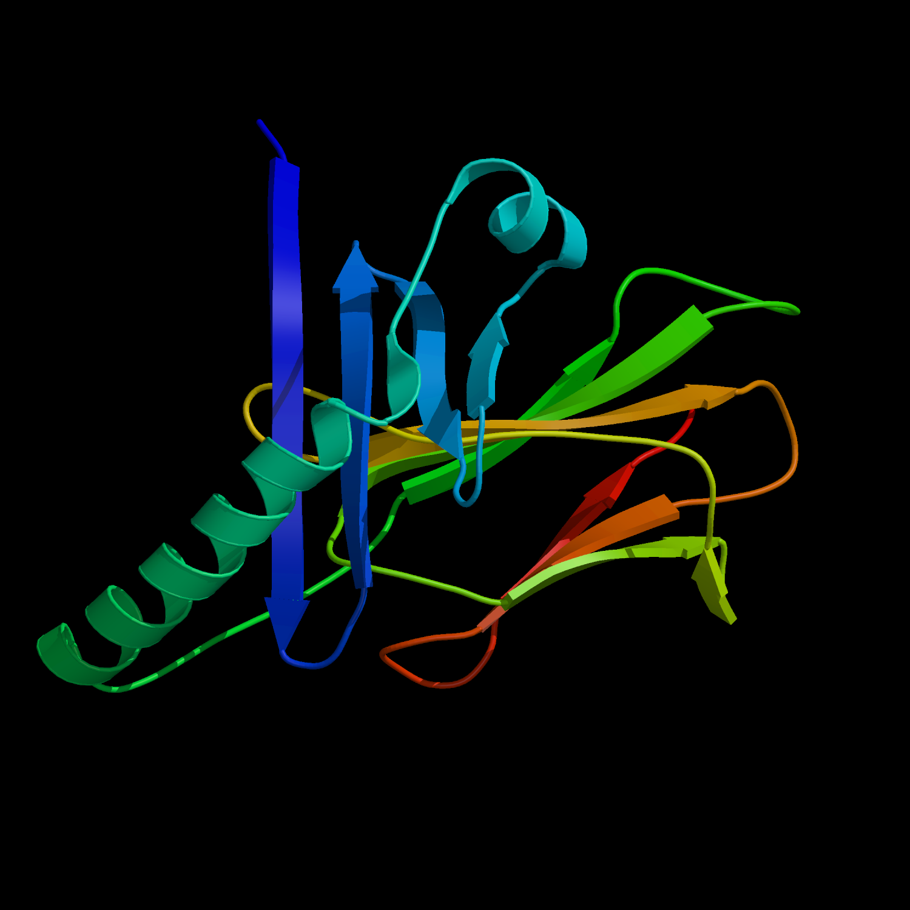
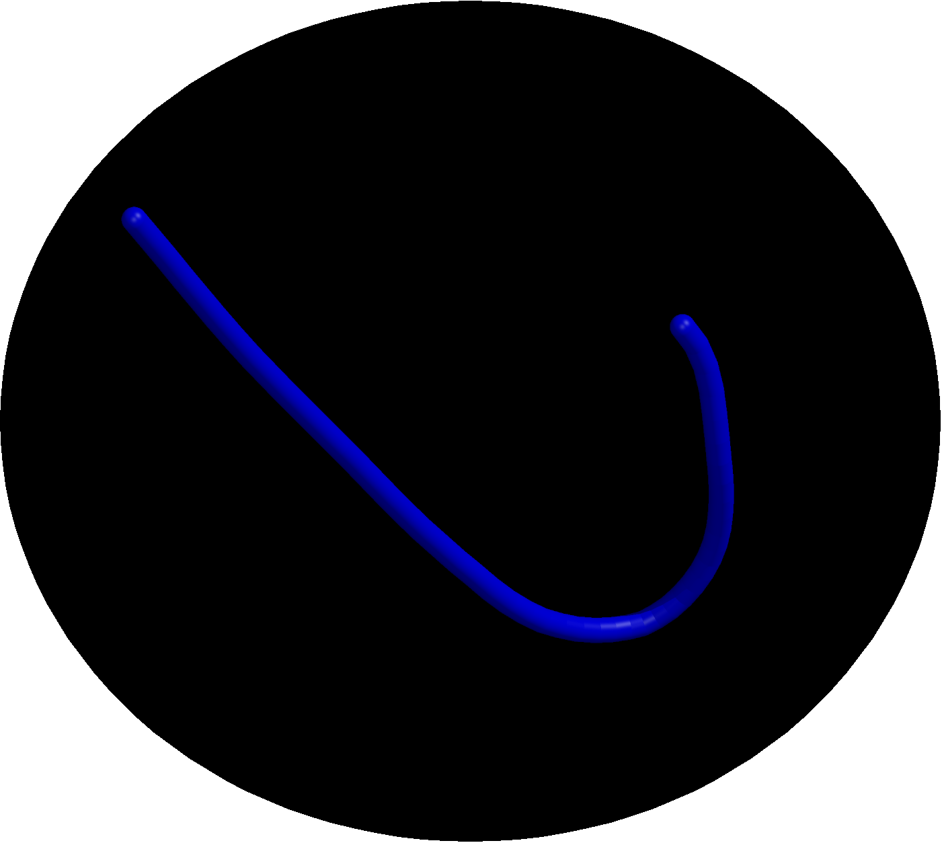

Prediction of protein secondary structure
ß-strand
Helix
Bend
Turn

Slide 53
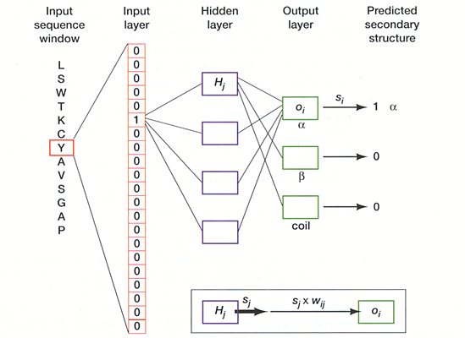
Sparse encoding of amino acid sequence windows

Slide 54
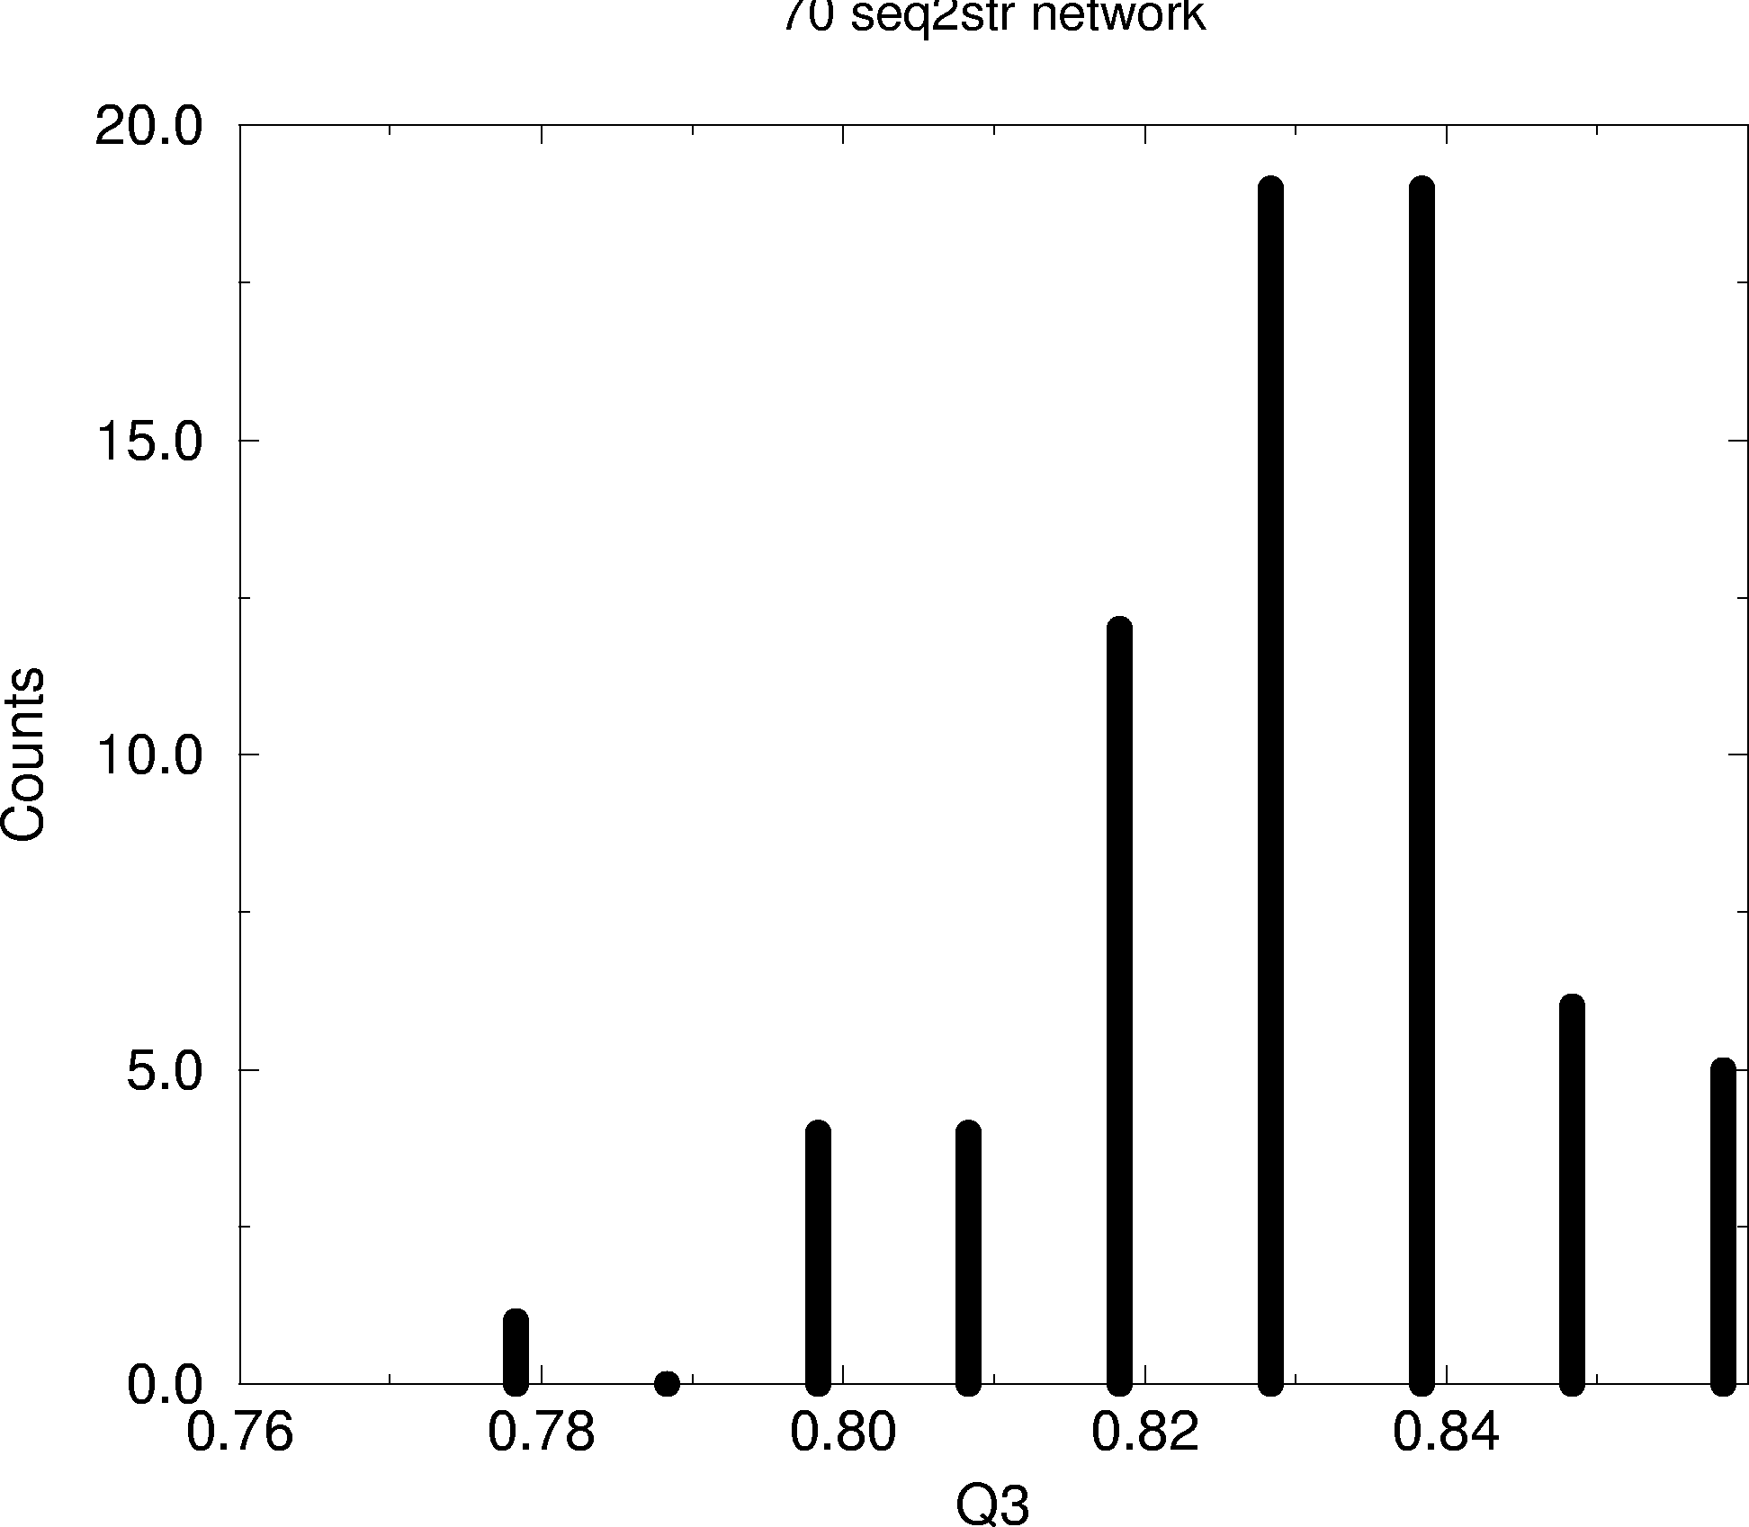
Why use network ensembles?
Network ensemble with 70 networks each trained with
different data, number of hidden neurons, or initial weight configurations
Q3 is the overall accuracy
Notes:
Why not just the best one? Because the best one does not exist!

Slide 55
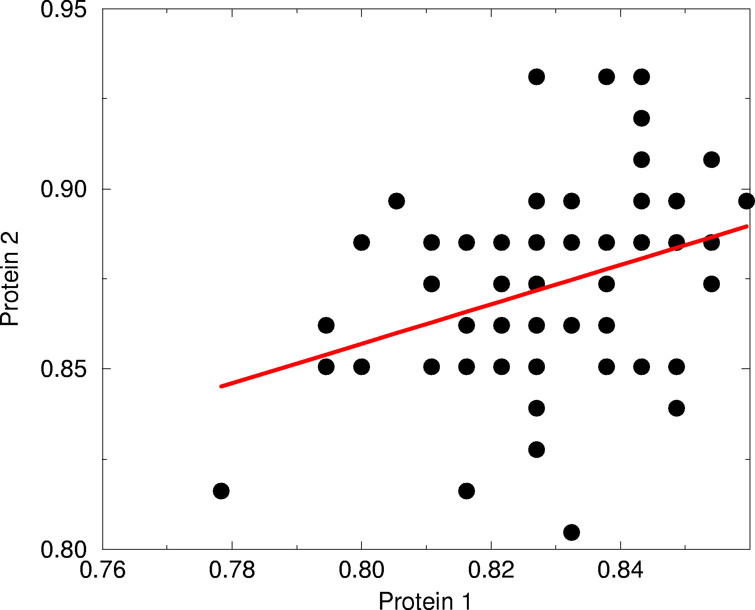
Why not select the best?
Notes:
Each point is two Q3s values each for a network with a given architecture for two different proteins. Some networks are best on protein 1 some are best on protein 2!

Slide 56
What have we learned?
Neural networks are not so bad as their reputation
Neural networks can deal with higher order correlations
Be careful when training a neural network
  Over-fitting is an important issue
  Always use cross validated training

