Slide 1
Dealing with Sequence redundancy Morten Nielsen Department of Health Technology, DTU

Slide 2
Outline
What is data redundancy?
Why is it a problem?
How can we deal with it?

Slide 3
Databases are redundant
Biological reasons
Some protein functions, or sequence motifs are more common than others
Laboratory artifacts
Some protein families have been heavily investigated, others not
Mutagenesis studies makes large and almost identical replica of data
This bias is non-biological

Slide 4
Why is it important
If you have high redundant data
and the redundancy is artificial, you will learn something non-biological
A machine learning method could focus on the largest class, and might never learn the minority patterns
If you have redundancy between the data used for model development and evaluation, the “trained” model could become a look-up table with limited power to generalize

Slide 5
Date redundancy
10 MHC restricted peptides
What can we learn?
A at P1 favors
binding?
I is not allowed at P9?
K at P4 favors binding?
Which positions are important for binding?
ALAKAAAAM
ALAKAAAAN
ALAKAAAAR
ALAKAAAAT
ALAKAAAAV
GMNERPILT
GILGFVFTM
TLNAWVKVV
KLNEPVLLL
AVVPFIVSV

Slide 6
Redundant data
ALAKAAAAM
ALAKAAAAN
ALAKAAAAR
ALAKAAAAT
ALAKAAAAV
GMNERPILT
GILGFVFTM
TLNAWVKVV
KLNEPVLLL
AVVPFIVSV

Slide 7
PDB. Example
1055 protein sequence
Len 50-2000
142 Function annotations
ACTIN-BINDING
ANTIGEN
COAGULATION
HYDROLASE/DNA
LYASE/OXIDOREDUCTASE
ENDOCYTOSIS/EXOCYTOSIS
…

Slide 8
PDB. Example

Slide 9
What is similarity?
Sequence identity?
Blast e-values
Often too conservative
Other
ACDFG
ACEFG
80% ID versus 24% ID
DFLKKVPDDHLEFIPYLILGEVFPEWDERELGVGEKLLIKAVA------------MATGIDAKEIEESVKDTGDL-GE
DVLLGADDGSLAFVP---------- SEFSISPGEKIVFKNNAGFPHNIVFDEDSIPSGVDASKISMSEEDLLNAKGE

Slide 10
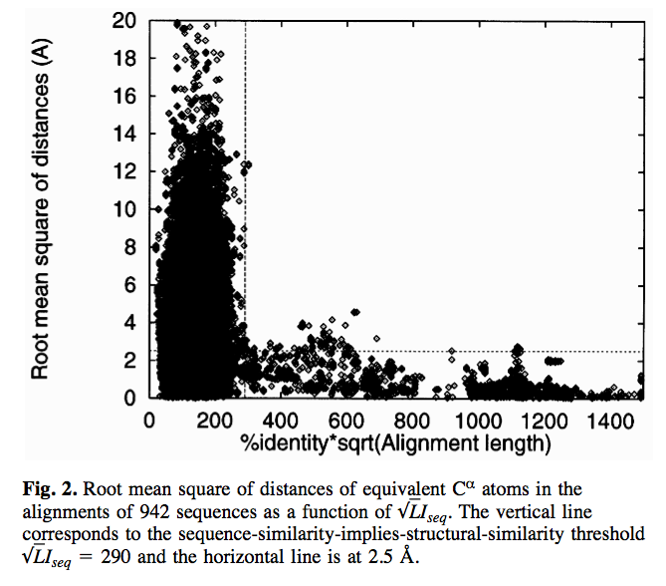
Ole Lund et al. (Protein engineering 1997)

Slide 11
Ole’s formula
Note, this formula is only relevant for protein sequences

Slide 12
How to deal with redundancy
Hobohm 1
Fast
Requires a prior sorting of data
Hobohm 2
Slow
Gives unique answer always
No prior sorting

Slide 13
Hobohm 1
Input data - sorted list
Unique
A
B
C
Add next data point to list of unique if it is NOT similar to any of the elements already on the unique list
D
E
F
G
H
I

Slide 14
Hobohm 1
Input data
Unique
A
B
C
Add next data point to list of unique if it is NOT similar to any of the elements already on the unique list
D
E
F
G
H
I

Slide 15
Hobohm 1
Input data
Unique
B
A
C
Add next data point to list of unique if it is NOT similar to any of the elements already on the unique list
D
E
F
G
H
I

Slide 16
Hobohm 1
Input data
Unique
B
A
D
C
E
F
G
I
H
Add next data point to list of unique if it is NOT similar to any of the elements already on the unique list
Need only to align sequences against the Unique list!

Slide 17
Hobohm-2
Align all against all
Make similarity matrix D (N*N) with value 1 if is similar to j, otherwise 0
While data points have more than one neighbor
Remove data point S with most nearest neighbors

Slide 18
Hobohm-2
D:
A B C D E F G H I
A 1 1 1 0 0 0 0 0 0
B 1 1 1 0 0 0 0 1 1
C 1 1 1 0 0 0 0 0 0
D 0 0 0 1 1 1 1 1 1
E 0 0 0 1 1 1 1 1 1
F 0 0 0 1 1 1 0 0 1
G 0 0 0 1 1 0 1 1 1
H 0 1 0 1 1 0 1 1 1
I 0 1 0 1 1 1 1 1 1
Make similarity matrix N*N

Slide 19
Hobohm-2
D:
A B C D E F G H I
A 1 1 1 0 0 0 0 0 0
B 1 1 1 0 0 0 0 1 1
C 1 1 1 0 0 0 0 0 0
D 0 0 0 1 1 1 1 1 1
E 0 0 0 1 1 1 1 1 1
F 0 0 0 1 1 1 0 0 1
G 0 0 0 1 1 0 1 1 1
H 0 1 0 1 1 0 1 1 1
I 0 1 0 1 1 1 1 1 1
N
3
5
3
6
6
4
5
6
7
S
Find point S with the largest number of similarities

Slide 20
Hobohm-2
D:
D:
A B C D E F G H I
A 1 1 1 0 0 0 0 0 0
B 1 1 1 0 0 0 0 1 1
C 1 1 1 0 0 0 0 0 0
D 0 0 0 1 1 1 1 1 1
E 0 0 0 1 1 1 1 1 1
F 0 0 0 1 1 1 0 0 1
G 0 0 0 1 1 0 1 1 1
H 0 1 0 1 1 0 1 1 1
I 0 1 0 1 1 1 1 1 1
N
3
5
3
6
6
4
5
6
7
A B C D E F G H
A 1 1 1 0 0 0 0 0
B 1 1 1 0 0 0 0 1
C 1 1 1 0 0 0 0 0
D 0 0 0 1 1 1 1 1
E 0 0 0 1 1 1 1 1
F 0 0 0 1 1 1 0 0
G 0 0 0 1 1 0 1 1
H 0 1 0 1 1 0 1 1
N
3
4
3
5
5
3
4
5
Remove point S with the largest number of similarities, and update N counts

Slide 21
Hobohm-2 (repeat this)
D:
D:
A B C D E F G H
A 1 1 1 0 0 0 0 0
B 1 1 1 0 0 0 0 1
C 1 1 1 0 0 0 0 0
D 0 0 0 1 1 1 1 1
E 0 0 0 1 1 1 1 1
F 0 0 0 1 1 1 0 0
G 0 0 0 1 1 0 1 1
H 0 1 0 1 1 0 1 1
N
3
4
3
5
5
3
4
5
A B C E F G H
A 1 1 1 0 0 0 0
B 1 1 1 0 0 0 1
C 1 1 1 0 0 0 0
E 0 0 0 1 1 1 1
F 0 0 0 1 1 0 0
G 0 0 0 1 0 1 1
H 0 1 0 1 0 1 1
N
3
4
3
4
2
3
4
Remove point S with the largest number of similarities

Slide 22
Hobohm-2 (until N=1 for all)
D:
D’:
A B C D E F G H I
A 1 1 1 0 0 0 0 0 0
B 1 1 1 0 0 0 0 1 1
C 1 1 1 0 0 0 0 0 0
D 0 0 0 1 1 1 1 1 1
E 0 0 0 1 1 1 1 1 1
F 0 0 0 1 1 1 0 0 1
G 0 0 0 1 1 0 1 1 1
H 0 1 0 1 1 0 1 1 1
I 0 1 0 1 1 1 1 1 1
N
3
5
3
6
6
4
5
6
7
C F H
C 1 0 0
F 0 1 0
H 0 0 1
N
1
1
1
=>
Unique list is C, F, H

Slide 23
Hobohm

Slide 24
Hobohm-1

Slide 25
Hobohm-2

Slide 26
Why two algorithms?
Hobohm-2
Unbiased
Slow (O2)
Focuses on lonely sequences
Example from exercise
1000 Sequences alignment 2 hours
Hobohm-2: 22 seconds
Hobohm-1
Biased. Prioritized list
Fast (0)
Focuses on populated sequence areas
Example from exercise
1000 Sequences
Hobohm-1: 12 seconds
Hobohm2 in general gives more sequences than Hobohm1

Slide 27
Hobohm-1 versus Hobohm-2
Prioritized lists
PDB structures. Not all structures are equally good
Low resolution, NMR, old?
Peptide binding data
Strong binding more important than weak binding
Quantitative data (yes no data)
All data are equally important

