Slide 1
Hidden Markov Models, HMM’s
Morten Nielsen Department of Health Technology, DTU

Slide 2
Objectives
Introduce Hidden Markov models and understand that they are just weight matrices with gaps
How to construct an HMM
How to “align/score” sequences to HMM’s
Viterbi decoding
Forward decoding
Backward decoding
Posterior Decoding
Use and construct a Profile HMM
HMMer

Slide 3
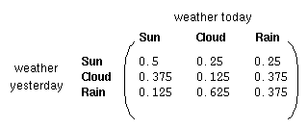
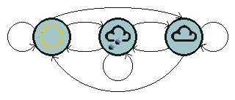
Markov Chains
Rain
Sunny
Cloudy
State transition matrix : The probability of
the weather given the previous day's weather.
States : Three states - sunny, cloudy, rainy.
Initial Distribution : Defining the probability of the system being in each of the states at time 0.

Slide 4
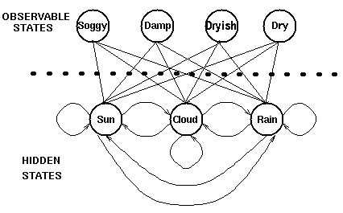
Hidden Markov Models
Emission probabilities
Transition probabilities
Hidden states : the (TRUE) states of a system that may be described by a Markov process (e.g., the weather).
Observable states : the states of the process that are `visible' (e.g., seaweed dampness).

Slide 5
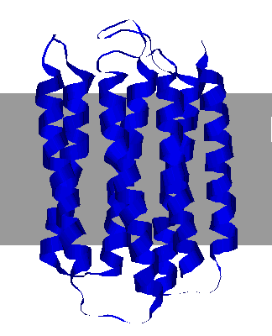
TMHMM (trans-membrane HMM) (Sonnhammer, von Heijne, and Krogh)
Extra cellular
Trans membrane
Intra cellular

Slide 6
TMHMM (trans-membrane HMM) (Sonnhammer, von Heijne, and Krogh)
Model TM length distribution.
Power of HMM.
Difficult in alignment.
ALLYVDWQILPVIL

Slide 7
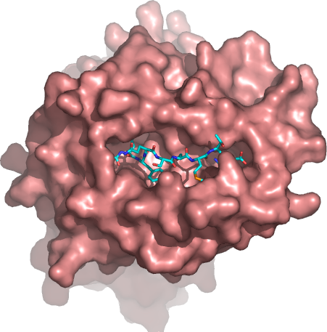
Weight matrix construction
SLLPAIVEL YLLPAIVHI TLWVDPYEV GLVPFLVSV KLLEPVLLL LLDVPTAAV LLDVPTAAV LLDVPTAAV
LLDVPTAAV VLFRGGPRG MVDGTLLLL YMNGTMSQV MLLSVPLLL SLLGLLVEV ALLPPINIL TLIKIQHTL
HLIDYLVTS ILAPPVVKL ALFPQLVIL GILGFVFTL STNRQSGRQ GLDVLTAKV RILGAVAKV QVCERIPTI
ILFGHENRV ILMEHIHKL ILDQKINEV SLAGGIIGV LLIENVASL FLLWATAEA SLPDFGISY KKREEAPSL
LERPGGNEI ALSNLEVKL ALNELLQHV DLERKVESL FLGENISNF ALSDHHIYL GLSEFTEYL STAPPAHGV
PLDGEYFTL GVLVGVALI RTLDKVLEV HLSTAFARV RLDSYVRSL YMNGTMSQV GILGFVFTL ILKEPVHGV
ILGFVFTLT LLFGYPVYV GLSPTVWLS WLSLLVPFV FLPSDFFPS CLGGLLTMV FIAGNSAYE KLGEFYNQM
KLVALGINA DLMGYIPLV RLVTLKDIV MLLAVLYCL AAGIGILTV YLEPGPVTA LLDGTATLR ITDQVPFSV
KTWGQYWQV TITDQVPFS AFHHVAREL YLNKIQNSL MMRKLAILS AIMDKNIIL IMDKNIILK SMVGNWAKV
SLLAPGAKQ KIFGSLAFL ELVSEFSRM KLTPLCVTL VLYRYGSFS YIGEVLVSV CINGVCWTV VMNILLQYV
ILTVILGVL KVLEYVIKV FLWGPRALV GLSRYVARL FLLTRILTI HLGNVKYLV GIAGGLALL GLQDCTMLV
TGAPVTYST VIYQYMDDL VLPDVFIRC VLPDVFIRC AVGIGIAVV LVVLGLLAV ALGLGLLPV GIGIGVLAA
GAGIGVAVL IAGIGILAI LIVIGILIL LAGIGLIAA VDGIGILTI GAGIGVLTA AAGIGIIQI QAGIGILLA
KARDPHSGH KACDPHSGH ACDPHSGHF SLYNTVATL RGPGRAFVT NLVPMVATV GLHCYEQLV PLKQHFQIV
AVFDRKSDA LLDFVRFMG VLVKSPNHV GLAPPQHLI LLGRNSFEV PLTFGWCYK VLEWRFDSR TLNAWVKVV
GLCTLVAML FIDSYICQV IISAVVGIL VMAGVGSPY LLWTLVVLL SVRDRLARL LLMDCSGSI CLTSTVQLV
VLHDDLLEA LMWITQCFL SLLMWITQC QLSLLMWIT LLGATCMFV RLTRFLSRV YMDGTMSQV FLTPKKLQC
ISNDVCAQV VKTDGNPPE SVYDFFVWL FLYGALLLA VLFSSDFRI LMWAKIGPV SLLLELEEV SLSRFSWGA
YTAFTIPSI RLMKQDFSV RLPRIFCSC FLWGPRAYA RLLQETELV SLFEGIDFY SLDQSVVEL RLNMFTPYI
NMFTPYIGV LMIIPLINV TLFIGSHVV SLVIVTTFV VLQWASLAV ILAKFLHWL STAPPHVNV LLLLTVLTV
VVLGVVFGI ILHNGAYSL MIMVKCWMI MLGTHTMEV MLGTHTMEV SLADTNSLA LLWAARPRL GVALQTMKQ
GLYDGMEHL KMVELVHFL YLQLVFGIE MLMAQEALA LMAQEALAF VYDGREHTV YLSGANLNL RMFPNAPYL
EAAGIGILT TLDSQVMSL STPPPGTRV KVAELVHFL IMIGVLVGV ALCRWGLLL LLFAGVQCQ VLLCESTAV
YLSTAFARV YLLEMLWRL SLDDYNHLV RTLDKVLEV GLPVEYLQV KLIANNTRV FIYAGSLSA KLVANNTRL
FLDEFMEGV ALQPGTALL VLDGLDVLL SLYSFPEPE ALYVDSLFF SLLQHLIGL ELTLGEFLK MINAYLDKL
AAGIGILTV FLPSDFFPS SVRDRLARL SLREWLLRI LLSAWILTA AAGIGILTV AVPDEIPPL FAYDGKDYI
AAGIGILTV FLPSDFFPS AAGIGILTV FLPSDFFPS AAGIGILTV FLWGPRALV ETVSEQSNV ITLWQRPLV

Slide 8
PSSM construction
Calculate amino acid frequencies at each position using
Sequence weighting
Pseudo counts
Define background model
Use background amino acids frequencies
PSSM is

Slide 9
More on scoring
Probability of observation given Model
Probability of observation given Prior (background)

Slide 10
Hidden Markov Models
Weight matrices do not deal with insertions and deletions
In alignments, this is done in an ad-hoc manner by optimization of the two gap penalties for first gap and gap extension
HMM is a natural framework where insertions/deletions are dealt with explicitly

Slide 11
Multiple sequence alignment Learning from evolution
QUERY HAMDIRCYHSGG-PLHL-GEI-EDFNGQSCIVCPWHKYKITLATGE--GLYQSINPKDPS
Q8K2P6 HAMDIRCYHSGG-PLHL-GEI-EDFNGQSCIVCPWHKYKITLATGE--GLYQSINPKDPS
Q8TAC1 HAMDIRCYHSGG-PLHL-GDI-EDFDGRPCIVCPWHKYKITLATGE--GLYQSINPKDPS
Q07947 FAVQDTCTHGDW-ALSE-GYL-DGD----VVECTLHFGKFCVRTGK--VKAL------PA
P0A185 YATDNLCTHGSA-RMSD-GYL-EGRE----IECPLHQGRFDVCTGK--ALC------APV
P0A186 YATDNLCTHGSA-RMSD-GYL-EGRE----IECPLHQGRFDVCTGK--ALC------APV
Q51493 YATDNLCTHGAA-RMSD-GFL-EGRE----IECPLHQGRFDVCTGR--ALC------APV
A5W4F0 FAVQDTCTHGDW-ALSD-GYL-DGD----IVECTLHFGKFCVRTGK--VKAL------PA
P0C620 FAVQDTCTHGDW-ALSD-GYL-DGD----IVECTLHFGKFCVRTGK--VKAL------PA
P08086 FAVQDTCTHGDW-ALSD-GYL-DGD----IVECTLHFGKFCVRTGK--VKAL------PA
Q52440 FATQDQCTHGEW-SLSE-GGY-LDGD---VVECSLHMGKFCVRTGK-------------V
Q7N4V8 FAVDDRCSHGNA-SISE-GYL-ED---NATVECPLHTASFCLRTGK--ALCL------PA
P37332 FATQDRCTHGDW-SLSDGGYL-EGD----VVECSLHMGKFCVRTGK-------------V
A7ZPY3 YAINDRCSHGNA-SMSE-GYL-EDD---ATVECPLHAASFCLKTGK--ALCL------PA
P0ABW1 YAINDRCSHGNA-SMSE-GYL-EDD---ATVECPLHAASFCLKTGK--ALCL------PA
A8A346 YAINDRCSHGNA-SMSE-GYL-EDD---ATVECPLHAASFCLKTGK--ALCL------PA
P0ABW0 YAINDRCSHGNA-SMSE-GYL-EDD---ATVECPLHAASFCLKTGK--ALCL------PA
P0ABW2 YAINDRCSHGNA-SMSE-GYL-EDD---ATVECPLHAASFCLKTGK--ALCL------PA
Q3YZ13 YAINDRCSHGNA-SMSE-GYL-EDD---ATVECPLHAASFCLKTGK--ALCL------PA
Q06458 YALDNLEPGSEANVLSR-GLL-GDAGGEPIVISPLYKQRIRLRDG---------------
Core
Insertion
Deletion

Slide 12
What is hidden?
The unfair casino: Loaded die p(6) = 0.5; switch fair to load:0.05; switch load to fair: 0.1
Model generates numbers
312453666641
Does not tell which die was used
Alignment (decoding) can give the most probable solution/path (Viterbi)
FFFFFFLLLLLL
Or most probable set of states
FFFFFFLLLLLL
0.95
0.9
1:1/6
2:1/6
3:1/6
4:1/6
5:1/6
6:1/6
1:1/10
2:1/10
3:1/10
4:1/10
5:1/10
6:1/2
0.05
0.10
Fair
Loaded

Slide 13
HMM (a simple example)
Example from A. Krogh
Core region defines the number of states in the HMM (red)
Insertion and deletion statistics are derived from the non-core part of the alignment (black)
ACA---ATG
TCAACTATC
ACAC--AGC
AGA---ATC
ACCG--ATC
Core of alignment

Slide 14
HMM construction (supervised learning)
5 matches. A, 2xC, T, G
5 transitions in gap region
C out, G out
A-C, C-T, T out
Out transition 3/5
Stay transition 2/5
ACA---ATG
TCAACTATC
ACAC--AGC
AGA---ATC
ACCG--ATC
.4
A
C
G
T
.2
.4
.2
.2
.6
.6
A
C
G
T
.8
A
C
G
T
1.
A
C
G
T
.8
A
C
G
T
1
A
C
G
T
1.
A
C
G
T
1.
.8
.2
.4
1.
.8
.2
.2
.2
.2
.8
ACA---ATG 0.8x1x0.8x1x0.8x0.4x1x1x0.8x1x0.2 = 3.3x10⁻²

Slide 15
Scoring a sequence to an HMM
ACA---ATG 0.8x1x0.8x1x0.8x0.4x1x0.8x1x0.2 = 3.3x10⁻²
TCAACTATC 0.2x1x0.8x1x0.8x0.6x0.2x0.4x0.4x0.4x0.2x0.6x1x1x0.8x1x0.8 = 0.0075x10⁻²
ACAC--AGC = 1.2x10⁻²
Consensus:
ACAC--ATC = 4.7x10⁻², ACA---ATC = 13.1x10⁻²
Exceptional:
TGCT--AGG = 0.0023x10⁻²

Slide 16
Align sequence to HMM - Null model
Score depends strongly on length
Null model is a random model. For length L the score is 0.25^{L}
Log-odds score for sequence S
Log( P(S)/0.25^{L})
Positive score means more likely than Null model
This is just like we did for PSSM log(p/q)!
ACA---ATG = 4.9
TCAACTATC = 3.0
ACAC--AGC = 5.3
AGA---ATC = 4.9
ACCG--ATC = 4.6
Consensus:
ACAC--ATC = 6.7
ACA---ATC = 6.3
Exceptional:
TGCT--AGG = -0.97
ACA---ATG = 3.3x10⁻²
TCAACTATC = 0.0075x10⁻²
ACAC--AGC = 1.2x10⁻²
ACAC--ATC = 4.7x10⁻²
Consensus
ACA---ATC = 13.1x10⁻²
Exception
TGCT--AGG = 0.0023x10⁻²
Note!

Slide 17
Aligning a sequence to an HMM
Find the path through the HMM states that has the highest probability
For alignments, we found the path through the scoring matrix that had the highest sum of scores
The number of possible paths rapidly gets very large making brute force search infeasible
Just like checking all path for alignment did not work
Use dynamic programming
The Viterbi algorithm does the job

Slide 18
The Viterbi algorithm
The unfair casino: Loaded dice p(6) = 0.5; switch fair to load:0.05; switch load to fair: 0.1
Model generates numbers
312453666641
0.95
0.9
1:1/6
2:1/6
3:1/6
4:1/6
5:1/6
6:1/6
1:1/10
2:1/10
3:1/10
4:1/10
5:1/10
6:1/2
0.05
0.10
Fair
Loaded

Slide 19
Model decoding (Viterbi)
Example: 566. What was the most likely series of dice used to generate this output?
Use Brute force
0.95
0.9
1:1/6
2:1/6
3:1/6
4:1/6
5:1/6
6:1/6
1:1/10
2:1/10
3:1/10
4:1/10
5:1/10
6:1/2
0.05
0.10
Fair
Loaded
FFF = 0.5*0.167*0.95*0.167*0.95*0.167 = 0.0021
FFL = 0.5*0.167*0.95*0.167*0.05*0.5 = 0.00333
FLF = 0.5*0.167*0.05*0.5*0.1*0.167 = 0.000035
FLL = 0.5*0.167*0.05*0.5*0.9*0.5 = 0.00094
LFF = 0.5*0.1*0.1*0.167*0.95*0.167 = 0.00013
LFL = 0.5*0.1*0.1*0.167*0.05*0.5 = 0.000021
LLF = 0.5*0.1*0.9*0.5*0.1*0.167 = 0.00038
LLL = 0.5*0.1*0.9*0.5*0.9*0.5 = 0.0101

Slide 20
Or in log space
Example: 566. What was the most likely series of dice used to generate this output?
Log model
-0.02
-0.046
1:-0.78
2:-0.78
3:-0.78
4:-0.78
5:-0.78
6:-0.78
1:-1
2:-1
3:-1
4:-1
5:-1
6:-0.3
-1.3
-1
Fair
Loaded
Log(P(LLL|M)) = log(0.5*0.1*0.9*0.5*0.9*0.5) = log(0.0101)
or
Log(P(LLL|M)) = log(0.5)+log(0.1)+log(0.9)+log(0.5)+log(0.9)+log(0.5)
= -0.3 -1 -0.046 -0.3 -0.046 -0.3 = -1.99

Slide 21
Model decoding (Viterbi)
Example: 566611234. What was the most likely series of dice used to generate this output?
Pick the fair die at random
Log model
Make a 5 with the fair die
-0.02
-0.046
1:-0.78
2:-0.78
3:-0.78
4:-0.78
5:-0.78
6:-0.78
1:-1
2:-1
3:-1
4:-1
5:-1
6:-0.3
F = 0.5*0.167
log(F) = log(0.5) + log(0.167) = -1.08
L = 0.5*0.1
log(L) = log(0.5) + log(0.1) = -1.30
-1.3
-1
Fair
Loaded
 | 5 | 6 | 6 | 6 | 1 | 1 | 2 | 3 | 4
F | -1.08
L | -1.30

Slide 22
Model decoding (Viterbi)
Example: 566611234. What was the most likely series of dice used to generate this output?
FF = 0.5*0.167*0.95*0.167
Log(FF) = -0.30 -0.78 – 0.02 -0.78 = -1.88
LF = 0.5*0.1*0.1*0.167
Log(LF) = -0.30 -1 -1 -0.78 = -3.08
FL = 0.5*0.167*0.05*0.5
Log(FL) = -0.30 -0.78 – 1.30 -0.30 = -2.68
LL = 0.5*0.1*0.9*0.5
Log(LL) = -0.30 -1 -0.046 -0.3 = -1.65
Log model
-0.02
-0.046
1:-0.78
2:-0.78
3:-0.78
4:-0.78
5:-0.78
6:-0.78
1:-1
2:-1
3:-1
4:-1
5:-1
6:-0.3
-1.3
-1
Fair
Loaded
 | 5 | 6 | 6 | 6 | 1 | 1 | 2 | 3 | 4
F | -1.08
L | -1.30

Slide 23
Model decoding (Viterbi)
Example: 566611234. What was the most likely series of dice used to generate this output?
FF = 0.5*0.167*0.95*0.167
Log(FF) = -0.30 -0.78 – 0.02 -0.78 = -1.88
LF = 0.5*0.1*0.1*0.167
Log(LF) = -0.30 -1 -1 -0.78 = -3.08
FL = 0.5*0.167*0.05*0.5
Log(FL) = -0.30 -0.78 – 1.30 -0.30 = -2.68
LL = 0.5*0.1*0.9*0.5
Log(LL) = -0.30 -1 -0.046 -0.3 = -1.65
Log model
-0.02
-0.046
1:-0.78
2:-0.78
3:-0.78
4:-0.78
5:-0.78
6:-0.78
1:-1
2:-1
3:-1
4:-1
5:-1
6:-0.3
-1.3
-1
Fair
Loaded
 | 5 | 6 | 6 | 6 | 1 | 1 | 2 | 3 | 4
F | -1.08 | -1.88
L | -1.30 | -1.65

Slide 24
Model decoding (Viterbi)
Example: 566611234. What was the most likely series of dice used to generate this output?
Log model
FFF = 0.5*0.167*0.95*0.167*0.95*0.167 = 0.0021
FLF = 0.5*0.167*0.05*0.5*0.1*0.167 = 0.000035
LFF = 0.5*0.1*0.1*0.167*0.95*0.167 = 0.00013
LLF = 0.5*0.1*0.9*0.5*0.1*0.167 = 0.00038
FLL = 0.5*0.167*0.05*0.5*0.9*0.5 = 0.00094
FFL = 0.5*0.167*0.95*0.167*0.05*0.5 = 0.00333
LFL = 0.5*0.1*0.1*0.167*0.05*0.5 = 0.000021
LLL = 0.5*0.1*0.9*0.5*0.9*0.5 = 0.0101
-0.02
-0.046
1:-0.78
2:-0.78
3:-0.78
4:-0.78
5:-0.78
6:-0.78
1:-1
2:-1
3:-1
4:-1
5:-1
6:-0.3
-1.3
-1
Fair
Loaded
 | 5 | 6 | 6 | 6 | 1 | 1 | 2 | 3 | 4
F | -1.08 | -1.88
L | -1.30 | -1.65

Slide 25
Model decoding (Viterbi)
Example: 566611234. What was the most likely series of dice used to generate this output?
Log model
-0.02
-0.046
1:-0.78
2:-0.78
3:-0.78
4:-0.78
5:-0.78
6:-0.78
1:-1
2:-1
3:-1
4:-1
5:-1
6:-0.3
FFF = 0.5*0.167*0.95*0.167*0.95*0.167 = 0.0021
Log(P(FFF))=-2.68
LLL = 0.5*0.1*0.9*0.5*0.9*0.5 = 0.0101
Log(P(LLL))=-1.99
-1.3
-1
Fair
Loaded
 | 5 | 6 | 6 | 6 | 1 | 1 | 2 | 3 | 4
F | -1.08 | -1.88 | -2.68
L | -1.30 | -1.65 | -1.99

Slide 26
Model decoding (Viterbi)
Example: 566611234. What was the most likely series of dice used to generate this output?
Log model
-0.02
-0.046
1:-0.78
2:-0.78
3:-0.78
4:-0.78
5:-0.78
6:-0.78
1:-1
2:-1
3:-1
4:-1
5:-1
6:-0.3
-1.3
-1
Fair
Loaded
 | 5 | 6 | 6 | 6 | 1 | 1 | 2 | 3 | 4
F | -1.08 | -1.88 | -2.68
L | -1.30 | -1.65 | -1.99

Slide 27
Model decoding (Viterbi)
Example: 566611234. What was the most likely series of dice used to generate this output?
Log model
-0.02
-0.046
1:-0.78
2:-0.78
3:-0.78
4:-0.78
5:-0.78
6:-0.78
1:-1
2:-1
3:-1
4:-1
5:-1
6:-0.3
-1.3
-1
Fair
Loaded
 | 5 | 6 | 6 | 6 | 1 | 1 | 2 | 3 | 4
F | -1.08 | -1.88 | -2.68
L | -1.30 | -1.65 | -1.99

Slide 28
Model decoding (Viterbi)
Example: 566611234. What was the most likely series of dice used to generate this output?
Log model
-0.02
-0.046
1:-0.78
2:-0.78
3:-0.78
4:-0.78
5:-0.78
6:-0.78
1:-1
2:-1
3:-1
4:-1
5:-1
6:-0.3
-1.3
-1
Fair
Loaded
 | 5 | 6 | 6 | 6 | 1 | 1 | 2 | 3 | 4
F | -1.08 | -1.88 | -2.68 | -3.48
L | -1.30 | -1.65 | -1.99

Slide 29
Model decoding (Viterbi)
Now we can formalize the algorithm!
Log model
-0.02
-0.046
1:-0.78
2:-0.78
3:-0.78
4:-0.78
5:-0.78
6:-0.78
1:-1
2:-1
3:-1
4:-1
5:-1
6:-0.3
-1.3
-1
Fair
Loaded
New match
Old max score
for being in state k
after having made i
Transition
from k to l

Slide 30
Model decoding (Viterbi)
Example: 566611234. What was the most likely series of dice used to generate this output?
Log model
Initialization
-0.02
-0.046
1:-0.78
2:-0.78
3:-0.78
4:-0.78
5:-0.78
6:-0.78
1:-1
2:-1
3:-1
4:-1
5:-1
6:-0.3
F = 0.5*0.167
log(F) = log(0.5) + log(0.167) = -1.08
L = 0.5*0.1
log(L) = log(0.5) + log(0.1) = -1.30
-1.3
-1
Fair
Loaded
 | 5 | 6 | 6 | 6 | 1 | 1 | 2 | 3 | 4
F | -1.08
L | -1.30

Slide 31
Model decoding (Viterbi). Can you do it?
Example: 566611234. What was the mots likely series of dice used to generate this output?
Fill out the table using the Viterbi recursive algorithm
Add the arrows for backtracking
Find the optimal path
Log model
-0.02
-0.046
1:-0.78
2:-0.78
3:-0.78
4:-0.78
5:-0.78
6:-0-78
1:-1
2:-1
3:-1
4:-1
5:-1
6:-0.3
-1.3
-1
Fair
Loaded
 | 5 | 6 | 6 | 6 | 1 | 1 | 2 | 3 | 4
F | -1.08 | -1.88 | -2.68 | -3.48
L | -1.30 | -1.65 | -1.99
Notes:
Make this shorter!

Slide 32
Model decoding (Viterbi). Can you do it?
Example: 566611234. What was the most likely series of dice used to generate this output?
Fill out the table using the Viterbi recursive algorithm
Add the arrows for backtracking
Find the optimal path
Log model
-0.02
-0.046
1:-0.78
2:-0.78
3:-0.78
4:-0.78
5:-0.78
6:-0-78
1:-1
2:-1
3:-1
4:-1
5:-1
6:-0.3
-1.3
-1
Fair
Loaded
 | 5 | 6 | 6 | 6 | 1 | 1 | 2 | 3 | 4
F | -1.08 | -1.88 | -2.68 | -3.48 |  | -4.92 |  | -6.52
L | -1.30 | -1.65 | -1.99 |  | -3.39 |  |  | -6.53

Slide 33
Model decoding (Viterbi). Can you do it?

Slide 34
Model decoding (Viterbi). Can you do it?
Example: 566611234. What was the most lilely series of dice used to generate this output?
Fill out the table using the Viterbi recursive algorithm
Add the arrows for backtracking
Find the optimal path
Log model
-0.02
-0.046
1:-0.78
2:-0.78
3:-0.78
4:-0.78
5:-0.78
6:-0-78
1:-1
2:-1
3:-1
4:-1
5:-1
6:-0.3
-1.3
-1
Fair
Loaded
 | 5 | 6 | 6 | 6 | 1 | 1 | 2 | 3 | 4
F | -1.08 | -1.88 | -2.68 | -3.48 | -4.12 | -4.92 | -5.72 | -6.52 | -7.33
L | -1.30 | -1.65 | -1.99 | -2.34 | -3.39 | -4.44 | -5.49 | -6.53 | -7.57

Slide 35
Model decoding (Viterbi). Can you do it?
Example: 566611234. What was the most likely series of dice used to generate this output?
The most likely path is
LLLLFFFFF
Log model
-0.02
-0.046
1:-0.78
2:-0.78
3:-0.78
4:-0.78
5:-0.78
6:-0-78
1:-1
2:-1
3:-1
4:-1
5:-1
6:-0.3
-1.3
-1
Fair
Loaded
 | 5 | 6 | 6 | 6 | 1 | 1 | 2 | 3 | 4
F | -1.08 | -1.88 | -2.68 | -3.48 | -4.12 | -4.92 | -5.72 | -6.52 | -7.33
L | -1.30 | -1.65 | -1.99 | -2.34 | -3.39 | -4.44 | -5.49 | -6.53 | -7.57

Slide 36
Model decoding (Viterbi).
What happens if you have three dice?
 | 5 | 6 | 6 | 6 | 1 | 1 | 2 | 3 | 4
F | -1.0
L1 | -1.2
L2 | -1.3

Slide 37
And if you have a trans-membrane model
What is the most likely path (alignment) of a protein sequence to the model
 | D | G | V | L | I | M | A | D | Q
iC | -1.0
M | -1.2
xC | -1.3

Slide 38
The Forward algorithm
The Viterbi algorithm finds the most probable path giving rise to a given sequence
One other interesting question would be
What is the probability that a given sequence can be generated by the hidden Markov model
Calculated by summing over all path giving rise to a given sequence

Slide 39
The Forward algorithm
Calculate summed probability over all path giving rise to a given sequence
The number of possible paths is very large making (once more) brute force calculations infeasible
Use dynamic (recursive) programming

Slide 40
The Forward algorithm
Say we know the probability of generating the sequence up to and including x_{i} ending in state k
Then the probability of observing the element i+1 of x ending in state l is
where p_{l}(x_{i+1}) is the probability of observing x_{i+1} is state l, and a_{kl} is the transition probability from state k to state l
Then

Slide 41
Forward algorithm
0.95
0.9
1:1/6
2:1/6
3:1/6
4:1/6
5:1/6
6:1/6
1:1/10
2:1/10
3:1/10
4:1/10
5:1/10
6:1/2
0.05
Initialization
0.10
Fair
Loaded
 | 5 | 6 | 6 | 6 | 1 | 1 | 2 | 3 | 4
F
L

Slide 42
Forward algorithm
0.95
0.9
1:1/6
2:1/6
3:1/6
4:1/6
5:1/6
6:1/6
1:1/10
2:1/10
3:1/10
4:1/10
5:1/10
6:1/2
0.05
0.10
Fair
Loaded
 | 5 | 6 | 6 | 6 | 1 | 1 | 2 | 3 | 4
F | 8.3e-2
L | 5e-2

Slide 43
Forward algorithm
0.95
0.9
1:1/6
2:1/6
3:1/6
4:1/6
5:1/6
6:1/6
1:1/10
2:1/10
3:1/10
4:1/10
5:1/10
6:1/2
0.05
0.10
Fair
Loaded
 | 5 | 6 | 6 | 6 | 1 | 1 | 2 | 3 | 4
F | 8.3e-2
L | 5e-2

Slide 44
Forward algorithm
0.95
0.9
1:1/6
2:1/6
3:1/6
4:1/6
5:1/6
6:1/6
1:1/10
2:1/10
3:1/10
4:1/10
5:1/10
6:1/2
0.05
0.10
Fair
Loaded
 | 5 | 6 | 6 | 6 | 1 | 1 | 2 | 3 | 4
F | 0.083
L | 0.05

Slide 45
Forward algorithm
0.95
0.9
1:1/6
2:1/6
3:1/6
4:1/6
5:1/6
6:1/6
1:1/10
2:1/10
3:1/10
4:1/10
5:1/10
6:1/2
0.05
0.10
Fair
Loaded
 | 5 | 6 | 6 | 6 | 1 | 1 | 2 | 3 | 4
F | 0.083 | 0.014
L | 0.05

Slide 46
Forward algorithm. Can you do it yourself?
0.95
0.9
1:1/6
2:1/6
3:1/6
4:1/6
5:1/6
6:1/6
1:1/10
2:1/10
3:1/10
4:1/10
5:1/10
6:1/2
0.05
Fill out the empty cells in the
table!
What is P(x)?
0.10
Fair
Loaded
 | 5 | 6 | 6 | 6 | 1 | 1 | 2 | 3 | 4
F | 8.30e-2 |  | 2.63e-3 | 6.08e-4 | 1.82e-4 | 3.66e-5 |  | 1.09e-6 | 1.79e-7
L | 5.00e-2 | 2.46e-2 | 1.14e-2 |  | 4.71e-4 | 4.33e-5 |  | 4.00e-7 | 4.14e-8

Slide 47
Forward algorithm. Can you do it yourself?

Slide 48
Forward algorithm
0.95
0.9
1:1/6
2:1/6
3:1/6
4:1/6
5:1/6
6:1/6
1:1/10
2:1/10
3:1/10
4:1/10
5:1/10
6:1/2
0.05
0.10
Fair
Loaded
 | 5 | 6 | 6 | 6 | 1 | 1 | 2 | 3 | 4
F | 8.30e-2 | 1.40e-2 | 2.63e-3 | 6.08e-4 | 1.82e-4 | 3.66e-5 | 6.48e-6 | 1.09e-6 | 1.79e-7
L | 5.00e-2 | 2.46e-2 | 1.14e-2 | 5.20e-3 | 4.71e-4 | 4.33e-5 | 4.08e-6 | 4.00e-7 | 4.14e-8

Slide 49
The Posterior decoding (Backward algorithm)
One other interesting question would be
What is the probability that an observation x_{i} came from a state k given the observed sequence x

Slide 50
The Backward algorithm
The probability of generation the sequence up to and including x_{i} ending in state k
Forward algorithm!
The probability of generation the rest of the sequence starting from state k
Backward algorithm!
 | 5 | 6 | 6 | 6 | 1 | 1 | 2 | 3 | 4
F |  |  |  | ?
L

Slide 51
The Backward algorithm
Forward algorithm
Backward algorithm
Forward-Backward
algorithm

Slide 52
Backward algorithm
0.95
0.9
1:1/6
2:1/6
3:1/6
4:1/6
5:1/6
6:1/6
1:1/10
2:1/10
3:1/10
4:1/10
5:1/10
6:1/2
0.05
0.10
Fair
Loaded
 | 5 | 6 | 6 | 6 | 1 | 1 | 2 | 3 | 4
F |  |  |  |  |  |  |  | 0.163 | 1
L |  |  |  |  |  |  |  | 0.107 | 1

Slide 53
Backward algorithm
0.95
0.9
1:1/6
2:1/6
3:1/6
4:1/6
5:1/6
6:1/6
1:1/10
2:1/10
3:1/10
4:1/10
5:1/10
6:1/2
0.05
0.10
Fair
Loaded
 | 5 | 6 | 6 | 6 | 1 | 1 | 2 | 3 | 4
F | 6.83e-7 | 3.18e-6 | 1.76e-5 | 1.07e-4 | 6.69e-5 | 4.19e-3 | 2.61e-2 | 0.163 | 1
L | 3.27e-6 | 7.14e-6 | 1.52e-5 | 2.98e-5 | 2.08e-4 | 1.54e-3 | 1.23e-2 | 0.107 | 1

Slide 54
Backward algorithm
Note that the sum of first column of the backward matric is NOT equal to the sum of the last column of the forward matrix
This is because the first column of the backward matrix gives the probability values of generating the sequence AFTER having generated the first observation
You hence cannot get the P(x) value directly from the backward matrix

Slide 55
Posterior decoding
What is the posterior probability that observation x_{i} came from state k given the observed sequence X?
or
What is the probability that a given amino acid is part of the trans-membrane helix given the protein sequence is X?

Slide 56
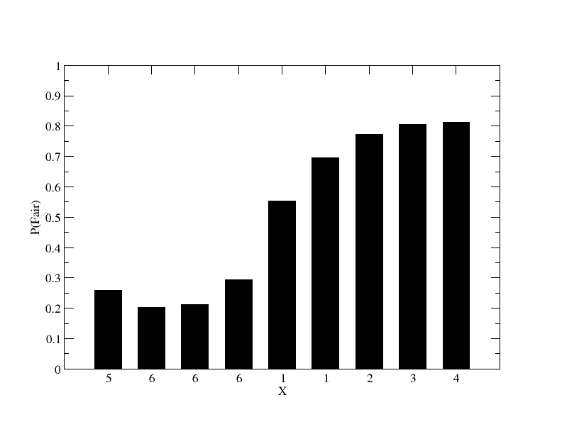
Posterior decoding
What is the posterior probability that observation x_{i} came from state k given the observed sequence X.

Slide 57
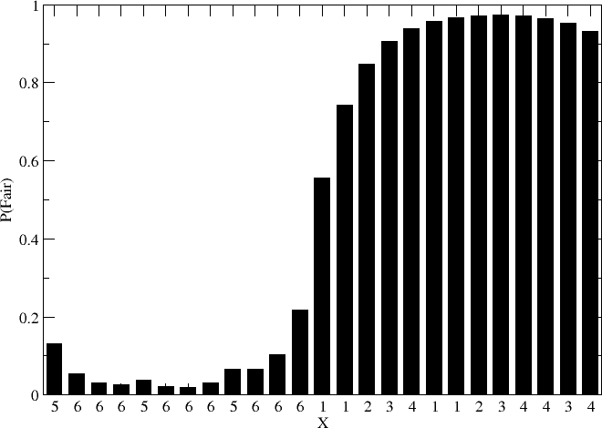
Posterior decoding
The probability is context dependent

Slide 58
Training of HMM
Supervised training
If each symbol is assigned to one state, all parameters can be found by simply counting number of emissions and transitions as we did for the DNA model
Un-supervised training
We do not know to which state each symbol is assigned so another approach is needed
Find emission and transition parameters that most likely produces the observed data
Baum-Welsh does this

Slide 59
Supervised learning
5 matches. A, 2xC, T, G
5 transitions in gap region
C out, G out
A-C, C-T, T out
Out transition 3/5
Stay transition 2/5
ACA---ATG
TCAACTATC
ACAC--AGC
AGA---ATC
ACCG--ATC
.4
A
C
G
T
.2
.4
.2
.2
.6
.6
A
C
G
T
.8
A
C
G
T
1.
A
C
G
T
.8
A
C
G
T
1
A
C
G
T
1.
A
C
G
T
1.
.8
.2
.4
1.
.8
.2
.2
.2
.2
.8
ACA---ATG 0.8x1x0.8x1x0.8x0.4x1x1x0.8x1x0.2 = 3.3x10⁻²

Slide 60
Un-supervised learning
312453666641456667543
5666663331234
a11
a22
1:e11
2:e12
3:e13
4:e14
5:e15
6:e16
1:e21
2:e22
3:e23
4:e24
5:e25
6:e26
Can we find the model parameters that optimizes the probability of observing these sequences?
a12
a21
Fair
Loaded

Slide 61
Baum-Welsh
The probability of being in state k at time i, and state l at time i + 1, given the model and the observation sequence is
The probability of being in state k at time i, given the observation sequence O is
Note

Slide 62
Baum-Welsh
Now
is the expected number of times that state k is visited, or the expected number of transitions made from state k (given the observed sequence), and
is the expected number of transitions from state k to state l (given the observed sequence)

Slide 63
Baum-Welsh
Now
Estimate probability of transition between state k and l
and
Estimate probability emitting symbol a in state k

Slide 64
Baum-Welsh
Use these relations
To update a, and e, and iterate until convergence

Slide 65
HMM’s and weight matrices
In the case of un-gapped alignments HMM’s become simple weight-matrices
To achieve high performance, the emission frequencies are estimated using the techniques of
Sequence weighting
Pseudo counts

Slide 66
Profile HMM’s
Alignments based on conventional scoring matrices (BLOSUM62) scores all positions in a sequence in an equal manner
Some positions are highly conserved, some are highly variable (more than what is described in the BLOSUM matrix)
Profile HMM’s are ideal suited to describe such position specific variations

Slide 67
Sequence profiles
Insertion
Conserved
deletion
Non-conserved
ADDGSLAFVPSEF--SISPGEKIVFKNNAGFPHNIVFDEDSIPSGVDASKISMSEEDLLN
TVNGAI--PGPLIAERLKEGQNVRVTNTLDEDTSIHWHGLLVPFGMDGVPGVSFPG---I
-TSMAPAFGVQEFYRTVKQGDEVTVTIT-----NIDQIED-VSHGFVVVNHGVSME---I
IE--KMKYLTPEVFYTIKAGETVYWVNGEVMPHNVAFKKGIV--GEDAFRGEMMTKD---
-TSVAPSFSQPSF-LTVKEGDEVTVIVTNLDE------IDDLTHGFTMGNHGVAME---V
ASAETMVFEPDFLVLEIGPGDRVRFVPTHK-SHNAATIDGMVPEGVEGFKSRINDE----
TVNGQ--FPGPRLAGVAREGDQVLVKVVNHVAENITIHWHGVQLGTGWADGPAYVTQCPI
TVNGQ--FPGPRLAGVAREGDQVLVKVVNHVAENITIHWHGVQLGTGWADGPAYVTQCPI
TKAVVLTFNTSVEICLVMQGTSIV----AAESHPLHLHGFNFPSNFNLVDPMERNTAGVP
Matching any thing but G => large negative score
Any thing can match

Slide 68
HMM vs. alignment
Detailed description of core
Conserved/variable positions
Price for insertions/deletions varies at different locations in sequence
These features cannot be captured in conventional alignments

Slide 69
Profile HMM’s
All P/D pairs must be visited once
L₁- Y₂A₃V₄R₅- I₆
P₁D₂P₃P₄I₄P₅D₆P₇

Slide 70
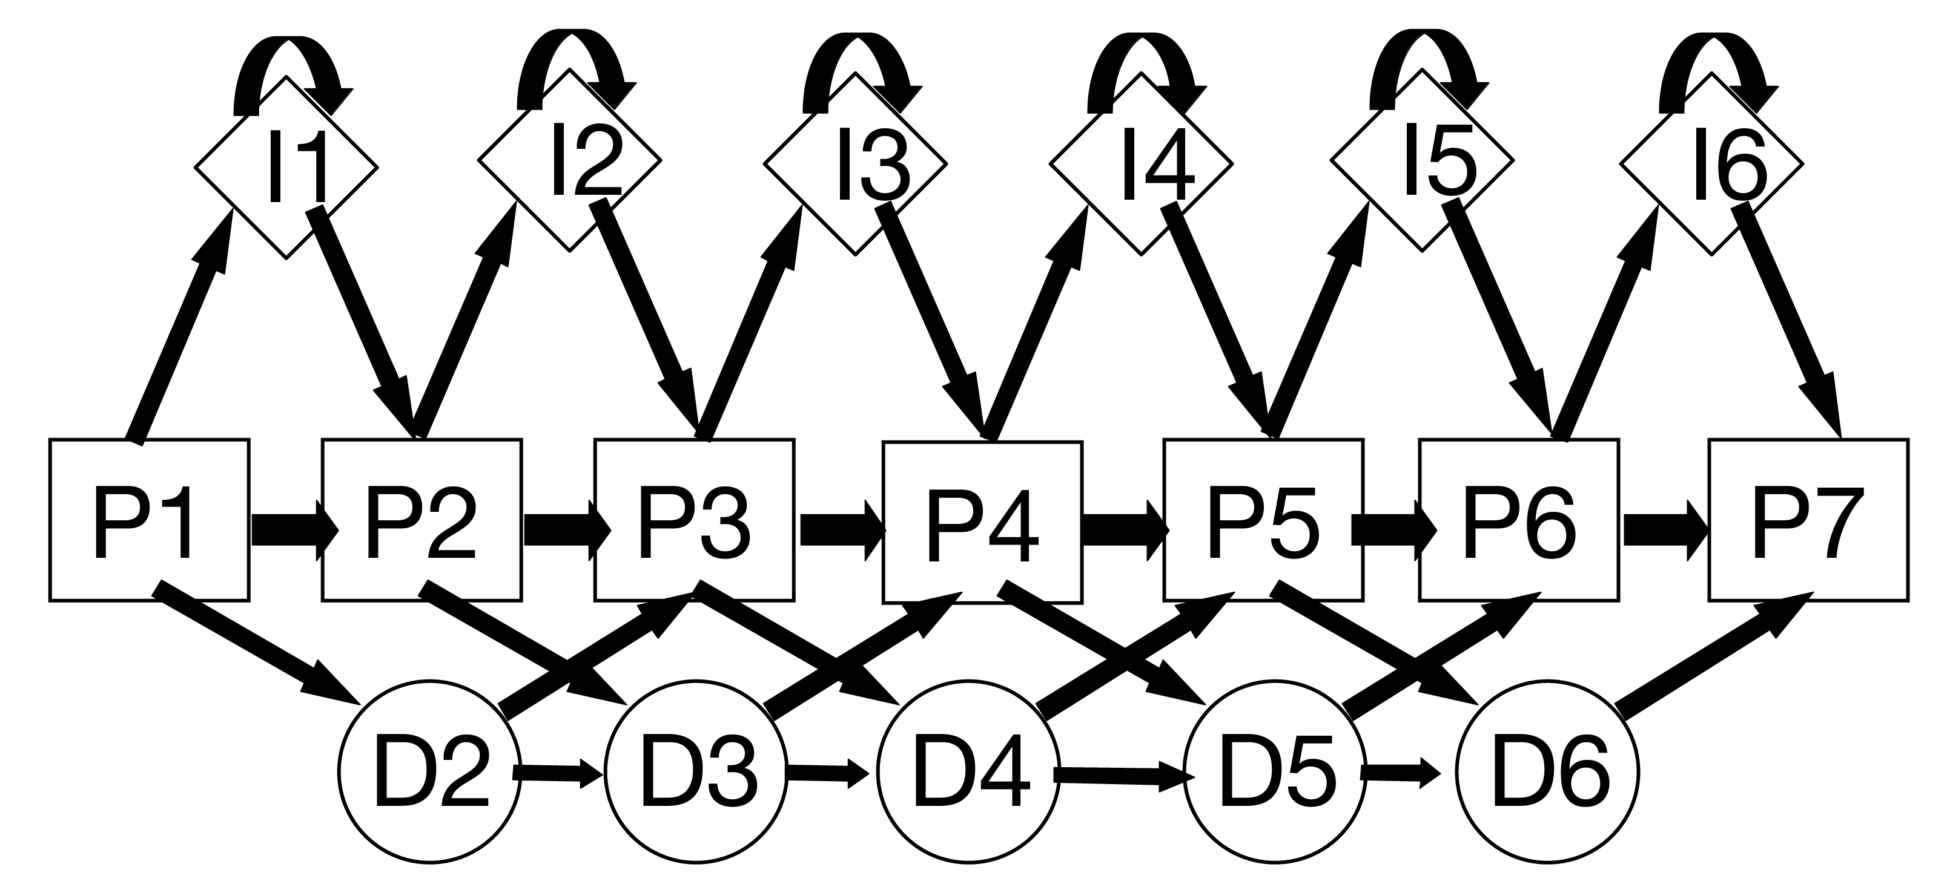
Profile HMM
Un-gapped profile HMM is just a sequence profile

Slide 71
Profile HMM
Un-gapped profile HMM is just a sequence profile
A:0.05
C:0.01
D:0.08
E:0.08
F:0.03
G:0.02
..
V:0.08
Y:0.01
P1
P2
P3
P4
P5
P6
P7
a_{lk}=1.0

Slide 72
Example. Where is the active site?
Sequence profiles might show you where to look!
The active site could be around
S9, G42, N74, and H195

Slide 73
Profile HMM
Profile HMM (deletions and insertions)

Slide 74
Profile HMM (deletions and insertions)
QUERY HAMDIRCYHSGG-PLHL-GEI-EDFNGQSCIVCPWHKYKITLATGE--GLYQSINPKDPS
Q8K2P6 HAMDIRCYHSGG-PLHL-GEI-EDFNGQSCIVCPWHKYKITLATGE--GLYQSINPKDPS
Q8TAC1 HAMDIRCYHSGG-PLHL-GDI-EDFDGRPCIVCPWHKYKITLATGE--GLYQSINPKDPS
Q07947 FAVQDTCTHGDW-ALSE-GYL-DGD----VVECTLHFGKFCVRTGK--VKAL------PA
P0A185 YATDNLCTHGSA-RMSD-GYL-EGRE----IECPLHQGRFDVCTGK--ALC------APV
P0A186 YATDNLCTHGSA-RMSD-GYL-EGRE----IECPLHQGRFDVCTGK--ALC------APV
Q51493 YATDNLCTHGAA-RMSD-GFL-EGRE----IECPLHQGRFDVCTGR--ALC------APV
A5W4F0 FAVQDTCTHGDW-ALSD-GYL-DGD----IVECTLHFGKFCVRTGK--VKAL------PA
P0C620 FAVQDTCTHGDW-ALSD-GYL-DGD----IVECTLHFGKFCVRTGK--VKAL------PA
P08086 FAVQDTCTHGDW-ALSD-GYL-DGD----IVECTLHFGKFCVRTGK--VKAL------PA
Q52440 FATQDQCTHGEW-SLSE-GGY-LDGD---VVECSLHMGKFCVRTGK-------------V
Q7N4V8 FAVDDRCSHGNA-SISE-GYL-ED---NATVECPLHTASFCLRTGK--ALCL------PA
P37332 FATQDRCTHGDW-SLSDGGYL-EGD----VVECSLHMGKFCVRTGK-------------V
A7ZPY3 YAINDRCSHGNA-SMSE-GYL-EDD---ATVECPLHAASFCLKTGK--ALCL------PA
P0ABW1 YAINDRCSHGNA-SMSE-GYL-EDD---ATVECPLHAASFCLKTGK--ALCL------PA
A8A346 YAINDRCSHGNA-SMSE-GYL-EDD---ATVECPLHAASFCLKTGK--ALCL------PA
P0ABW0 YAINDRCSHGNA-SMSE-GYL-EDD---ATVECPLHAASFCLKTGK--ALCL------PA
P0ABW2 YAINDRCSHGNA-SMSE-GYL-EDD---ATVECPLHAASFCLKTGK--ALCL------PA
Q3YZ13 YAINDRCSHGNA-SMSE-GYL-EDD---ATVECPLHAASFCLKTGK--ALCL------PA
Q06458 YALDNLEPGSEANVLSR-GLL-GDAGGEPIVISPLYKQRIRLRDG---------------
Core
Insertion
Deletion

Slide 75
The HMMer program
HMMer is a open source program suite for profile HMM for biological sequence analysis
Used to make the Pfam database of protein families
http://pfam.sanger.ac.uk/

Slide 76
A HMMer example
Example from the CASP8 competition
What is the best PDB template for building a model for the sequence T0391
>T0391 rieske ferredoxin, mouse, 157 residues
SDPEISEQDEEKKKYTSVCVGREEDIRKSERMTAVVHDREVVIFYHKGEYHAMDIRCYHS
GGPLHLGEIEDFNGQSCIVCPWHKYKITLATGEGLYQSINPKDPSAKPKWCSKGVKQRIH
TVKVDNGNIYVTLSKEPFKCDSDYYATGEFKVIQSSS

Slide 77
A HMMer example
What is the best PDB template for building a model for the sequence T0391
Use Blast
No hits
Use Psi-Blast
No hits
Use Hmmer

Slide 78
A HMMer example
Use Hmmer
Make multiple alignment using Blast
Make model using
hmmbuild
Find PDB template using
hmmsearch

Slide 79
A HMMer example
Make multiple alignment using Blast
blastpgp -j 3 -e 0.001 -m 6 -i T0391.fsa -d sp -b 10000000 -v 10000000 > T0391.fsa.blastout
Make Stockholm format
# STOCKHOLM 1.0
QUERY DPEISEQDEEKKKYTSVCVGREEDIRKS-ERMTAVVHD-RE--V-V-IF--Y-H-KGE-Y
Q8K2P6 DPEISEQDEEKKKYTSVCVGREEDIRKS-ERMTAVVHD-RE--V-V-IF--Y-H-KGE-Y
Q8TAC1 ----SAQDPEKREYSSVCVGREDDIKKS-ERMTAVVHD-RE--V-V-IF--Y-H-KGE-Y
Build HMM
hmmbuild T0391.hmm T0391.fsa.blastout.sto
Search for templates in PDB
hmmsearch T0391.hmm pdb > T0391.out

Slide 80
A HMMer example
Sequence Description Score E-value N
-------- ----------- ----- ------- ---
2E4Q.A mol:aa ELECTRON TRANSPORT 163.7 6.7e-45 1
2E4P.B mol:aa ELECTRON TRANSPORT 163.7 6.7e-45 1
2E4P.A mol:aa ELECTRON TRANSPORT 163.7 6.7e-45 1
2E4Q.C mol:aa ELECTRON TRANSPORT 163.7 6.7e-45 1
2YVJ.B mol:aa OXIDOREDUCTASE/ELECTRON TRANSPORT 163.7 6.7e-45 1
1FQT.A mol:aa OXIDOREDUCTASE 160.9 4.5e-44 1
1FQT.B mol:aa OXIDOREDUCTASE 160.9 4.5e-44 1
2QPZ.A mol:aa METAL BINDING PROTEIN 137.3 5.6e-37 1
2Q3W.A mol:aa ELECTRON TRANSPORT 116.2 1.3e-30 1
1VM9.A mol:aa ELECTRON TRANSPORT 116.2 1.3e-30 1

Slide 81
Validation. CE structural alignment
CE 2E4Q A 3D89 A (run on IRIX machines at CBS)
Structure Alignment Calculator, version 1.01, last modified: May 25, 2000.
CE Algorithm, version 1.00, 1998.
Chain 1: /usr/cbs/bio/src/ce_distr/data.cbs/pdb2e4q.ent:A (Size=109)
Chain 2: /usr/cbs/bio/src/ce_distr/data.cbs/pdb3d89.ent:A (Size=157)
Alignment length = 101 Rmsd = 2.03A Z-Score = 5.5 Gaps = 20(19.8%) CPU = 1s Sequence identities = 18.1%
Chain 1: 2 TFTKACSVDEVPPGEALQVSHDAQKVAIFNVDGEFFATQDQCTHGEWSLSEGGYLDG----DVVECSLHM
Chain 2: 16 TSVCVGREEDIRKSERMTAVVHDREVVIFYHKGEYHAMDIRCYHSGGPLH-LGEIEDFNGQSCIVCPWHK
Chain 1: 68 GKFCVRTGKVKS-----PPPC---------EPLKVYPIRIEGRDVLVDFSRAALH
Chain 2: 85 YKITLATGEGLYQSINPKDPSAKPKWCSKGVKQRIHTVKVDNGNIYVTL-SKEPF

Slide 82
HMM packages
HMMER (http://hmmer.wustl.edu/)
S.R. Eddy, WashU St. Louis. Freely available.
SAM (http://www.cse.ucsc.edu/research/compbio/sam.html)
R. Hughey, K. Karplus, A. Krogh, D. Haussler and others, UC Santa Cruz. Freely available to academia, nominal license fee for commercial users.
META-MEME (http://metameme.sdsc.edu/)
William Noble Grundy, UC San Diego. Freely available. Combines features of PSSM search and profile HMM search.
NET-ID, HMMpro (http://www.netid.com/html/hmmpro.html)
Freely available to academia, nominal license fee for commercial users.
Allows HMM architecture construction.
EasyGibbs (http://www.cbs.dtu.dk/biotools/EasyGibbs/)
Webserver for Gibbs sampling of proteins sequences

