Slide 1
Metropolis Monte Carlo sampling Gibbs Clustering Morten Nielsen Department of Health Technology DTU, Denmark

Slide 2
Metropolis Monte Carlo
What to do if you cannot do the math or your error function cannot be differentiated?
?

Slide 3
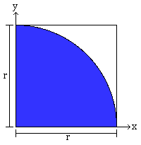
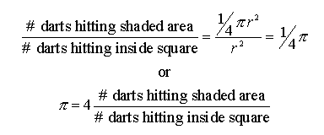
Example: Estimating Π by Independent Monte-Carlo Samples
Suppose we throw darts randomly (and uniformly) at the square:
Algorithm:
For i=[1..ntrials]
x = (random# in [0..r])
y = (random# in [0..r])
distance = sqrt (x^2 + y^2)
if distance ≤ r
hits++
End
Output:
http://www.chem.unl.edu/zeng/joy/mclab/mcintro.html
Adapted from course slides by Craig Douglas

Slide 4
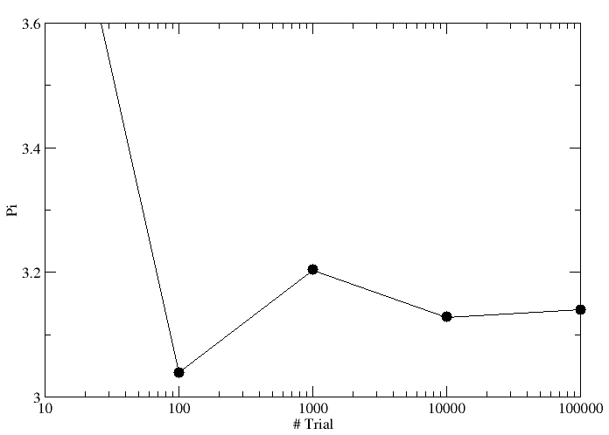
Estimating Π

Slide 5
Monte Carlo
Because of their reliance on repeated computation of random or pseudo-random numbers, Monte Carlo methods are most suited to calculation by a computer. Monte Carlo methods tend to be used when it is unfeasible or impossible to compute an exact result with a deterministic algorithm
Or when you are too stupid to do the math yourself?

Slide 6
Class II MHC binding
MHC class II binds peptides in the class II antigen presentation pathway
Binds peptides of length 9-18 (even whole proteins can bind!)
Binding cleft is open
Binding core is 9 aa

Slide 7
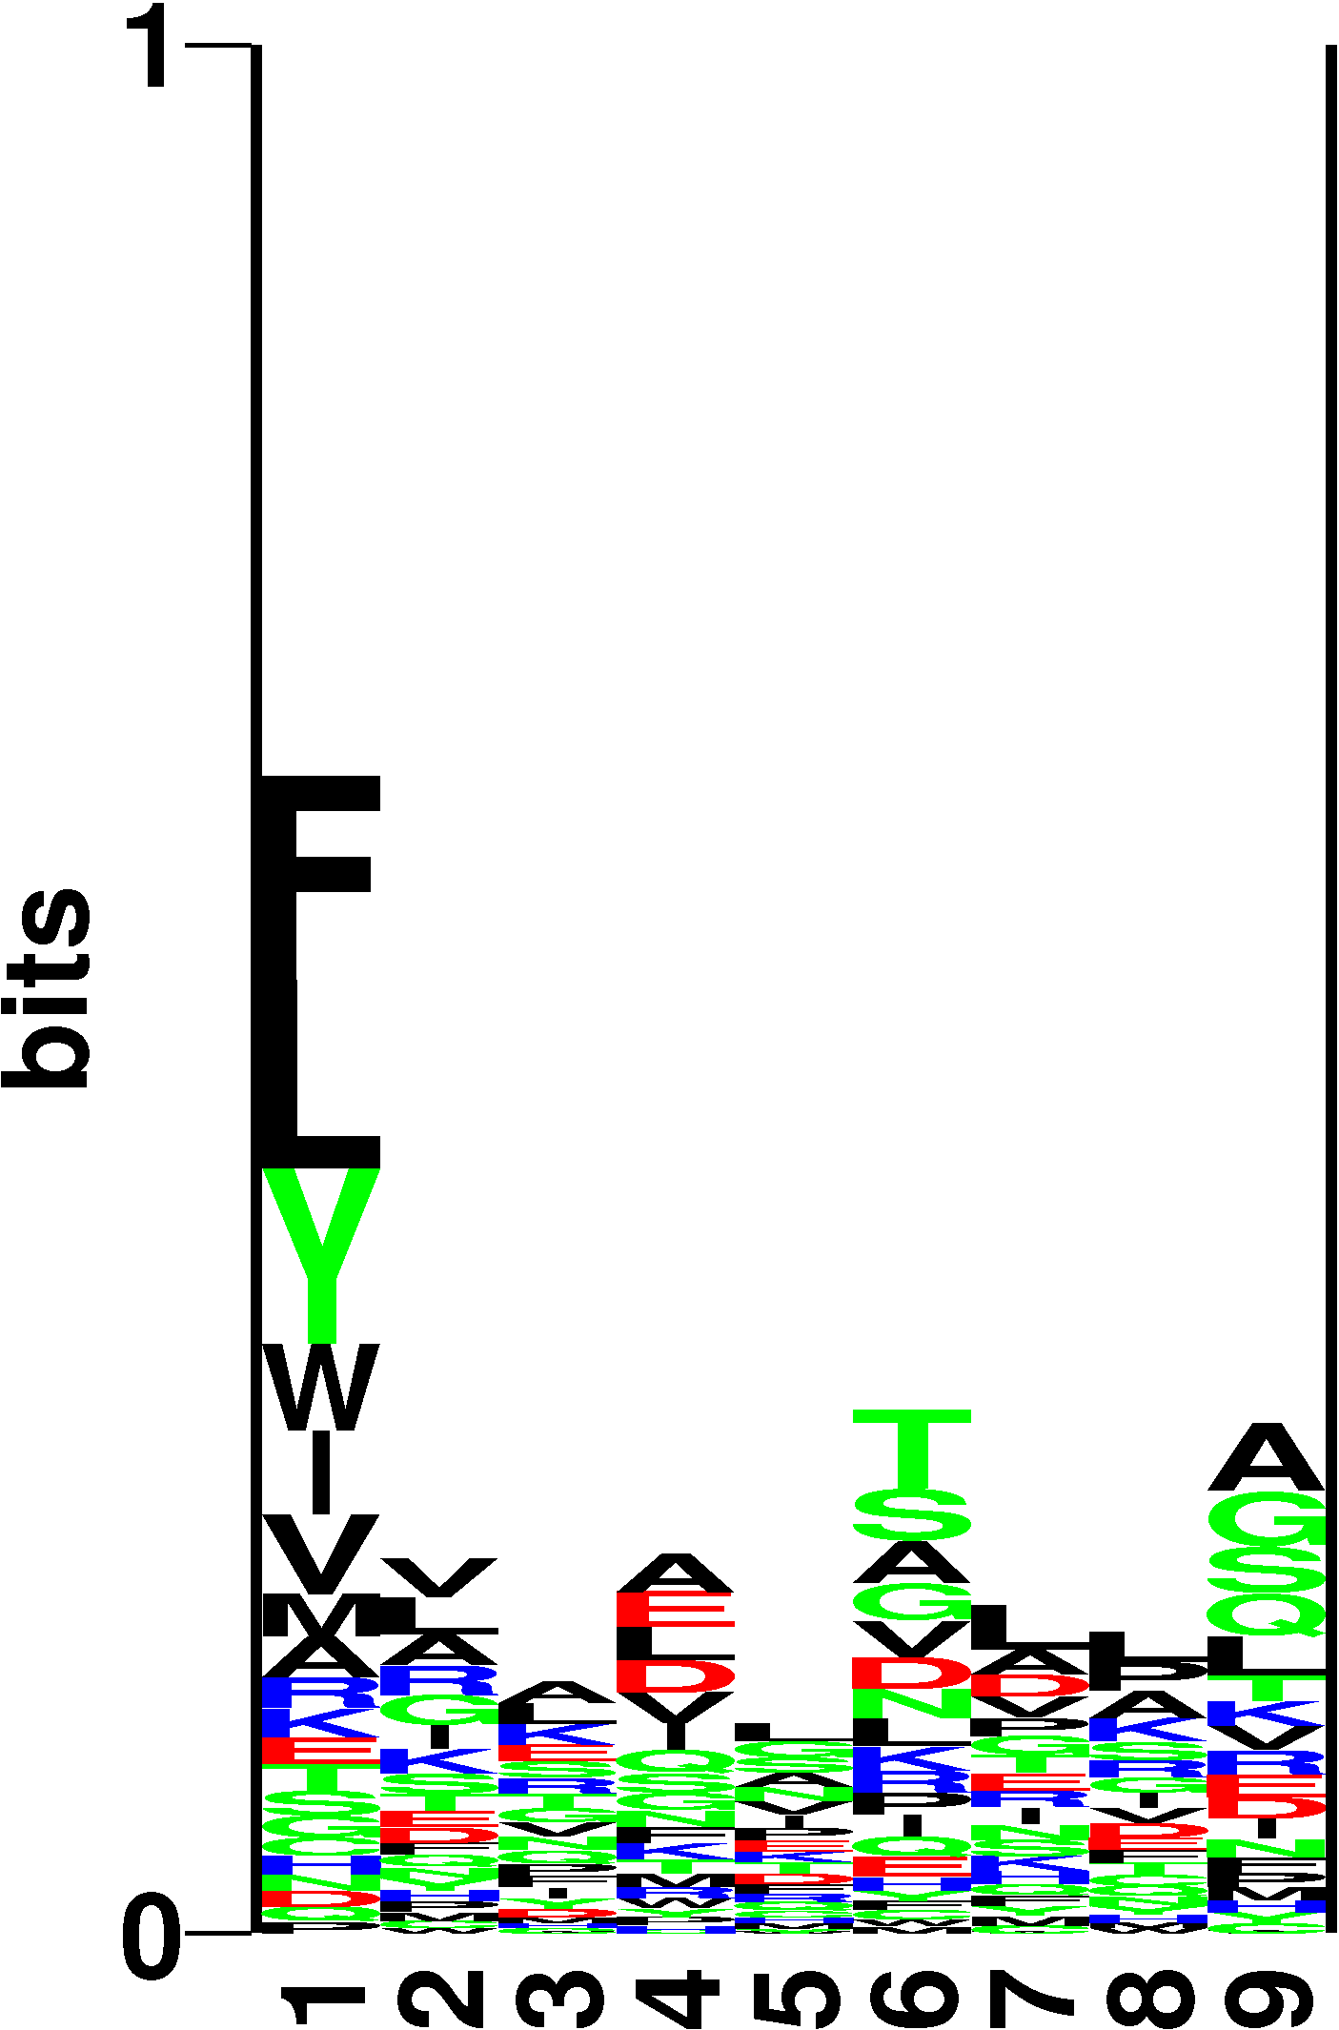
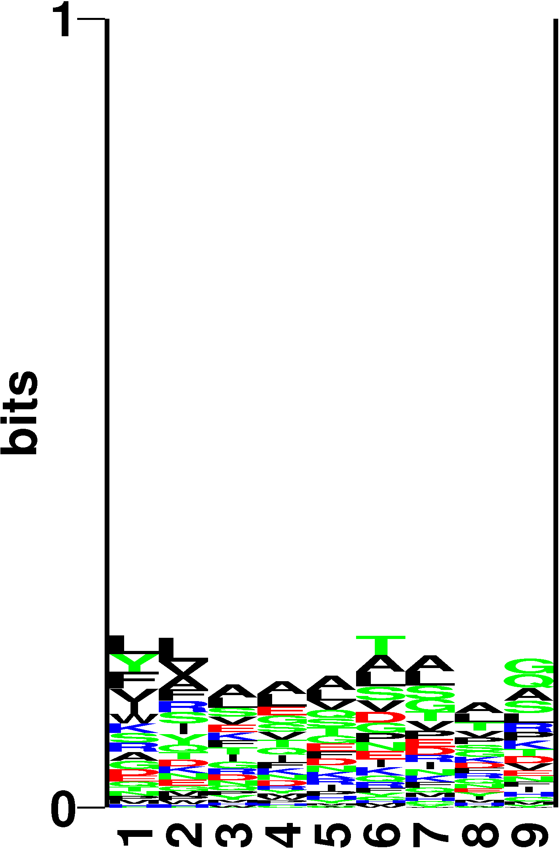
Conventional Gibbs sampling
MHC class II binding
9 AAs
SLFIGLKGDIRESTV
DGEEEVQLIAAVPGK
VFRLKGGAPIKGVTF
SFSCIAIGIITLYLG
IDQVTIAGAKLRSLN
WIQKETLVTFKNPHAKKQDV
KMLLDNINTPEGIIP
ELLEFHYYLSSKLNK
LNKFISPKSVAGRFA
ESLHNPYPDYHWLRT
...
...
...
...
DFAAQVDYPSTGLY
SLFIGLKGDIRESTV
DGEEEVQLIAAVPGK
VFRLKGGAPIKGVTF
SFSCIAIGIITLYLG
IDQVTIAGAKLRSLN
WIQKETLVTFKNPHAKKQDV
KMLLDNINTPEGIIP
ELLEFHYYLSSKLNK
LNKFISPKSVAGRFA
ESLHNPYPDYHWLRT
...
...
...
...
DFAAQVDYPSTGLY

Slide 8
Gibbs sampling - sequence alignment
Why sampling?
SLFIGLKGDIRESTV
DGEEEVQLIAAVPGK
VFRLKGGAPIKGVTF
SFSCIAIGIITLYLG
IDQVTIAGAKLRSLN
WIQKETLVTFKNPHAKKQDV
KMLLDNINTPEGIIP
ELLEFHYYLSSKLNK
LNKFISPKSVAGRFA
ESLHNPYPDYHWLRT
...
...
...
...
DFAAQVDYPSTGLY
50 sequences 12 amino acids long
try all possible combinations with a 9-mer overlap
4⁵⁰ ~ 10³⁰ possible combinations
...computationally unfeasible

Slide 9
Gibbs sampling - sequence alignment
State transition
SLFIGLKGDIRESTV
DGEEEVQLIAAVPGK
VFRLKGGAPIKGVTF
SFSCIAIGIITLYLG
IDQVTIAGAKLRSLN
WIQKETLVTFKNPHAKKQDV
KMLLDNINTPEGIIP
ELLEFHYYLSSKLNK
LNKFISPKSVAGRFA
ESLHNPYPDYHWLRT
move to state +1

Slide 10
Gibbs sampling - sequence alignment
State transition
SLFIGLKGDIRESTV
DGEEEVQLIAAVPGK
VFRLKGGAPIKGVTF
SFSCIAIGIITLYLG
IDQVTIAGAKLRSLN
WIQKETLVTFKNPHAKKQDV
KMLLDNINTPEGIIP
ELLEFHYYLSSKLNK
LNKFISPKSVAGRFA
ESLHNPYPDYHWLRT
SLFIGLKGDIRESTV
DGEEEVQLIAAVPGK
VFRLKGGAPIKGVTF
SFSCIAIGIITLYLG
IDQVTIAGAKLRSLN
WIQKETLVTFKNPHAKKQDV
KMLLDNINTPEGIIP
ELLEFHYYLSSKLNK
LNKFISPKSVAGRFA
ESLHNPYPDYHWLRT
move to state +1
Accept or reject the move?
Note that the probability of going to the new state depends on the previous state only

Slide 11
Gibbs sampling - sequence alignment
Numerical example - 1
SLFIGLKGDIRESTV
DGEEEVQLIAAVPGK
VFRLKGGAPIKGVTF
SFSCIAIGIITLYLG
IDQVTIAGAKLRSLN
WIQKETLVTFKNPHAKKQDV
KMLLDNINTPEGIIP
ELLEFHYYLSSKLNK
LNKFISPKSVAGRFA
ESLHNPYPDYHWLRT
SLFIGLKGDIRESTV
DGEEEVQLIAAVPGK
VFRLKGGAPIKGVTF
SFSCIAIGIITLYLG
IDQVTIAGAKLRSLN
WIQKETLVTFKNPHAKKQDV
KMLLDNINTPEGIIP
ELLEFHYYLSSKLNK
LNKFISPKSVAGRFA
ESLHNPYPDYHWLRT
move to state +1
Accept move with Prob = 100%

Slide 12
Gibbs sampling - sequence alignment
Numerical example - 2
SLFIGLKGDIRESTV
DGEEEVQLIAAVPGK
VFRLKGGAPIKGVTF
SFSCIAIGIITLYLG
IDQVTIAGAKLRSLN
WIQKETLVTFKNPHAKKQDV
KMLLDNINTPEGIIP
ELLEFHYYLSSKLNK
LNKFISPKSVAGRFA
ESLHNPYPDYHWLRT
SLFIGLKGDIRESTV
DGEEEVQLIAAVPGK
VFRLKGGAPIKGVTF
SFSCIAIGIITLYLG
IDQVTIAGAKLRSLN
WIQKETLVTFKNPHAKKQDV
KMLLDNINTPEGIIP
ELLEFHYYLSSKLNK
LNKFISPKSVAGRFA
ESLHNPYPDYHWLRT
move to state +1
Accept move with Prob = 63.8%

Slide 13
Gibbs sampling - sequence alignment
What is the MC temperature?
it’s a scalar decreased during the simulation
T
iteration

Slide 14
Gibbs sampling - sequence alignment
What is the MC temperature?
it’s a scalar decreased during the simulation
E.g. same dE=-0.3 but at different temperatures
T
t₁=0.4
t₂=0.1
t₃=0.02
iteration

Slide 15
f(Z)
Z
Move freely around states when the system is “warm”, then cool it off to force it into a state of high fitness

Slide 16
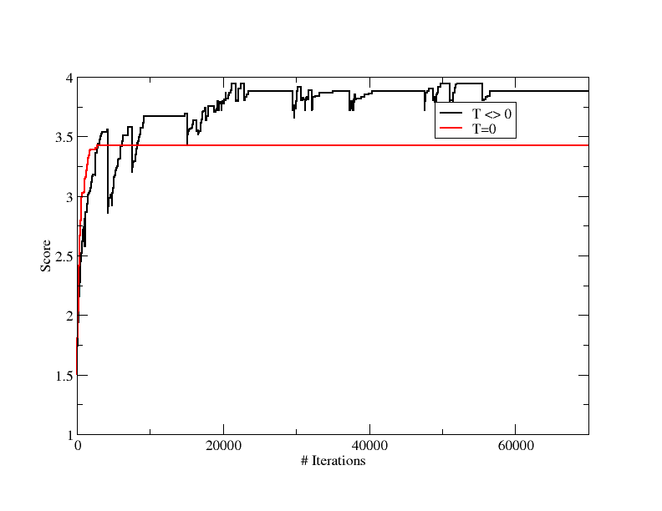
Local minima

Slide 17
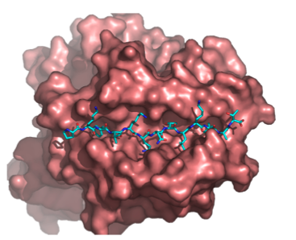
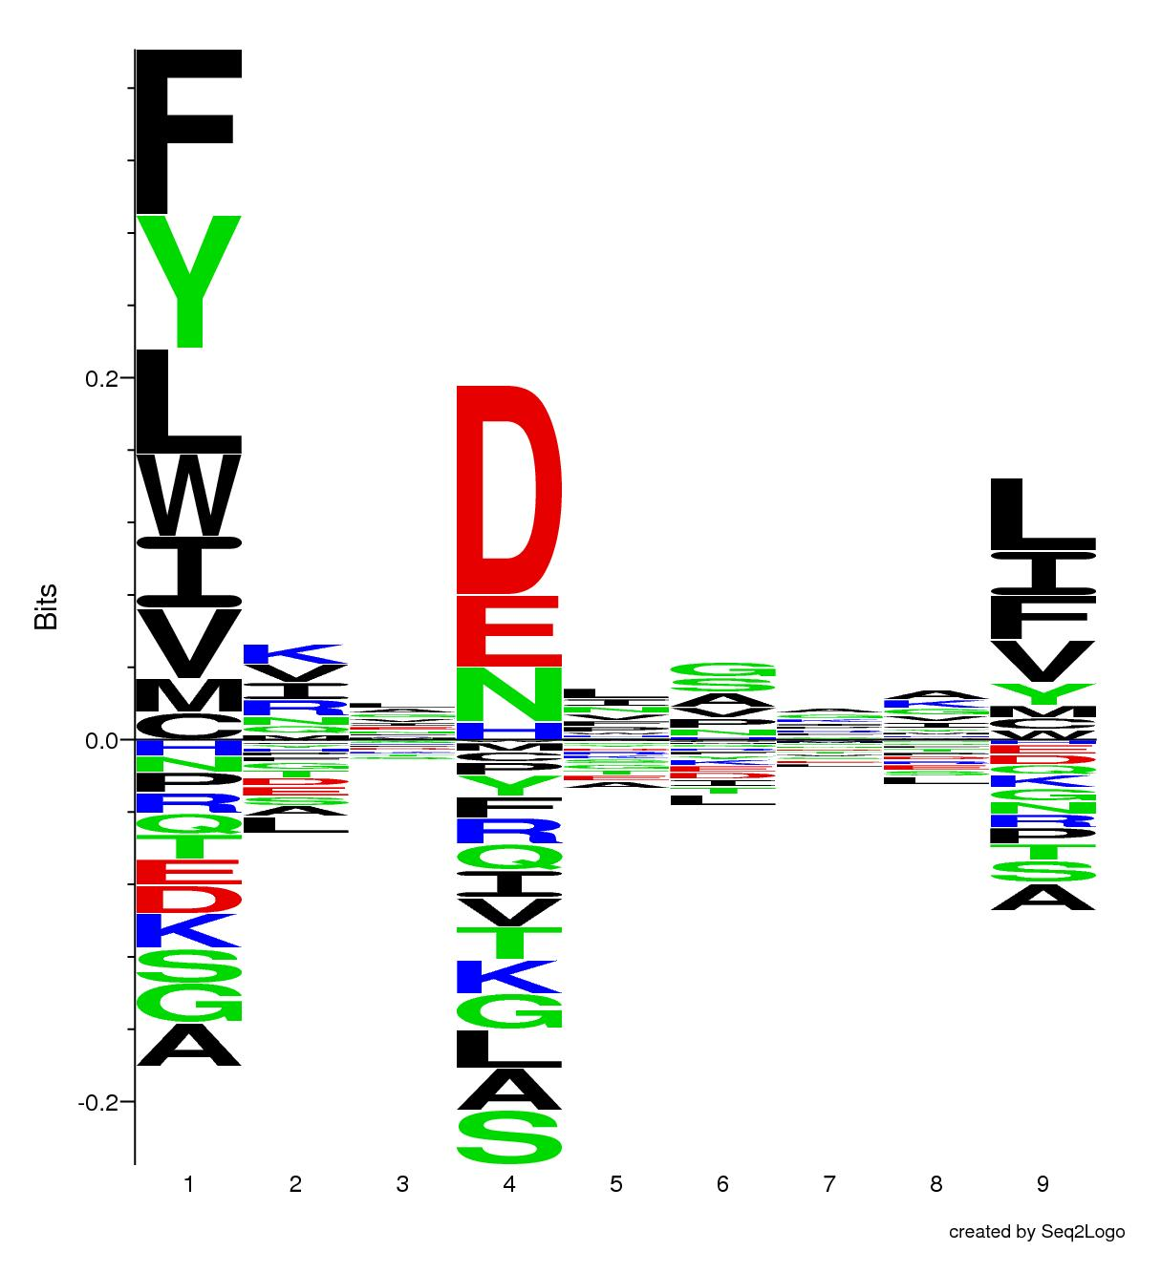
Does it work?
HLA-DRB3*01:01

Slide 18
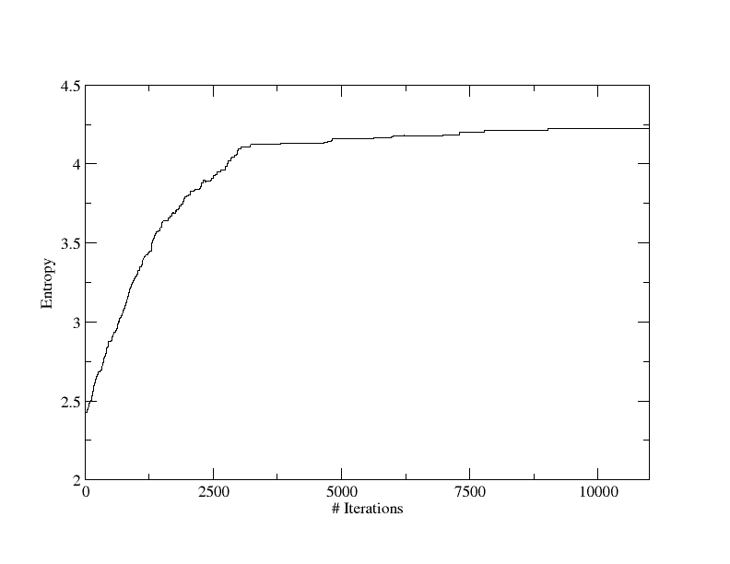
It works
High Temperature
Low Temperature

Slide 19
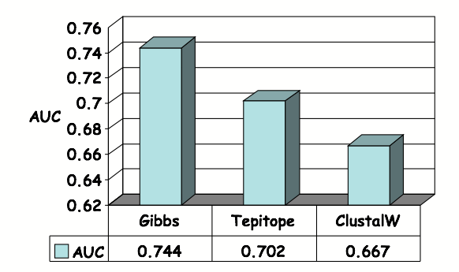
Gibbs sampler. Prediction accuracy

Slide 20
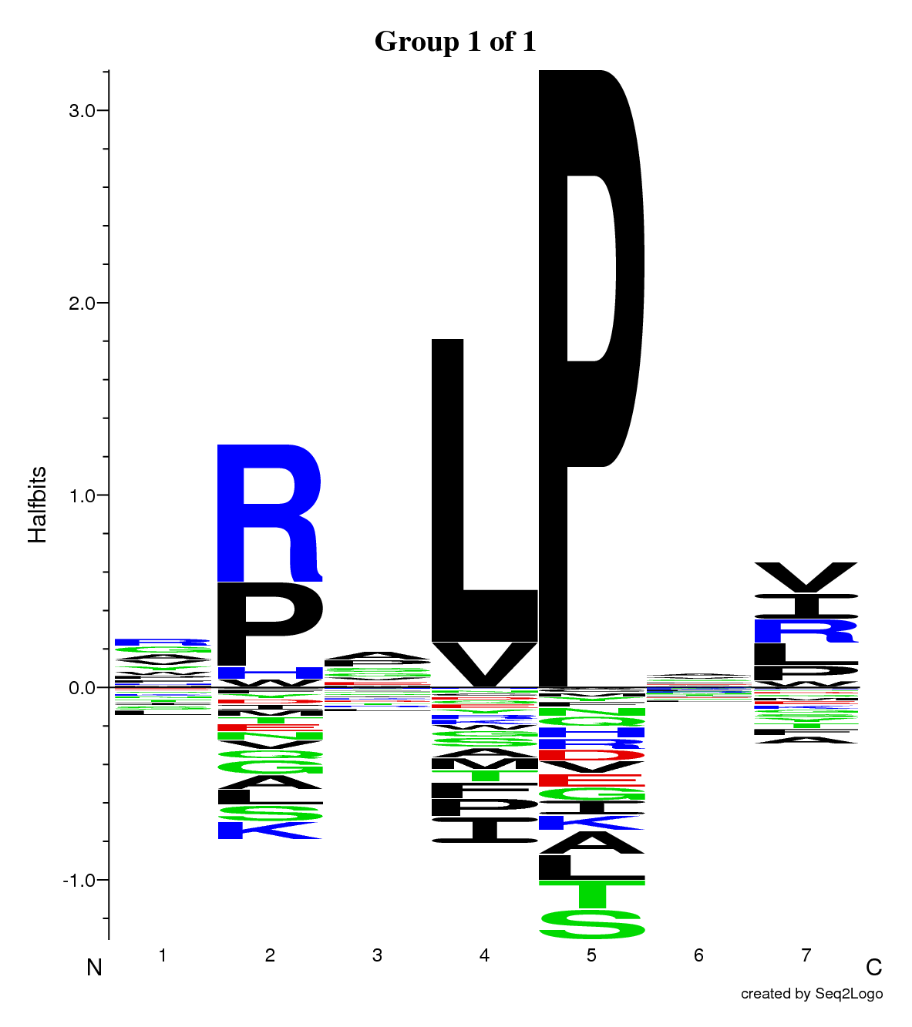
Next generation peptide-chip technology

Slide 21
Identification of receptor binding motifs

Slide 22
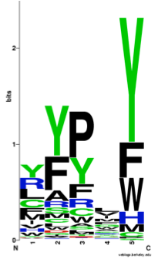
Data interpretation
Peptide | Signal
LMLSLFEQSLSCQAQ | 9
QGTDATKSIIFEAER | -12
RLEEAQAYLAAGQHD | 10
EISELRTKVQEQQKQ | 44
FAGAKKIFGSLAFLP | 70
VRASSRVSGSFPEDS | -7
CKAFFKRSIQGHNDY | 86
CEGCKAFFKRSIQGH | 100
RLSEADIRGFVAAVV | -7
Notes:
EXPLAIN LOGOS

Slide 23
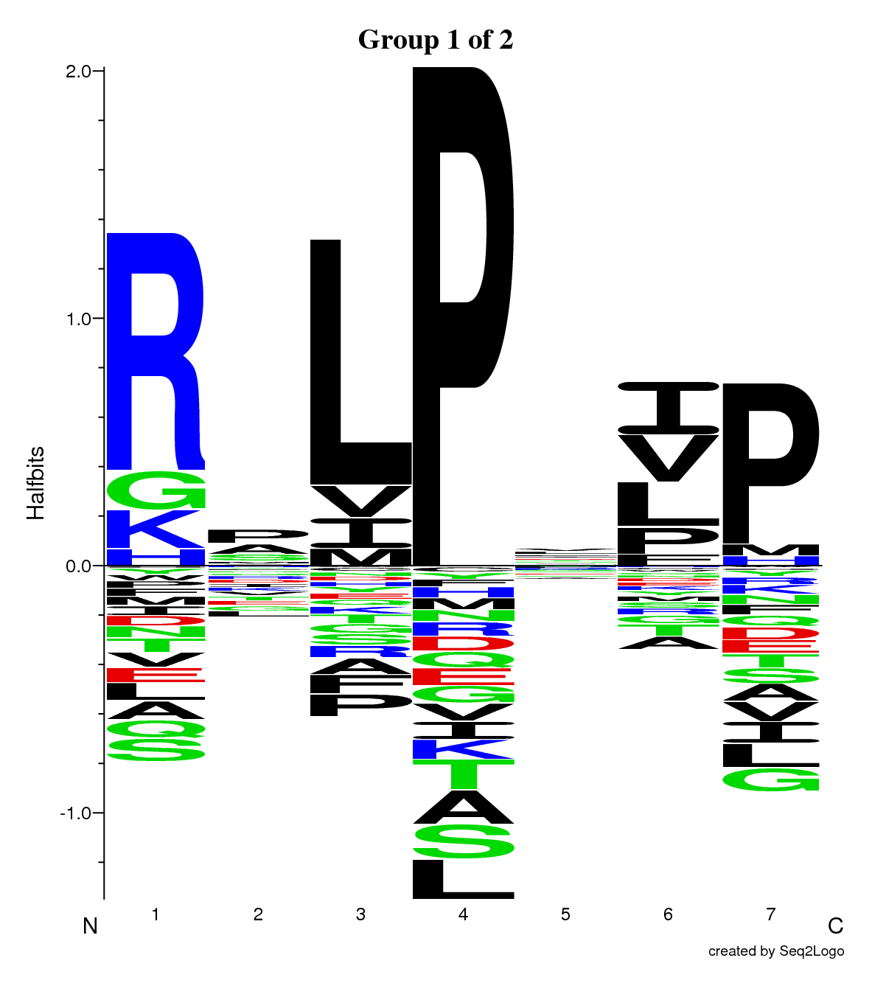
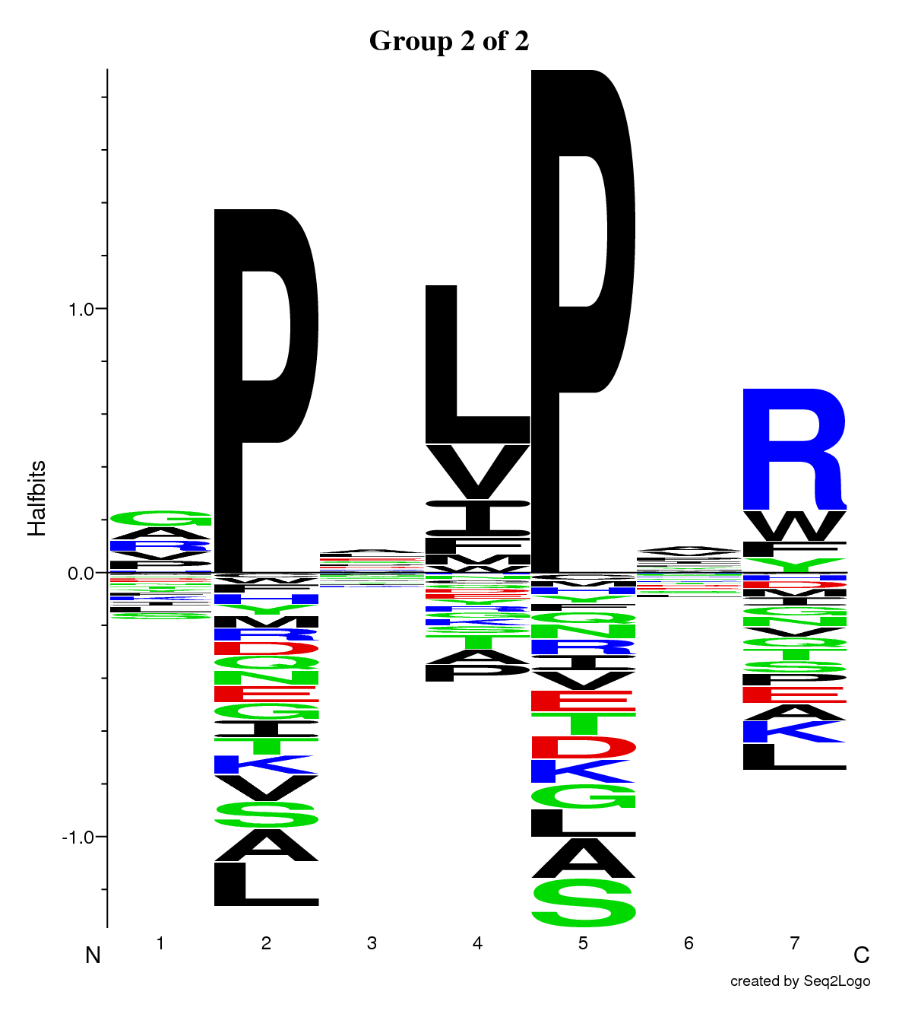
Gibbs clustering (multiple specificities)
Multiple motifs!
Cluster 1
SLFIGLKGDIRESTV
DGEEEVQLIAAVPGK
VFRLKGGAPIKGVTF
SFSCIAIGIITLYLG
IDQVTIAGAKLRSLN
WIQKETLVTFKNPHAKKQDV
KMLLDNINTPEGIIP
ELLEFHYYLSSKLNK
LNKFISPKSVAGRFA
ESLHNPYPDYHWLRT
NKVKSLRILNTRRKL
MMGMFNMLSTVLGVS
AKSSPAYPSVLGQTI
RHLIFCHSKKKCDELAAK
----SLFIGLKGDIRESTV--
--DGEEEVQLIAAVPGK----
------VFRLKGGAPIKGVTF
---SFSCIAIGIITLYLG---
----IDQVTIAGAKLRSLN--
WIQKETLVTFKNPHAKKQDV-
------KMLLDNINTPEGIIP
Cluster 2
--ELLEFHYYLSSKLNK----
------LNKFISPKSVAGRFA
ESLHNPYPDYHWLRT------
-NKVKSLRILNTRRKL-----
--MMGMFNMLSTVLGVS----
AKSSPAYPSVLGQTI------
--RHLIFCHSKKKCDELAAK-

Slide 24
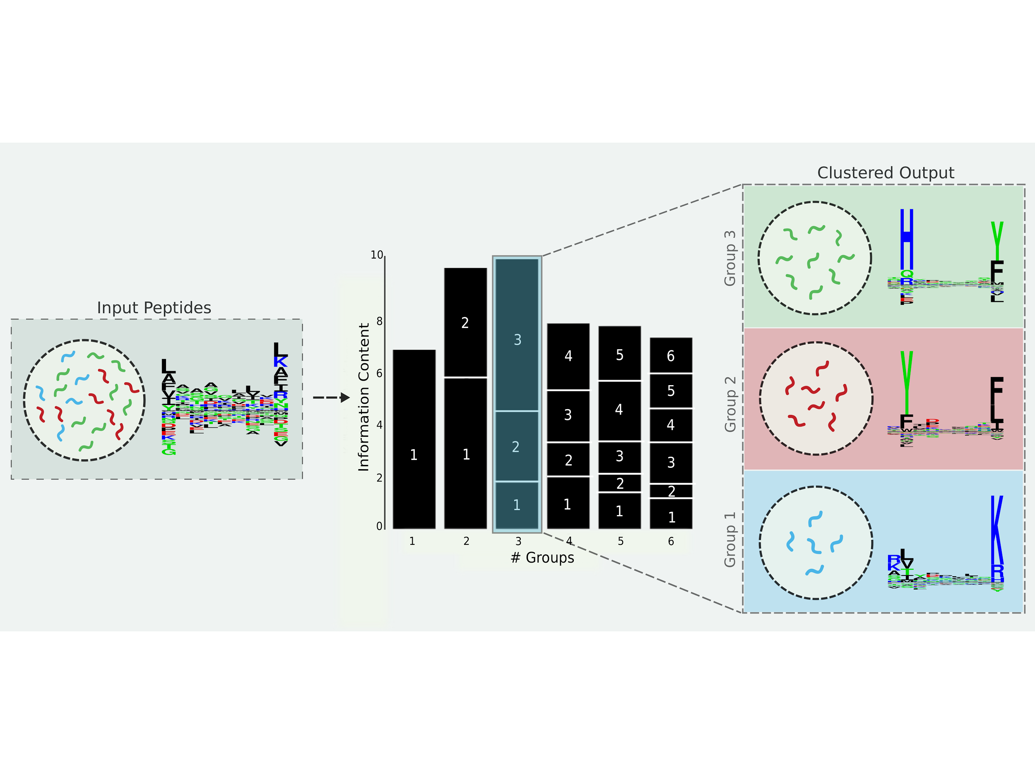
Interpreting and benefitting from MS eluted ligand data sets
Gibbs Cluster analysis
Michal Bassani-Sternberg et. al, MCP, 2015
GibbsCluster, Andreatta, Alvarez, Nielsen, NAR, 2017

Slide 25
The algorithm
1. List of peptides
SLFIGLKGDIRESTV
DGEEEVQLIAAVPGK
VFRLKGGAPIKGVTF
SFSCIAIGIITLYLG
IDQVTIAGAKLRSLN
WIQKETLVTFKNPHAKKQDV
KMLLDNINTPEGIIP
ELLEFHYYLSSKLNK
LNKFISPKSVAGRFA
ESLHNPYPDYHWLRT
NKVKSLRILNTRRKL
MMGMFNMLSTVLGVS
AKSSPAYPSVLGQTI
RHLIFCHSKKKCDELAAK

Slide 26
The algorithm
1. List of peptides
2. create N
random groups
SLFIGLKGDIRESTV
DGEEEVQLIAAVPGK
VFRLKGGAPIKGVTF
SFSCIAIGIITLYLG
IDQVTIAGAKLRSLN
WIQKETLVTFKNPHAKKQDV
KMLLDNINTPEGIIP
ELLEFHYYLSSKLNK
LNKFISPKSVAGRFA
ESLHNPYPDYHWLRT
NKVKSLRILNTRRKL
MMGMFNMLSTVLGVS
AKSSPAYPSVLGQTI
RHLIFCHSKKKCDELAAK
g₁
g₂
g_{N}
----IDQVTIAGAKLRSLN-
WIQKETLVTFKNPHAKKQDV
--ELLEFHYYLSSKLNK---
--MMGMFNMLSTVLGVS---
---AKSSPAYPSVLGQTI--
-SLFIGLKGDIRESTV--
---SFSCIAIGIITLYLG
KMLLDNINTPEGIIP---
-LNKYVHGTWRSILP---
--NKVKSLRILNTRRKL-
---ESLHNPYPDYHWLRT-
RHLIFCHSKKKCDELAAK-
----VFRLKGGAPIKGVTF
--LNKFISPKSVAGRFA--
DGEEEVQLIAAVPGK----
3
Simple shift
Remove peptide

Slide 27
The algorithm
1. List of peptides
2. create N
random groups
SLFIGLKGDIRESTV
DGEEEVQLIAAVPGK
VFRLKGGAPIKGVTF
SFSCIAIGIITLYLG
IDQVTIAGAKLRSLN
WIQKETLVTFKNPHAKKQDV
KMLLDNINTPEGIIP
ELLEFHYYLSSKLNK
LNKFISPKSVAGRFA
ESLHNPYPDYHWLRT
NKVKSLRILNTRRKL
MMGMFNMLSTVLGVS
AKSSPAYPSVLGQTI
RHLIFCHSKKKCDELAAK
g₁
g₂
g_{N}
----IDQVTIAGAKLRSLN-
WIQKETLVTFKNPHAKKQDV
--ELLEFHYYLSSKLNK---
--MMGMFNMLSTVLGVS---
---AKSSPAYPSVLGQTI--
-SLFIGLKGDIRESTV--
---SFSCIAIGIITLYLG
KMLLDNINTPEGIIP---
-LNKYVHGTWRSILP---
--NKVKSLRILNTRRKL-
---ESLHNPYPDYHWLRT-
RHLIFCHSKKKCDELAAK-
----VFRLKGGAPIKGVTF
--LNKFISPKSVAGRFA--
DGEEEVQLIAAVPGK----
3. Finding the optimal configuration (the MC moves)
3
MMGMFNMLSTVLGVS

Slide 28
The algorithm
1. List of peptides
2. create N
random groups
SLFIGLKGDIRESTV
DGEEEVQLIAAVPGK
VFRLKGGAPIKGVTF
SFSCIAIGIITLYLG
IDQVTIAGAKLRSLN
WIQKETLVTFKNPHAKKQDV
KMLLDNINTPEGIIP
ELLEFHYYLSSKLNK
LNKFISPKSVAGRFA
ESLHNPYPDYHWLRT
NKVKSLRILNTRRKL
MMGMFNMLSTVLGVS
AKSSPAYPSVLGQTI
RHLIFCHSKKKCDELAAK
g₁
g₂
g_{N}
----IDQVTIAGAKLRSLN-
WIQKETLVTFKNPHAKKQDV
--ELLEFHYYLSSKLNK---
---AKSSPAYPSVLGQTI--
-SLFIGLKGDIRESTV--
---SFSCIAIGIITLYLG
KMLLDNINTPEGIIP---
-LNKYVHGTWRSILP---
--NKVKSLRILNTRRKL-
---ESLHNPYPDYHWLRT-
RHLIFCHSKKKCDELAAK-
----VFRLKGGAPIKGVTF
--LNKFISPKSVAGRFA--
DGEEEVQLIAAVPGK----
3. Finding the optimal configuration (the MC moves)
MMGMFNMLSTVLGVS
5. Score new core to log-odds matrices
4. Random shift of the core
MMGMFNMLSTVLGVS
6. Accept or reject move

Slide 29
The algorithm
1. List of peptides
2. create N
random groups
SLFIGLKGDIRESTV
DGEEEVQLIAAVPGK
VFRLKGGAPIKGVTF
SFSCIAIGIITLYLG
IDQVTIAGAKLRSLN
WIQKETLVTFKNPHAKKQDV
KMLLDNINTPEGIIP
ELLEFHYYLSSKLNK
LNKFISPKSVAGRFA
ESLHNPYPDYHWLRT
NKVKSLRILNTRRKL
MMGMFNMLSTVLGVS
AKSSPAYPSVLGQTI
RHLIFCHSKKKCDELAAK
g₁
g₂
g_{N}
----IDQVTIAGAKLRSLN-
WIQKETLVTFKNPHAKKQDV
--ELLEFHYYLSSKLNK---
--MMGMFNMLSTVLGVS---
---AKSSPAYPSVLGQTI--
-SLFIGLKGDIRESTV--
---SFSCIAIGIITLYLG
KMLLDNINTPEGIIP---
-LNKYVHGTWRSILP---
--NKVKSLRILNTRRKL-
---ESLHNPYPDYHWLRT-
RHLIFCHSKKKCDELAAK-
----VFRLKGGAPIKGVTF
--LNKFISPKSVAGRFA--
DGEEEVQLIAAVPGK----
3
Simple shift
Remove peptide
MMGMFNMLSTVLGVS

Slide 30
The algorithm
1. List of peptides
2. create N
random groups
SLFIGLKGDIRESTV
DGEEEVQLIAAVPGK
VFRLKGGAPIKGVTF
SFSCIAIGIITLYLG
IDQVTIAGAKLRSLN
WIQKETLVTFKNPHAKKQDV
KMLLDNINTPEGIIP
ELLEFHYYLSSKLNK
LNKFISPKSVAGRFA
ESLHNPYPDYHWLRT
NKVKSLRILNTRRKL
MMGMFNMLSTVLGVS
AKSSPAYPSVLGQTI
RHLIFCHSKKKCDELAAK
g₁
g₂
g_{N}
----IDQVTIAGAKLRSLN-
WIQKETLVTFKNPHAKKQDV
--ELLEFHYYLSSKLNK---
---AKSSPAYPSVLGQTI--
-SLFIGLKGDIRESTV--
---SFSCIAIGIITLYLG
KMLLDNINTPEGIIP---
-LNKYVHGTWRSILP---
--NKVKSLRILNTRRKL-
---ESLHNPYPDYHWLRT-
RHLIFCHSKKKCDELAAK-
----VFRLKGGAPIKGVTF
--LNKFISPKSVAGRFA--
DGEEEVQLIAAVPGK----
3
Simple shift
Remove peptide
MMGMFNMLSTVLGVS
4b. Random shift of the core
MMGMFNMLSTVLGVS

Slide 31
The algorithm
1. List of peptides
2. create N
random groups
SLFIGLKGDIRESTV
DGEEEVQLIAAVPGK
VFRLKGGAPIKGVTF
SFSCIAIGIITLYLG
IDQVTIAGAKLRSLN
WIQKETLVTFKNPHAKKQDV
KMLLDNINTPEGIIP
ELLEFHYYLSSKLNK
LNKFISPKSVAGRFA
ESLHNPYPDYHWLRT
NKVKSLRILNTRRKL
MMGMFNMLSTVLGVS
AKSSPAYPSVLGQTI
RHLIFCHSKKKCDELAAK
g₁
g₂
g_{N}
----IDQVTIAGAKLRSLN-
WIQKETLVTFKNPHAKKQDV
--ELLEFHYYLSSKLNK---
---AKSSPAYPSVLGQTI--
-SLFIGLKGDIRESTV--
---SFSCIAIGIITLYLG
KMLLDNINTPEGIIP---
-LNKYVHGTWRSILP---
--NKVKSLRILNTRRKL-
---ESLHNPYPDYHWLRT-
RHLIFCHSKKKCDELAAK-
----VFRLKGGAPIKGVTF
--LNKFISPKSVAGRFA--
DGEEEVQLIAAVPGK----
3
Simple shift
Remove peptide
MMGMFNMLSTVLGVS
5b. Score new core to all log-odds matrices
4b. Random shift of the core
MMGMFNMLSTVLGVS
E₁
E₂
E₃

Slide 32
The algorithm
1. List of peptides
2. create N
random groups
SLFIGLKGDIRESTV
DGEEEVQLIAAVPGK
VFRLKGGAPIKGVTF
SFSCIAIGIITLYLG
IDQVTIAGAKLRSLN
WIQKETLVTFKNPHAKKQDV
KMLLDNINTPEGIIP
ELLEFHYYLSSKLNK
LNKFISPKSVAGRFA
ESLHNPYPDYHWLRT
NKVKSLRILNTRRKL
MMGMFNMLSTVLGVS
AKSSPAYPSVLGQTI
RHLIFCHSKKKCDELAAK
g₁
g₂
g_{N}
----IDQVTIAGAKLRSLN-
WIQKETLVTFKNPHAKKQDV
--ELLEFHYYLSSKLNK---
---AKSSPAYPSVLGQTI--
-SLFIGLKGDIRESTV--
---SFSCIAIGIITLYLG
KMLLDNINTPEGIIP---
-LNKYVHGTWRSILP---
--NKVKSLRILNTRRKL-
---ESLHNPYPDYHWLRT-
RHLIFCHSKKKCDELAAK-
----VFRLKGGAPIKGVTF
--LNKFISPKSVAGRFA--
DGEEEVQLIAAVPGK----
-MMGMFNMLSTVLGVS---
3
Simple shift
Remove peptide
MMGMFNMLSTVLGVS
5b. Score new core to all log-odds matrices
4b. Random shift of the core
MMGMFNMLSTVLGVS
6b. Accept or reject move
E₁
E₂
E₃

Slide 33
The scoring function
-SLFIGLKGDIRESTV--
---SFSCIAIGIITLYLG
KMLLDNINTPEGIIP---
-LNKYVHGTWRSILP---
--NKVKSLRILNTRRKL-
-SLFIGLKGDIRESTV--
-SFSCIAIGIITLYLG--
KMLLDNINTPEGIIP---
-LNKYVHGTWRSILP---
--NKVKSLRILNTRRKL-
Avoid small specialized clusters (σ = 10)
Maximize intra cluster similarity whilst minimize inter cluster similarity
P = Probability of accepting the move

Slide 34
A mixture of 500 9mer peptides. How many motifs?

Slide 35
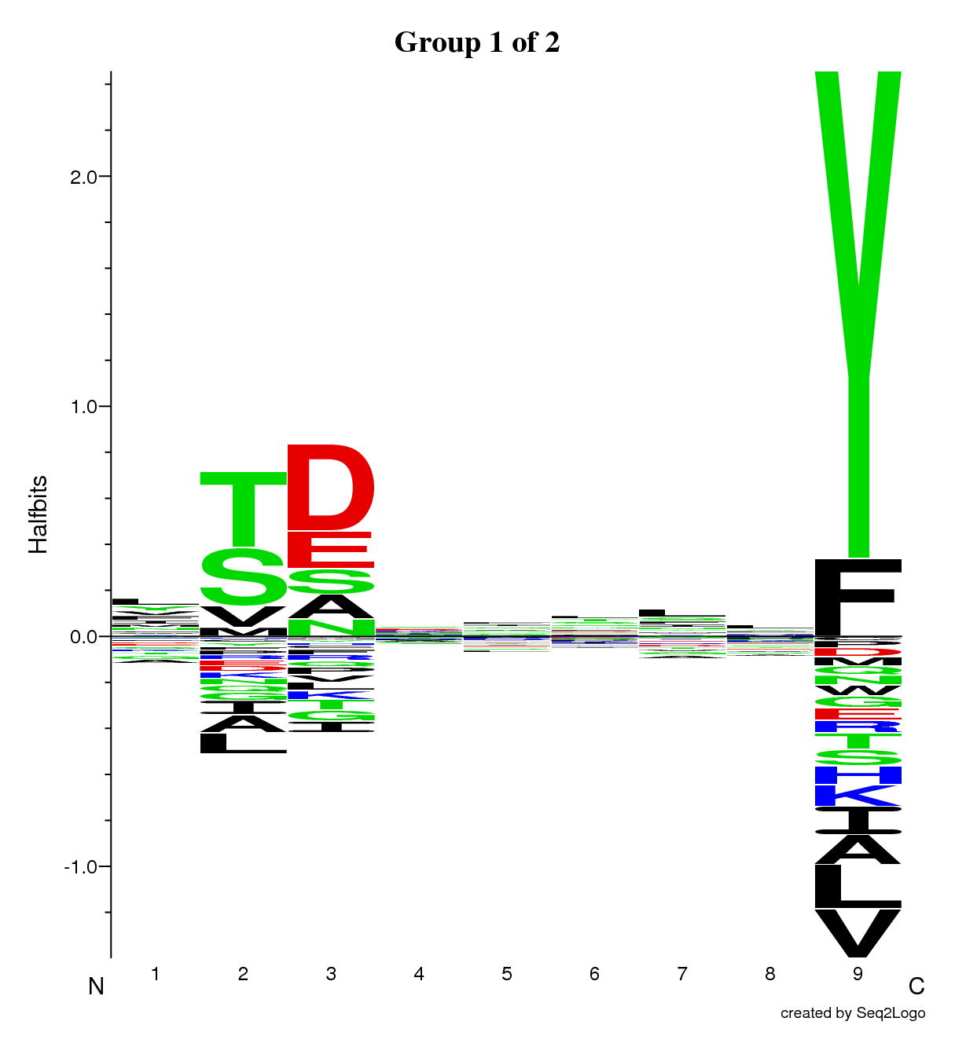
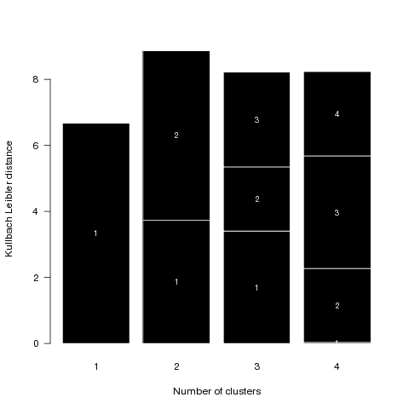
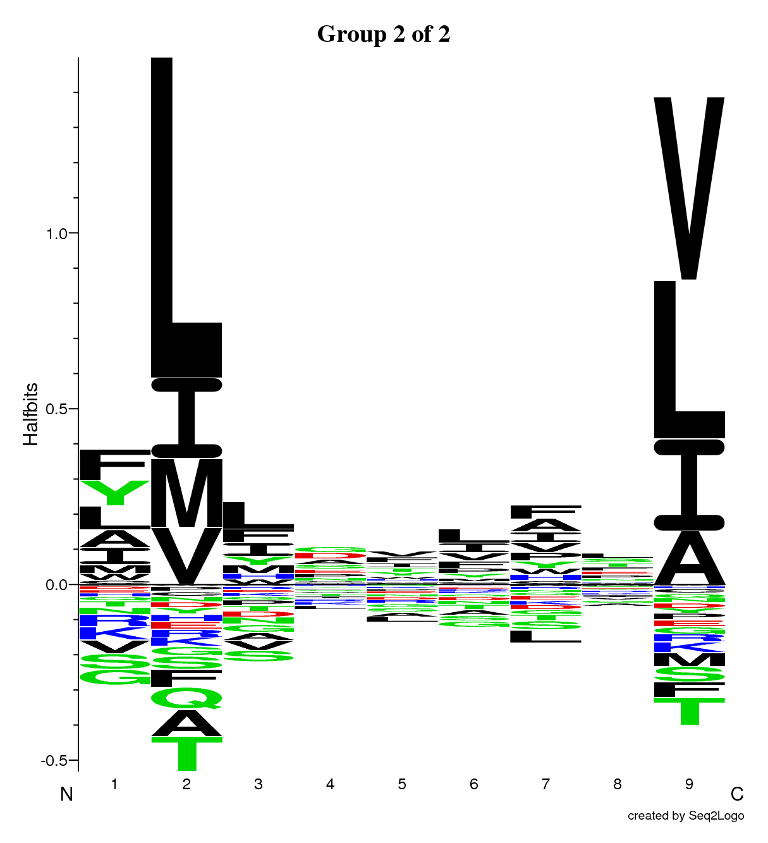
A mixture of 500 9mer peptides. How many motifs?

Slide 36
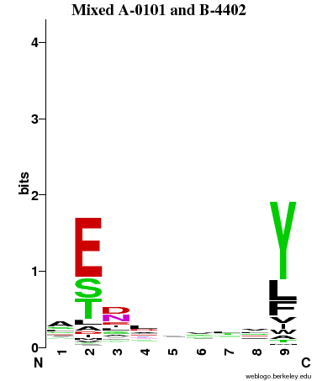
Two MHC class I alleles: HLA-A*0101 and HLA-B*4402
Mixture of 100 binders for the two alleles
ATDKAAAAY A*0101
EVDQTKIQY A*0101
AETGSQGVY B*4402
ITDITKYLY A*0101
AEMKTDAAT B*4402
FEIKSAKKF B*4402
LSEMLNKEY A*0101
GELDRWEKI B*4402
LTDSSTLLV A*0101
FTIDFKLKY A*0101
TTTIKPVSY A*0101
EEKAFSPEV B*4402
AENLWVPVY B*4402

Slide 37
Two MHC class I alleles: HLA-A*0101 and HLA-B*4402
Mixed
A0101
B4402
G 1
G 2

Slide 38
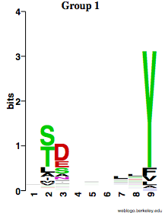
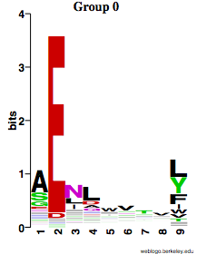
Two MHC class I alleles: HLA-A*0101 and HLA-B*4402
Mixed
A0101
B4402
97 | 3
3 | 97
G 1
G 2
Resolved

Slide 39
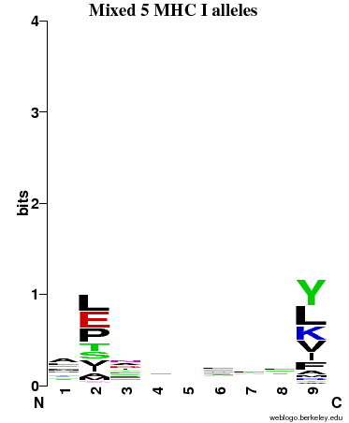
Five MHC class I alleles
A0101
A0201
A0301
B0702
B4402
G 0
G 1
G 2
G 3
G 4

Slide 40
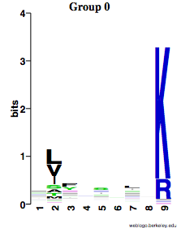
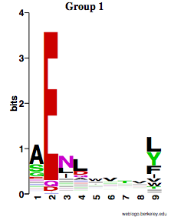
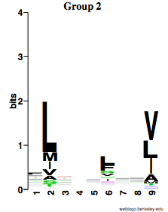
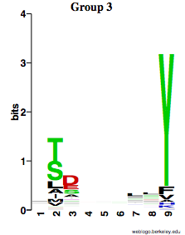
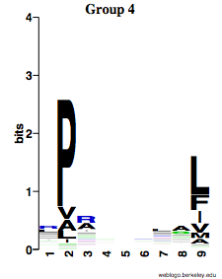
Five MHC class I alleles
A0101
A0201
A0301
B0702
B4402
G 0
0 | 1 | 76 | 1 | 0
2 | 4 | 0 | 0 | 95
5 | 87 | 5 | 1 | 0
93 | 2 | 19 | 0 | 2
0 | 6 | 0 | 98 | 3
G 1
G 2
G 3
G 4
HLA-A0301
97%
HLA-A0101
80%
HLA-A0201
89%
HLA-B4402
94%
HLA-B0702
92%

Slide 41
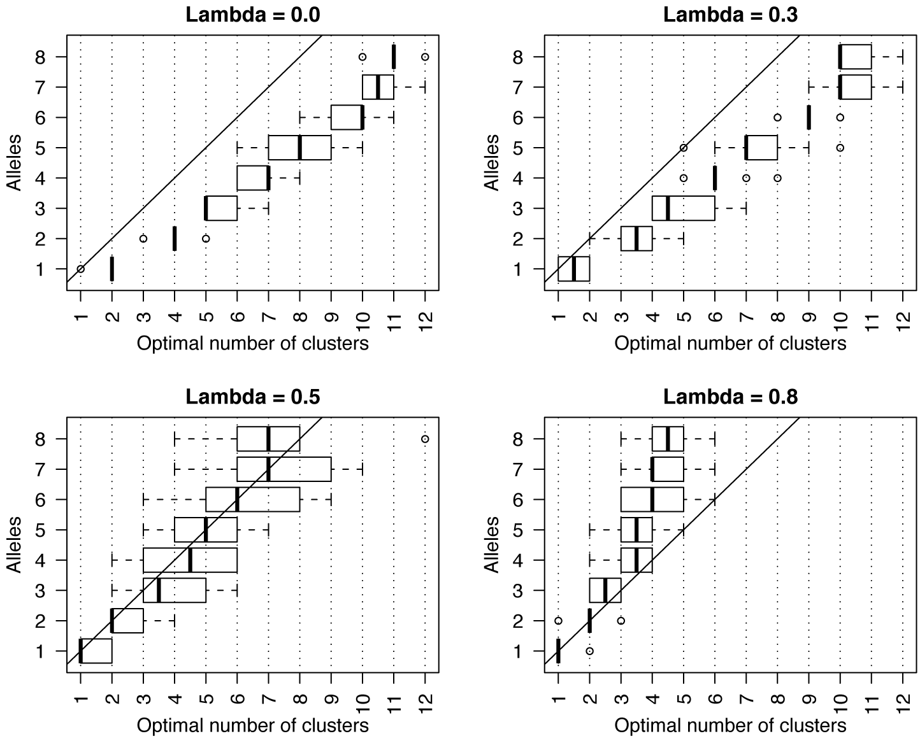
The right number of specificities

Slide 42
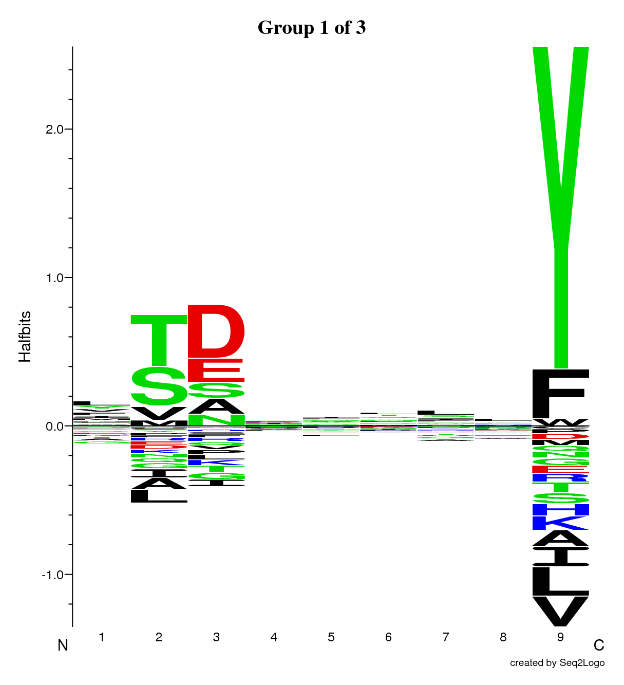
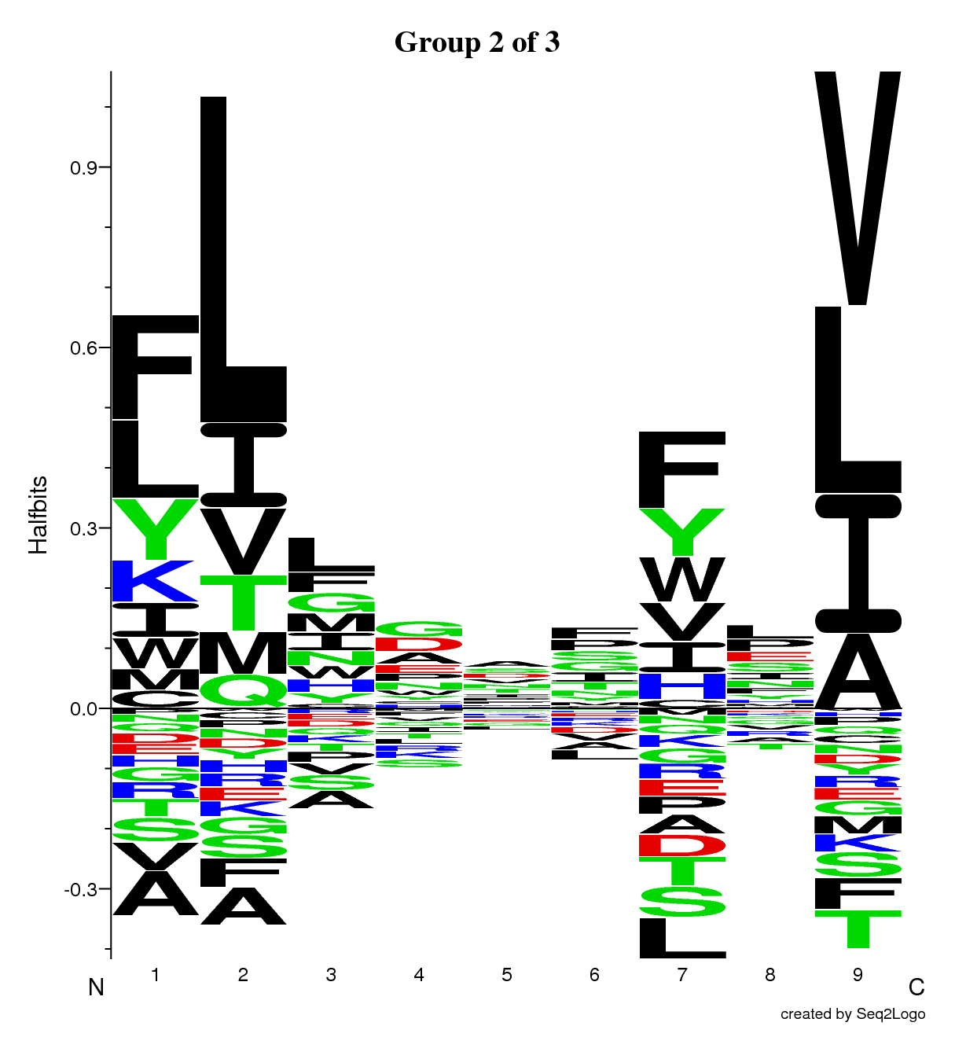
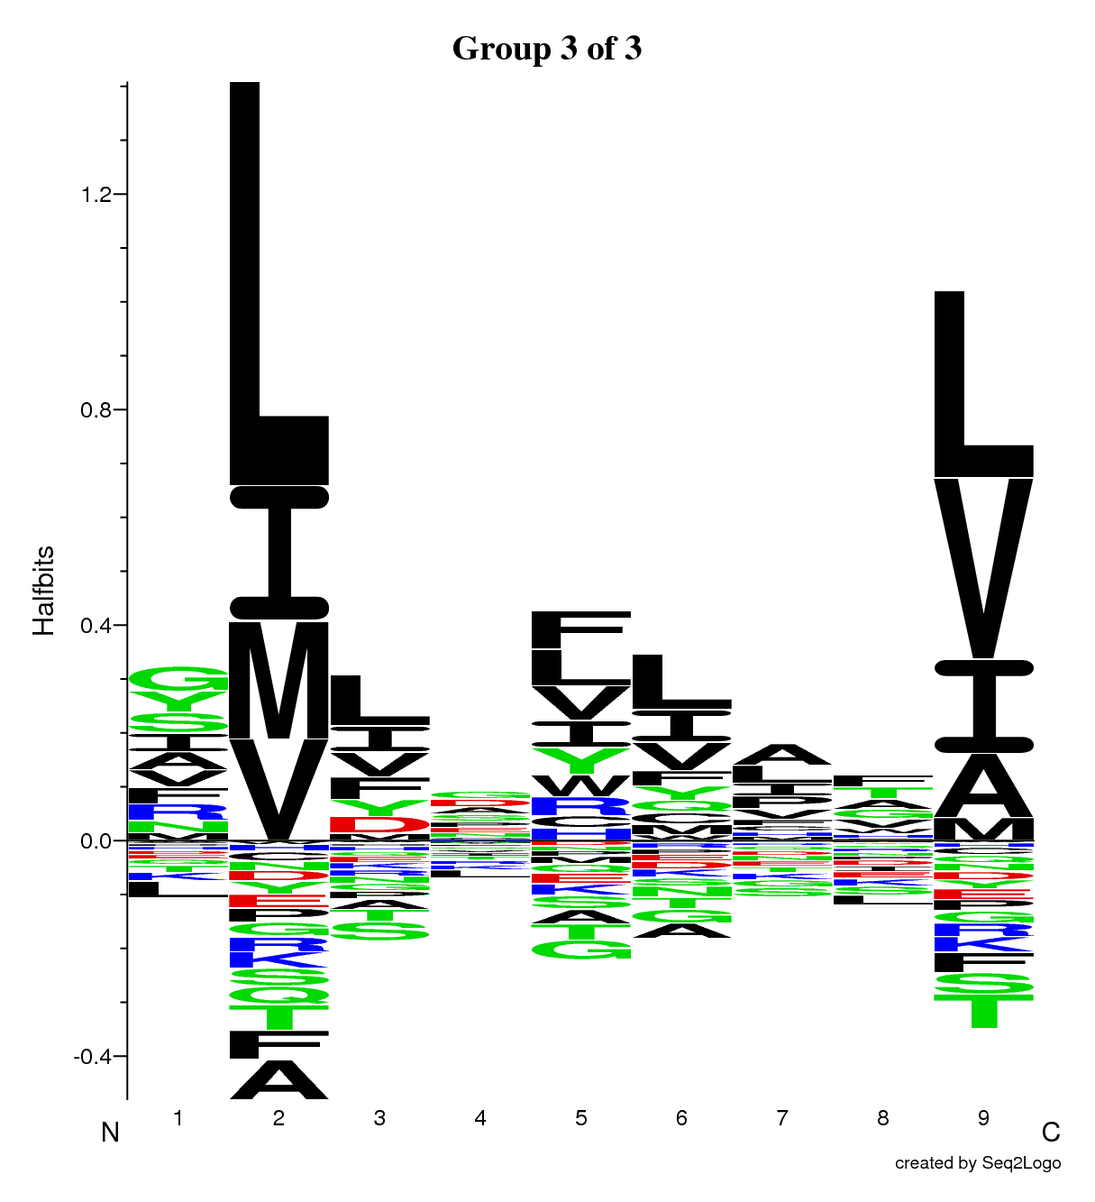
How many motifs?
λ=0

Slide 43
How many motifs?
OR
λ>0

Slide 44
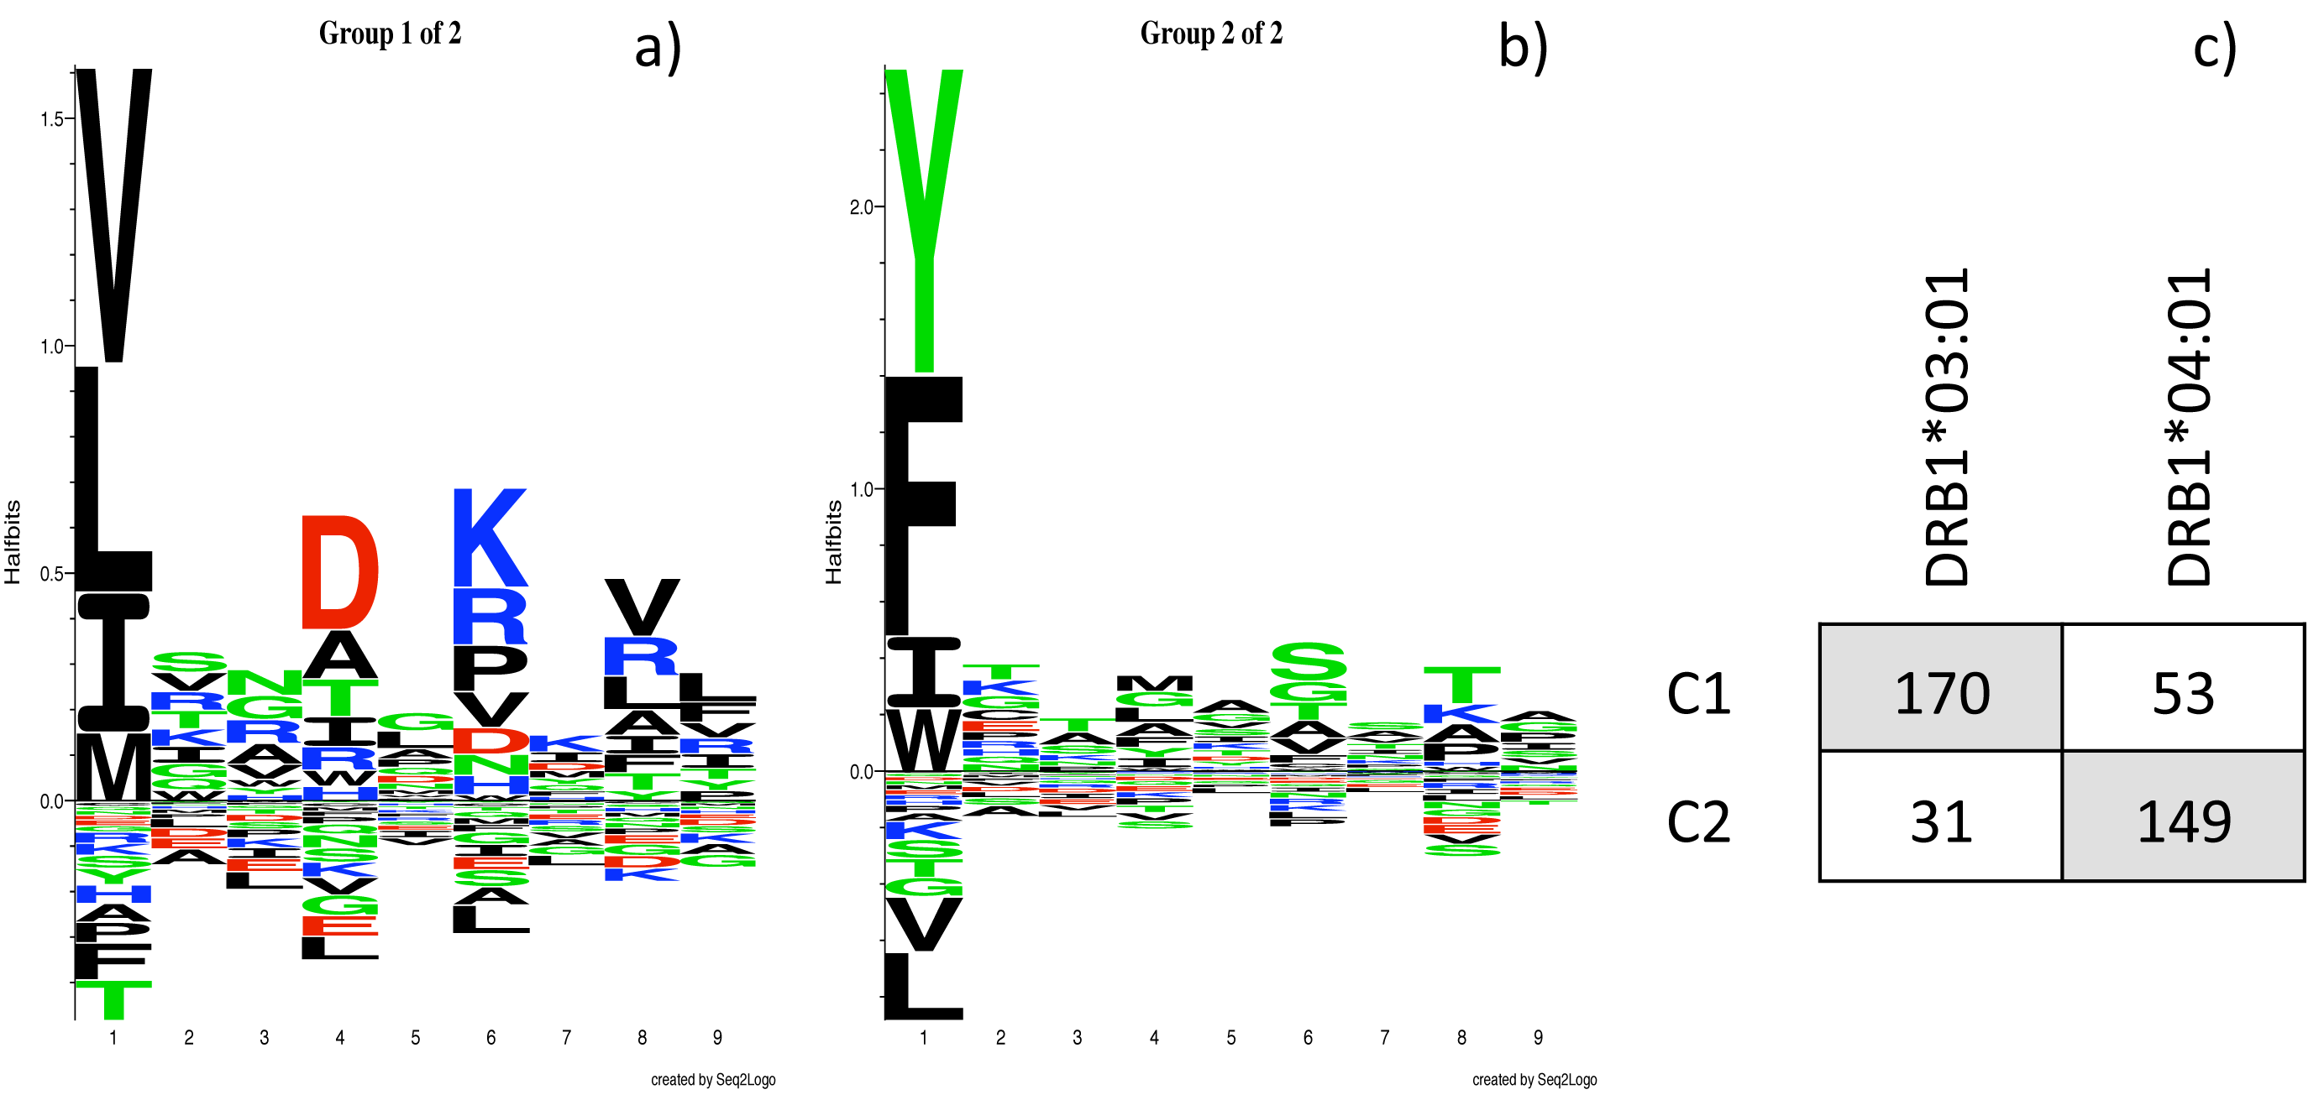
Adding in alignment (MHC class II)
HLA-DRB1*03:01
HLA-DRB1*04:01
SLFIGLKGDIRESTV
DGEEEVQLIAAVPGK
VFRLKGGAPIKGVTF
SFSCIAIGIITLYLG
IDQVTIAGAKLRSLN
WIQKETLVTFKNPHAKKQDV
KMLLDNINTPEGIIP
ELLEFHYYLSSKLNK
LNKFISPKSVAGRFA
ESLHNPYPDYHWLRT
NKVKSLRILNTRRKL
MMGMFNMLSTVLGVS
AKSSPAYPSVLGQTI
RHLIFCHSKKKCDELAAK

Slide 45
Dealing with noisy data
Experimental data often contain false positives
Outliers do not match any recurrent motif
Introduce a garbage bin to collect outliers

Slide 46
Dealing with noisy data
Introduce a garbage bin to collect outliers
SLFIGLKGDIRESTV
DGEEEVQLIAAVPGK
VFRLKGGAPIKGVTF
SFSCIAIGIITLYLG
IDQVTIAGAKLRSLN
WIQKETLVTFKNPHAKKQDV
KMLLDNINTPEGIIP
ELLEFHYYLSSKLNK
LNKFISPKSVAGRFA
ESLHNPYPDYHWLRT
NKVKSLRILNTRRKL
MMGMFNMLSTVLGVS
AKSSPAYPSVLGQTI
RHLIFCHSKKKCDELAAK
Move to the trash cluster peptides that do not match any motif
g1
g2
gn
trash

Slide 47
Dealing with noisy data
200 binders to 3 MHC class I alleles
50 random sequences are added to the data set
3 alleles | HLA-A0101 | HLA-B0702 | HLA-B4001 | Random
g0 | 0 | 197 | 2 | 6 | 205
g1 | 199 | 1 | 0 | 2 | 202
g2 | 0 | 0 | 196 | 5 | 201
trash | 1 | 2 | 2 | 37 | 42
 | 200 | 200 | 200 | 50

Slide 48
Dealing with noisy data
200 binders to 3 MHC class I alleles
50 random sequences are added to the data set
3 alleles | HLA-A0101 | HLA-B0702 | HLA-B4001 | Random
g0 | 0 | 197 | 2 | 6 | 205
g1 | 199 | 1 | 0 | 2 | 202
g2 | 0 | 0 | 196 | 5 | 201
trash | 1 | 2 | 2 | 37 | 42
 | 200 | 200 | 200 | 50
DHHFTPQII
ELPIVTPAL
ADKNLIKCS
NAFGWENAY
SQTSYQYLI

Slide 49
Dealing with noisy data

Slide 50
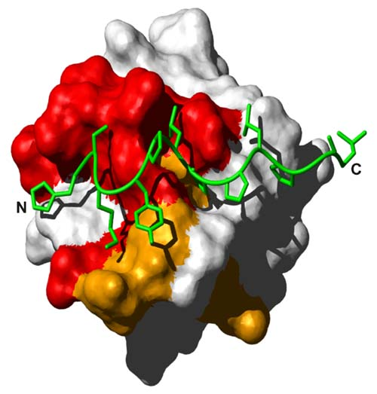
SH3 domains
SH3 domains are small interaction modules abundantly found in eukaryotes
They preferentially bind proline-rich regions (minimum consensus sequence is PxxP)
Two main classes of ligands exist:
class I
+xφPxφP
class II
φPxφPx+
Surface representation of the Hck SH3 domain bound to an artificial high-affinity peptide ligand, in green. Schmidt et al. (2007)
+: R or K
φ: hydrophobic
x: any amino acid

Slide 51
SH3 domains - Gibbs clustering
Large data set of 2,457 unique peptide sequences* binding to Src SH3 domain
12 amino acids long peptides, unaligned with respect to the binding core
WVTAPRSLPVLP
GSWVVDISNVED
NYSGNRPLPGIW
RSPIVRQLPSLP
RALPVMPTNGPM
AKSRPLPMVGLV
VRPLPSPEGFGQ
YRGRMLPVIWGT
RALPLPRAYEGI
VPLLPIRNGAVN
PVRVLPNIPLSV
...
*Kim, T., et al. (2011) MUSI: an integrated system for identifying multiple specificity from large peptide or nucleic acid data sets, Nucleic Acids Res, 1-8.

Slide 52
SH3 domains
Gibbs clustering - 1 cluster
class I
+xφPxφP
class II
φPxφPx+
2,350 sequences
(107 to trash)

Slide 53
SH3 domains
Gibbs clustering - 2 clusters
Class I
Class II
class I
+xφPxφP
class II
φPxφPx+
1,928 sequences
466 sequences
(63 to trash)

Slide 54
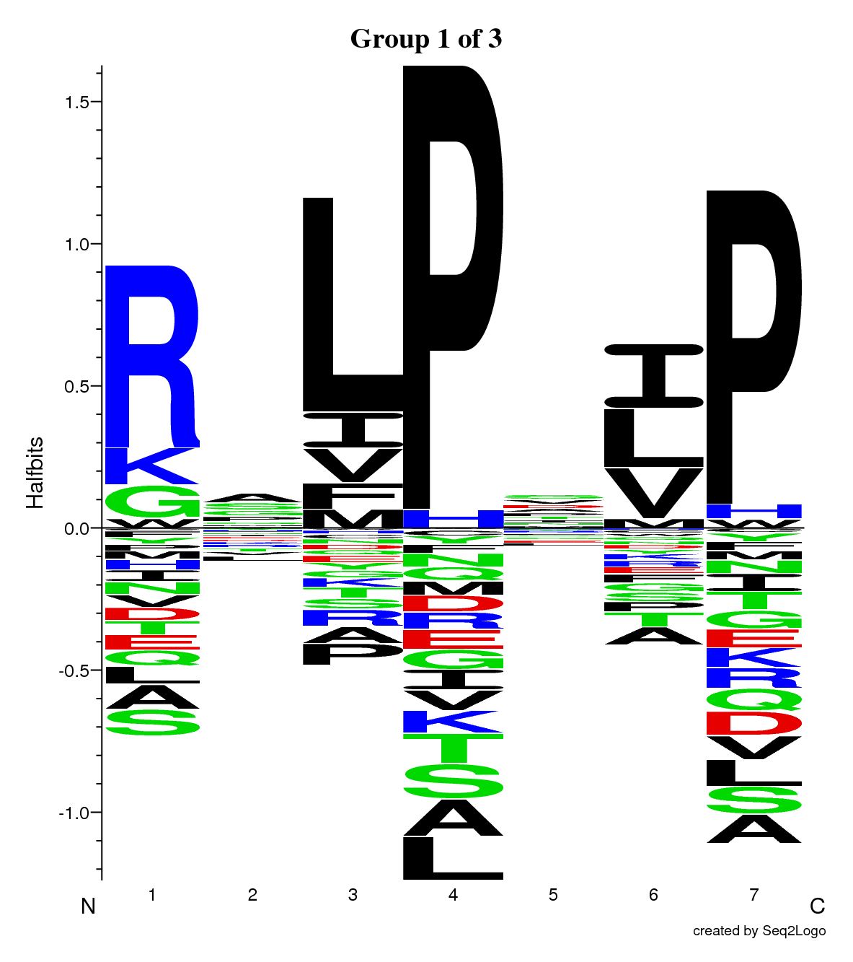
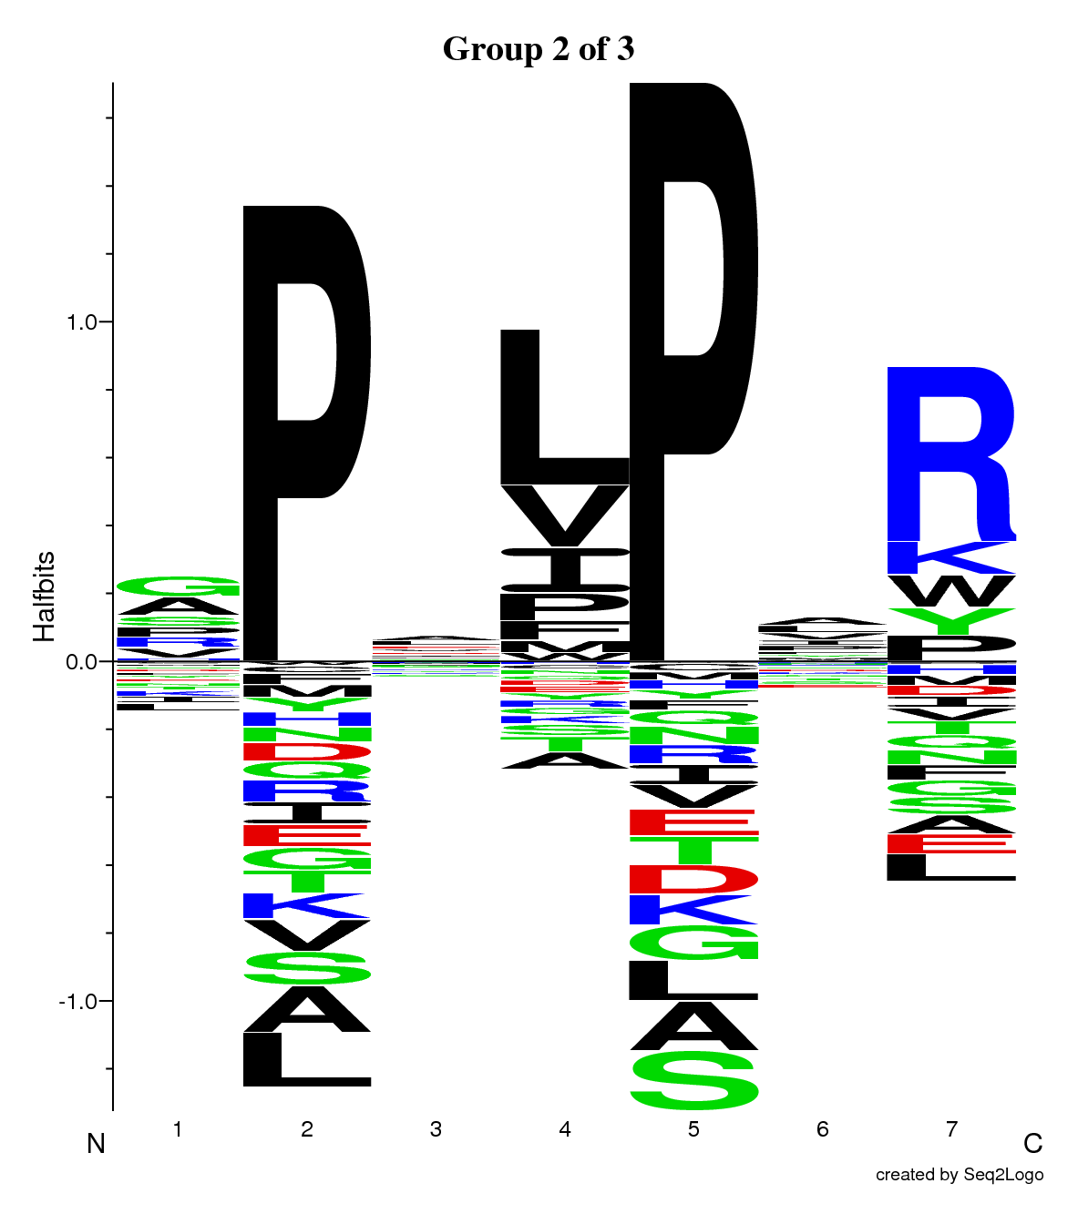
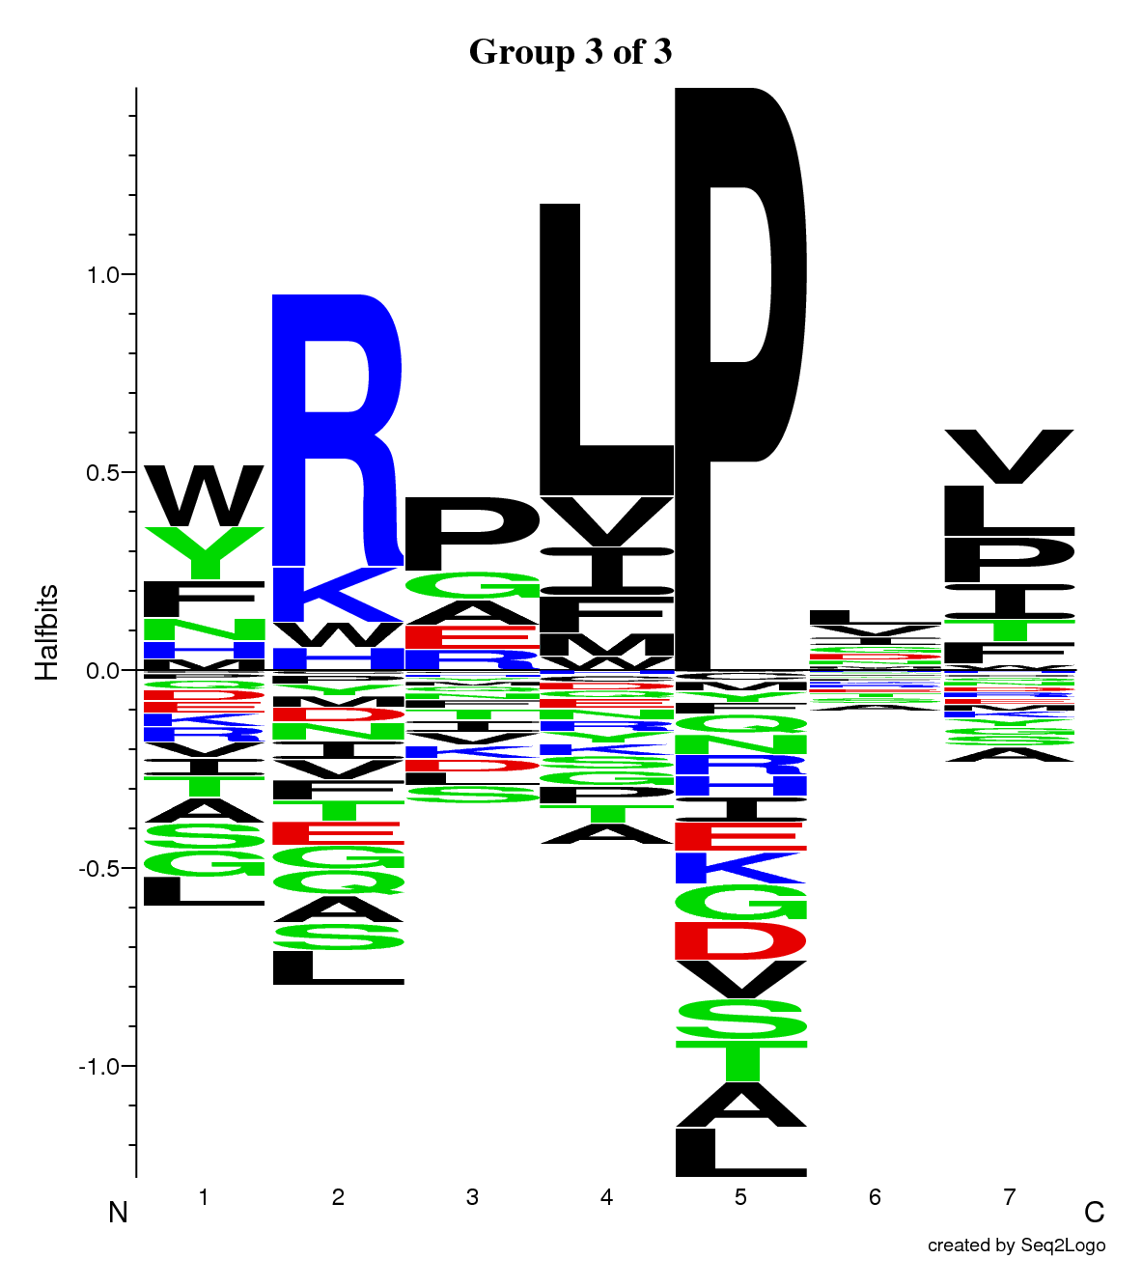
SH3 domains
Gibbs clustering - 3 clusters
class I
+xφPxφP
class II
φPxφPx+
1,404 sequences
445 sequences
560 sequences
(48 to trash)

Slide 55
SH3 domains
class I
+xφPxφP
class II
φPxφPx+
Optimal solution has two specificities

Slide 56
http://www.cbs.dtu.dk/services/GibbsCluster

Slide 57
Acknowledgements
Massimo Andreatta, PhD (for doing all the work)
John Sidney (La Jolla Institute for Allergy and Immunology, California, USA) for the binding affinity validation of the predicted MHC class I outliers.
The European Union 7th Framework Program FP7/2007-2013 [grant number 222773]
Notes:
57

