Slide 1
Blast heuristics, Psi-Blast, and Sequence profiles Morten Nielsen Department of Health Technology, DTU

Slide 2
Outline
Basic Local Alignment Search Tool
What are the Blast heuristics?
How does Blast calculate E-values?
What are the limits of Blast?
Understand why BLAST often fails for low sequence similarity
Psi-Blast
Why does it work so much better
See the beauty of sequence profiles
Position specific scoring matrices (PSSMs)
Use BLAST to generate sequence profiles
Use profiles to identify amino acids essential for protein function and structure

Slide 3
Why alignment is slow
99% of the cpu time is spend aligning no-similar sequences
The execution time for gapped alignments is 500 times that for un-gapped

Slide 4
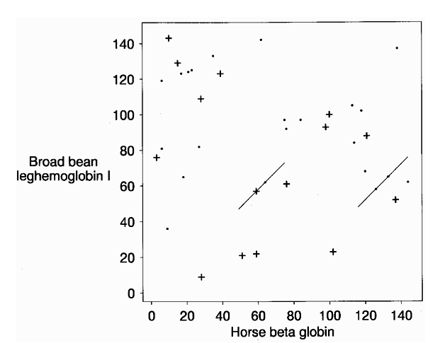
Blast heuristics
Hits (High scoring segment pairs, HSP)
Triplets of amino acids that scores at least T
Notes:
15 hits score 13 (+). Additional 22 hits score 11 (.). Two hits with T=11 heuristics trigger extension

Slide 5
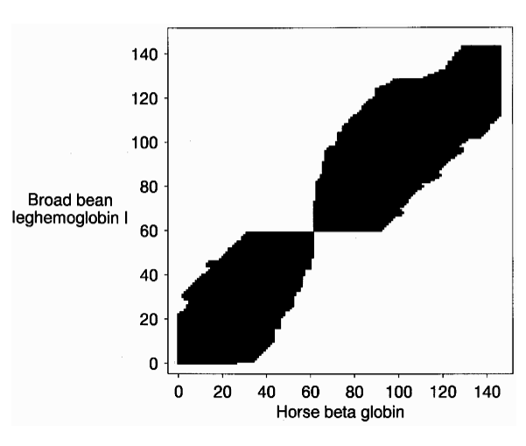
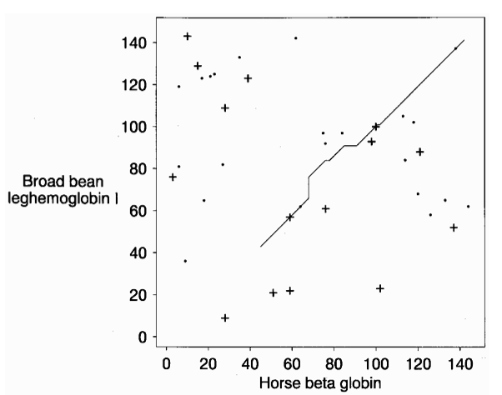
Hit extension

Slide 6
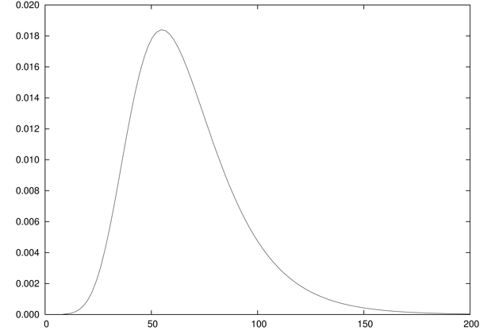
What are P and E values?
E-value
Number of expected hits in database with score higher than match
Depends on database size
P-value
Probability that a random hit will have score higher than match
Database size independent
Score 150
10 hits with higher score (E=10)
10000 hits in database => P=10/10000 = 0.001
P(Score)
Score

Slide 7
Blast E-values
Normalized score S’ (bit score) is
λ and K are calculable given s_{ij} and p_{i}
The number E of sequences with a score of at least S’ is
Altschul et al., 1997. Nucleic Acids Research

Slide 8
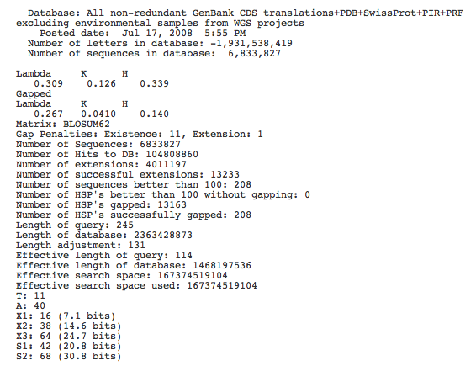
Blast output

Slide 9
Edge Effects
A high-scoring alignment must have some length, and therefore can not begin near to the end of either of two sequences being compared. This "edge effect" may be corrected for by calculating an "effective length" for sequences; the BLAST programs implement such a correction.

Slide 10
Blast output

Slide 11
Blast E-values. Example
Score = 506 bits (1302), Expect = 7e-142,
Identities = 245/245 (100%), Positives = 245/245 (100%)
..
Lambda K
0.267 0.0410
Matrix: BLOSUM62
The number E of sequences with a score of at least S’ is
Database length query length

Slide 12
Blast
Only align subset of sequences
Only do gap extension at few seed sites
Only extend gaps close to diagonal
Approximate (and conservative) E-value estimates
Details on the Blast algorithm
www.ncbi.nlm.nih.gov/BLAST/tutorial/Altschul-1.html

Slide 13
What goes wrong when Blast fails?
Conventional sequence alignment uses a (Blosum) scoring matrix to identify amino acid matches in the two protein sequences

Slide 14
Blosum scoring matrix
A R N D C Q E G H I L K M F P S T W Y V
A 4 -1 -2 -2 0 -1 -1 0 -2 -1 -1 -1 -1 -2 -1 1 0 -3 -2 0
R -1 5 0 -2 -3 1 0 -2 0 -3 -2 2 -1 -3 -2 -1 -1 -3 -2 -3
N -2 0 6 1 -3 0 0 0 1 -3 -3 0 -2 -3 -2 1 0 -4 -2 -3
D -2 -2 1 6 -3 0 2 -1 -1 -3 -4 -1 -3 -3 -1 0 -1 -4 -3 -3
C 0 -3 -3 -3 9 -3 -4 -3 -3 -1 -1 -3 -1 -2 -3 -1 -1 -2 -2 -1
Q -1 1 0 0 -3 5 2 -2 0 -3 -2 1 0 -3 -1 0 -1 -2 -1 -2
E -1 0 0 2 -4 2 5 -2 0 -3 -3 1 -2 -3 -1 0 -1 -3 -2 -2
G 0 -2 0 -1 -3 -2 -2 6 -2 -4 -4 -2 -3 -3 -2 0 -2 -2 -3 -3
H -2 0 1 -1 -3 0 0 -2 8 -3 -3 -1 -2 -1 -2 -1 -2 -2 2 -3
I -1 -3 -3 -3 -1 -3 -3 -4 -3 4 2 -3 1 0 -3 -2 -1 -3 -1 3
L -1 -2 -3 -4 -1 -2 -3 -4 -3 2 4 -2 2 0 -3 -2 -1 -2 -1 1
K -1 2 0 -1 -3 1 1 -2 -1 -3 -2 5 -1 -3 -1 0 -1 -3 -2 -2
M -1 -1 -2 -3 -1 0 -2 -3 -2 1 2 -1 5 0 -2 -1 -1 -1 -1 1
F -2 -3 -3 -3 -2 -3 -3 -3 -1 0 0 -3 0 6 -4 -2 -2 1 3 -1
P -1 -2 -2 -1 -3 -1 -1 -2 -2 -3 -3 -1 -2 -4 7 -1 -1 -4 -3 -2
S 1 -1 1 0 -1 0 0 0 -1 -2 -2 0 -1 -2 -1 4 1 -3 -2 -2
T 0 -1 0 -1 -1 -1 -1 -2 -2 -1 -1 -1 -1 -2 -1 1 5 -2 -2 0
W -3 -3 -4 -4 -2 -2 -3 -2 -2 -3 -2 -3 -1 1 -4 -3 -2 11 2 -3
Y -2 -2 -2 -3 -2 -1 -2 -3 2 -1 -1 -2 -1 3 -3 -2 -2 2 7 -1
V 0 -3 -3 -3 -1 -2 -2 -3 -3 3 1 -2 1 -1 -2 -2 0 -3 -1 4

Slide 15
What goes wrong when Blast fails?
Conventional sequence alignment uses a (Blosum) scoring matrix to identify amino acids matches in the two protein sequences
This scoring matrix is identical at all positions in the protein sequence!
EVVFIGDSLVQLMHQC
X
X
X
X
X
X
AGDS.GGGDS

Slide 16
Alignment
Blosum62 score matrix. Fg=1. Ng=0?
Score =2+6+6+4-1=17
Alignment
 | L | A | G | D | S | D
F | 0 | -2 | -3 | -3 | -2 | -3
I | 2 | 1 | -4 | -3 | -2 | -3
G | -4 | 0 | 6 | -1 | 0 | -1
D | -4 | -2 | -1 | 6 | 0 | 6
S | -2 | 1 | 0 | 0 | 4 | 0
L | 4 | -1 | -4 | -4 | -2 | -4
LAGDS
I-GDS

Slide 17
When Blast works!
1PLC._
1PLB._

Slide 18
When Blast fails!
1PLC._
1PMY._

Slide 19
Sequence profiles
In reality not all positions in a protein are equally likely to mutate
Some amino acids (active cites) are highly conserved, and the score for mismatch must be very high
Other amino acids can mutate almost for free, and the score for mismatch should be lower than the BLOSUM score
Sequence profiles can capture these differences

Slide 20
Sequence profiles
TVNGQ--FPGPRLAGVAREGDQVLVKVVNHVAENITIHWHGVQLGTGWADGPAYVTQCPI
TKAVVLTFNTSVEICLVMQGTSIV----AAESHPLHLHGFNFPSNFNLVDPMERNTAGVP

Slide 21
Sequence profiles - OR
TVNGQ—-FPGPRLAGVAREGDQVLVKVVNHVA---ENITIHWHGVQLGTGWADGPAYVTQCPI
TKAVVLTFNTSVEICLVMQGTSIVAAESHPLHLHGFNFPSNFNLVDPMERNTAGVP

Slide 22
Sequence profiles
Conserved
Non-conserved
ADDGSLAFVPSEF--SISPGEKIVFKNNAGFPHNIVFDEDSIPSGVDASKISMSEEDLLN
TVNGAI--PGPLIAERLKEGQNVRVTNTLDEDTSIHWHGLLVPFGMDGVPGVSFPG---I
-TSMAPAFGVQEFYRTVKQGDEVTVTIT-----NIDQIED-VSHGFVVVNHGVSME---I
IE--KMKYLTPEVFYTIKAGETVYWVNGEVMPHNVAFKKGIV--GEDAFRGEMMTKD---
-TSVAPSFSQPSF-LTVKEGDEVTVIVTNLDE------IDDLTHGFTMGNHGVAME---V
ASAETMVFEPDFLVLEIGPGDRVRFVPTHK-SHNAATIDGMVPEGVEGFKSRINDE----
TVNGQ--FPGPRLAGVAREGDQVLVKVVNHVAENITIHWHGVQLGTGWADGPAYVTQCPI
TVNGQ--FPGPRLAGVAREGDQVLVKVVNHVAENITIHWHGVQLGTGWADGPAYVTQCPI
TKAVVLTFNTSVEICLVMQGTSIV----AAESHPLHLHGFNFPSNFNLVDPMERNTAGVP
Matching any thing but G => large negative score
Any thing can match

Slide 23
Sequence profiles
TVNGQ--FPGPRLAGVAREGDQVLVKVVNHVAENITIHWHGVQLGTGWADPPAYVTQCPI

Slide 24
Sequence profiles
Conserved
Non-conserved
ADDGSLAFVPSEF--SISPGEKIVFKNNAGFPHNIVFDEDSIPSGVDASKISMSEEDLLN
TVNGAI--PGPLIAERLKEGQNVRVTNTLDEDTSIHWHGLLVPFGMDGVPGVSFPG---I
-TSMAPAFGVQEFYRTVKQGDEVTVTIT-----NIDQIED-VSHGFVVVNHGVSME---I
IE--KMKYLTPEVFYTIKAGETVYWVNGEVMPHNVAFKKGIV--GEDAFRGEMMTKD---
-TSVAPSFSQPSF-LTVKEGDEVTVIVTNLDE------IDDLTHGFTMGNHGVAME---V
ASAETMVFEPDFLVLEIGPGDRVRFVPTHK-SHNAATIDGMVPEGVEGFKSRINDE----
TVNGQ--FPGPRLAGVAREGDQVLVKVVNHVAENITIHWHGVQLGTGWADPPAYVTQCPI
TKAVVLTFNTSVEICLVMQGTSIV----AAESHPLHLHGFNFPSNFNLVDGMERNTAGVP
Matching any thing but G => large negative score
Any thing can match

Slide 25
Visualization of Sequence logos
ALAKAAAAM
ALAKAAAAN
ALAKAAAAR
ALAKAAAAT
ALAKAAAAV
GMNERPILT
GILGFVFTM
TLNAWVKVV
KLNEPVLLL
AVVPFIVSV
P_{A} = 6/10 = 0.6
P_{G} = 2/10 = 0.2
P_{T} = P_{K} = 1/10 = 0.1
P_{C} = P_{D} = …P_{V} = 0.0
q_{A} = 0.07
q_{G} = 0.07
q_{T} = 0.05
q_{K} = 0.06

Slide 26
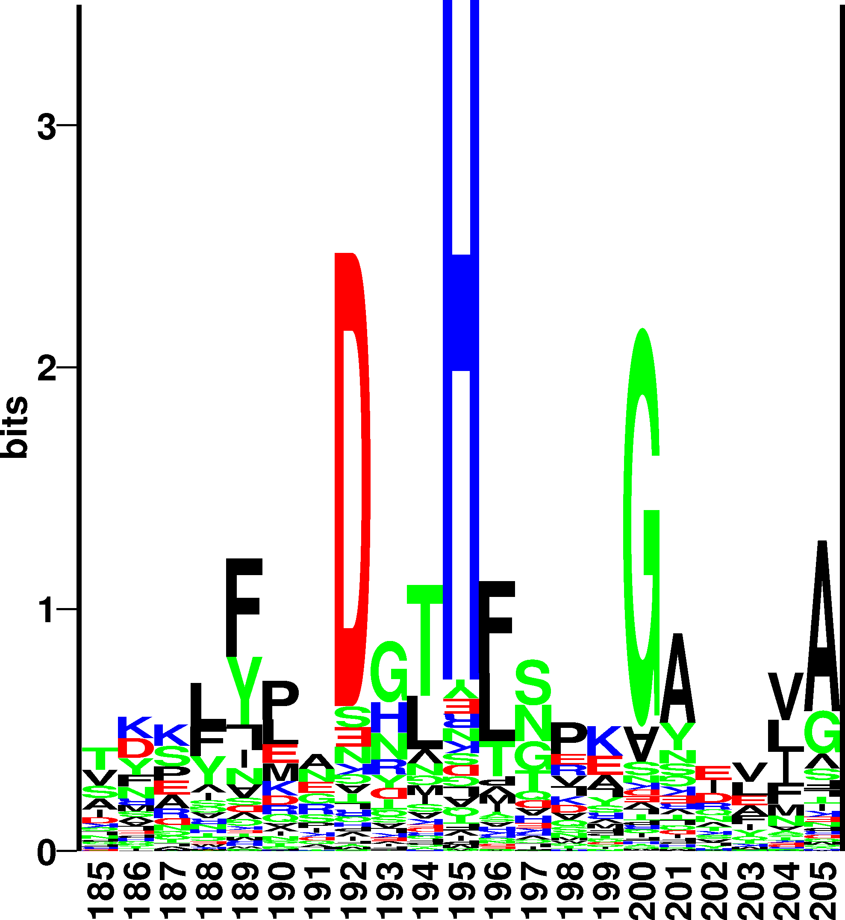
Sequence logos (Kullback-Leibler)
High information
positions
Height of a column equal to I
Relative height of a letter is p
(Letters upside-down if p_{a} < q_{a})

Slide 27
How to make sequence profiles
Align (BLAST) sequence against large sequence database (Swiss-Prot)
Select significant alignments and make sequence profile
Use profile to align against sequence database to find new significant hits
Repeat 2 and 3 (normally 3 times!)

Slide 28
Blast iterations
Protein world
Protein

Slide 29
How to make sequence profiles
The blast command
blastpgp -d db -e 0.00001 -j 4 -Q blastprofile -i fastafile -o out
Last position-specific scoring matrix computed
A R N D C Q E G H I L K M F P S T W Y V
1 T -1 -3 -2 -3 -3 -2 -2 -3 -3 -3 -4 -2 -3 -4 -3 5 6 -5 -4 -3
2 T -3 1 -1 -4 -4 -2 -3 -4 -4 -4 -4 5 -4 -5 -4 -2 6 -5 -4 -3
3 V -3 -4 -6 -6 -4 -5 -6 -5 -6 6 2 -5 -2 -2 -6 -5 -3 1 -4 4
4 Y 0 -5 -6 -6 1 -3 -5 -2 -1 0 2 -5 -2 4 -6 -4 -4 0 4 4
5 L -2 -5 -6 -6 3 -5 -6 -6 -5 3 4 -5 1 5 -6 -5 -1 -1 -1 1
6 A 3 -5 -5 -6 0 -2 -5 -3 -5 3 1 -5 1 4 -5 -4 -1 -1 -2 2
7 G -3 -5 -3 -4 -6 -5 -5 7 -5 -7 -7 -5 -6 -6 -5 -2 -4 -6 -6 -6
8 D -3 -4 1 8 -6 -3 -1 -4 -4 -6 -6 -4 -6 -6 -4 -3 -3 -7 -6 -6
9 S -2 -4 -1 -3 -4 -3 -3 -3 -4 -5 -6 -3 -5 -6 -4 7 -2 -6 -5 -5
10 T -2 -3 -4 -5 -4 -3 -5 -5 -5 6 1 -4 -2 -4 -5 -3 5 -5 -4 0
11 M 0 -4 -3 -4 -4 -4 -3 -4 -5 -1 -2 -4 3 -2 -2 1 6 -5 -4 2
12 A 4 -1 0 0 1 2 0 -2 2 -4 -4 -1 -3 -1 -3 0 -1 1 -1 -2

Slide 30
Sequence profiles for a single sequence
A R N D C Q E G H I L K M F P S T W Y V
A 4 -1 -2 -2 0 -1 -1 0 -2 -1 -1 -1 -1 -2 -1 1 0 -3 -2 0
R -1 5 0 -2 -3 1 0 -2 0 -3 -2 2 -1 -3 -2 -1 -1 -3 -2 -3
N -2 0 6 1 -3 0 0 0 1 -3 -3 0 -2 -3 -2 1 0 -4 -2 -3
D -2 -2 1 6 -3 0 2 -1 -1 -3 -4 -1 -3 -3 -1 0 -1 -4 -3 -3
C 0 -3 -3 -3 9 -3 -4 -3 -3 -1 -1 -3 -1 -2 -3 -1 -1 -2 -2 -1
Q -1 1 0 0 -3 5 2 -2 0 -3 -2 1 0 -3 -1 0 -1 -2 -1 -2
E -1 0 0 2 -4 2 5 -2 0 -3 -3 1 -2 -3 -1 0 -1 -3 -2 -2
G 0 -2 0 -1 -3 -2 -2 6 -2 -4 -4 -2 -3 -3 -2 0 -2 -2 -3 -3
H -2 0 1 -1 -3 0 0 -2 8 -3 -3 -1 -2 -1 -2 -1 -2 -2 2 -3
I -1 -3 -3 -3 -1 -3 -3 -4 -3 4 2 -3 1 0 -3 -2 -1 -3 -1 3
L -1 -2 -3 -4 -1 -2 -3 -4 -3 2 4 -2 2 0 -3 -2 -1 -2 -1 1
K -1 2 0 -1 -3 1 1 -2 -1 -3 -2 5 -1 -3 -1 0 -1 -3 -2 -2
M -1 -1 -2 -3 -1 0 -2 -3 -2 1 2 -1 5 0 -2 -1 -1 -1 -1 1
F -2 -3 -3 -3 -2 -3 -3 -3 -1 0 0 -3 0 6 -4 -2 -2 1 3 -1
P -1 -2 -2 -1 -3 -1 -1 -2 -2 -3 -3 -1 -2 -4 7 -1 -1 -4 -3 -2
S 1 -1 1 0 -1 0 0 0 -1 -2 -2 0 -1 -2 -1 4 1 -3 -2 -2
T 0 -1 0 -1 -1 -1 -1 -2 -2 -1 -1 -1 -1 -2 -1 1 5 -2 -2 0
W -3 -3 -4 -4 -2 -2 -3 -2 -2 -3 -2 -3 -1 1 -4 -3 -2 11 2 -3
Y -2 -2 -2 -3 -2 -1 -2 -3 2 -1 -1 -2 -1 3 -3 -2 -2 2 7 -1
V 0 -3 -3 -3 -1 -2 -2 -3 -3 3 1 -2 1 -1 -2 -2 0 -3 -1 4
TKAVVLTFNTSVEICLVMQGTSIV----AAESHPLHLHGFNFPSNFNLVDPMERNTAGVP

Slide 31
Sequence profiles (1K7C.A)
A R N D C Q E G H I L K M F P S T W Y V
A 4 -1 -2 -2 0 -1 -1 0 -2 -1 -1 -1 -1 -2 -1 1 0 -3 -2 0
R -1 5 0 -2 -3 1 0 -2 0 -3 -2 2 -1 -3 -2 -1 -1 -3 -2 -3
N -2 0 6 1 -3 0 0 0 1 -3 -3 0 -2 -3 -2 1 0 -4 -2 -3
D -2 -2 1 6 -3 0 2 -1 -1 -3 -4 -1 -3 -3 -1 0 -1 -4 -3 -3
C 0 -3 -3 -3 9 -3 -4 -3 -3 -1 -1 -3 -1 -2 -3 -1 -1 -2 -2 -1
Q -1 1 0 0 -3 5 2 -2 0 -3 -2 1 0 -3 -1 0 -1 -2 -1 -2
E -1 0 0 2 -4 2 5 -2 0 -3 -3 1 -2 -3 -1 0 -1 -3 -2 -2
G 0 -2 0 -1 -3 -2 -2 6 -2 -4 -4 -2 -3 -3 -2 0 -2 -2 -3 -3
H -2 0 1 -1 -3 0 0 -2 8 -3 -3 -1 -2 -1 -2 -1 -2 -2 2 -3
I -1 -3 -3 -3 -1 -3 -3 -4 -3 4 2 -3 1 0 -3 -2 -1 -3 -1 3
L -1 -2 -3 -4 -1 -2 -3 -4 -3 2 4 -2 2 0 -3 -2 -1 -2 -1 1
K -1 2 0 -1 -3 1 1 -2 -1 -3 -2 5 -1 -3 -1 0 -1 -3 -2 -2
M -1 -1 -2 -3 -1 0 -2 -3 -2 1 2 -1 5 0 -2 -1 -1 -1 -1 1
F -2 -3 -3 -3 -2 -3 -3 -3 -1 0 0 -3 0 6 -4 -2 -2 1 3 -1
P -1 -2 -2 -1 -3 -1 -1 -2 -2 -3 -3 -1 -2 -4 7 -1 -1 -4 -3 -2
S 1 -1 1 0 -1 0 0 0 -1 -2 -2 0 -1 -2 -1 4 1 -3 -2 -2
T 0 -1 0 -1 -1 -1 -1 -2 -2 -1 -1 -1 -1 -2 -1 1 5 -2 -2 0
W -3 -3 -4 -4 -2 -2 -3 -2 -2 -3 -2 -3 -1 1 -4 -3 -2 11 2 -3
Y -2 -2 -2 -3 -2 -1 -2 -3 2 -1 -1 -2 -1 3 -3 -2 -2 2 7 -1
V 0 -3 -3 -3 -1 -2 -2 -3 -3 3 1 -2 1 -1 -2 -2 0 -3 -1 4
0 iterations (Blosum62)

Slide 32
Sequence profiles (1K7C.A)
A R N D C Q E G H I L K M F P S T W Y V
A 4 -1 -2 -2 0 -1 -1 0 -2 -1 -1 -1 -1 -2 -1 1 0 -3 -2 0
R -1 5 0 -2 -3 1 0 -2 0 -3 -2 2 -1 -3 -2 -1 -1 -3 -2 -3
N -2 0 6 1 -3 0 0 0 1 -3 -3 0 -2 -3 -2 1 0 -4 -2 -3
D -2 -2 1 6 -3 0 2 -1 -1 -3 -4 -1 -3 -3 -1 0 -1 -4 -3 -3
C 0 -3 -3 -3 9 -3 -4 -3 -3 -1 -1 -3 -1 -2 -3 -1 -1 -2 -2 -1
Q -1 1 0 0 -3 5 2 -2 0 -3 -2 1 0 -3 -1 0 -1 -2 -1 -2
E -1 0 0 2 -4 2 5 -2 0 -3 -3 1 -2 -3 -1 0 -1 -3 -2 -2
G 0 -2 0 -1 -3 -2 -2 6 -2 -4 -4 -2 -3 -3 -2 0 -2 -2 -3 -3
H -2 0 1 -1 -3 0 0 -2 8 -3 -3 -1 -2 -1 -2 -1 -2 -2 2 -3
I -1 -3 -3 -3 -1 -3 -3 -4 -3 4 2 -3 1 0 -3 -2 -1 -3 -1 3
L -1 -2 -3 -4 -1 -2 -3 -4 -3 2 4 -2 2 0 -3 -2 -1 -2 -1 1
K -1 2 0 -1 -3 1 1 -2 -1 -3 -2 5 -1 -3 -1 0 -1 -3 -2 -2
M -1 -1 -2 -3 -1 0 -2 -3 -2 1 2 -1 5 0 -2 -1 -1 -1 -1 1
F -2 -3 -3 -3 -2 -3 -3 -3 -1 0 0 -3 0 6 -4 -2 -2 1 3 -1
P -1 -2 -2 -1 -3 -1 -1 -2 -2 -3 -3 -1 -2 -4 7 -1 -1 -4 -3 -2
S 1 -1 1 0 -1 0 0 0 -1 -2 -2 0 -1 -2 -1 4 1 -3 -2 -2
T 0 -1 0 -1 -1 -1 -1 -2 -2 -1 -1 -1 -1 -2 -1 1 5 -2 -2 0
W -3 -3 -4 -4 -2 -2 -3 -2 -2 -3 -2 -3 -1 1 -4 -3 -2 11 2 -3
Y -2 -2 -2 -3 -2 -1 -2 -3 2 -1 -1 -2 -1 3 -3 -2 -2 2 7 -1
V 0 -3 -3 -3 -1 -2 -2 -3 -3 3 1 -2 1 -1 -2 -2 0 -3 -1 4
0 iterations (Blosum62)

Slide 33
Sequence profiles (1K7C.A)
3 iterations
Sequence profile
A R N D C Q E G H I L K M F P S T W Y V
T -1 -2 -1 -2 -2 -2 -2 -3 -3 -2 -3 -2 -2 -4 -2 2 6 -4 -3 -1
T -2 3 -2 -3 -3 -2 -3 -4 -3 -3 -4 2 -3 -4 -3 -1 6 -5 -4 -3
V -3 -5 -6 -6 -3 -5 -5 -6 -5 6 2 -5 -1 0 -5 -4 -3 -5 -3 4
Y -3 -5 -5 -6 -4 -4 -5 -3 1 -1 0 -5 -2 6 -5 -4 -4 2 6 2
L -4 -5 -6 -6 1 -5 -5 -6 -5 4 5 -5 1 1 -5 -5 -2 0 -3 1
A 4 -4 -4 -5 2 -4 -4 -2 -5 3 -1 -4 -2 1 -4 -2 -1 -5 -3 2
G -2 -5 -3 -4 -5 -4 -4 7 -4 -6 -6 -4 -5 -5 -4 -1 -4 -5 -5 -5
D -4 -4 0 8 -6 -3 -1 -4 -3 -6 -6 -3 -5 -6 -4 -3 -3 -7 -5 -6
S -1 -3 -2 -3 -3 -2 -2 -3 -3 -5 -5 -3 -4 -5 -3 7 -1 -5 -4 -4
T -3 -4 -3 -4 -3 -3 -3 -4 -4 2 -1 -3 -3 -4 -4 -1 7 -5 -4 -2
M 2 -4 -4 -4 -3 -3 -4 -4 -4 -1 -2 -4 5 -3 -4 -1 3 -5 -4 4
A 5 -2 -1 -1 3 0 -2 -1 -3 -4 -4 -1 -3 -4 -3 1 -2 -4 0 -3
K -1 2 1 3 -4 0 0 0 -3 -2 -4 2 -3 -5 -2 -1 2 -5 -4 1
N -2 -3 3 2 2 1 0 -1 -2 -4 -3 -1 -3 -1 -4 -1 -1 -2 6 -4
G -2 -3 -1 -1 -4 1 0 4 -3 -4 -3 -1 -4 -4 3 1 -3 -4 1 -3
G 0 -2 2 3 -3 0 0 3 1 -3 -2 0 -3 -2 -1 0 0 -3 0 -3
G 1 1 3 -1 -3 -1 0 1 2 -3 -2 0 -3 -3 -1 1 0 0 1 -2
S 2 2 3 1 -3 -2 0 1 0 -3 -3 -1 -3 -3 -3 0 -1 -3 2 -3
G 0 -3 -1 -3 -3 -3 -3 2 -3 -3 -1 -1 -3 -4 6 -1 -2 -4 -3 -1
T -1 1 -2 -2 -3 3 2 -2 -2 -1 -1 1 2 -1 0 -1 1 2 2 -2

Slide 34
Example. Are these two sequences alike?
>1K7C.A
TTVYLAGDSTMAKNGGGSGTNGWGEYLASYLSATVVNDAVAGRSARSYTREGRFENIADV
VTAGDYVIVEFGHNDGGSLSTDNGRTDCSGTGAEVCYSVYDGVNETILTFPAYLENAAKL
FTAKGAKVILSSQTPNNPWETGTFVNSPTRFVEYAELAAEVAGVEYVDHWSYVDSIYETL
GNATVNSYFPIDHTHTSPAGAEVVAEAFLKAVVCTGTSLKSVLTTTSFEGTCL
>1WAB.A
ENPASKPTPVQDVQGDGRWMSLHHRFVADSKDKEPEVVFIGDSLVQLMHQCEIWRELFSP
LHALNFGIGGDSTQHVLWRLENGELEHIRPKIVVVWVGTNNHGHTAEQVTGGIKAIVQLV
NERQPQARVVVLGLLPRGQHPNPLREKNRRVNELVRAALAGHPRAHFLDADPGFVHSDGT
ISHHDMYDYLHLSRLGYTPVCRALHSLLLRLL

Slide 35
When Blast fails!
1K7A.A
1WAB._

Slide 36
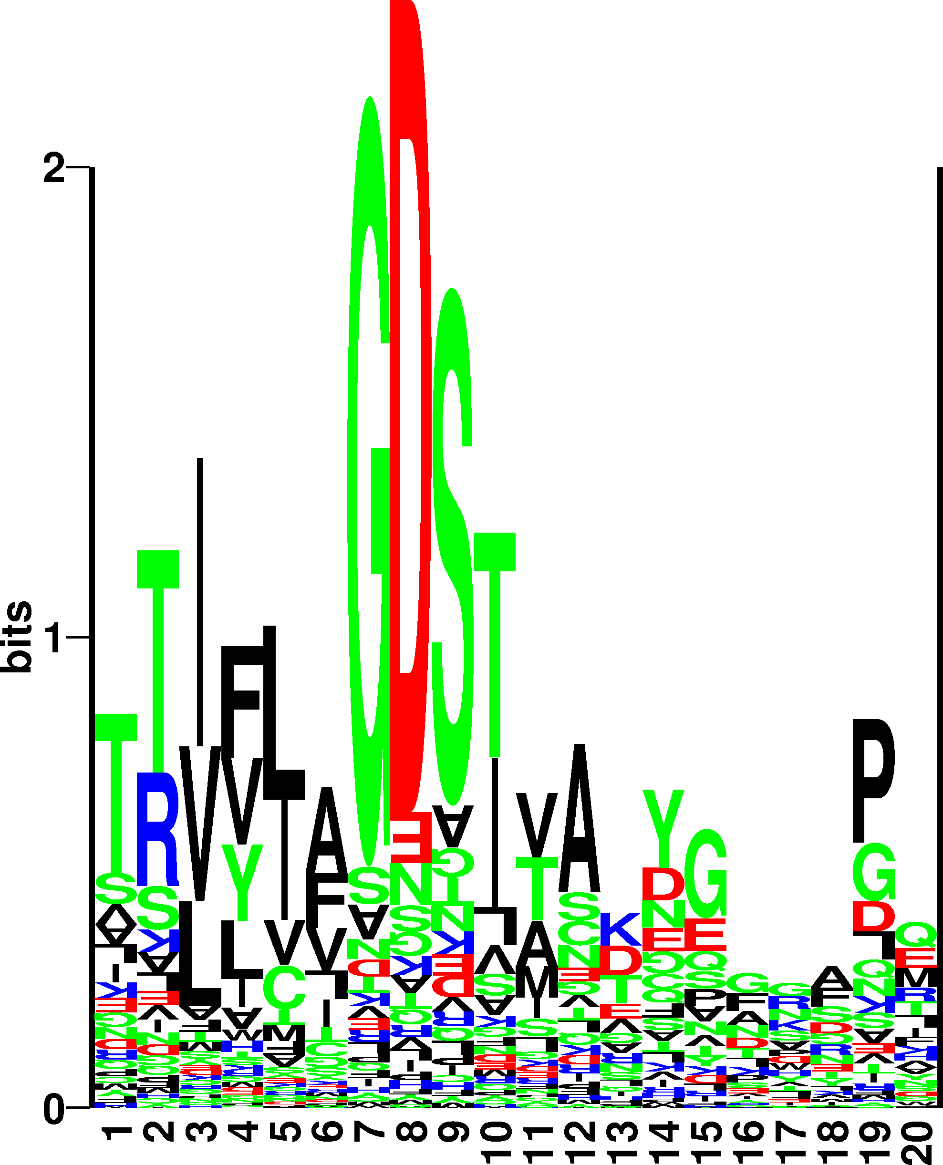
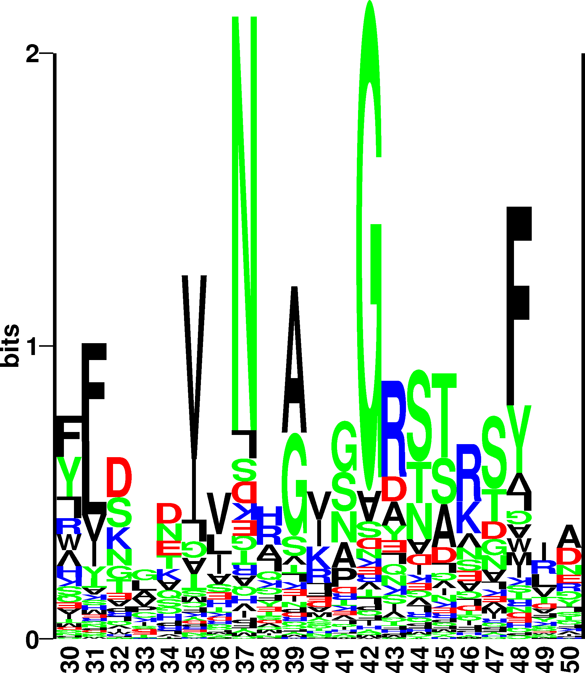
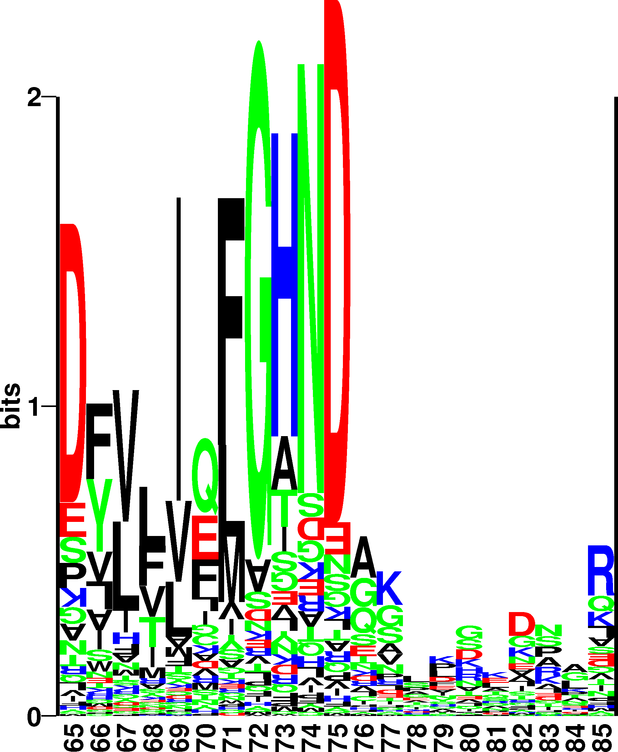
Example. (SGNH active site)

Slide 37
Example. Where is the active site?
Sequence profiles might show you where to look!
The active site could be around
S9, G42, N74, and H195

Slide 38
Profile-profile scoring matrix
1K7C.A
1WAB._

Slide 39
Profile-profile scoring matrix
Sequence profile
ARNDCQEGHILKMFPSTWYV
1K7C.A F 71 -4 -5 -5 -6 -5 -5 -5 -3 -4 -1 0 -5 4 8 -3 -4 -2 0 -3
1K7C.A G 72 0 -5 -3 -4 -5 -4 -4 7 -4 -6 -6 -4 -5 -6 -3 -4 -5 -5 -5
1K7C.A H 73 -2 -3 -1 -4 -5 -2 -3 -2 10 -1 -4 -3 -1 -4 -3 -2 -5 0 -4
1K7C.A N 74 -4 -3 8 -1 -5 -2 -3 -3 -2 -6 -6 -3 -5 -5 -2 -2 -6 -5 -5
1K7C.A D 75 -4 -4 -1 8 -6 -3 0 -4 -3 -6 -6 -3 -5 -6 -3 -3 -7 -5 -6
1K7C.A G 76 2 -2 -1 -3 -4 5 2 3 -3 -4 -4 -1 -3 -5 -1 -3 -4 -4 -2
1K7C.A G 77 -1 -1 1 -2 -3 -1 -2 3 -2 -3 -2 5 -3 -3 1 -1 -3 -1 -3
1K7C.A S 78 1 2 -1 -1 3 -2 1 -2 -2 0 -1 -1 -2 -3 1 0 -3 -1 -1
1K7C.A L 79 0 -2 1 2 -3 -1 1 -1 -2 -1 0 0 -1 -2 -1 -1 -3 -1 0
1K7C.A S 80 1 0 1 3 -2 -1 1 1 -2 -3 -3 1 -2 -3 2 -1 -3 -2 -2

Slide 40
Example. Where is the active site?
Align using sequence profiles
ALN 1K7C.A 1WAB._ RMSD = 5.29522. 14% ID
1K7C.A TVYLAGDSTMAKNGGGSGTNGWGEYLASYLSATVVNDAVAGRSARSYTREGRFENIADVVTAGDYVIVEFGHNDGGSLSTDN
S G N
1WAB._ EVVFIGDSLVQLMHQCE---IWRELFS---PLHALNFGIGGDSTQHVLW--RLENGELEHIRPKIVVVWVGTNNHG------
1K7C.A GRTDCSGTGAEVCYSVYDGVNETILTFPAYLENAAKLFTAK--GAKVILSSQTPNNPWETGTFVNSPTRFVEYAEL-AAEVA
1WAB._ ---------------------HTAEQVTGGIKAIVQLVNERQPQARVVVLGLLPRGQ-HPNPLREKNRRVNELVRAALAGHP
1K7C.A GVEYVDHWSYVDSIYETLGNATVNSYFPIDHTHTSPAGAEVVAEAFLKAVVCTGTSL
H
1WAB._ RAHFLDADPG---FVHSDG--TISHHDMYDYLHLSRLGYTPVCRALHSLLLRL---L

Slide 41
Profile-profile scoring matrix
Blosum profile
ARNDCQEGHILKMFPSTWYV
1K7C.A G 84 0 -2 0 -1 -3 -2 -2 6 -2 -4 -4 -2 -3 -3 -2 0 -2 -2 -3 -3
1K7C.A R 85 -1 5 0 -2 -3 1 0 -2 0 -3 -2 2 -1 -3 -2 -1 -1 -3 -2 -3
1K7C.A T 86 0 -1 0 -1 -1 -1 -1 -2 -2 -1 -1 -1 -1 -2 -1 1 5 -2 -2 0
1K7C.A D 87 -2 -2 1 6 -3 0 2 -1 -1 -3 -4 -1 -3 -3 -1 0 -1 -4 -3 -3
1K7C.A C 88 0 -3 -3 -3 9 -3 -4 -3 -3 -1 -1 -3 -1 -2 -3 -1 -1 -2 -2 -1
….
1K7C.A C 96 0 -3 -3 -3 9 -3 -4 -3 -3 -1 -1 -3 -1 -2 -3 -1 -1 -2 -2 -1
1K7C.A Y 97 -2 -2 -2 -3 -2 -1 -2 -3 2 -1 -1 -2 -1 3 -3 -2 -2 2 7 -1
1K7C.A S 98 1 -1 1 0 -1 0 0 0 -1 -2 -2 0 -1 -2 -1 4 1 -3 -2 -2
1K7C.A V 99 0 -3 -3 -3 -1 -2 -2 -3 -3 3 1 -2 1 -1 -2 -2 0 -3 -1 4
1K7C.A Y 100 -2 -2 -2 -3 -2 -1 -2 -3 2 -1 -1 -2 -1 3 -3 -2 -2 2 7 -1
Sequence profile
1K7C.A G 84 1 -1 0 -1 -2 -1 -1 2 -1 -1 0 -1 0 1 -1 -1 -1 1 1 0
1K7C.A R 85 -1 6 -1 -1 -2 -1 -1 -2 -1 -2 -1 0 -1 -2 -1 -1 -1 -2 -1 -2
1K7C.A T 86 0 -1 -1 -1 -2 0 -1 3 3 -2 -2 -1 -1 -2 0 1 1 -2 -1 -2
1K7C.A D 87 0 -1 -1 2 1 -1 0 -1 -1 0 0 -1 -1 -1 -1 1 1 -1 -1 1
….
1K7C.A C 96 0 -1 -1 -1 6 1 -1 -1 -1 -1 -1 0 -1 0 -1 -1 1 -1 1 -1
1K7C.A Y 97 0 0 -1 0 -1 1 1 -1 -1 0 -1 0 -1 1 1 0 1 -1 2 -1
1K7C.A S 98 -1 -1 2 -1 -1 0 -1 0 -1 -1 -1 -1 0 -1 -1 2 2 -1 1 0
1K7C.A V 99 0 0 -1 -1 -1 0 1 -1 -1 0 -1 0 -1 -1 2 0 1 3 -1 1
1K7C.A Y 100 0 1 2 -1 -1 -1 0 -1 -1 0 -1 0 -1 0 3 -1 0 -1 2 -1
Notes:
You see that for the region in the alignment with a large insertion (a loop region) the blosum profile has high pos and neg number whereas the Sequence profile has very low numbers.

Slide 42
And now you

Slide 43
And now you

Slide 44
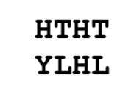
And now you

Slide 45
And now you
Scores: 2, -1, 8, -1.
Two are >= 0

Slide 46
And now you
Scores: 2, 0, 10, 2.
All 4 are >= 0

Slide 47
Summary
Blast allows for extremely fast protein sequence alignment
HSP
E-value heuristics
Psi-Blast allows for position specific scoring in alignment
Higher sensitivity maintaining high specificity

