Slide 1
Sequence Alignment Algorithms Morten Nielsen Department of Health Technology, DTU

Slide 2
Why learn about alignment algorithms?
All publicly available alignment programs do the same thing
Sequence alignment using amino acids substitution matrices and affine gap penalties
This is fast but not optimal
Protein alignment is done much more accurate using sequence profiles and position specific gap penalties (price for gaps depends on the structure)
Must implement your own alignment algorithm to do this

Slide 3
Outline
What you have been told is not entirely true :-)
Alignment algorithms are more complex
The true sequence alignment algorithm story
The slow algorithm (O3)
The fast algorithm (O2)

Slide 4
Sequence alignment The old Story

Slide 5
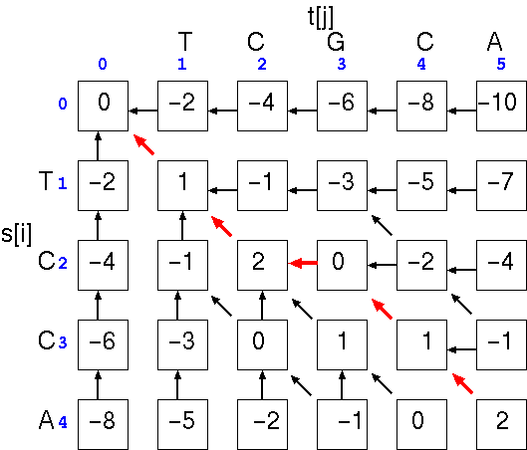
Pairwise alignment: the solution
”Dynamic programming”
(the Needleman-Wunsch algorithm)
Match score = 1
Mismatch score -1
Gap penalty = -2

Slide 6
Alignment depicted as path in matrix
T C G C A
T
C
C
A
Match score = 1
Mismatch score = -1
Gap penalty = -2
TCGCA
TC-CA
Score=2
T C G C A
T
C
C
A
TCGCA
T-CCA
Score=0

Slide 7
Alignment depicted as path in matrix
T C G C A
T
C
C
A
Meaning of point in matrix: all residues up to this point have been aligned (but there are many different possible paths).
x
Position labeled “x”: TC aligned with TC
--TC -TC TC
TC-- T-C TC

Slide 8
Dynamic programming: computation of scores
T C G C A
T
C
C
A
Any given point in matrix can only be reached from three possible positions (you cannot “align backwards”).
=> Best scoring alignment ending in any given point in the matrix can be found by choosing the highest scoring of the three possibilities.
x

Slide 9
Dynamic programming: computation of scores
T C G C A
T
C
C
A
Any given point in matrix can only be reached from three possible positions (you cannot “align backwards”).
=> Best scoring alignment ending in any given point in the matrix can be found by choosing the highest scoring of the three possibilities.
x
score(x,y-1) - gap-penalty
score(x,y) = max

Slide 10
Dynamic programming: computation of scores
T C G C A
T
C
C
A
Any given point in matrix can only be reached from three possible positions (you cannot “align backwards”).
=> Best scoring alignment ending in any given point in the matrix can be found by choosing the highest scoring of the three possibilities.
x
score(x,y-1) - gap-penalty
score(x-1,y-1) + substitution-score(x,y)
score(x,y) = max

Slide 11
Dynamic programming: computation of scores
T C G C A
T
C
C
A
Any given point in matrix can only be reached from three possible positions (you cannot “align backwards”).
=> Best scoring alignment ending in any given point in the matrix can be found by choosing the highest scoring of the three possibilities.
x
score(x,y-1) - gap-penalty
score(x-1,y-1) + substitution-score(x,y)
score(x-1,y) - gap-penalty
score(x,y) = max

Slide 12
Dynamic programming: computation of scores
T C G C A
T
C
C
A
Any given point in matrix can only be reached from three possible positions (you cannot “align backwards”).
=> Best scoring alignment ending in any given point in the matrix can be found by choosing the highest scoring of the three possibilities.
x
Each new score is found by choosing the maximum of three possibilities. For each square in matrix: keep track of where best score came from.
Fill in scores one row at a time, starting in upper left corner of matrix, ending in lower right corner.
score(x,y-1) - gap-penalty
score(x-1,y-1) + substitution-score(x,y)
score(x-1,y) - gap-penalty
score(x,y) = max

Slide 13
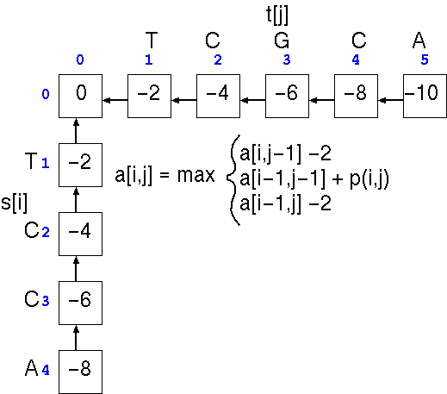
Dynamic programming: example
A C G T
A 1 -1 -1 -1
C -1 1 -1 -1
G -1 -1 1 -1
T -1 -1 -1 1
Gaps: -2

Slide 14
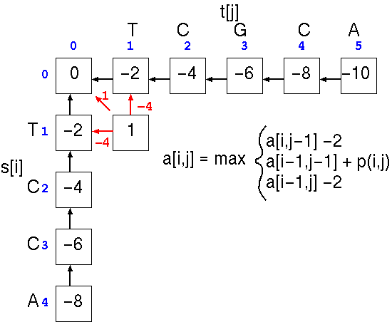
Dynamic programming: example
A C G T
A 1 -1 -1 -1
C -1 1 -1 -1
G -1 -1 1 -1
T -1 -1 -1 1
Gaps: -2

Slide 15
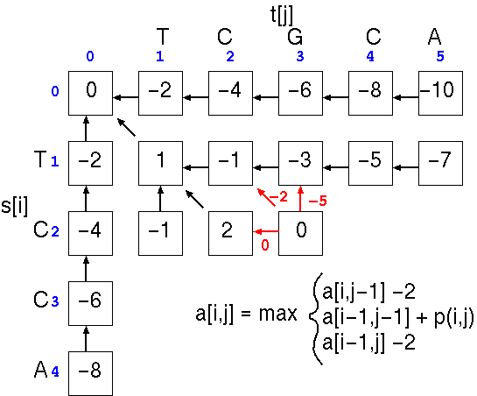
Dynamic programming: example
A C G T
A 1 -1 -1 -1
C -1 1 -1 -1
G -1 -1 1 -1
T -1 -1 -1 1
Gaps: -2

Slide 16
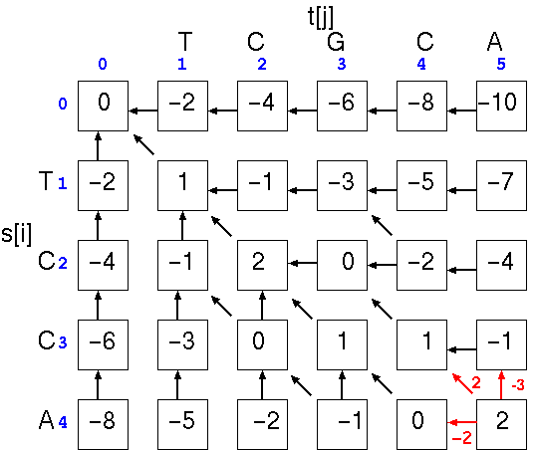
Dynamic programming: example
A C G T
A 1 -1 -1 -1
C -1 1 -1 -1
G -1 -1 1 -1
T -1 -1 -1 1
Gaps: -2

Slide 17
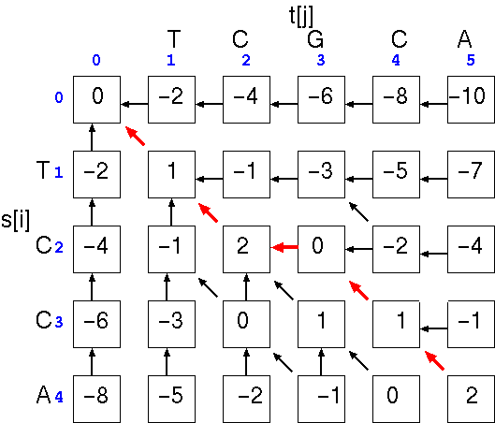
Dynamic programming: example
T C G C A
: : : :
T C - C A
1+1-2+1+1 = 2

Slide 18
But in reality is a little more complex

Slide 19
Dynamic programming: computation of scores
T C G C A
T
C
C
A
Any given point in matrix can only be reached from three possible positions (you cannot “align backwards”).
=> Best scoring alignment ending in any given point in the matrix can be found by choosing the highest scoring of the three possibilities.
x

Slide 20
Dynamic programming: example
What about j-2 and a gap extension?

Slide 21
And now the true algorithm
V
L
I
L
P
V
L
n
L
P
Start from here
m

Slide 22
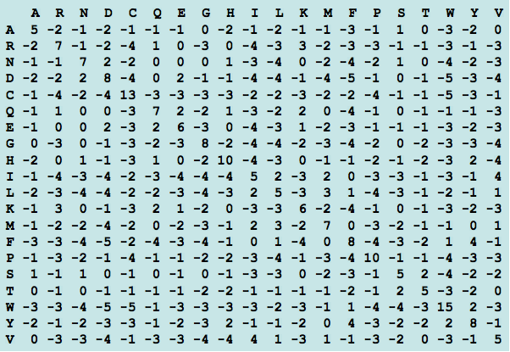
How does it work (score matrix d)?
d matrix
Blosum 50 matrix
V
L
I
L
P
V
5
1
4
1
-3
L
1
5
2
5
-4
L
1
5
2
5
-4
P
-3
-4
-3
-4
10

Slide 23
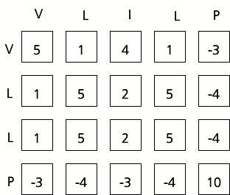
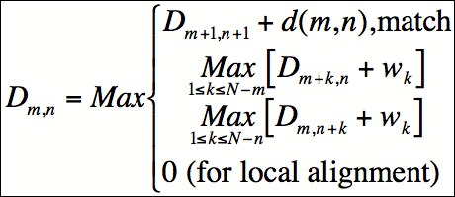
How does it work? (The slow way O3)
D matrix
d matrix
V
L
I
L
P
V
9
3
0
L
17
10
4
0
L
10
15
5
0
P
4
5
10
0
Gap-open W₁ = -5
Gap-extension U = -1
0
0
0
0
0
0
Start from here!

Slide 24
How does it work? (The slow way O3)
D matrix
d matrix
V
L
I
L
P
V
0
L
17
10
4
0
L
10
15
5
0
P
4
5
10
0
Gap-open W₁ = -5
Gap-extension U = -1
0
0
0
0
0
0
Check all positions in (green) row and column to check score for gap extension.
CPU intensive (O3)

Slide 25
And now you!
Notes:
Change location of P and Q matrices so that we have D,P newline Q E

Slide 26
How does it work? Fill out the D matrix
D matrix
d matrix
V
L
I
L
P
V
20
14
3
0
L
11
17
10
4
0
L
9
10
15
5
0
P
2
4
5
10
0
Gap-open W₁ = -5
Gap-extension U = -1
0
0
0
0
0
0
Check all positions in (green) row and column to check score for gap extension.
CPU intensive (O3)

Slide 27
How does it work (The slow way O3)
D matrix
d matrix
V
L
I
L
P
V
20
18
14
9
3
0
L
11
15
17
10
4
0
L
8
9
10
15
5
0
P
2
3
4
5
10
0
Gap-open W₁ = -5
Gap-extension U = -1
0
0
0
0
0
0
Check all positions in (green) row and column to check score for gap extension.
CPU intensive (O3)

Slide 28
And now the fast algorithm (O2)
Database (m)
Query (n)
P
Q
Affine gap penalties
Open a gap
Extending a gap

Slide 29
And now the fast algorithm (O2)
Database (m)
Query (n)
P
Q
Open a gap
Extending a gap

Slide 30
And now the true algorithm (cont.)
Database (m)
Query (n)
P
Q

Slide 31
How does it work (D,Q, and P-matrices)
D
m
V
L
I
L
P
0
V
0
L
n
5
0
L
2
3
4
5
10
0
P
0
0
0
0
0
0
P
V
L
I
L
P
0
V
0
W₁ = -5
U = -1
L
-1
0
L
5
-1
0
P
0
0
0
0
0
0

Slide 32
How does it work (D,Q,P, and E-matrices)
D
m
V
L
I
L
P
0
P works horizontally
V
0
L
n
5
0
L
2
3
4
5
10
0
P
0
0
0
0
0
0
P
V
L
I
L
P
0
V
0
W₁ = -5
U = -1
L
0
-1
0
L
5
-1
0
P
0
0
0
0
0
0

Slide 33
How does it work (D,Q, and P-matrices)
D
m
V
L
I
L
P
V
L
I
L
P
Q
0
V
V
0
L
L
n
5
0
5
0
L
L
2
3
4
5
10
0
-1
-1
-1
-1
-1
0
P
P
0
0
0
0
0
0
0
0
0
0
0
0
W₁ = -5
U = -1

Slide 34
How does it work (D,Q,P, and E-matrices)
D
m
V
L
I
L
P
V
L
I
L
P
Q
0
V
V
0
L
L
n
5
0
0
5
0
L
L
2
3
4
5
10
0
-1
-1
-1
-1
-1
0
P
P
0
0
0
0
0
0
0
0
0
0
0
0
W₁ = -5
U = -1

Slide 35
How does it work (D, Q, and P-matrices)
D
m
V
L
I
L
P
V
L
I
L
P
Q
0
V
V
0
L
L
n
5
0
0
5
0
L
L
2
3
4
5
10
0
-1
-1
-1
-1
-1
0
P
P
0
0
0
0
0
0
0
0
0
0
0
0
P
V
L
I
L
P
0
V
0
L
0
-1
0
L
5
-1
0
P
0
0
0
0
0
0

Slide 36
How does it work (D, Q, and P-matrices)
Q works vertically
D
m
V
L
I
L
P
V
L
I
L
P
Q
0
V
V
0
L
L
n
0
5
0
15
5
0
L
L
2
3
4
5
10
0
-1
-1
-1
-1
-1
0
P
P
0
0
0
0
0
0
0
0
0
0
0
0
P
V
L
I
L
P
0
V
0
L
0
-1
0
L
5
-1
0
P
0
0
0
0
0
0

Slide 37
How does it work. Eij-matrix. (Keeping track on the path)
V
L
I
L
P
0
V
0
eij = 1 match
eij = 2 insertion open query
(move vertical)
eij = 3 insertion-extension query
(move vertical) eij = 4 insertion-opening database
(move horizontal) eij = 5 insertion-extension database
(move horizontal)
L
2
0
L
4
1
0
P
0
0
0
0
0
0

Slide 38
The fast algorithm (cont.)
E
1
4
5
2
3
Database (m)
eij = 1 match
eij = 2 gap-opening database eij = 3 gap-extension database eij = 4 gap-opening query eij = 5 gap-extension query
Query (n)
P
Q

Slide 39
How does it work (D,Q,P, and E-matrices)
D
m
V
L
I
L
P
V
L
I
L
P
Q
0
V
V
0
L
L
n
15
5
0
0
5
0
L
L
2
3
4
5
10
0
-1
-1
-1
-1
-1
0
P
P
0
0
0
0
0
0
0
0
0
0
0
0
P
V
L
I
L
P
V
L
I
L
P
0
0
E
V
V
0
0
L
L
0
-1
0
1
2
0
L
L
5
-1
0
4
1
0
P
P
0
0
0
0
0
0
0
0
0
0
0
0

Slide 40
How does it work (D,Q,P, and E-matrices)
D
m
V
L
I
L
P
V
L
I
L
P
Q
20
18
14
9
3
0
6
10
12
9
3
0
V
V
11
15
17
10
4
0
3
4
5
10
4
0
L
L
n
8
9
10
15
5
0
-2
-2
-1
0
5
0
L
L
2
3
4
5
10
0
-1
-1
-1
-1
-1
0
P
P
0
0
0
0
0
0
0
0
0
0
0
0
P
V
L
I
L
P
V
L
I
L
P
13
9
4
-2
-1
0
1
1
1
3
3
0
E
V
V
11
12
5
-1
-1
0
5
1
1
1
3
0
L
L
8
9
10
0
-1
0
5
1
4
1
2
0
L
L
2
3
4
5
-1
0
5
5
5
4
1
0
P
P
0
0
0
0
0
0
0
0
0
0
0
0

Slide 41
And the alignment
D
m
V
L
I
L
P
V
L
I
L
P
20
18
14
9
3
0
1
1
1
3
3
0
E
V
V
11
15
17
10
4
0
5
1
1
1
3
0
L
L
n
8
9
10
15
5
0
5
1
4
1
2
0
L
L
2
3
4
5
10
0
5
5
5
4
1
0
P
P
0
0
0
0
0
0
0
0
0
0
0
0
VLILP
VL-LP

Slide 42
And the alignment. Gap extensions
D-matrix
m
E-matrix
V
L
I
A
L
P
V
L
I
A
L
P
E
V
19
13
17
10
9
3
0
1
1
1
1
3
3
0
V
L
9
14
12
13
10
4
0
1
1
1
1
1
3
0
n
L
L
7
8
9
10
15
5
0
5
1
5
4
1
2
0
L
P
1
2
3
4
5
10
0
5
5
5
5
4
1
0
P
0
0
0
0
0
0
0
0
0
0
0
0
0
0

Slide 43
And the alignment
D
m
V
L
I
A
L
P
V
L
I
A
L
P
E
V
19
13
17
10
9
3
0
1
1
1
1
3
3
0
V
L
9
14
12
13
10
4
0
1
1
1
1
1
3
0
n
L
L
7
8
9
10
15
5
0
5
1
5
4
1
2
0
L
P
1
2
3
4
5
10
0
5
5
5
5
4
1
0
P
0
0
0
0
0
0
0
0
0
0
0
0
0
0
15 -5 -1 = 9?

Slide 44
And the alignment
D
m
V
L
I
A
L
P
V
L
I
A
L
P
E
V
19
13
17
10
9
3
0
1
1
1
1
3
3
0
V
L
9
14
12
13
10
4
0
1
1
1
1
1
3
0
n
L
L
7
8
9
10
15
5
0
5
1
5
4
1
2
0
L
P
1
2
3
4
5
10
0
5
5
5
5
4
1
0
P
0
0
0
0
0
0
0
0
0
0
0
0
0
0
5 -5 -1 = 9?

Slide 45
And the alignment
D
m
V
L
I
A
L
P
V
L
I
A
L
P
E
V
19
13
17
10
9
3
0
1
1
1
1
3
3
0
V
L
9
14
12
13
10
4
0
1
1
1
1
1
3
0
n
L
L
7
8
9
10
15
5
0
5
1
5
4
1
2
0
L
P
1
2
3
4
5
10
0
5
5
5
5
4
1
0
P
0
0
0
0
0
0
0
0
0
0
0
0
0
0
15 -5 -1 = 9? ***
VLIALP
VL--LP
5 -5 -1 = 9?

Slide 46
And now you!
Notes:
Change location of P and Q matrices so that we have D,P newline Q E

Slide 47
Notes:
Change location of P and Q matrices so that we have D,P newline Q E

Slide 48
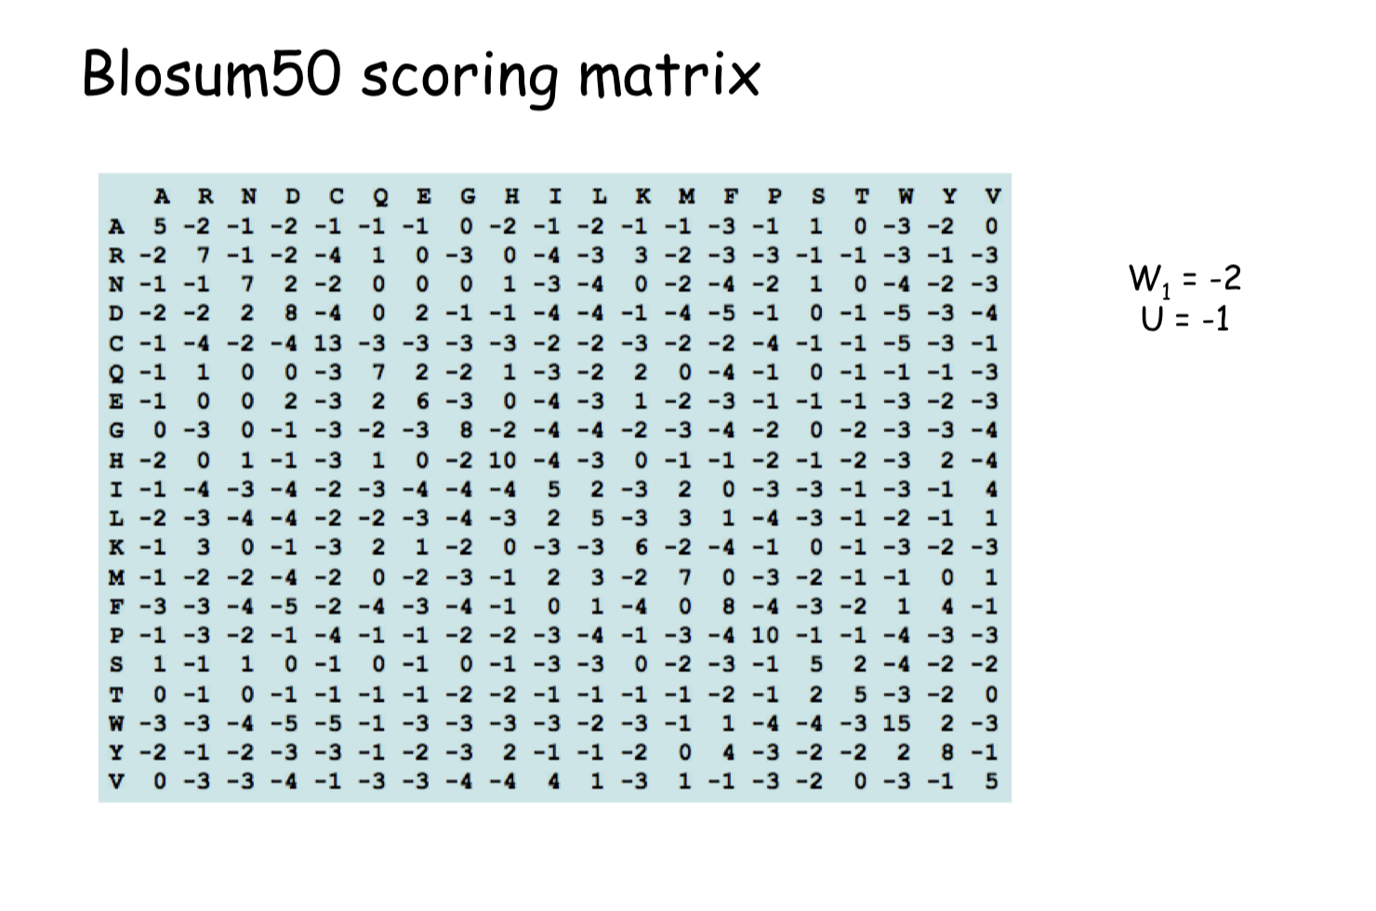
Notes:
Change location of P and Q matrices so that we have D,P newline Q E

Slide 49
Notes:
Change location of P and Q matrices so that we have D,P newline Q E

Slide 50
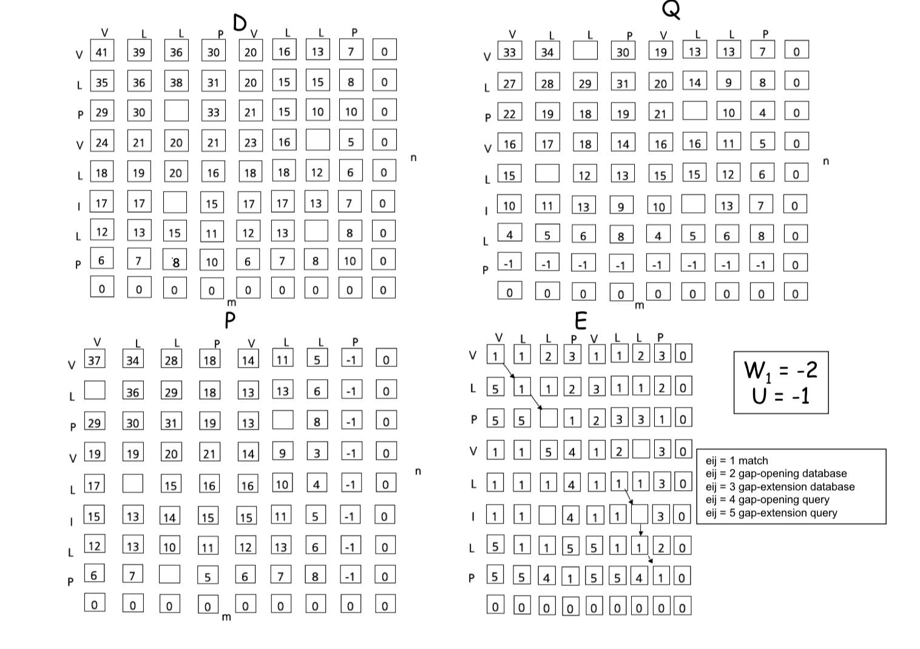
Notes:
Change location of P and Q matrices so that we have D,P newline Q E

Slide 51
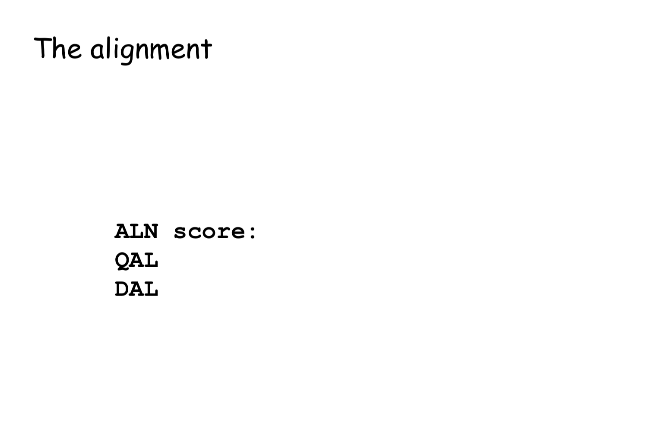
Query sequence alignment
Database sequence alignment
Notes:
Change location of P and Q matrices so that we have D,P newline Q E

Slide 52
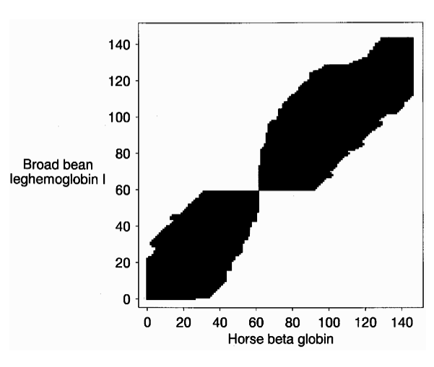
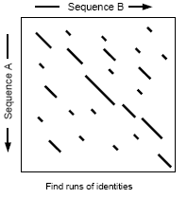
Summary
Alignment is more complicated than what you have been told.
Simple algorithmic tricks allow for alignment in O2 time
More heuristics to improve speed
Limit gap length
Look for high scoring regions

