Slide 2
DTU Health Technology
Bioinformatics
Alignment
Gisle Vestergaard
Associate Professor
Section of Bioinformatics
Technical University of Denmark
gisves@dtu.dk

Slide 3
Menu
Alignment approaches
Burrows-Wheeler Transform
Read depth
SAM/BAM

Slide 4
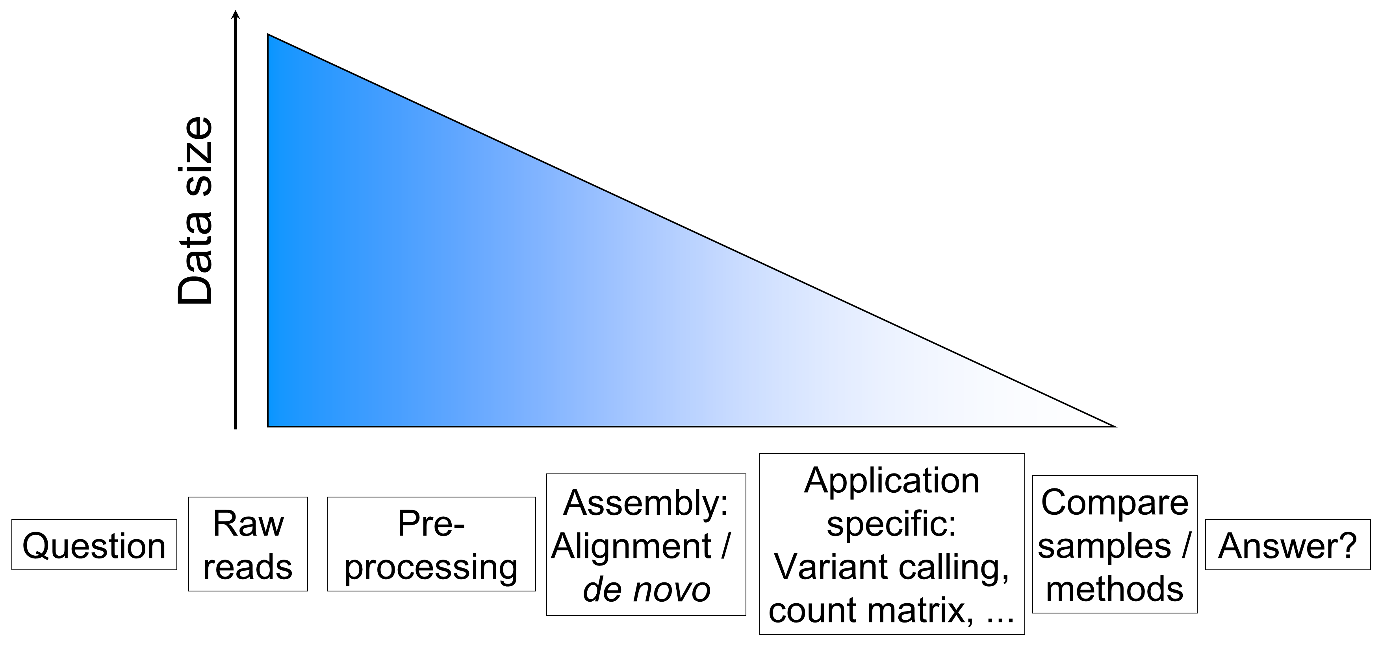
Generalized NGS analysis

Slide 5
Alignment/Mapping
Sometimes we have specific genomes of interest
Sometimes we have specific genes of interest
Assemble your reads by aligning them to a closely related reference genome
Reads
Genome

Slide 6
Sounds easy?
Some pitfalls:
Divergence between sample and reference genome
Repeats in the genome
Recombination and re-arrangements
Poor reference genome quality
Read errors
Regions not in the ref. genome
Contaminated sample

Slide 7
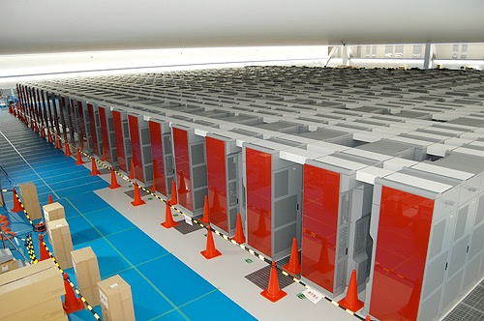
Simplest solution
Exact string matches:
We need to allow mismatches/indels (Smith-Waterman, Needleman-Wunsch)
One of the worlds fastest computer (K computer - RIKEN)
20 mill reads 100 nt reads vs. human genome ~ 1 month
We search each read vs. the entire reference
Reference: ACGTGCGGACGCTGAACGTGACG
Read: GTG
GTG
G TG
GTG

Slide 8
How about BLAST?
Everybody uses BLAST
Everybody will believe your BLAST hits (pun intended)
However BLAST
finds local alignments - not always what we want for short reads
and other stuff (alignment scores, output format, speed
What we can learn: Reducing the search space

Slide 9
Smart solution
1. Use algorithm to quickly find possible matches
3.2Gb
Drastically reduced search space
X possible matches
2. Allow us to perform slow/precise alignment for possible matches (Smith-Waterman)
1 best match

Slide 10
Hash based algorithms
Lookups in hashes are fast!
1. Index the reference using k-mers.
2. Search reads vs. hash k-mers
3. Perform alignment of entire read around seed
4. Report alignments
Key
Value
.
.
.
.
.
.
ACTGCGTGTGA
Chr1_pos1234; Chr2_pos567
ACTGCGTGTGC
Chr7_posX
ACTGCGTGTGT
Chr7_posZ; ...
.
.
.
.
.
.
Also known as Seed and extend

Slide 11
Spaced seeds
Key/k-mer is called a seed
BLAST uses k=11 and all must be matches
Smarter: Spaced seeds (only care about “1” in seed)
Higher sensitivity
11111111111
L = 11, 11 matches
111010010100110111
L = 18, 11 matches

Slide 12
Multiple seeds & drawbacks
One could require multiple short seeds
Instead of extending around each seed, extend around positions with several seed matches
Drawbacks of hash-based approaches:
Lots(!) of RAM to keep index in memory (hg ~48Gb!)

Slide 13
Burrows-Wheeler Transform (BWT)
Reversible compression of data
Transform stores data using lexicographical (alphabetical) sorting
Sorted data reduces search space!
Allows compression because characters cluster together
Reversible nature means we can recreate the sequence around known locations
Ringeren_I_Ringe_ringer_ringere_end_ringeren_ringer_i_Ringsted$
$d__ _nIiernerdenrgtrr_gggggnnnnnnn_RrrrRrReeeiiiiiiieeeee____gs

Slide 14
BWT for alignment
BWT used in many alignment implimentations and allows
We only need to store some locations
We can calculate missing parts on the fly
Sorted means fast!
Compressed means less memory!
Human genome can be effectively indexed and searched using 3Gb RAM!

Slide 15
Two implementations in BWA
Burrows Wheeler Aligner (BWA) can use:
bwa aln: First ~30nt of read as seed
Extend around positions with seed match
For short reads
bwa mem: Multiple short seeds across the read
Extend around positions with several seed matches
For longer reads
Read
Seed
Read
Seeds

Slide 16
Single vs. Paired alignment
Always get paired end reads (if possible)
Can map across repeats
Less mapping errors
?
Unmapped read can be “rescued” by a good aligning mate

Slide 17
Coverage of reference genomes
Coverage/depth is how many times that your data covers the genome (on average)
Example:
N: Number of reads: 5 mill
L: Read length: 100
G: Genome size: 5 Mbases
C = 5*100/5 = 100X
On average there are 100 reads covering each position in the genome

Slide 18
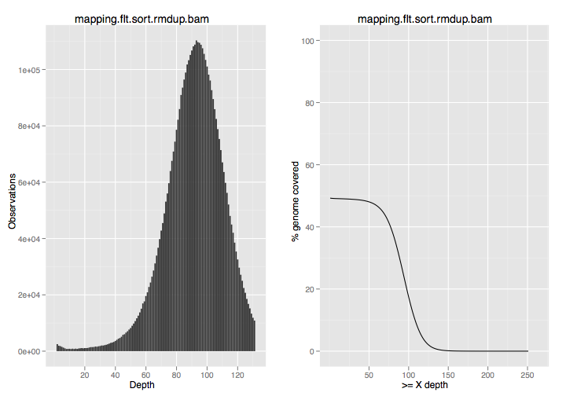
Actual depth
We aligned reads to the genome - how much do we actually cover?
Avg. depth ~ 90X
Range from 0-250X
Only 50% of the genome was covered with reads
~90X
50%

Slide 19
SAM/BAM format
Sequence Alignment / Map format
BAM = Binary SAM and zipped - always convert to BAM
Two sections
Header: All lines start with “@”
Alignments: All other lines

Slide 20
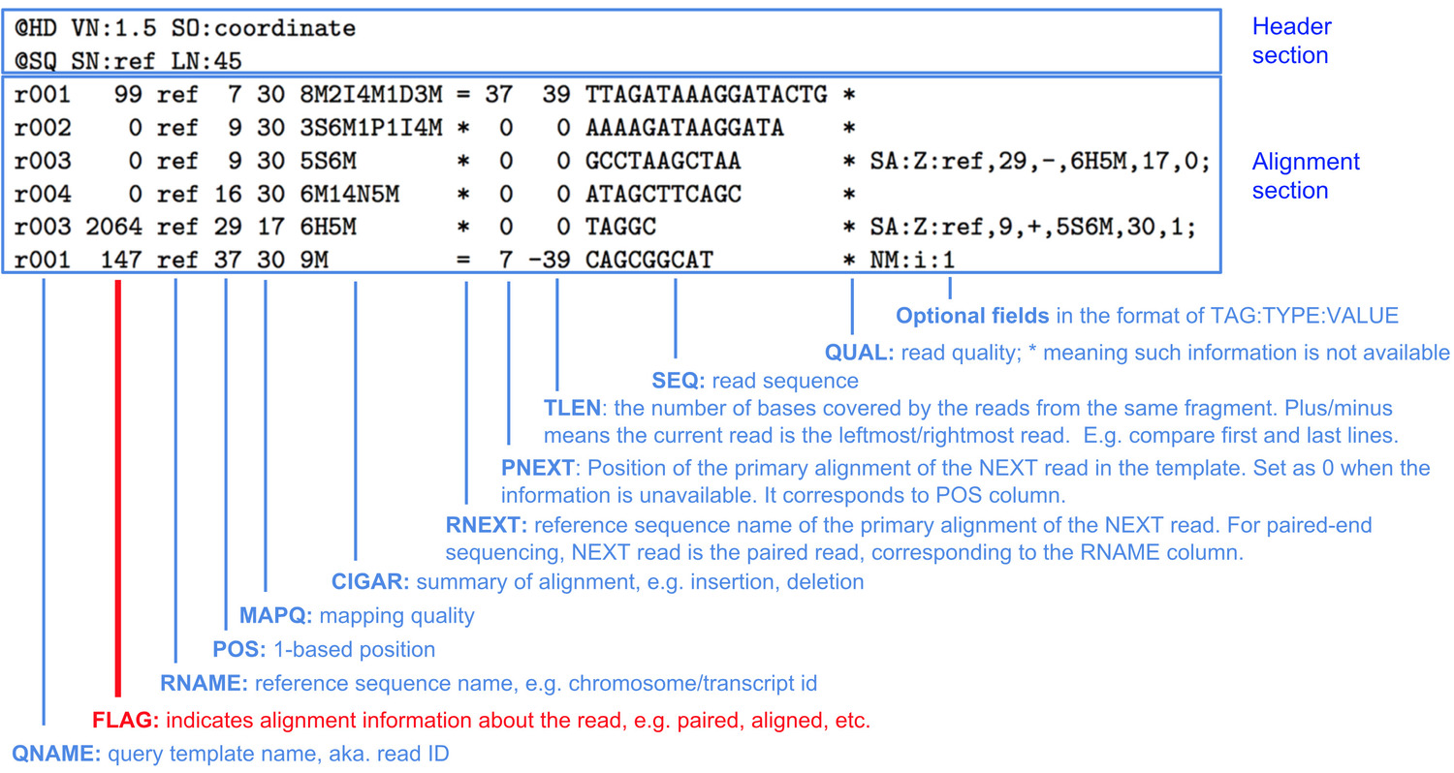
SAM - Example

Slide 21
Exercise time!
http://teaching.healthtech.dtu.dk/22126/index.php/Alignment_exercise

