Slide 1
Long read sequencing
Frederikke Byron Pedersen MscEng
Clinical Scientist & PhD Student
Department of Clinical Immunology
The University Hospital of Copenhagen, Rigshospitalet
Frederikke.Byron.Pedersen@regionh.dk
Next-Generation-Sequencing Analysis
09-01-2025

Slide 2
About the presenter
Part time PhD student (Public Health and Epidemiology, KU), part time Clinical Scientist at Rigshospitalet since 2024
Worked fulltime at the Department of Clinical Immunology at Rigshospitalet from 2021-2023
Worked at Nanopore Technologies from 2019-2021
Graduated from DTU in 2019, master in Biotechnology
Worked with longread sequencing since 2018, and short reads since 2021
How to get in touch?
Frederikke.Byron.Pedersen@regionh.dk

Slide 3
Sequencing Techniques: An overview
Sanger Sequencing
(First generation sequencing)
Next generation Sequencing
Second generation sequencing
Third generation sequencing
Illumina
Ion Torrent
PacBio
Nanopore

Slide 4
Quiz
5 multiple choice questions
Note your answers on a piece of paper or laptop

Slide 5
Question 1: What is the longest read that can be obtained using Nanopore Sequencing? Note, not average read length
25kb
100kb
10kb
No limit

Slide 6
Question 2: What is the longest read that can be obtained using PacBio Sequencing? Note, not average read length
25kb
100kb
10kb
No limit

Slide 7
Question 3: What is phasing?
To introduce something in stages over a particular period of time
Phasing is the rhythmic equivalent of cycling through the phase of two waveforms as in phasing
The process of statistical estimation of haplotypes from genotype data
All of the above

Slide 8
Question 4: What is one of the main advantages of Long Read Sequencing?
Haplotyping and SVs are easier resolved
Cheaper and Faster
Higher quality/Q-Score
All of the above

Slide 9
Question 5: Which sequencing platform is the best?
PacBio
Nanopore
Illumina
It depends on what you want to do

Slide 10
Why Long Read Sequencing?
Assembly
Phasing/Haplotyping
Plasmids
Methylation
Structural Variants (SVs)
Large Repetitive Regions
Plant genomes
More?
Disclaimer:
Each of these could fill an entire lecture. The next slides will give a quick overview of each.

Slide 11
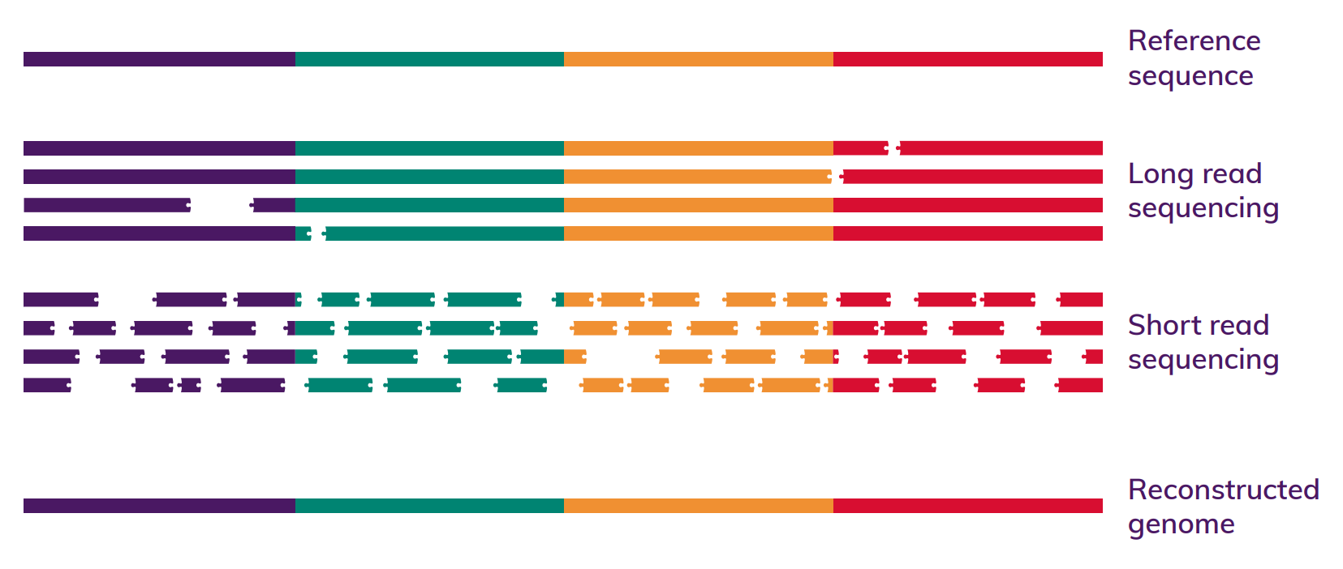
Assembly with reference genome
Another thing that is much easier with Long Reads is De novo assembly
https://www.phgfoundation.org/briefing/clinical-long-read-sequencing

Slide 12
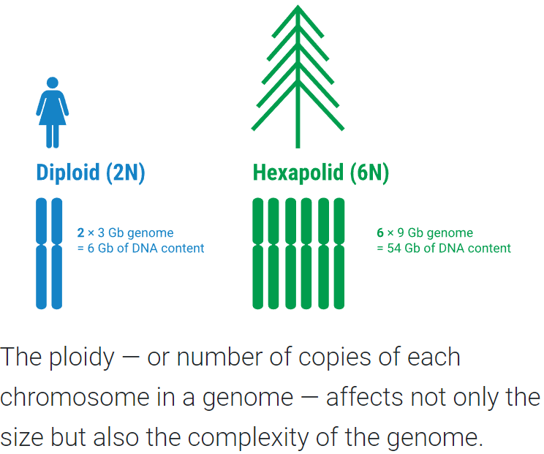
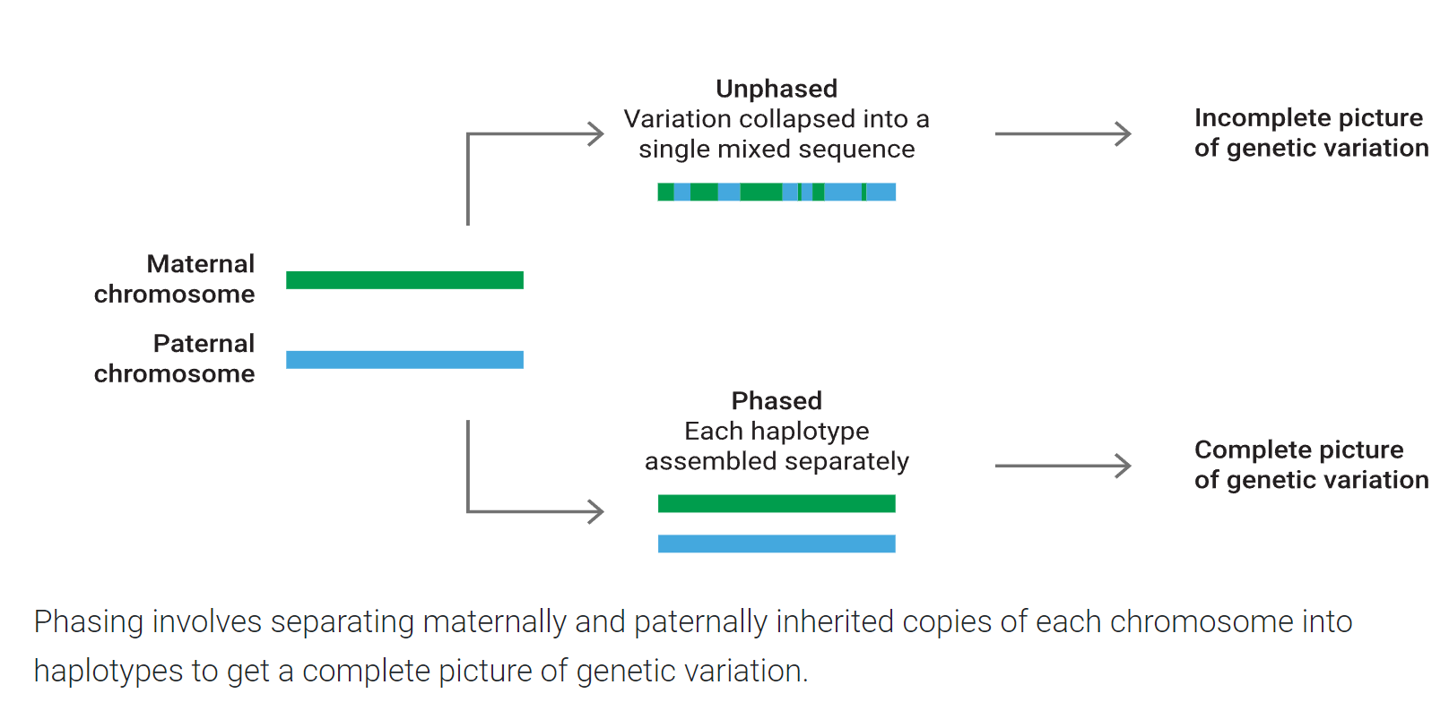
Phasing
https://www.pacb.com/blog/ploidy-haplotypes-and-phasing/

Slide 13
Assembly/Haplotyping, diploid (Human)
What assemblies will we get?
Maternal
A
B
C
D
B
E
Paternal
Short read Sequencing
A
B
C
Assemblies
D
B
E
A
B
E
D
B
C

Slide 14
Assembly/Haplotyping, diploid (Human)
Maternal
A
B
C
D
B
E
Paternal
Long read Sequencing
A
B
C
Assembly
D
B
E

Slide 15
Assembly/Haplotyping, diploid (Human)
Maternal
A
B
C
D
B
E
Paternal
Ultra
Long read Sequencing
A
B
C
Assembly
D
B
E

Slide 16
Assembly/Haplotyping, hexaploid (Plant)
Would short reads ever be able to properly phase it?
A
B
C
A
D
C
D
B
E
D
B
A
B
C
D
D
B
C
Short read Sequencing

Slide 17
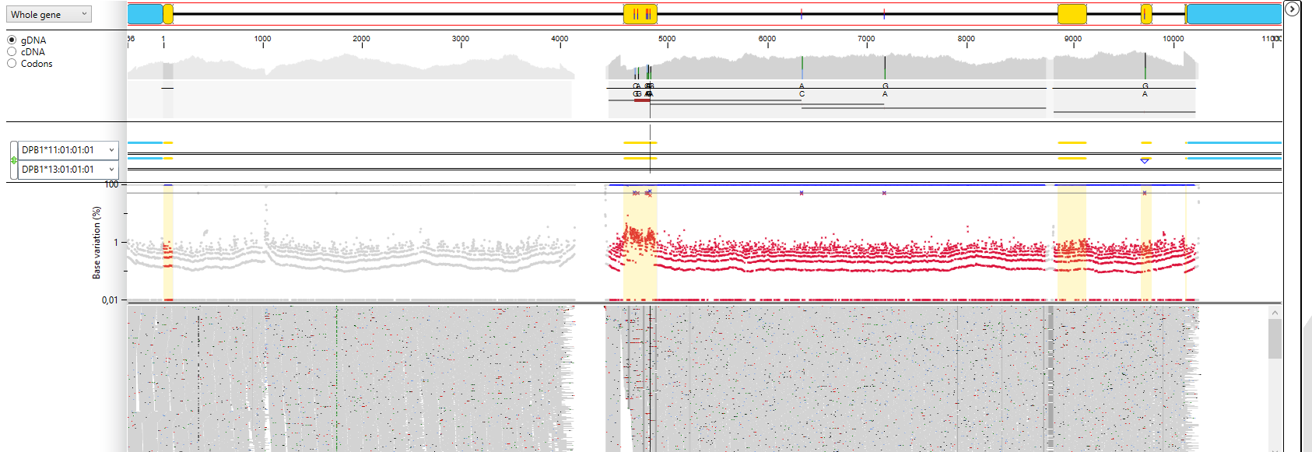
Phasing – A real life example, using Illumina sequencing
Over 2kb to nearest heterozygote position
Our analysis program warns us that this is a new DPB1 type called DPB1*13:New

Slide 18
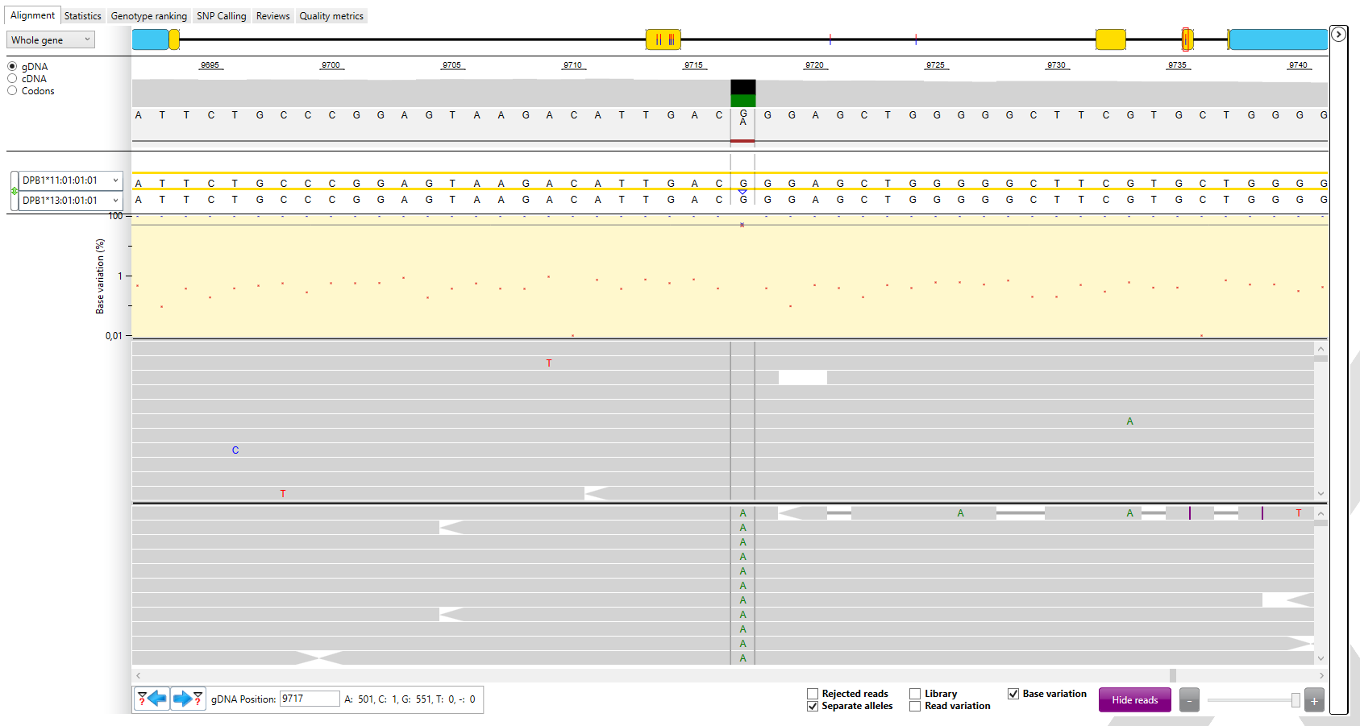

Slide 19
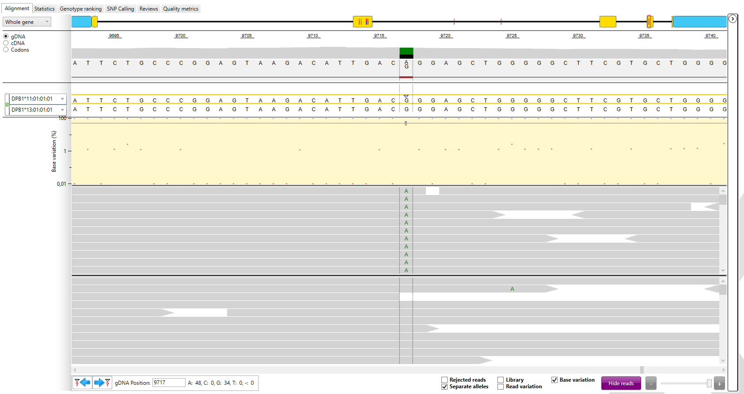
Upon re-running the sample, it now calls it a DPB1*11:New

Slide 20
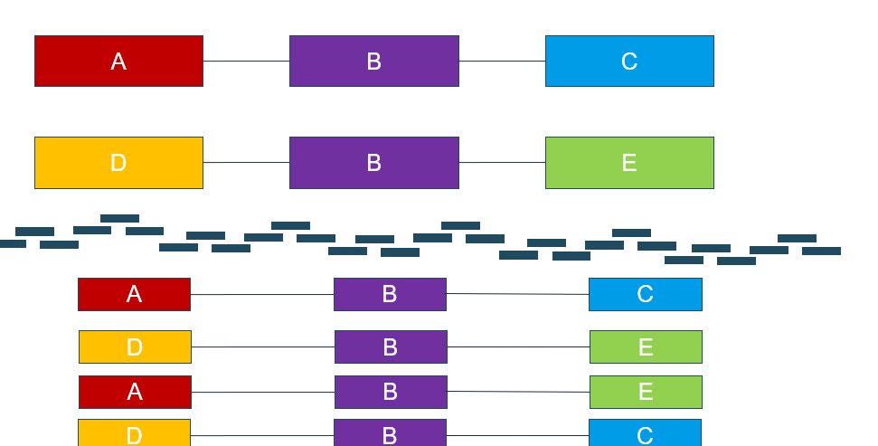
What happened?

Slide 21
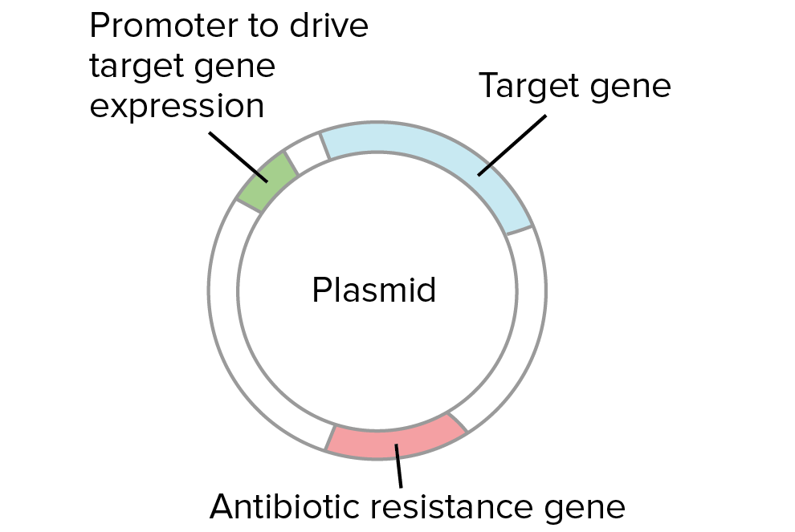
Plasmids
Why use long reads for Plasmids sequencing?
Plasmids can be up to several hundred kb
It is important to be able to know which plasmid an antibiotic resistance gene is on, to be able to track it.

Slide 22
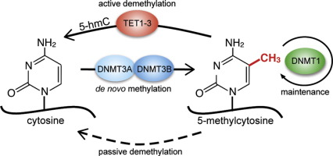
Methylation, what is it, and is it useful information?
Briefly: gene expression regulation. Among other things, it influences what type of cell a naïve cell becomes, by determining which genes are expressed.
Ambrosi et al. 2017 ”Dynamics and context dependent roles of DNA Methylation”

Slide 23
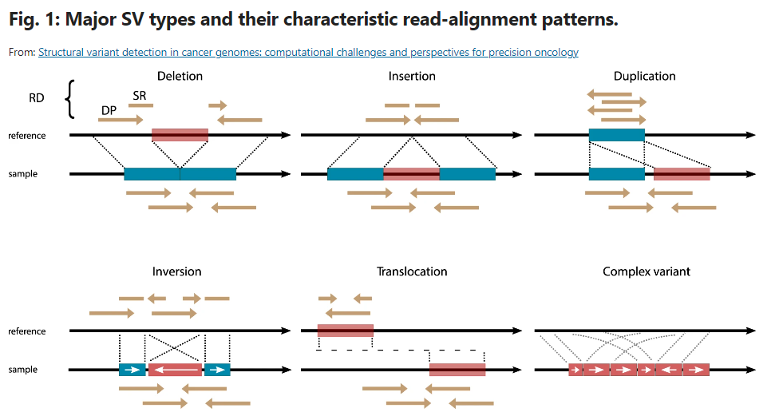
Structural Variants (SVs)
https://www.nature.com/articles/s41698-021-00155-6

Slide 24
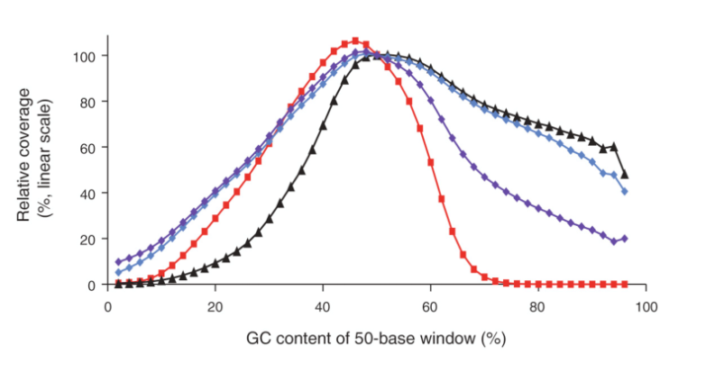
Repetitive regions and their challenge
Repetitive sequences, why are they a problem when sequencing?:
High or low GC regions are hard to amplify
DNA fragmentation is not random
Hard to assemble with short reads, if the repetitive region becomes larger than 100bp. Tandem repeats can be up to 1,7Mbp in size
To overcome this, use sequencing methods that do not require PCR and fragmentation, and produces long reads.
Shown is the GC bias in Illumina reads from a 400-bp fragment library amplified using the standard PCR protocol (Phusion HF, short denaturation) on a fast-ramping thermocycler (red squares), Phusion HF with long denaturation and 2M betaine (black triangles), AccuPrime Taq HiFi with long denaturation and primer extension at 65°C (blue diamonds) or 60°C (purple diamonds)
https://genomebiology.biomedcentral.com/articles/10.1186/gb-2011-12-2-r18
Old overview, but still illustrates the issues with short read sequencing

Slide 25
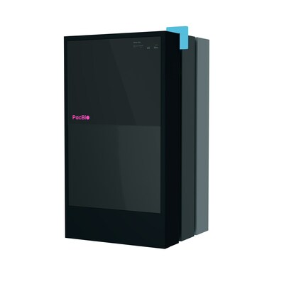
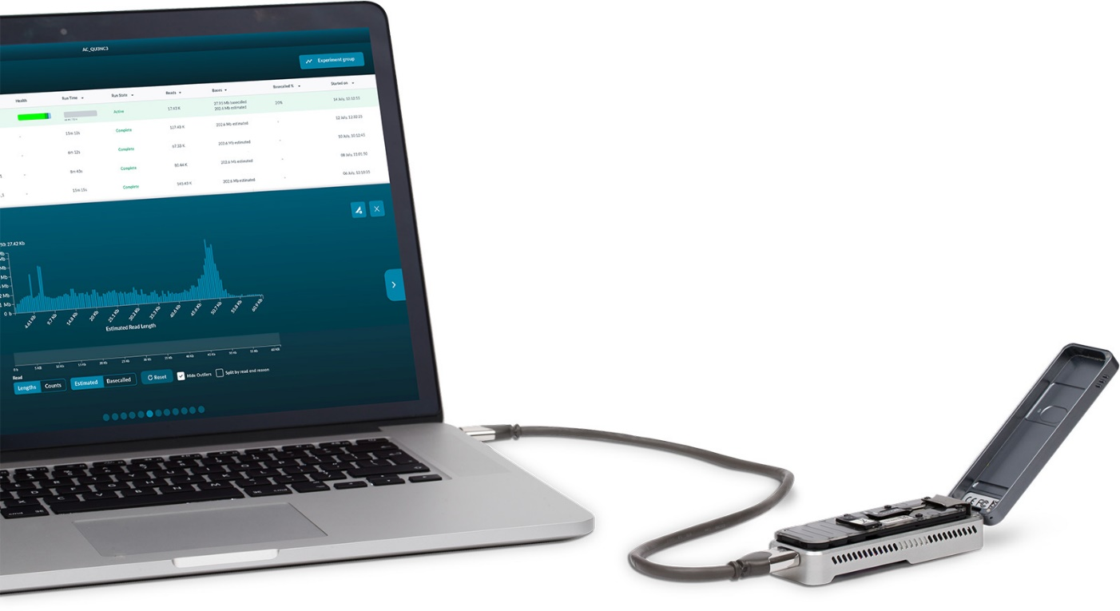
The two main Long Read Sequencing technologies
Not to scale

Slide 26
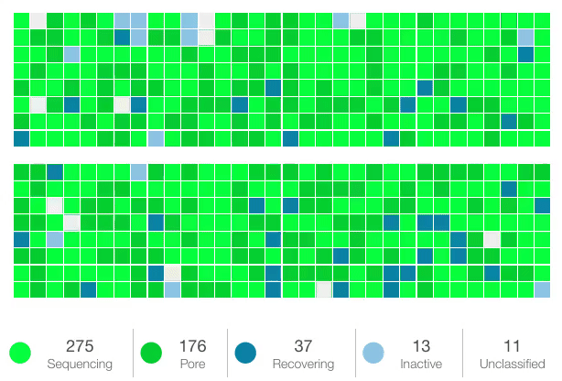
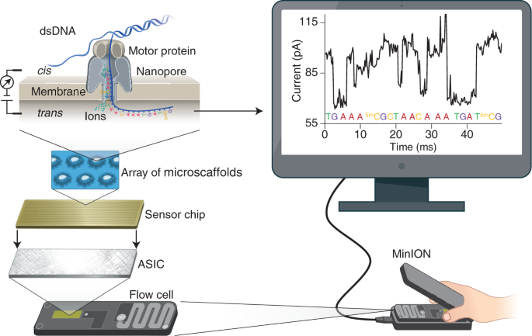
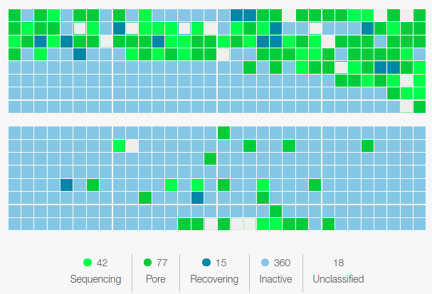
Nanopore sequencing
Source: Nature.com Nanopore sequencing technology, bioinformatics and applications

Slide 27
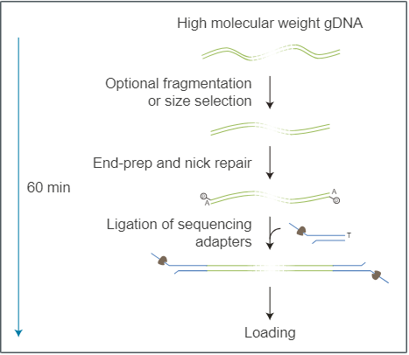
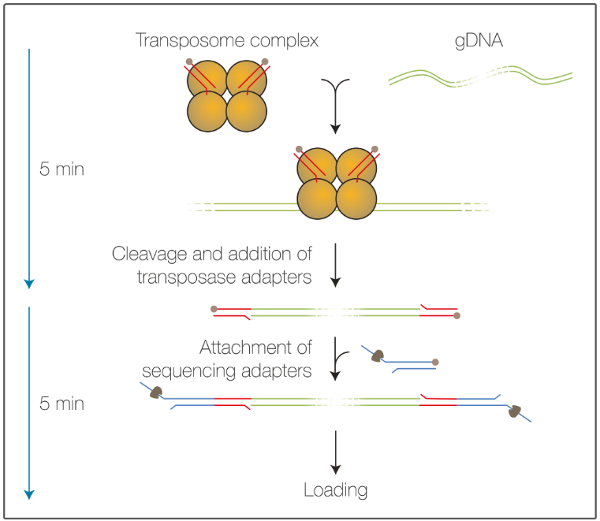
Library preparation: highlighted methods
Ligation Sequencing Kit
Rapid Sequencing Kit
https://nanoporetech.com/products/prepare/dna-library-preparation
Both have barcoding options up to 96, and there are many other library preparation methods, including for RNA and cDNA

Slide 28
Biggest hurdle with Nanopore: Homopolymers

Slide 29
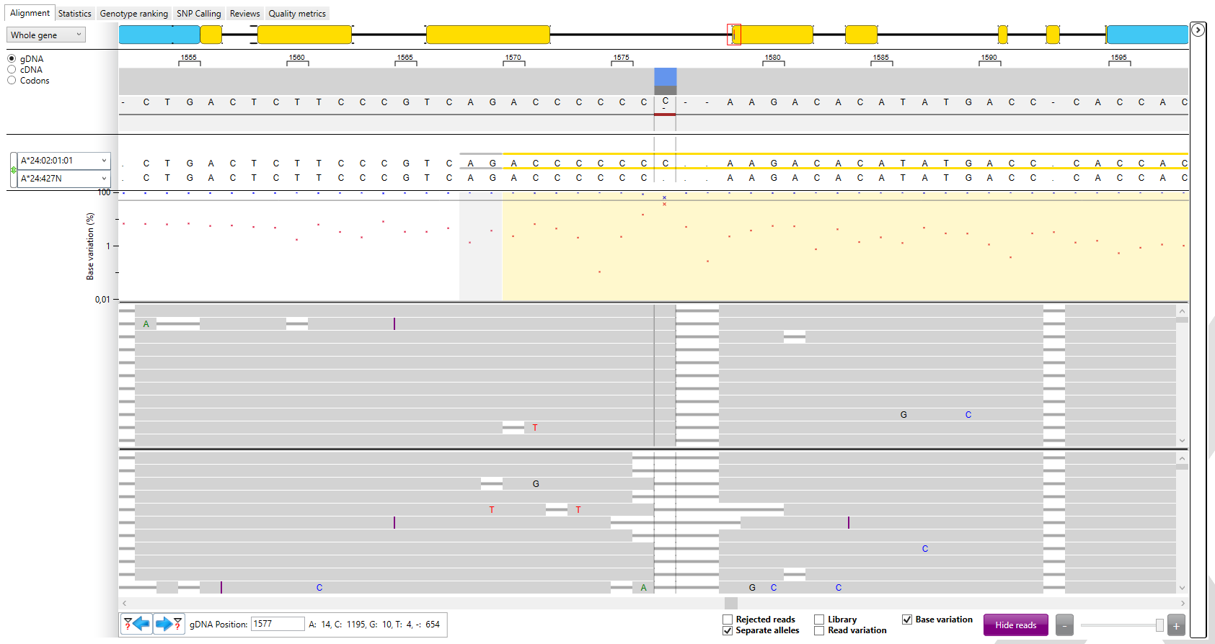
Real life example, typing of HLA in a Stem Cell Donor
Suddenly random errors become systematic base calling errors

Slide 30
Duplex basecalling to overcome homopolymers?
What base should
this have been?
https://nanoporetech.com/resource-centre/video/ncm22/advances-in-duplex-basecalling
So, better Q/Phred score, but lower output. Only ~20% of the reads are duplex, and this does not work with barcoded reads (yet)

Slide 31
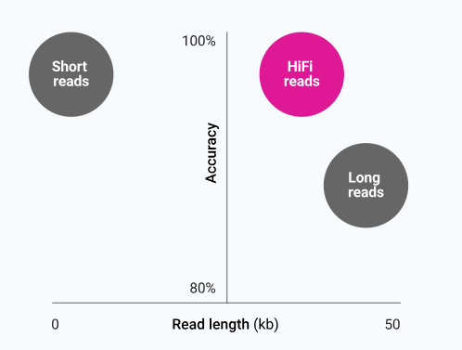
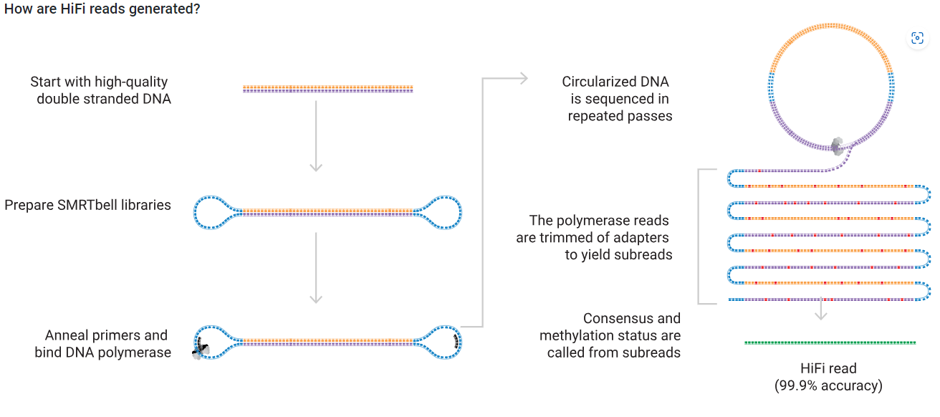
PacBio (HiFi)
https://www.pacb.com/technology/hifi-sequencing/

Slide 32
PacBio Sequencing

Slide 33
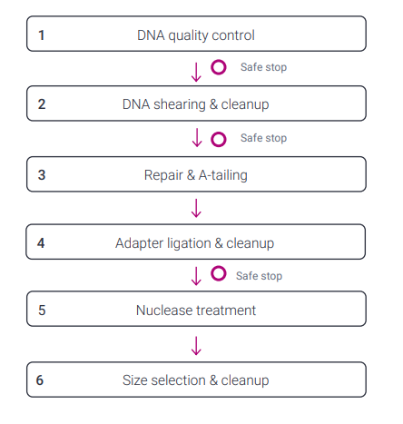
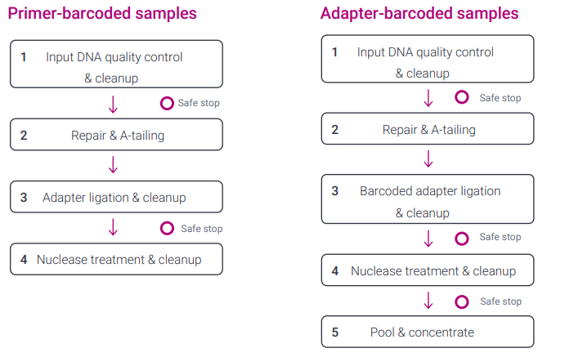
Library preparation
SMRTbell® prep kit 3.0
Preparing multiplexed amplicon libraries using SMRTBell prep kit 3.0

Slide 34
Biggest hurdles with Pacbio HiFi/Revio
Limited read length
Requires shearing or amplification, which may lead to low coverage of high or low GC rich areas
Fixed sequencing time for a SMRT cell
It’s large

Slide 35
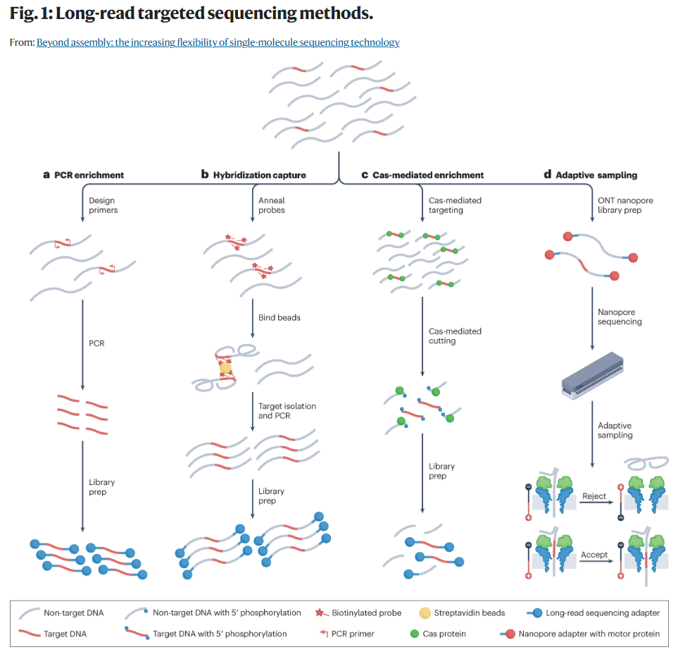
The enrichment strategies can be used on all sequencing platforms, except Adaptive Sampling, which requires the use of Nanopore’s ability to flick out a read using the positive and negative charge.
https://www.nature.com/articles/s41576-023-00600-1

Slide 36
My experiences with Long Read Sequencing
Plasmids, tracking of antibiotic resistance – SSI
Cas9 Mediated Enrichment – Oxford Nanopore Technologies (ONT)
Leukemia panel (AML), one diagnostic tool for all types of AML – ONT
Covid-19 test – ONT
De Novo Assembly of viral DNA in metagenomic samples, getting a consensus/reference sequence for new variants/virus – ONT
HLA typing – The University Hospital of Copenhagen, Rigshospitalet

Slide 37
Comparison of the 3 major players in sequencing
 | Illumina (MiSeq) | Nanopore (MinION) | PacBio (Revio/SMRT)
Maximum read length | 600bp | None (record >4mb) | 25kb
Cost per instrument | $128,000 | $1,000* | $779,000
Q score | ~Q40 (Min Q30) | ~Q20 (Personal experience say it’s Q15) | ~Q30 (Min Q20)
Minimum Run Time | 4h (1x36bp) 56h (2x300bp) | None | 24h
Methylation? | No | Yes | Yes
Direct RNA Seq | No | Yes | No
Mobile | No | Yes | No
Reusable flow cells | No | Yes | No
*lease of the instrument

Slide 38
Quiz
Same questions, compare your answers to those at the start of the lecture. Have they changed?

Slide 39
Question 1: What is the longest read that can be obtained using Nanopore Sequencing? Note, not average read length
25kb
100kb
10kb
No limit

Slide 40
Question 2: What is the longest read that can be obtained using PacBio Sequencing? Note, not average read length
25kb
100kb
10kb
No limit

Slide 41
Question 3: What is phasing?
To introduce something in stages over a particular period of time
Phasing is the rhythmic equivalent of cycling through the phase of two waveforms as in phasing
The process of statistical estimation of haplotypes from genotype data
All of the above

Slide 42
Question 4: What is one of the main advantages of Long Read Sequencing?
Haplotyping and SVs are easier resolved
Cheaper and Faster
Higher quality/Q-Score
All of the above

Slide 43
Question 5: Which sequencing platform is the best?
PacBio
Nanopore
Illumina
It depends on what you want to do

Slide 44
Questions?

