Slide 1
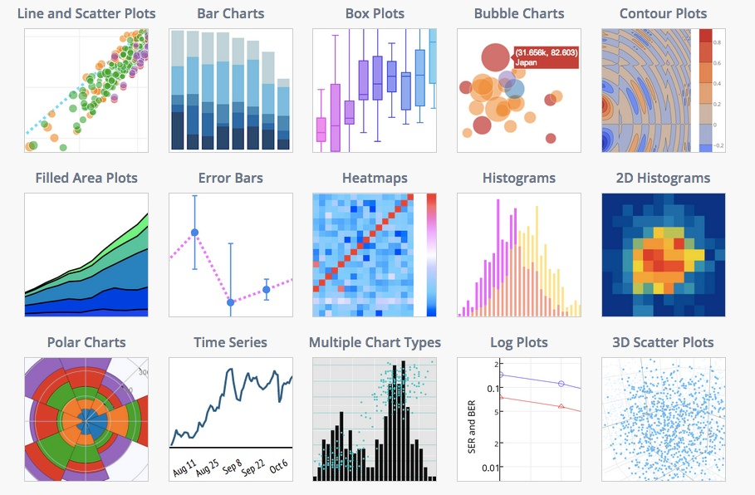
Python Plotting, Matplotlib, Seaborn
Cecilie Thystrup
DTU Food, Research Group for Foodborne Pathogens and Epidemiology

Slide 2
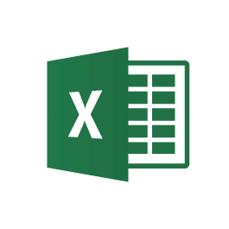
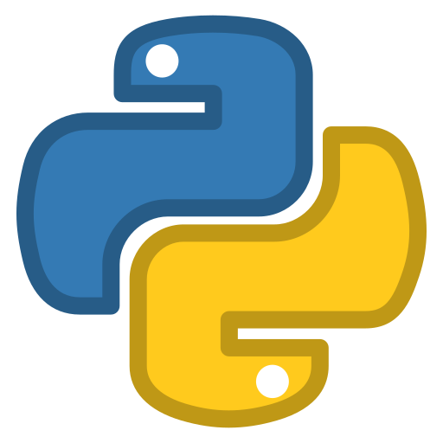
What is plotting?
Why do we need to know how to plot in Python when we have Excel?
We are scientists and we need to be able to convey our research to others.
Plotting accurately in a meaningful way is crucial as a good scientist
Scalability and big data! Excel can only handle so much
Plotting in python enables automation capabilities. We don’t have to do repetitive work if we do it right in the beginning
Connecting to cloud-based services (AWS, Google API, etc.) is easier in python than in Excel
vs

Slide 3
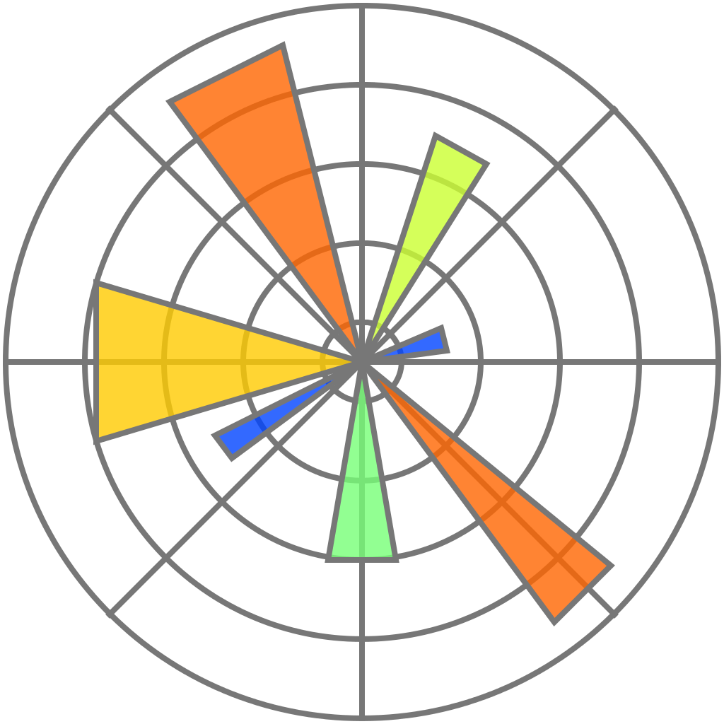
Libraries for plotting
There are multiple different libraries for plotting graphs (and other illustrations) in python. They are all third-party libraries, so they need to be installed before we use them.
In this course, we will only focus on seaborn and matplotlib. Using these two packages to install will enable to make 99% of the plots that you need to make as a scientist.

Slide 4
Libraries for plotting
Matplotlib
Matplotlib is the most popular and widely-used library for graph plotting in Python. It works well with other data science libraries (pandas, sklearn, NumPy) and is best for simple plots.
Examples of basic plots in matplotlib:
plot: For continuous data (distribution, frequency, etc.)
scatter: For individual datapoints (clustered meaningfully)
bar: For cummulative data
There are many (!) more types of plot to make in matplotlib.
Check out this website for tips.

Slide 5
Libraries for plotting
Seaborn
Seaborn is a library for making statistical graphics in Python. It builds on top of matplotlib and integrates closely with pandas data structures. It is great for advanced plots.
Examples of basic plots in seaborn:
relplot: For drawing relational plots
facetgrid: For plotting conditional relationships
boxplot: For plotting distributions of quantative data
There are also many more examples of plots that can be made using seaborn.
Check them out using this link

Slide 6
Scientific Libraries
How to import seaborn and matplotlib
Standard way to import the plotting libraries in python
#!/usr/bin/python
import matplotlib.pyplot as plt
import seaborn as sns
import os
import math
import matplotlib.pyplot as plt
from scikit-learn import lineal_model
(But you can call them whatever you want)

Slide 7
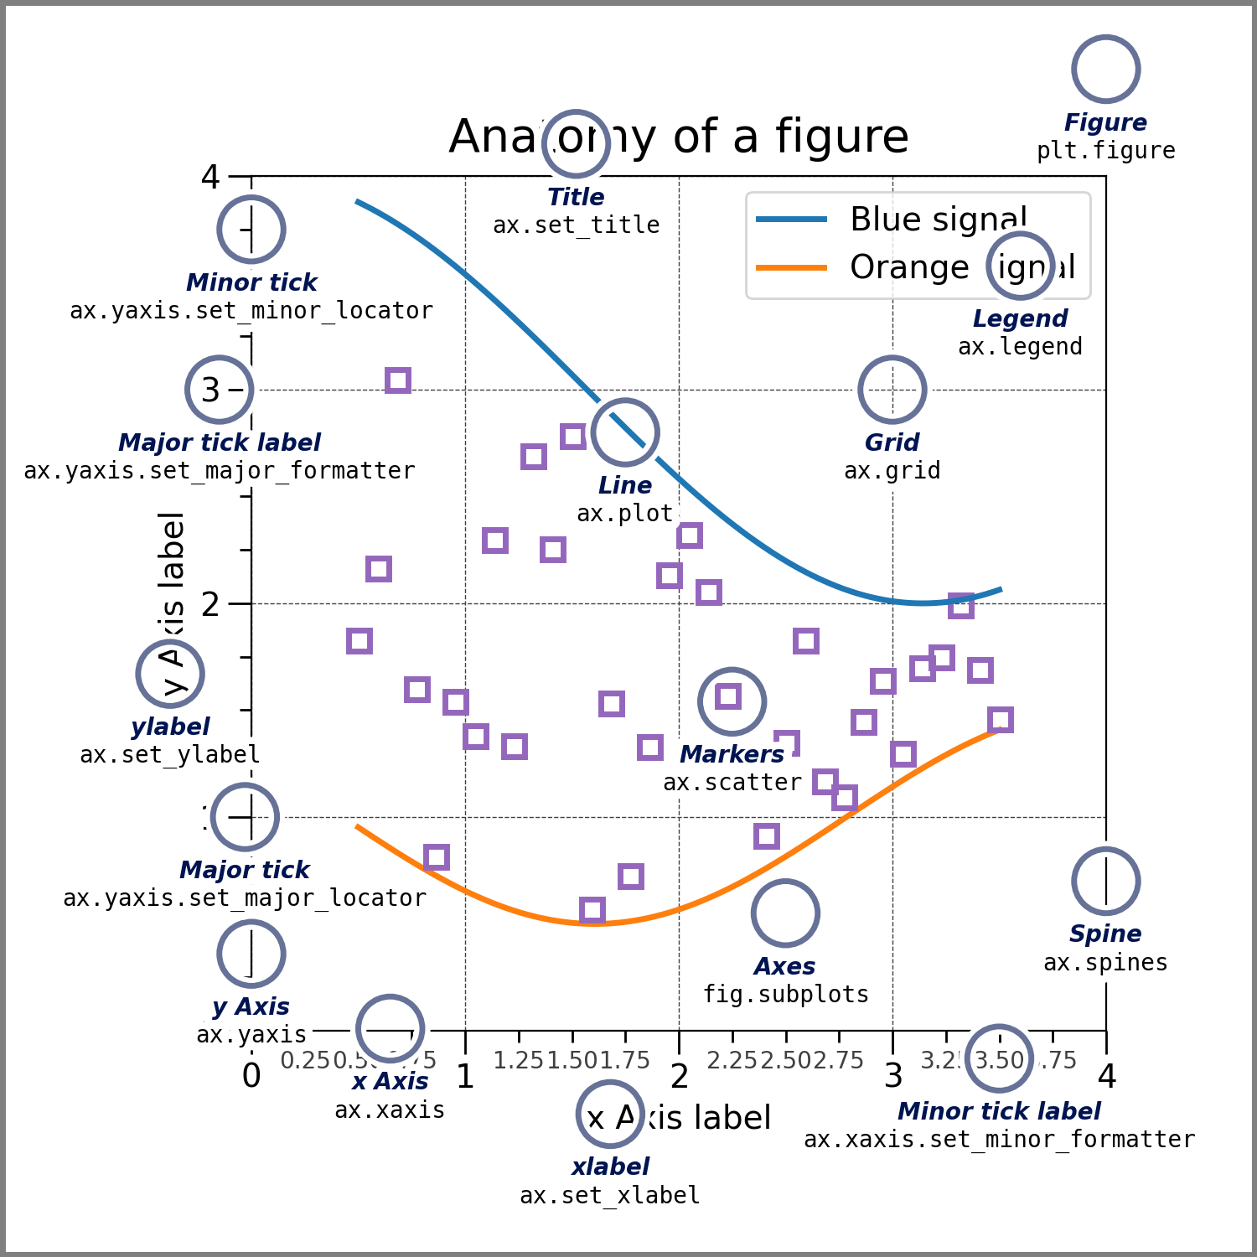
Theory: Anatomy of a plot

Slide 8
Theory: Implicit vs explicit
Figure
Implicit vs. Explicit
Figure: Whole image, may contain one or more axes
axes: Represents an individual plot (called ”Artists”)
axis: Sets the scale and limits for the plots. Are used to generate ticks and ticklabels.
Growth
Time
Axes 2
Axes 2
Axes 1
Axis 1
Axis 2
Axis 2
Notes:
Figure is like a paper that you can draw anything you want
We have to draw a chart in a “cell”, which is Axes in this context
If we’re drawing only one graph, we don’t have to draw a “cell” first, just simply draw on the paper anyway. So, we can use plt.plot(...).

Slide 9
Ax vs plt
Difference between ”axes” and ”plt”
If we’re only making one graph, we don’t have to create an axes object. However, in this example, we can only use the plt interface, which means that we can only use a single axes in each figure.
plt.plot(x,y)
If we give a name and a handle to our axes object, we can use the axes object later to plot, make a histogram, etc.
ax = plt.subplot()
ax.plot(x,y)
If you want to do full object oriented plotting, you can instantiate a figure object and add subplots to this plot
fig = plt.figure()
plot_1 = fig.add_subplot()
plot_1.plot(x,y)

Slide 10
Theory: The anatomy of a plot
#!/usr/bin/python
import matplotlib.pyplot as plt
fig, ax = plt.subplots()
time = [1,2,3,4,5,6,7,8,9]
doses = [0,1,4,2,4,2,7,11,6,3.4,99]
ax.plot(time, doses)
ax.set_xlabel(‘time (h)')
ax.set_ylabel(‘Concentration')
plt.savefig(“concentration_CH3.png”)
plt.show()
Create a figure containing a single axes.
Plot data
Add labels to plot
Save plot
Show plot

Slide 11
How to view the plots
1) In Anaconda
Use an interpreter (like anaconda or pycharm) to see the plots in real time
2) In the terminal
Write plt.show() in the end of the file
Image interpreter will open automatically
(On Mac: Xcode, on Windows: ??)
3) Save as picture
Using the command
plt.savefig(path + ”name_of_plot.png”)
Open picture in Internet browser, Word, etc.

Slide 12
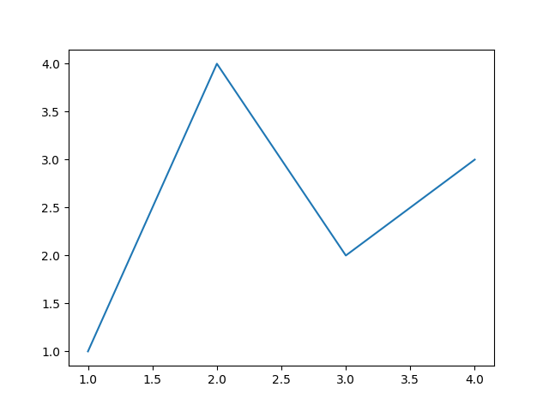
Code example: Simple plot
Let’s try it out in Python!

Slide 13
Useful commands - matplotlib
Plot types
plt.bar() Used for categorical plotting
plt.plot() Used for line plots
Plt.scatter() Used for scatter plots
Plt.hist() Used for plotting histograms
Visual elements
plt.Set_xlabel() Add label to x-axis
plt.Set_xticklabels() Add ticks to x-axis
plt.Set_ylabel() Add label to y-axis
plt.Set_yticklabels() Add ticks to y-axis
Plt.title() Add title
plt.legend() Add legend
plt.grid() Add grid to plot
plt.axvline() Add a vertical line

Slide 14
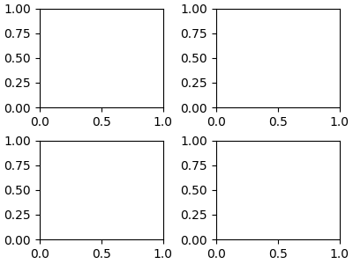
Advanced plots in python
There is a number of ways to make more complicated plots in python using the simple commands that we introduced before.
Here are some examples:
Set layout of plot
Make 4 smaller plots
fig, axs = plt.subplots(2, 2, figsize=(4, 3), layout='constrained')
Set size of sub plots

Slide 15
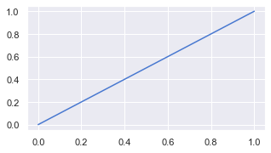
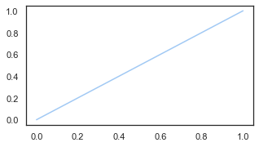
Advanced plots in python
You can modify plots in many ways. Almost all of the functions in matplotlib and seaborn have options that you can specify to tweak the plot to your liking.
sns.set(style=“darkgrid”, palette=“muted”)
sns.set(style=“white”, palette=“pastel”)

Slide 16
Useful commands - seaborn
Other
sns.set() Set the interface of the plot
sns.heatmap() Make a heatmap
sns.lineplot() Draw a line plot
sns.scatterplot() Make a scatterplot
sns.displot() Make a distribution plot
sns.violinplot() Make a violin plot
sns.regplot() Make a regressionplot

Slide 17
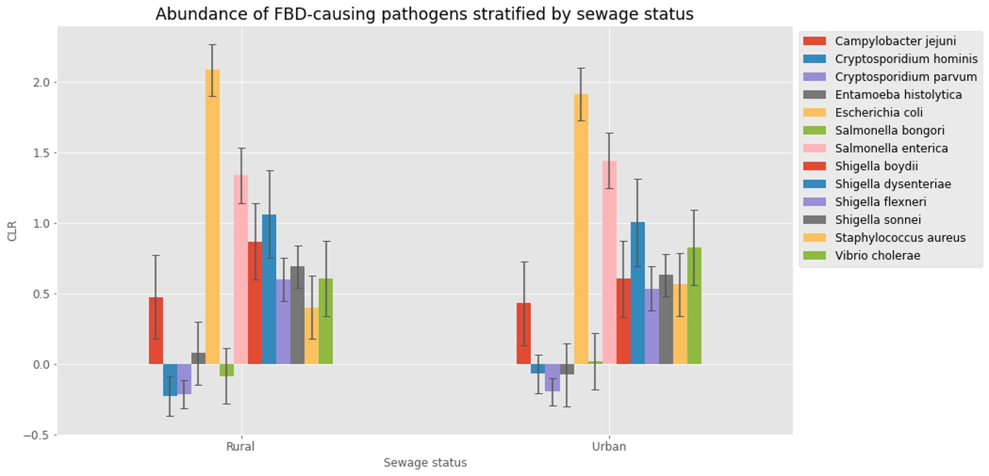
Advanced plots in Python

Slide 18
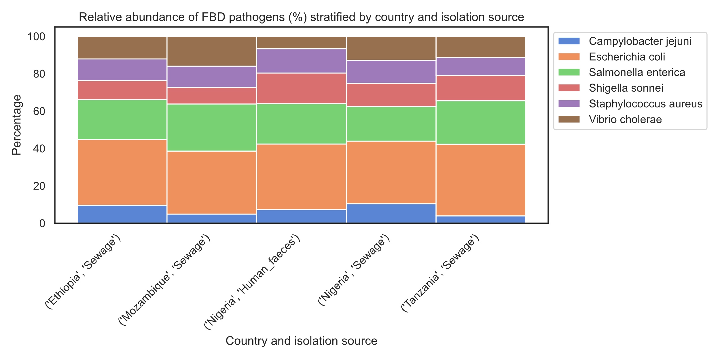
Advanced plots in Python

Slide 19
Theory
Tips and tricks
plt.tight_layout()
Adjust the padding between and around the subplots
plt.savefig(”name_of_pic.[file_ending]”, dpi=300)
Save the figure in a specific resolution
ax.legend(loc='upper left', bbox_to_anchor=(1,1))
Specify the position of the legend in the plot
ax.scatter(X, Y, 40, ”C1”, lw=0, alpha=0.1)
Make the scatter transparant
cmap = plt.get_cmap(”Oranges”)
Use colormap to pick from a range of continuous colors

Slide 20
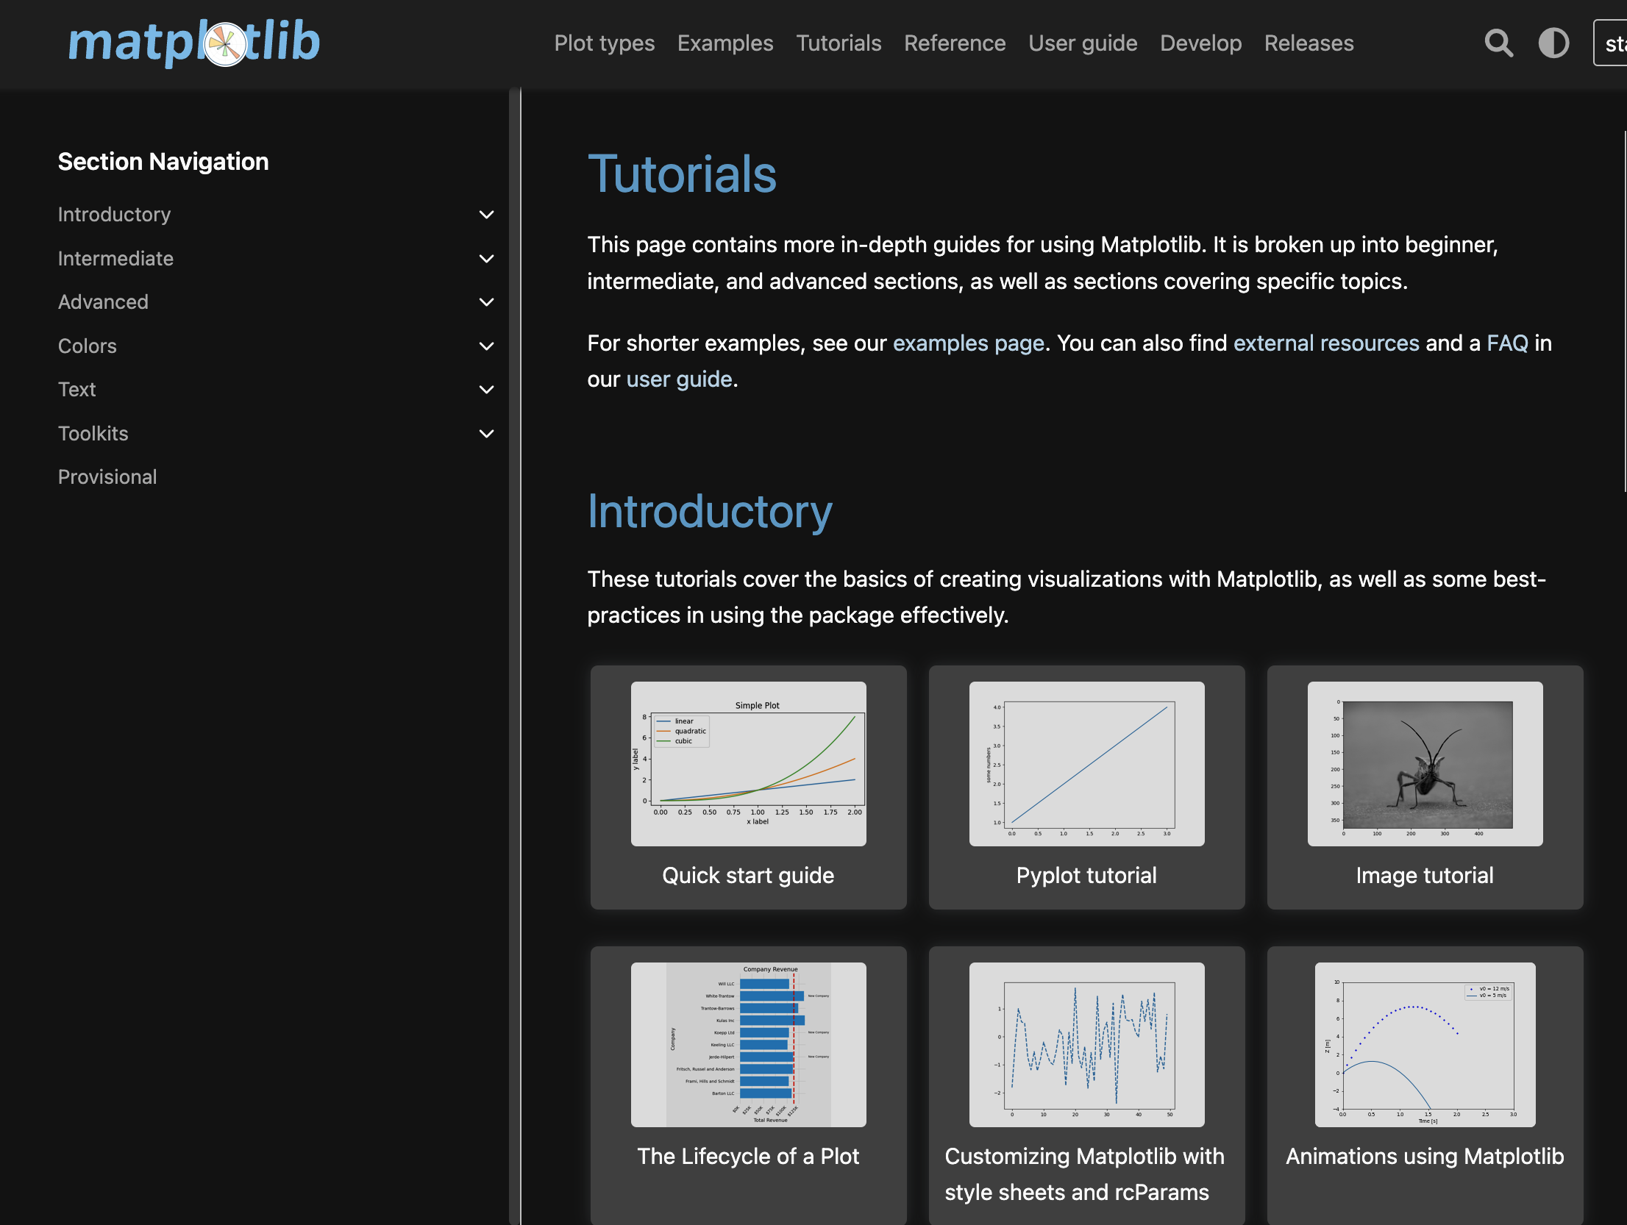
Take home messages
Remember!!
There are endless ways to make plots in Python. Use the documentation that is available online if you want to know how to make something.
Go to matplotlib.org
(or just google ”matplotlib [name of function you want to know more about]”)

