Slide 1
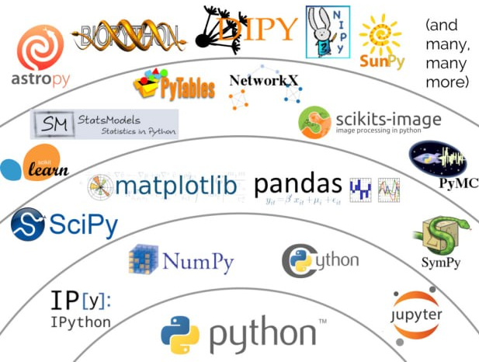
Python Scientific Libraries
Pandas & Numpy
Alfred Ferrer Florensa
PhD, Genomic Epidemiology
DTU
Standing in the shoulders of giants

Slide 2
Python Libraries
Your very exceptional code / approach
Create code every time you need it
1st Classes
Task performed regularly
Common file format
Popular data structure
...
2nd Classes
Make my own code once (class) and re-use it
3rd Classes?
Is all our code unique, exceptional and singular?
Python Libraries

Slide 3
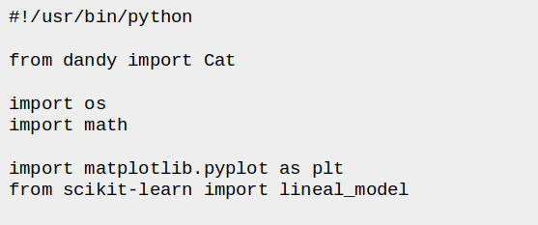
Python Libraries
Using Libraries in our approaches
Usage and types
Sometimes somebody else has already created the functions/data structures we need.
From basic math to very particular file formats/operations.
First-party library
Second-party library
(Standard Python Libraries)
Benefits:
Less time consuming
More stable data structures
Wrappers of C/C++
Reproducibility (if widely used)
Can be very specific
Drawbacks:
Anybody can write a package
Not for widely used is better
Can be discontinued in the future
Documentation
Third-party library
(f. ex. Scientific Libraries)
> os.listdir()
> dandy.Cat()
> Cat()
> plt.lineplot()

Slide 4
Python Libraries
Standard Python’s Library
Scientific Libraries
Built-in modules (written in C)
Come with the Python distribution (no need to install)
Standardized solutions for everyday programming
Examples:
Any module not written by you (first party) nor included in the standard library (second party).
Need to be installed by you (not in standard Python distribution)
Add functionality not necessary for everybody
math | Mathematical Functions
os | Provide functionality to modify, arrange and navigate through the filesystem
subprocess | For running executables or processes from your python code.
json/csv/gzip | For managing json/csv/gzip files
argparse | Provide a platform for command line options and arguments
But how do I install them?
PyPI (pip)
conda

Slide 5
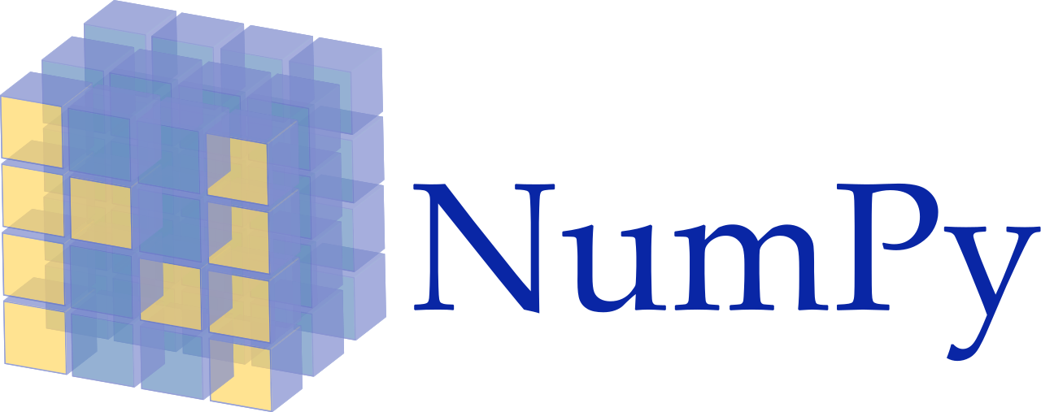
Python Libraries - PyPI
PyPI - Python Package Index
Examples
Contains all popular third party libraries
pip will automatically search there for the packages you want to install
Sckit-learn | Machine learning algorithms
Matplotlib/ Seaborn | Graph making software
Pytorch/ Tensorflow | Deep learning algorithms
Django | Web development tools
Biopython | Tools for bioinformaticians
Numpy | Perform a wide variety of mathematical operations on arrays
Pandas | Work with data organized in columns/rows
Scipy | Statistical analysis
pip - Python’s Package Manager
Use it to install, delete, upgrade packages.
$ pip install numpy
# or python -m pip install numpy
$ pip install numpy --upgrade

Slide 6
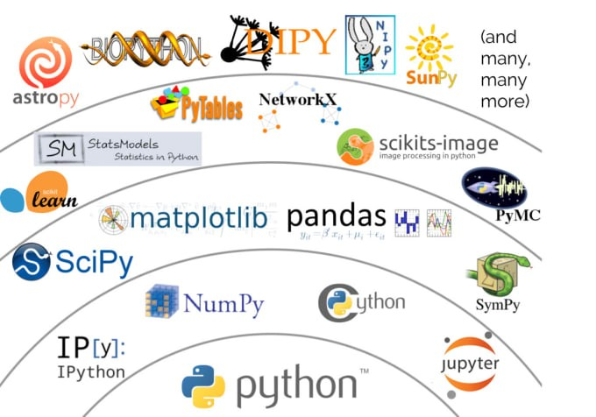
Python Libraries - Conda
Packages are interconnected
Virtual Environments
Packages can be interconnnected. In fact, a lot of packages are extensions of more “core” packages
Sometimes you will need to have packages with different versions in your computer.
For that reason, environments can be quite useful (like the ones provided by Conda).
$ conda create env -name “course”
$ conda activate course
$ conda install numpy
$ conda install numpy==1.16

Slide 7
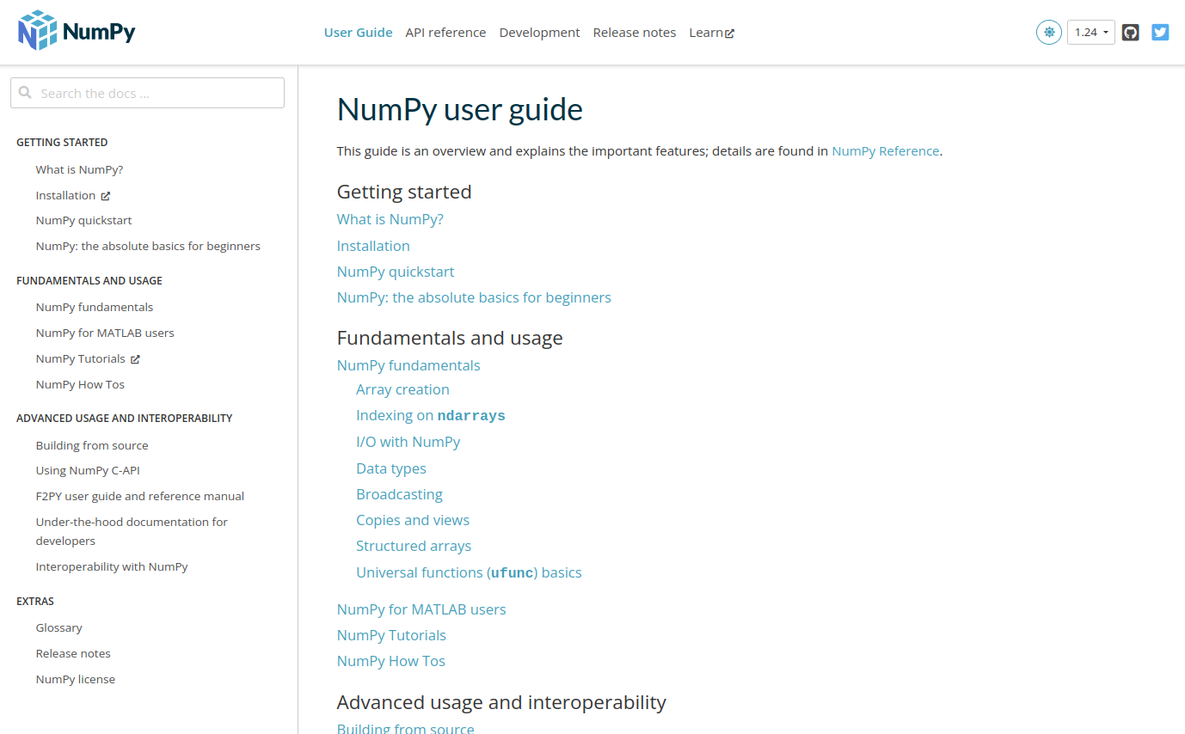
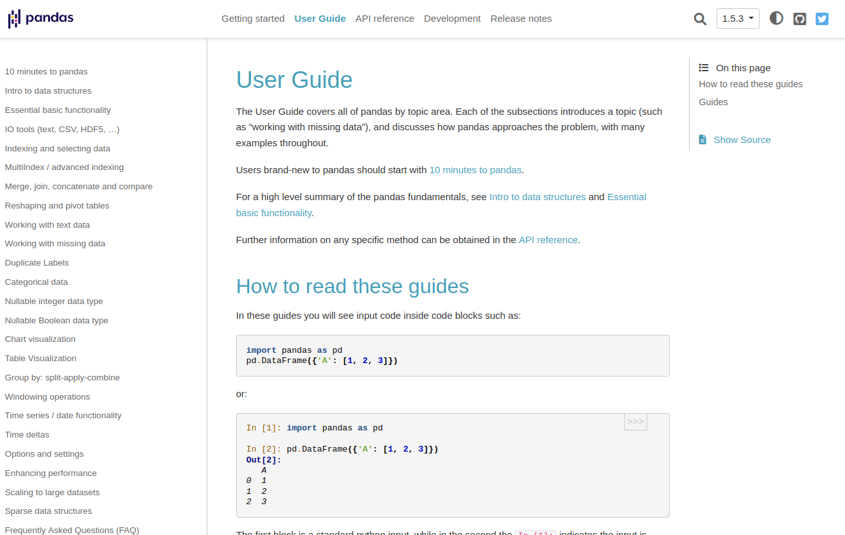
Scientific Python Libraries
How do I learn to use them?
You don’t
But they have Documentation and User Guides online.

Slide 8
Pandas
You are better than EXCEL

Slide 9
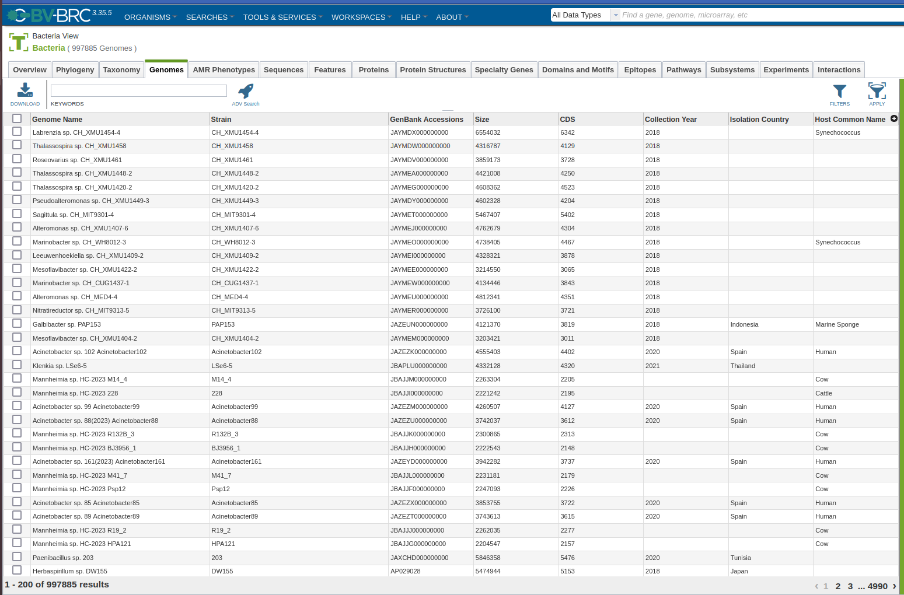
Pandas
Library for structured data
List of list, list of dictionaries, tuples of dicts… What about Excel-like metadata?
Pandas is a very popular toolkit when working with metadata data (like having R or Excel in Python).
It is built on Numpy. Though it is slower, it is much user friendly and works with more types of data.
> import pandas as pd
> # Two main data structures:
> serie = pd.Series([1.23, “F”, “T”])
> df = pd.DataFrame([1.23, “F”, “T”],
[0.23, “T”, “T”])

Slide 10
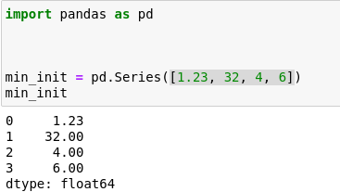
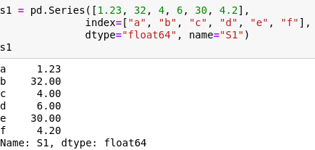
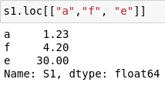
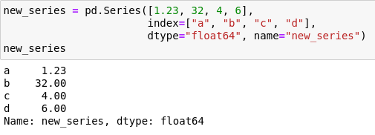
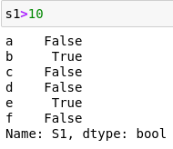
Pandas - Series
Column of an Excel/R sheet
Indexing/Slicing
Init from
List
Per Index
Dict
Per Value
Manually

Slide 11
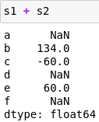
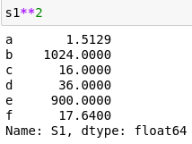
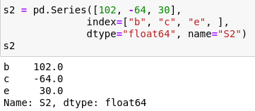
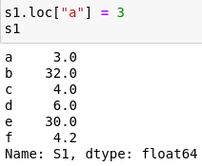
Pandas - Series
Operations
Operation between series
Operation on the series
Basic statistics on series
Replace values
Pandas has a large amount of functions to apply to your data. At the end, is created for people like you!

Slide 12
Pandas - DataFrames
2d Data structure made of Series
Index | S1
a | 2.3
b | 4.2
c | 0
d | 5.1
e | 22
Index | S3
a | 1.2
b | 9
c | 7.4
d | 2.2
e | 10
Index | S1 | S2 | S3 | S4
a | 2.3 | 3 | 1.2 | WT
b | 4.2 | 9 | 0.2 | Mut
c | 0 | 7.4 | 10.1 | Mut
d | 5.1 | 2.2 | 7.8 | WT
e | 22 | 10 | 3.2 | Mut
f | NaN | NaN | NaN | Mut
Index | S2
a | 3
b | 0.2
c | 10.1
d | 7.8
e | 3.2
Index | S4
a | WT
b | Mut
c | Mut
d | WT
e | Mut
f | Mut

Slide 13
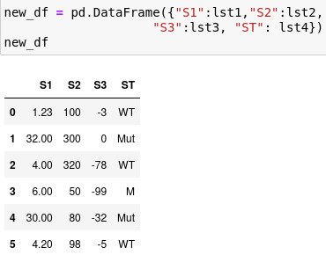
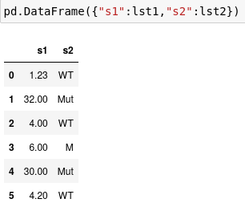
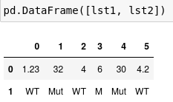
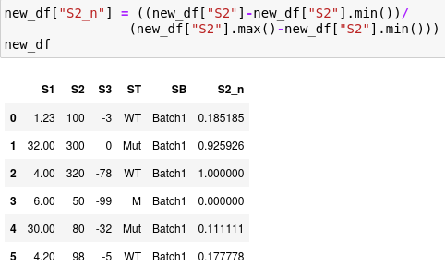
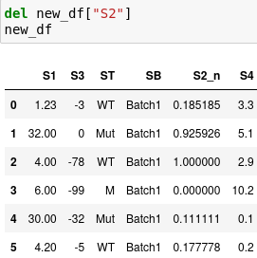
Pandas - DataFrames
From 1D to 2D
Column Addition/Deletion
Per Columns
Per Sample
Addition
Deletion

Slide 14
Pandas - DataFrames
Read/Write
File 1
Index | S1 | S2 | S3 | ST
a | 2.3 | 3 | 0 | WT
b | 4.2 | 0.2 | 1.2 | Mut
c | 0 | 10.1 | 9.0 | Mut
d | 5.1 | 7.8 | 7.4 | WT
,S1,S2,S3,ST
A,2.3,3,0,WT
B,4.2,0.2,1.2,Mut
C,0,10.1,9.0,Mut
D,5.1,7.8,7.4,WT
Read to
Write to
new_df = pd.read_csv(<filepath_or_buffer>, sep, header, names, index_col, dtype, use_cols, skiprows, compression, ...)
new_df.to_csv(<filepath>, sep, columns, header, index,...)

Slide 15
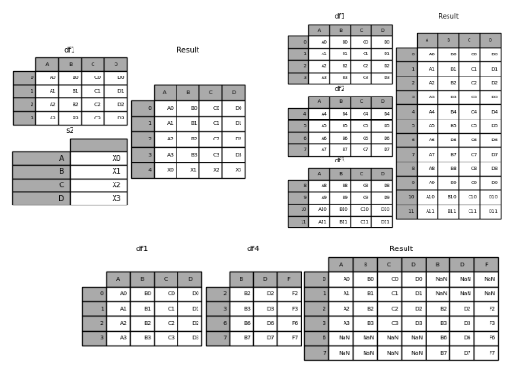
Pandas - DataFrames
Visualize DataFramesc
Join DataFrames
> df.head()
> df.tail()
Iterate over DataFrames
> for index, row in df.iterrows():
Concatenate DataFrames
Merge DataFrames

Slide 16
Pandas
Now I have to memorize all
these new functions,
data structures, features...
NO!
You have user guides, cookbooks, more dense documentation…
You just have to remember these tools EXISTS

Slide 17
Numpy
You are faster than loops

Slide 18
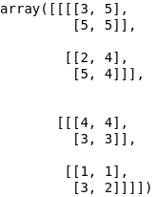
Numpy
Essential Scientific Package
ND–array as fundamental block
Numpy is the backbone of several Python data processing packages (Pandas), or can efficiently share data with (Scikit-learn, Pytorch, Theano).
Benefits:
Usually fastest
Consumes less memory
Code is more restraint
Will make you understand better other scientific packages
Easily adapted to run in GPUs
Grid of values with information of its data, its shape, how to locate an element, type of the elements, etc.
Faster, more restricted and more efficient than Python lists.
1D (vector)
2D (matrix)
5
4
4
1
3
5
3D (tensor)
4D (4d array)
> import numpy as np

Slide 19
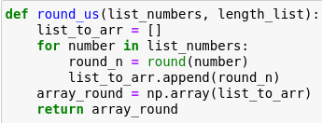
Numpy
Array Creation
From list
From iteration
From 1s/0s
From random numbers
From range
From distribution

Slide 20
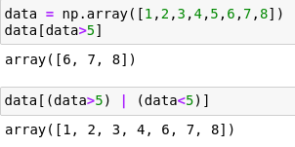
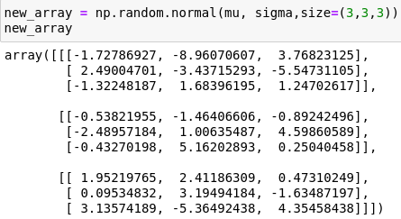
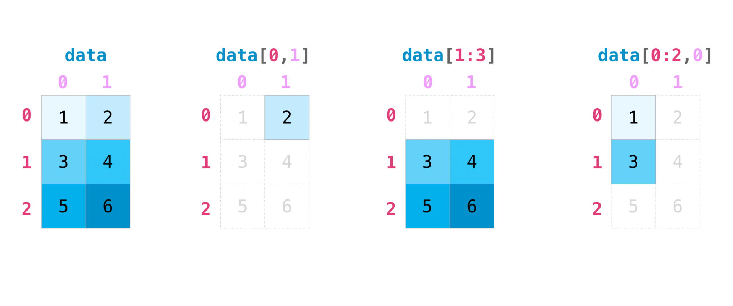
Numpy
Slicing/Indexing
Slicing per value
Slicing
Shape of array
Indexing

Slide 21
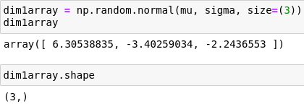
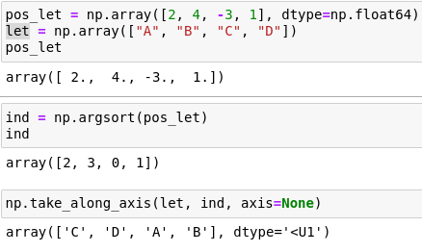
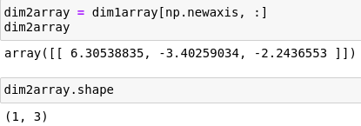
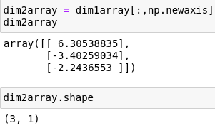
Numpy
Reshape/Transpose
Sorting array
Numerical
By another
Add dimensions

Slide 22
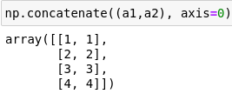
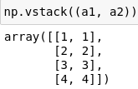
Numpy
Combine arrays
Mathematical Operation
Element-wise
1D -> 2D
Different Dimensions
Concatenate / Stack
Along Axis

Slide 23
Numpy
No more loops!
Yes to fast code!
And again:
There are some beautiful user guides, documentations, etc. waiting for you to explore when you do not know how to do what you want

